Slide 1
Shannah Mabry – Pathways to Partnerships, Project Manager Leigh Thrailkill – Pathways to Partnerships, Family Liaison
Pathways to Partnerships

Slide 2
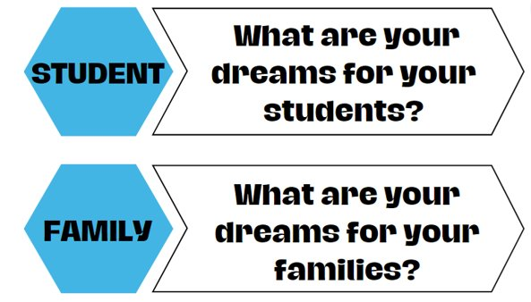
Big Dreams

Slide 3
P2P Mission: To improve training and preparation of children and youth with disabilities in Georgia to eventually obtain and maintain competitive integrated employment in conjunction and coordination with other state, local, and private entities.​

Slide 4
LET’S TALK JOB COACHING
Discover how personalized support empowers individuals with disabilities to reach their goals, build confidence, and thrive in the workplace.

Slide 5
WELCOME TO
WIREGRASS RESOURCE GROUP
Who We Are
Wiregrass Resource Group, Inc. is a mission-driven organization dedicated to empowering individuals with disabilities and barriers to employment through personalized vocational rehabilitation services.
Our Vision
To Ensure Employment Opportunities, Support & Resources for Individuals with Disabilities.
Our Mission
To Deliver the Best Possible Service and Exceed the Expectations of All We Serve.
Our Values
People, Relationships, Partnerships, Integrity, Excellence, Efficiency, Commitment

Slide 6
WRG SERVICES
Traditional Supported Employment (TSE)
A person-centered approach that helps individuals with disabilities find and keep competitive, integrated jobs in the community. Supports include job development, job coaching, and ongoing follow-along, with the goal of building independence, confidence, and long-term success at work.
Individual Job Placement Services (IJPS)
Designed for individuals with previous work experience who are ready to re-enter the workforce. This time-limited service focuses on securing competitive, integrated employment within 90 days of enrollment.
Customized Supported Employment (CSE)
Person-centered approach for individuals with significant disabilities who need a non-traditional path to employment. It focuses on discovering unique strengths and interests, then tailoring or creating job tasks that meet both the individual’s abilities and the employer’s needs.
Workplace Readiness Training (WPRT)
Delivered in structured units that teach essential soft skills for employment success. Topics include communication, time management, teamwork, and workplace behavior, helping individuals build the confidence and skills needed for competitive, integrated work.
Short-Term Job Coaching (JC)
Provides focused, unit-based support for individuals who are already employed but need assistance adjusting to their job. Coaching addresses specific areas such as learning job tasks, building workplace routines, communication, and problem-solving.

Slide 7
UNDERSTANDING JOB COACHING
Job coaching is a personalized support service that helps individuals with disabilities learn, keep, and thrive in a job.
A job coach is someone who works closely with a person at their workplace, offering hands-on guidance, encouragement, and training. The main goal is to help the person succeed on the job, feel confident, and grow more independent over time.

Slide 8
WHAT DOES A JOB COACH DO?
GETTING TO KNOW THE PARTICIPANT
JOB MATCHING
We match participants with job opportunities that fit their skills and abilities, while also considering current job market demands. Together, we discuss expectations in a competitive, integrated work environment to help prepare the participant for long-term success.
We use a mix of simple assessments and personal conversations to understand their strengths, interests, and goals.
EMPLOYER ENGAGEMENT
The job coach meets with the employer to explain how they will support the employee on the job, talk about any accommodations that may be needed, and set up clear communication to ensure ongoing collaboration and success.

Slide 9
WHEN YOU START WORKING
BUILDING ROUTINES
Creating consistent work routines—using visual schedules, step-by-step reminders, and repetition—helps your child adjust to their workplace, stay organized, and manage tasks more independently. This structure builds confidence and supports long-term success.
SIDE-BY-SIDE COACHING
By working directly alongside your child at the job site, the job coach can model how to perform tasks, offer gentle reminders when needed, and support appropriate social interactions—all of which help your child adjust and succeed in their new work environment.
BUILDING CONFIDENCE
The job coach helps build your child’s confidence by recognizing their efforts and progress. This encouragement motivates them to take on new challenges and supports greater independence in their job role."

Slide 10
INDEPENDENCE STRATEGIES
GROWTH & EXPECTATIONS
Coaches teach workplace expectations like punctuality and communication to establish a professional demeanor and foster successful interactions within the workplace.
GROWTH STRATEGIES
The coach encourages problem-solving and independent decision-making while providing backup support as confidence builds in your child’s role.
DOCUMENTING PROGRESS
Progress is tracked, and growth areas are documented to identify ongoing support needs and ensure sustained success in the workplace.

Slide 11
COMMUNICATION & PROBLEM-SOLVING
SOCIAL AND COMMUNICATION SUPPORT
The job coach helps participants build important workplace communication skills by:
Teaching them how to talk with coworkers and supervisors appropriately
Supporting everyday interactions like asking for help, taking breaks, or joining conversations
Encouraging respectful and confident communication to promote belonging in the workplace
PROBLEM-SOLVING SUPPORT
Sometimes things at work can feel confusing or overwhelming—and that’s okay. The job coach is there to:
Help participants work through challenges as they come up
Support emotional regulation and offer strategies to stay calm and focused
Talk with the manager if something needs to be adjusted, explained, or clarified

Slide 12
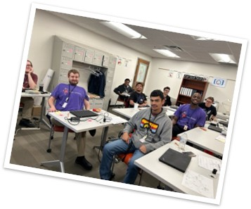
SUPPORT THAT GROWS WITH YOU
GROWTH STRATEGIES
Job coaching is designed to provide the right support at the right time—not permanent supervision. It begins with close, hands-on guidance and gradually fades as our participants build confidence, skills, and independence in the workplace.
As each participant becomes more comfortable on the job, the job coach will:
Be present less often, allowing for greater independence
Encourage natural supports from coworkers, supervisors, and workplace routines
Remain available to step back in if additional support is ever needed
The ultimate goal is long-term success: helping every participant grow into a confident, capable employee who can navigate work life with increasing independence.

Slide 13
FINAL THOUGHTS
At Wiregrass, we believe everyone deserves the opportunity for meaningful, competitive work. Through personalized job coaching, we support individuals in building skills, overcoming barriers, and growing with confidence. Families gain peace of mind knowing there's a team walking alongside their loved ones. Guided by dignity, equity, and opportunity, we're not just helping people find jobs—we're building futures.
We see your potential. We believe in your success. We’re here to help you achieve it. #PartnersInSuccess

Slide 14
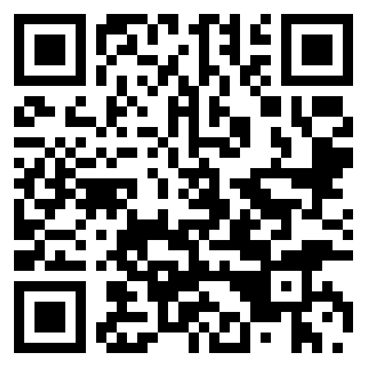
Pathways to Partnerships Family Learning Session Survey
We value your feedback and would appreciate it if you could take a few moments to complete this survey. Your responses will help improve our learning sessions.
The contents of this presentation were developed under a grant from the U.S. Department of Education (Department). The Department does not mandate or prescribe practices, models, or other activities described or discussed in this document. The contents of this presentation may contain examples of, adaptations of, and links to resources created and maintained by another public or private organization. The Department does not control or guarantee the accuracy, relevance, timeliness, or completeness of this outside information. The content of this presentation does not necessarily represent the policy of the Department. This publication is not intended to represent the views or policy of or be an endorsement of any views expressed or materials provided by any Federal agency.

