Slide 1
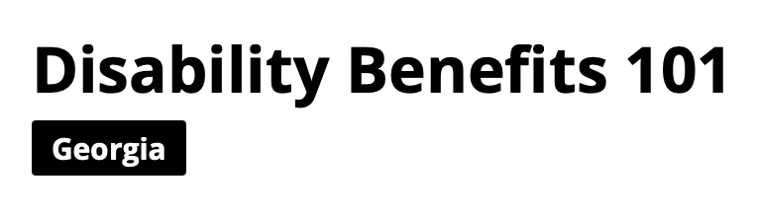
https://ga.db101.org
www.az.db101.org

Slide 2
Introduction
Heather Duncan
Chief Strategy Officer
World Institute on Disability (WID)
WID is dedicated to designing, building, and supporting whole community solutions by removing barriers to include people with disabilities.
www.wid.org
Disability Benefits 101 - www.db101.org

Slide 3
DB101 is Your Go-To Resource
🛠 It provides:
Interactive tools & estimators
Step-by-step guides
Clear, accessible information
💡 It helps:
Break down myths and misinformation
Ease fears about working and losing benefits
Empower people and their families with knowledge
Support planning for a more financially secure future

Slide 4
Myths About Work and Youth Benefits
Myth #1: Employers won’t hire your child because of a disability
Myth #2: Your child can’t work because of a disability
Myth #3: Your child will stop getting disability benefits because of a job

Slide 5
The Benefits of Work for Youth
Builds confidence - earning money, joining the community
Develops job skills at a forgiving age
Explores interests and learns what work is about
Creates friendships and a personal network
Builds independence and life skills
Earns more money - and shapes a successful adult career

Slide 6
Parental Support Matters
Parents who expect work → children get early work experience
Early work experience → far more likely to have jobs as adults
Your belief and expectations make a real difference

Slide 7
How Parents/Guardians Can Help
Set the expectation early - chores, small jobs for neighbors & friends
Be enthusiastic - share your child’s excitement about working
Support their efforts to find work now, in high school or college
It’s not about lots of hours - it’s about learning what a job is

Slide 8
The Bottom Line
Your child wants to work — and work is possible
Expect it, encourage it, and help them start early
Your belief makes a big difference
Learn more: DB101 (ga.db101.org)

Slide 9
Social Security Basics
For Youth
Starting on the Same Page
SSI & SSDI - Two Different Programs
with Different Rules

Slide 10
SSA Disability Definition
Over 18: Considered disabled if the person has a physical or mental impairment which:
  Has lasted or can be expected to last for at least 12 months, or
  Can be expected to result in death, and that
  Prevents the person from any Substantial Gainful Activity (SGA) (ability to earn a certain amount)
  Its about earning potential!
Child under 18: Based on functional limitations.
  SGA is not considered.
  Eligibility is based on parents’/guardians’ income and resources (No resources over $2,000)
  Disability redetermination at age 18 where resources are based on the individual
Notes:
Before someone can qualify for SSI or SSDI, they first have to meet Social Security’s definition of disability.
For adults age 18 and over, a person is considered disabled if:
They have a physical or mental impairment
That impairment has lasted—or is expected to last—at least 12 months or result in death
And it prevents them from engaging in Substantial Gainful Activity, or SGA
It’s a key part of how Social Security evaluates whether someone is eligible for benefits.
Now, SGA isn’t just about having a disability—it’s about earning potential.
If someone is able to earn over a certain monthly amount, Social Security may determine that they are not “disabled” by their definition—even if they have a documented medical condition.
We’ll dig deeper into how those income thresholds work a bit later.
For youth under 18, the rules are different.
Because we don’t expect children to work, SGA doesn’t apply.
Instead, eligibility is based on the child’s functional limitations and on their parents’ or guardians’ income and resources.
And yes, there’s that familiar $2,000 resource limit, which many advocates are actively working to raise. It’s one of the many outdated barriers in the system.
Then, when a child turns 18, they undergo a redetermination using the adult disability standard. At that point, only the young adult’s income and resources are counted—not the family’s.
Key takeaway for adults:
SSA’s disability definition is not just about a diagnosis—it’s about whether a person can work at a substantial level.

Slide 11
Supplemental Security Income (SSI)
SSI provides cash benefits to people with disabilities who have low income and resources with little or no work history. SSI is based on a financial need.
Maximum monthly payment amount is $994 (individual)/ $1,491 (couple)
$2,000 resource limit
($3,000 for couples)
Medicaid
Based on need and details of living situation
SSI Medicaid continues as long as SSI eligible
Individuals usually have more money by going to work

Slide 12
SSI Work Incentives
Income Exclusions: First $20 unearned/$65 earned are not counted
2 for 1 Reduction: For every two dollars earned, you keep one dollar of your SSI cash benefits!
Impairment Related Work Expenses (IRWE): Approved, documented disability-related expenses needed for work paid by the individual
Blind Work Expense: Majority of work expenses
Student Earned Income Exclusion (SEIE):
Students under 22 in school at least half-time can earn up to $2,410monthly (annual cap of $9,730) without a decrease to cash benefits or effect
on healthcare

Slide 13
Social Security Disability Insurance (SSDI)
SSDI provides cash benefits to people with disabilities who qualify because of their work history or the work history of a spouse or parent.
Social insurance based on work history and amount paid into the system (through FICA)
Medicare
Receive cash benefits or not based on earnings and phase of work
Different rules for each phase of work
Medicare and cash benefit continue for at least 8 years

Slide 14
SSDI Work Incentives
Trial Work Period (TWP): Nine months within a rolling five-year window where full cash benefits will be received despite earnings
  Triggered by earnings over $1,210 gross monthly
  Extended Period of Eligibility (EPE): 36-month period after TWP, cash benefits are received or not depending on Substantial Gainful Activity (SGA)
Substantial Gainful Activity (SGA): Monthly earned income shows ability to do significant work (per SSA)
  SGA threshold is $1,690 ($2,830 legally blind)
  SGA is not just a number!
  There are other factors to consider

Slide 15
SSDI Work Incentives
Impairment Related Work Expenses (IRWE): Approved, documented disability-related expenses paid by the individual necessary for work
Wage Subsidy & Special Conditions: On the job support or special conditions given by an employer or by a third party

Slide 16
Unable To Continue Working?
Expedited Reinstatement (EXR): Able to get benefits restarted quickly if they end due to employment earnings
  Available for up to five years after benefits end
  If countable earned income drops below the SGA
  Not medically improved
  Benefits can be restarted without the need to reapply
  Both SSI and SSDI

Slide 17
SGA Impact on Benefit Check
Countable earnings above SGA *
=
No benefit check
  SGA Threshold - $1,690 /$2,830 Legally Blind
Countable earnings below SGA *
=
Benefit check
*After deductions for IRWEs and subsidies

Slide 18
Maintain Healthcare While Working
Losing healthcare is the main reason people with disabilities state for not going to work.
For SSI: Medicaid - Continues after cash benefits stop due to work earnings (1619(b))
For SSDI: Medicare - Continues for 8 years (or longer)
Georgia Pathways to Coverage – a way of qualifying for Medicaid for people under 65 who have low income
Employer-sponsored Health Coverage - Public coverage and private coverage can be used together
Individual Health Coverage - Healthcare.gov

Slide 19
Earn More and Save More
Plan for Achieving Self-Support (PASS): Income or resources can be set aside to achieve a specific work goal without affecting benefits
  Mainly for SSI beneficiaries though those with low SSDI benefits may use a PASS
Achieving a Better Life Experience (ABLE or IABLE):
  Save up to $100,000 without affecting resource limits
  Will not affect SSI, Medicaid, or most other benefits
  Disability onset before age 46
  $20,000 annual contribution/additional $15,650 of earned income (working)
  Accounts can be opened in another state.
  For both SSI and SSDI
  Open an account to prepare to apply for benefits

Slide 20
GA DB101 Tools

Slide 21
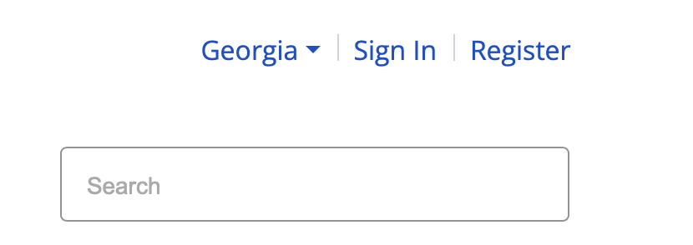
My DB101
A customized DB101 toolbox you can take anywhere
  Favorite Articles
  Favorite Tools
  Saved Estimator Sessions
Located at the top of site above the Search feature
Register first with organizational type; Sign-in to activate My DB101
All other features of GA DB101 is available without registration

Slide 22
Estimators
    What will happen to income, benefits, and health coverage when going to work?
    Actual earnings or estimated earnings entered to estimate income, benefits, and health coverage if a person receiving disability benefits goes to work
  Benefits and Work Estimator: For people aged
  18-64 using public disability benefits
  School and Work Estimator: For youth who have limited work experience

Slide 23
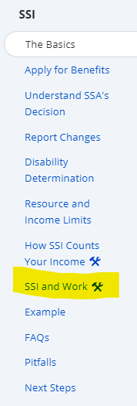
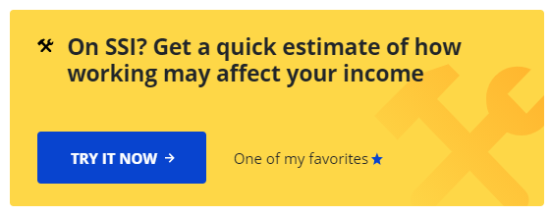
SSI/SSDI Quick Estimator
Great way to quickly motivate and
debunk myths
Afterwards client is more willing to go
through a complete Estimator session.
Tools in both the SSI and SSDI sections
  SSI and Work
  SSDI and Work

Slide 24
SSI Estimators Example
Jerry: Receives SSI and wants a part time job
Receives $994 monthly from SSI (max benefit rate in 2026)
No other benefits or cash assistance
Interested in part-time work as a mechanic for $7.25 an hour (Federal 2026 minimum wage)
Position is for 30 hours a week
  However, a friend told him he could only work 15 – 20 hours or he will lose his healthcare

Slide 25
Benefits and Work Estimators
Used to estimate impact income has on benefits, and health coverage when a person over 18 receiving SSI and/or SSDI disability benefits starts to work
    Follow the simple question prompts to receive results as a summary, graph, and snapshot
    Questions will adjust depending on answers provided:
      Housing, SNAP, other cash benefits, etc.
      Additional information on rent and expenses can be added to do work advantage analysis
In-depth explanation of results are under the Result Summary tabs

Slide 26
Reading Estimators Results
Summary: Chart and summary of Estimator results
Plan Recap: Review and change the work plan
Timeline: Most effective way to explain changes
in income and healthcare
Monthly Income/Expense: Month-by-month
5-year breakdown
Next Steps: Resources and steps to move forward

Slide 27
Estimators Example
Frank: Receives SSDI and SSI – Going to work full-time
Receives $500 monthly from SSDI and $497 monthly from SSI
No other benefits or cash assistance
Since receiving benefits, he worked in January and February of 2021 making over $1000 a month
Offered a full-time position at earning $14.00 an hour with employer healthcare

Slide 28

You Don’t Need to Be the Expert
DB101 is not meant to make the user a benefit expert nor is it meant to replace benefit counselors.
Vocational Rehabilitation (VR) office
IowaWORKS office
Ticket To Work Helpline
Benefit Specialist

Slide 29
GA DB101 Content

Slide 30
See how work and benefits go together
See how benefits support work
  Getting Past the Myths
Find programs that can help you find work
  Programs that Support Work
Discover ways to save up money while working
  Building Your Assets and Wealth
All Work & Benefits
  Interested in work?
    Programs that support work

Slide 31
Going to Work
You can make work a part of your plan.
  Getting Past the Myths: The Truth About Working
  Finding the Right Job for You
  Programs That Support Work

Slide 32
Your Money
Get ideas on what to do with the money you earn
  Building Your Assets and Wealth
  ABLE Accounts
  Plan to Achieve Self-Support (PASS)
  Tax Credits and Tools
  Trust Funds

Slide 33
Get the details health programs
Finding the Right Coverage For You
Disability-Based Medicaid
Georgia Pathways to Coverage
Medicare
Employer-Sponsored Health Coverage
Buying Health Coverage on Georgia Access

Slide 34
Cash Benefits
See which programs may help you pay for
basic needs.
What benefits do I get?
Supplemental Security Income (SSI)
Social Security Disability Insurance (SSDI)

Slide 35
Health Care Coverage
See which programs can help you stay healthy.
Iowa Health and Wellness Plan (IHAWP)
Disability-Based Medicaid
Medicaid for Employed People with Disabilities
Medicare
Employer-Sponsored Health Coverage
Buying Health Coverage on Healthcare.gov

