Slide 1


Shannah Mabry – Pathways to Partnerships, Project Manager
Leigh Thrailkill – Pathways to Partnerships, Family Liaison
Pathways to Partnerships

Slide 2

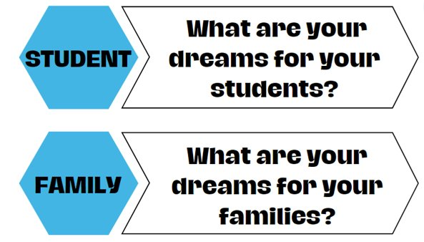
Big Dreams

Slide 3

P2P Mission: To improve training and preparation of children and youth with disabilities in Georgia to eventually obtain and maintain competitive integrated employment in conjunction and coordination with other state, local, and private entities.​

Slide 4
Financial Aid 101
Federal and State Aid

Slide 5
Financial Aid
Financial aid is money to help pay for college or career school.
Notes:
Let’s begin by discussing financial aid.

Slide 6


direct and indirect costs
Financial aid
Direct Costs
Tuition
Student fees
On-campus housing
Meal plan
Parking permits
Indirect Costs
Books
Rent for off-campus Housing
School supplies
Groceries
Notes:
Direct costs are paid directly to the institution. Some of these costs include: tuition and fees, on-campus housing, meal plan, and possibly even parking permits.
Indirect costs are expenses paid while a student is enrolled but the costs are not billed from the institution. Some examples are listed here.
(Presenter: be sure to read some of their responses: bedding, cell phone bill, gas, entertainment, etc.)

Slide 7
Types of Financial Aid
Financial aid is available in the form of grants, scholarships, work-study funds, and loans.
Notes:
If a college graduate is asked how they paid for their education, most would say by using financial aid, which is a general term. The real question is, which type?

Slide 8
Financial Aid forms and sources
financial aid
FORMS OF FINANCIAL AID
SOURCES OF FINANCIAL AID
Scholarships
Federal and State government
Colleges and universities
Grants
Professional organizations
Loans
Service organizations
Employers
Work-study Programs
Private foundations/companies
Notes:
Finding ways to pay for college is one of the most important, but also one of the most challenging tasks connected to attending college. Financial aid is any money used to help pay for college. Financial aid can cover tuition and fees, room and board, books and supplies, transportation and other college-related expenses.

Slide 9

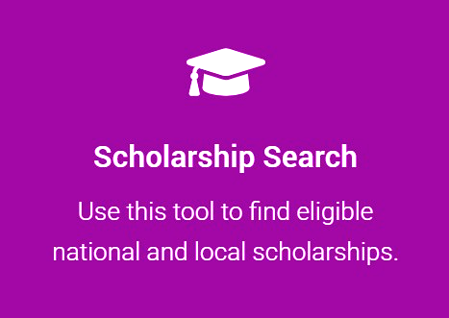
GAfutures Scholarship Search
Financial aid
Scholarship Search Tips
Start search early!
Don’t stop at one, two, or three!
Be creative!
    Consider family, hobbies, career interests, medical
    history, or college major
Look for scholarships even after beginning college!
DO NOT PAY ANYONE TO HELP YOU FIND OR APPLY FOR SCHOLARSHIPS!
Notes:
There are thousands of scholarships out there to help all types of students pay for college. Look for local and national scholarships with GAfutures.org’s search tool to find additional sources of financial aid. Some scholarships have some pretty unique eligibility requirements! Are you a vegetarian? An aspiring writer? An avid volunteer in your community? Then there may be a scholarship for you. Here are some tips to help.

Slide 10





Cast a wide net!

Slide 11
Federal Student Aid Programs
Federal student aid programs provide financial assistance to students attending a college or career school.
Notes:
It is important to know how the aid is funded.

Slide 12
How to Get Federal Student Aid
Federal student aid
Be a U.S. citizen or eligible non-citizen
Be a high school graduate or GED recipient
Be enrolled in an eligible degree/certificate program
Have a valid Social Security number
Maintain Satisfactory Academic Progress
Notes:
There are certain eligibility requirements in order to receive federal aid. These requirements are for the student not the parents.

Slide 13
Federal financial aid programs
Federal student aid
Federal Pell Grant
Need-based federal grant
Undergraduate student with financial need
Maximum amount for 2025-2026 is $7,395
Pell Grant
FSEOG
Federal Work Study
TEACH Grant
Loans
Notes:
The federal government has financial aid programs that include grants and work-study awards that do not need to be repaid, as well as various loans that require repayment. Grants are generally need-based and can come from the government (federal and state) or educational institutions themselves. The most well-known federal grant program is the Pell Grant.
Federal Pell Grants are usually awarded to undergraduate students who display financial need. A Federal Pell Grant, unlike a loan, does not have be repaid.

Slide 14
Federal financial aid programs
Federal student aid
Federal Supplemental Educational Opportunity Grant (FSEOG)
Undergraduate student with exceptional financial need
Pell Grant recipients receive priority
Up to $4,000
Pell Grant
FSEOG
Federal Work Study
TEACH Grant
Loans
Notes:
A FSEOG is a grant for undergraduate students with exception financial need. The FSEOG does not need to be repaid. These are grants you’ll want to apply for as soon as possible as there are limited funds.

Slide 15
Federal financial aid programs
Federal student aid
Federal Work Study Program
Full-time or part-time undergraduate or graduate student
Earn at least minimum wage
On-campus positions
Pell Grant
FSEOG
Federal Work Study
TEACH Grant
Loans
Notes:
Federal Work-Study is a federally funded program that provides part-time job opportunities to eligible students to earn money for education expenses. It’s a need-based program, meaning that it is primarily intended for students who demonstrate financial need.
The income earned through work-study is typically used to cover educational costs, and it does not have to be repaid.

Slide 16
Federal financial aid programs
Federal student aid
TEACH Grant Program
Enrolled in coursework to begin a career in teaching
Must agree to serve as a full-time teacher in a high-need field in a public or private elementary or secondary school that serves low-income students
Up to $4,000; becomes a loan if you do not teach as required
Pell Grant
FSEOG
Federal Work Study
TEACH Grant
Loans
Notes:
A TEACH Grant is different from other federal student grants because it requires you to agree to complete a teaching service obligation as a condition for receiving the grant.
You can receive up to $4,000 a year.

Slide 17
Federal financial aid programs
Federal student aid
Federal Loan Program
Direct Subsidized Loan
Direct Unsubsidized Loan
Federal PLUS Loan for parents of dependent undergraduate students
Pell Grant
FSEOG
Federal Work Study
TEACH Grant
Loans
Notes:
The FAFSA also determines the amount of loans, subsidized and unsubsidized, you are eligible for.
These loans, of course, will have to be repaid once you are no longer in school. Repayment begins six months after graduation or if the student is no longer enrolled at least half time.
Federal PLUS Loans are unsubsidized loans made to parents of undergraduate students. If your parents cannot obtain a PLUS loan, you may be eligible to borrow additional Unsubsidized Stafford loan funds. The interest rates may vary based on when the loan is borrowed.
With the Grad PLUS Loan, graduate and professional students are also eligible to borrow under the PLUS Loan program to help pay for their education.

Slide 18
Direct Subsidized & unsubsidized Loans
Federal student aid
Direct Subsidized Loan
Direct Unsubsidized Loan
  Available to undergraduate students with financial need
  Interest is paid by the government while enrolled (at least half time) and during grace period.
  Amount determined by institution and based on COA, financial need, other aid and loan limits
  Current interest rate 6.39% (undergraduate)
  Available to undergraduate and graduate students
  The student is responsible for the interest while enrolled and during grace period.
  Amount determined by institution and based on COA, financial need, other aid and loan limits
  Current interest rate 6.39% (undergraduate)
Notes:
<slide has animation>

Slide 19
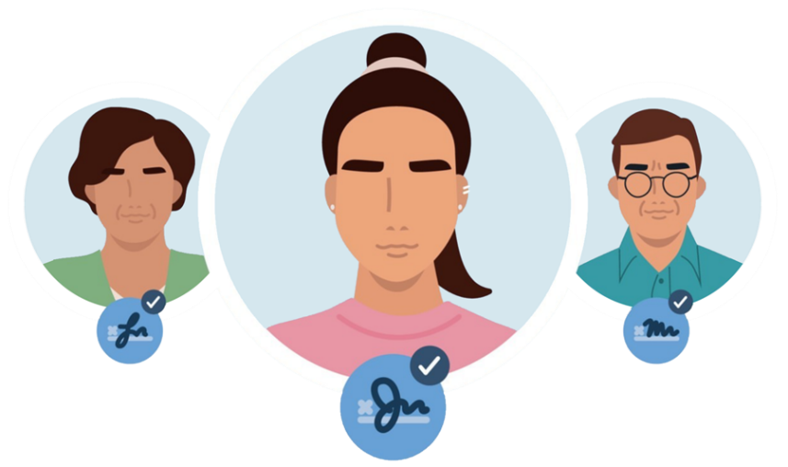
Direct Subsidized Loan
Federal student aid
Direct PLUS Loan for Parents
  Only one parent will be the borrower
  Can have more than one loan for additional dependent student
  Approval based on credit history
  Maximum amount is COA minus any other financial aid awarded
  Current interest rate is 8.94%
Notes:
<slide has animation>

Slide 20
Federal loan program limits
Federal student aid
2026 - 2027 Academic Year
Initial Loan Amount for dependent students whose parents are eligible for a PLUS Loan | Base | Additional Unsubsidized | Annual Maximum Amount
Freshmen | $3,500 | $2,000 | $5,500
Sophomore | $4,500 | $2,000 | $6,500
Junior/Senior | $5,500 | $2,000 | $7,500
Independent Students and Dependent Students whose Parents were Denied a PLUS Loan | Base | Additional Unsubsidized | Annual Maximum Amount
Freshmen | $3,500 | $6,000 | $9,500
Sophomore | $4,500 | $6,000 | $10,500
Junior/Senior | $5,500 | $7,000 | $12,500
Notes:
Depending on what type of loan you and/or your parents qualify for, there are some limits to the amount of funds you can receive.
First-year undergraduates are eligible for loans up to $5,500.
Amounts increase for subsequent years of study, with higher amounts for graduate students. The interest rates may vary based on when the loan is borrowed.

Slide 21
HOPE Program
Helping Outstanding Pupils Educationally Program
Notes:
Now let’s discuss financial aid opportunities offered by the state of Georgia.
Click

Slide 22

Helping Outstanding Pupils Educationally Program
HOPE Scholarship
Zell Miller Scholarship
HOPE
Grant
HOPE Career Grant
Zell Miller Grant
Notes:
Think of the HOPE Program as a family and the Georgia Lottery as the parent. The HOPE Program provides money to assist students with their educational costs.
click

Slide 23


Basic Eligibility Requirements
Hope program
Student must:
Be a U.S. citizen or eligible non-citizen
Be a Georgia resident (as determined by College/University)
Be working towards the first undergraduate program
Be in Good academic standing (SAP)
Attend a HOPE eligible institution
Attention Male Students: Georgia state law requires Selective Service registration for males (18+ years old) to qualify for state aid programs.
Notes:
These are the general eligibility requirements for the HOPE Program.

Slide 24
HOPE Scholarship
Hope program
HOPE Program
HOPE
Scholarship
Zell Miller
Scholarship
HOPE
Grant
Zell Miller
Grant
HOPE Career Grant
Notes:
Next, let’s talk about the eligibility requirements for the HOPE Scholarship.
Click

Slide 25
HOPE Scholarship Eligibility Requirements
Hope program
Student must:
Be enrolled in a degree program
Graduate with a 3.0 high school HOPE GPA
  High school HOPE GPA is different from cumulative high school GPA
  High school HOPE GPA is calculated from grades in core curriculum courses 9th – 12th grade
  After high school graduation, HOPE Scholarship may also be earned in college
Complete four (4) academically rigorous course credits during high school
Notes:
First, the HOPE Scholarship is awarded to students pursuing an associates or bachelors degree.
Students must graduate with a 3.0 high school HOPE GPA from a Georgia high school, and 4 academically rigorous course credits.
For home school students, the requirements differ. For more information, contact us.
Click

Slide 26
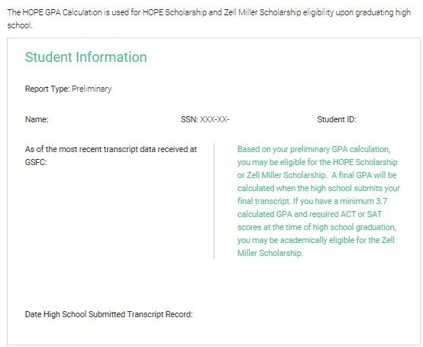
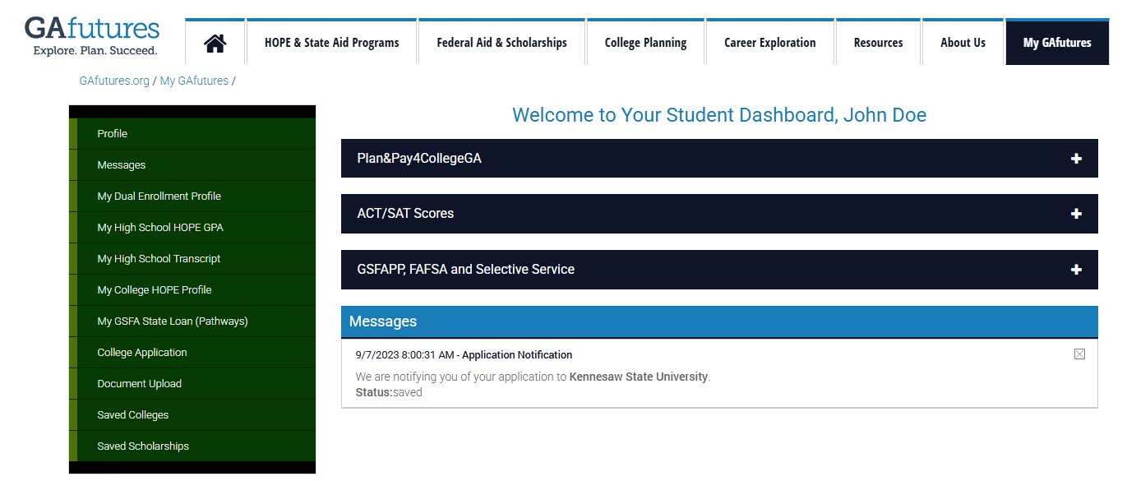
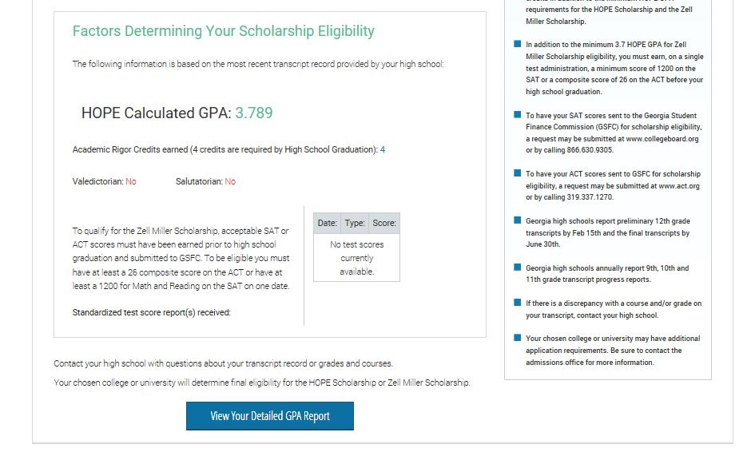
My High School HOPE GPA
HOPE program
Log in to GAfutures.org account to access your HOPE GPA.
Notes:
The high school HOPE GPA, found on GAfutures, may differ from the GPA from your high school. The high school HOPE GPA is ONLY calculated by GSFC and is based on core courses while the student is in high school.
High school HOPE GPAs are calculated every academic year, when transcripts are uploaded by high schools.
Students must also graduate with 4 rigor course credits.
Click

Slide 27
Zell miller scholarship
Hope program
HOPE Program
HOPE
Scholarship
Zell Miller
Scholarship
HOPE
Grant
Zell Miller
Grant
HOPE Career Grant
Notes:
Next, let’s talk about the Zell Miller Scholarship.
Click

Slide 28


ZELL MILLER SCHOLRSHIP
Hope program
Rigor Requirements and one of the following:
Designated valedictorian or salutatorian AND Meet minimum HOPE eligibility requirements | Minimum 3.7 high school HOPE GPA, as calculated by GSFC, in core curriculum courses AND 1200 SAT total test score OR 25 ACT composite score for students graduating after December 31, 2023
Notes:
To receive the Zell Miller Scholarship, a student must meet the general eligibility requirements of the HOPE Program, as well as the following:
If the student is designated as the valedictorian or salutatorian, they are eligible to receive the Zell Miller Scholarship.
All other students, must graduate with:
a 3.7 high school HOPE GPA,
4 rigor course credits and
a 1200 on the SAT OR a 25 on the ACT
Students can take the tests multiple times and use the highest score. The test scores must be earned in one sitting and taken prior to graduation.
Click

Slide 29
HOPE vs Zell Miller Scholarship
Hope program
 | HOPE Scholarship | Zell Miller Scholarship
High School HOPE GPA | 3.0 | 3.7
Rigor credits | 4 | 4
SAT Score | N/A | 1200
ACT Score | N/A | 25
Notes:
When comparing the HOPE and the Zell Miller Scholarship, here is a chart that summarizes the eligibility for each.
Pause
Click

Slide 30
HOPE PROGRAM GrantS
Hope program
HOPE Program
HOPE
Scholarship
Zell Miller
Scholarship
HOPE
Grant
Zell Miller
Grant
HOPE Career Grant
Notes:
Now let’s talk about the grants.
Click

Slide 31
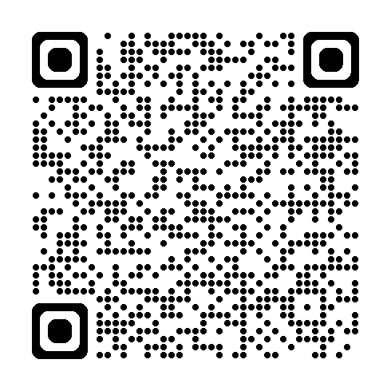
HOPE Grant Basic Eligibility
HOPE PROGRAM
Meet general eligibility requirements for HOPE Program
Enrolled in certificate or diploma program
High school diploma/GED not required
No high school GPA and/or test scores required
Types of Programs
Diploma programs are designed to be completed in about 1 to 2 years.
Certificate programs are designed to be completed in a shorter time frame compared to degree programs. They can range from a few months to a year.
Notes:
Like all components of the HOPE Program, the general eligibility requirements will also apply to the grants.
Yet, what’s different is that grants can only be used for students who are enrolled in a certificate or diploma program.
Also, there is no high school HOPE GPA requirement, and test scores are not considered.
Click

Slide 32

HOPE Grant Basic Eligibility
HOPE PROGRAM
Maintain 2.0 college cumulative GPA at the following checkpoints:
  30 paid semester credit hours
  60 paid semester credit hours
Maximum 63 paid semester hours
Notes:
To maintain the HOPE Grant, a student must have a 2.0 college HOPE GPA at the checkpoints.
Click

Slide 33
HOPE CAREER Grant Basic Eligibility
HOPE PROGRAM
The HOPE Career Grant is available to HOPE Grant-qualified students who enroll in select majors specifically aligned with industries in which there are more jobs available in Georgia than there are skilled workers to fill them.
Automotive
Aviation
Certified Engineer Technician
Commercial Truck Driving
Computer Programming
Computer Technology
Construction
Diesel Equipment Technology
Early Childhood Care and Education
Electrical Line Worker
Health Sciences
Industrial Maintenance Technology
Law Enforcement and Criminal Justice
Logistics
Movie Production and Set Design
Practical Nursing
Precision Manufacturing
Welding and Joining Technology
Notes:
The HOPE Career Grant has become a great financial resource for many students.
Students receiving the HOPE Grant or the Zell Miller Grant may also be eligible for additional financial assistance from this program.
This program was created to boost enrollment in high-demand certificate and diploma programs such as Commercial Trucking, Early Childhood Care/Education and Practical Nursing.
There are 17 in-demand career fields with more than 300 approved certificate and diploma programs eligible for the HOPE Career Grant.
Five new fields were added in FY 2018: Construction, Aviation, Electrical Line Work, Logistics and Automotive Technology.
The award is a fixed amount depending on the program and number of hours the student is enrolled.
You can find a list of approved programs and award amounts at GAfutures.org
This program is not available for dual enrollment students.

Slide 34
Award Amounts
HOPE Program
 | HOPE Scholarship | Zell Miller Scholarship
Public Institutions | 100% of previous year standard tuition rate | 100% of current year standard tuition rate
Private Institutions (full-time) | $2,496 per semester (fall, spring, summer) $1,664 per quarter (fall, winter, spring, summer) | $2,985 per semester (fall, spring, summer) $2,034 per quarter (fall, winter, spring, summer)
 | HOPE Grant | Zell Miller Grant
Public Institutions | 100% of previous year standard tuition rate | 100% of current year standard tuition rate
Notes:
Now we’ll talk about award amounts.
At public institutions, the HOPE Scholarship and Grant cover a portion of the tuition. Tuition rates can vary at each institution.
The Zell Miller Scholarship and Grant provide full tuition at our public institutions.
Neither award can be used for books, housing, meal plans, or fees. Only tuition.
Students can receive the HOPE or Zell Miller Scholarship at private institutions; it is a set amount per term of enrollment.
Students do not have to be enrolled full-time for these grants and scholarships. However, the awards are capped at 15 credit hours. This also applies to courses taken in the summer.
Click

Slide 35
Other State Programs
Georgia student finance commission
Georgia National Guard Service Cancelable Loan
  Tuition assistance to eligible members of the Georgia National Guard for undergraduate and graduate programs. Member agrees to service repayment.
Public Safety Memorial Grant
  Assistance to dependent children of Georgia public safety officers permanently disabled or killed in the line of duty
Tuition Equalization Grant (TEG)
  Grant for Georgia residents enrolled full-time at an eligible private college or university
Notes:
Here are some other programs administered by the Georgia Student Finance Commission.
Georgia National Guard Service Cancelable Loan assists with tuition for undergraduate and graduate school and may be forgiven if the Guard member completes commitment with the National Guard.
Georgia Public Safety Memorial Grant
Public safety officers include: law enforcement officers, firefighters, emergency medical technicians, paramedics, highway emergency response operators (HERO) and prison guards. Funds may be used toward the cost of attendance at eligible colleges or universities in Georgia.
Tuition Equalization Grant provides assistance to eligible students attending full-time at a HOPE-eligible private institution.

Slide 36
Other state programs
Georgia student finance commission
Georgia Military College State Service Scholarship
HERO Scholarship
REACH Scholarship (scholars selected during middle school)
Georgia College Completion Grant (GCCG)
University of North Georgia Military Scholarship
University of North Georgia ROTC Grant for Future Officers
Notes:
The Georgia Student Finance Commission administers a number of other state programs to help Georgians pay for college.
More information and eligibility requirements for all of these programs can be found at GAfutures.

Slide 37
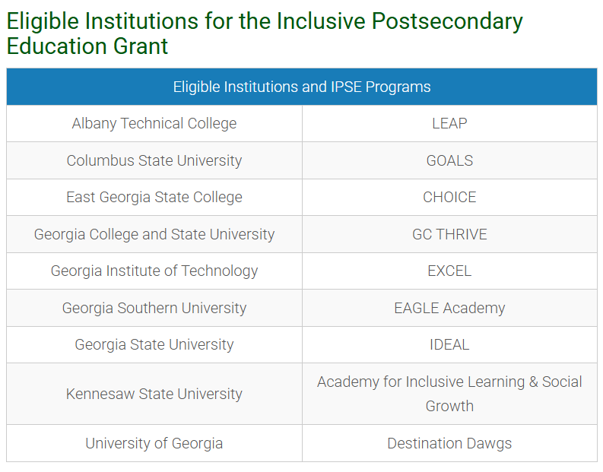
Inclusive Postsecondary Education Grant
IPSE Grant
Meet our Basic HOPE Eligibility Requirements
Be enrolled in an approved IPSE Program at a participating USG or TCSG Postsecondary Institution;
Meet criteria set by the Eligible Postsecondary Institution to be enrolled in their IPSE program and to complete program coursework
Notes:
To maintain the HOPE Grant, a student must have a 2.0 college HOPE GPA at the checkpoints.
Click

Slide 38
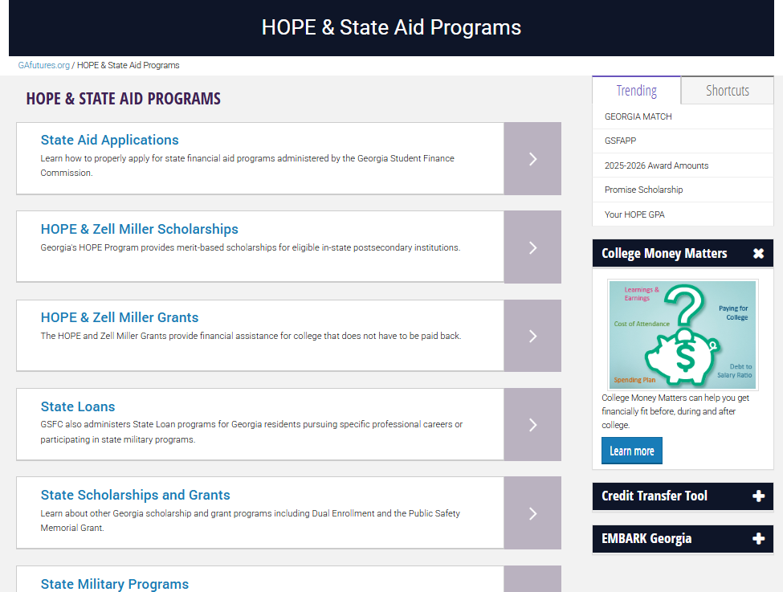
Apply for state programs
Georgia student finance commission
Notes:
Applying for state programs is very easy. Go to the Gafutures homepage and select the HOPE & State Aid Programs tab, then select the State Aid Applications link.

Slide 39
The Application Process
Federal and State Aid
Notes:
Students have two options when applying for the HOPE Scholarship, through the FAFSA and/or the GSFAPPS, located on GAfutures.org.
Click

Slide 40

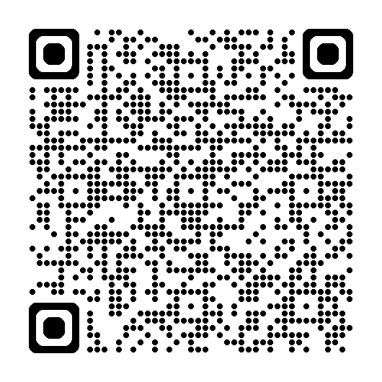
How to apply
The application process
FAFSA
GSFAPP
Federal Pell Grant
HOPE Scholarship/Grant
FSEOG
Zell Miller Scholarship/Grant
Federal Student Loans
HOPE Career Grant
Federal PLUS
HOPE Scholarship/Grant
HOPE Career Grant
Zell Miller Scholarship/Grant

Slide 41
Resources
Learn about financial aid resources to help pay for college.

Slide 42
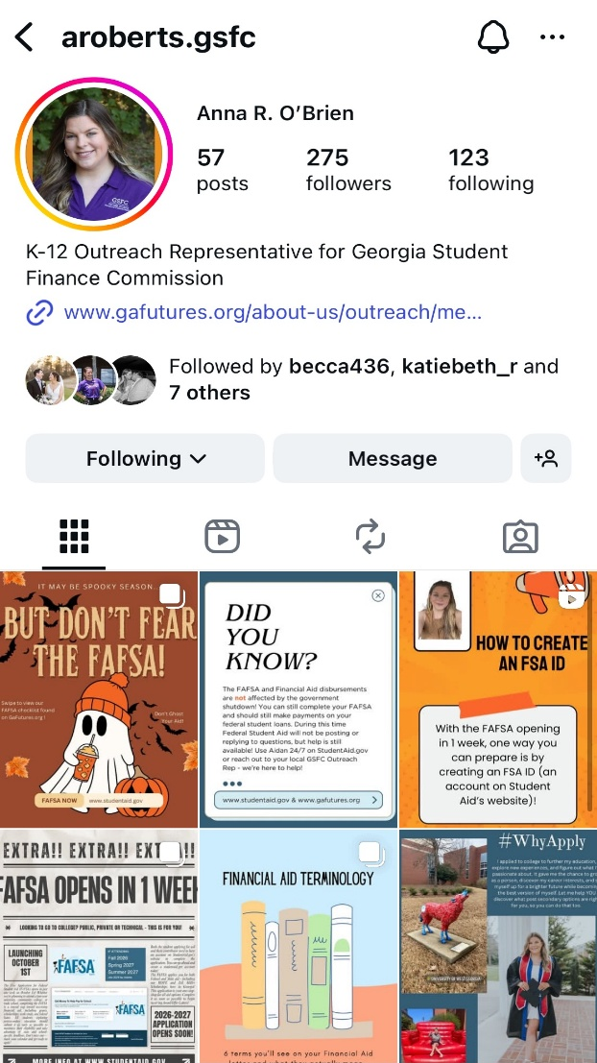



(404) 706-1550
resources
CONTACT US
aroberts@gsfc.org
@aroberts.gsfc
Notes:
You can also call our 800 number or email our Client Services with any questions you may have.

Slide 43

How Going to Work Affects Your Benefits
Notes:
JD

Slide 44

It’s complicated but our WIPA Program can help.
Work Incentives Planning and Assistance: Community Work Incentives Counselors are trained to help.
Walton Options, WIPA Project proudly serves the 102 counties in the eastern part of GA through a grant provided by the Social Security.
Notes:
There is no magic number, no take 1 for every 2 dollars rule
WIPA_ Work Incentives Planning and Assistance

Slide 45
MYTH: I can’t work because I have a disability.
  Social Security’s work incentives provide opportunities for you to try working while still receiving benefits.
  Vocational Rehabilitation or an Employment Network through the Ticket to Work program can help you explore your work goals and options, and offer services to help you achieve your work goals.
  Find out more about your rights as a person with a disability, such as reasonable accommodations to perform job duties.

Slide 46
MYTH: If I work I will automatically lose my benefits.
  Some work incentives allow you to try to work without affecting your benefits right away.
  Depending on the amount of your wages and the type of benefit you receive, you may be able to work and still receive some of your check.
  Working will most likely increase your overall monthly income.
  Make sure to keep pay stubs and other records and report to Social Security!

Slide 47
MYTH: If I try to go to work, I will automatically lose my Medicare or Medicaid.
Both Medicare Through Social Security Disability Insurance (SSDI) and Medicaid through Supplemental Security Income (SSI) have protections.
If you earn enough that your SSDI checks stop, Medicare can continue for at least 93 months after a Trial Work Period , as long as you still have a disability.
If you currently receive Medicaid with SSI, you may continue to receive Medicaid even after you stop receiving SSI benefits due to earnings from work.
www.chooseworkttw.net

Slide 48
MYTH: If I use my Ticket to go to work, Social Security will conduct a medical review, and I will lose my benefits.
If a medical Continuing Disability Review has already been scheduled for you before you assigned your ticket, Social Security will continue with the medical CDR.
If you participate in the Ticket program with either an Employment Network or your State Vocational Rehabilitation Agency, and make “timely progress” following your individual work plan, Social Security will not conduct a review of your medical condition.
www.chooseworkttw.net

Slide 49
MYTH: If my checks stop because I go to work and then I have to stop working because of my disability, I will have to reapply for benefits all over again.
You will not need to reapply if your benefits ended within the past five years due to your earnings and you meet a few other requirements, including that you still have the original medical condition or one related to it that prevents you from working.
You may even be able to receive up to six months of temporary cash benefits in addition to Medicare or Medicaid coverage while SSA conducts a medical review to determine if your benefits can be reinstated.
www.chooseworkttw.net

Slide 50
MYTH: The IRS will notify SSA about my work income.
  NO – It is your duty report your gross wages by the 10th of the month following the month of your wages.
  Example: Gross wages earned in August must be reported by September 10.

Slide 51
MYTH: SSA will automatically apply work incentives to my situation.
  While some are automatic, many are not.
  You should seek out help and learn what incentives apply to you and what documentation is required.
  Request that Social Security use work incentives that you think apply to you, and provide accurate documentation. Keep copies for your records.

Slide 52
MYTH: As long as I report my gross wages and employment supports, I will never have to worry about an overpayment.
  It is possible to be assessed an overpayment of benefits even with reporting.
  You can help out your situation by timely reporting all of your gross wages and work incentives, keeping documentation that you reported, keeping copies of documents you submitted, and not spending any benefits you know you are not entitled to.
  We can help you understand what you need, and what records to keep

Slide 53

Working is almost always a better deal!

Slide 54
How to contact the WIPA Project for Services
Call the National Ticket to Work Helpline at 866-968-7842 to be referred to the WIPA project for benefits counseling services

Slide 55
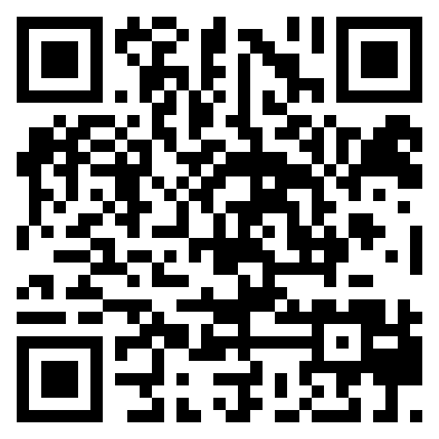

Pathways to Partnerships
Family Learning Session Survey
We value your feedback and would appreciate it if you could take a few moments to complete this survey. Your responses will help improve our learning sessions.

Slide 56
The contents of this presentation were developed under grant H421E230027 from the U.S. Department of Education (Department). The Department does not mandate or prescribe practices, models, or other activities described or discussed in this document. The contents of this presentation may contain examples of, adaptations of, and links to resources created and maintained by another public or private organization. The Department does not control or guarantee the accuracy, relevance, timeliness, or completeness of this outside information. The content of this presentation does not necessarily represent the policy of the Department. This publication is not intended to represent the views or policy of or be an endorsement of any views expressed or materials provided by any Federal agency. (EDGAR75.620)

