Slide 1
Shannah Mabry – Pathways to Partnerships, Project Manager Leigh Thrailkill – Pathways to Partnerships, Family Liaison
Pathways to Partnerships

Slide 2
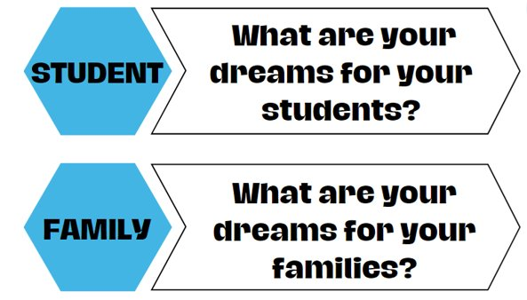
Big Dreams

Slide 3
P2P Mission: To improve training and preparation of children and youth with disabilities in Georgia to eventually obtain and maintain competitive integrated employment in conjunction and coordination with other state, local, and private entities.​

Slide 4
Family Learning Session
How can my child get financial help for training or education after high school?

Slide 5
Anna O’BRIEN
Georgia Student Finance Commission

Slide 6
Financial Aid 101:
Federal and State Aid
Anna R. O’Brien
aroberts@gsfc.org
Notes:
Because financial aid can be confusing for many, today, we will be spending time highlighting the process for a student to acquire funding for their post-secondary education.

Slide 7
Financial Aid Types and Sources
Forms of Financial Aid:
Scholarships
Grants
Loans
Work-study programs
Sources of Financial Aid:
Federal and state government
Colleges and universities
Private foundations
Professional and service organizations
Employers and private companies
Notes:
Finding ways to pay for college is one of the most important, but also one of the most challenging tasks connected to attending college. Financial aid is any money used to help pay for college. Financial aid can cover tuition and fees, room and board, books and supplies, transportation and other college-related expenses.

Slide 8
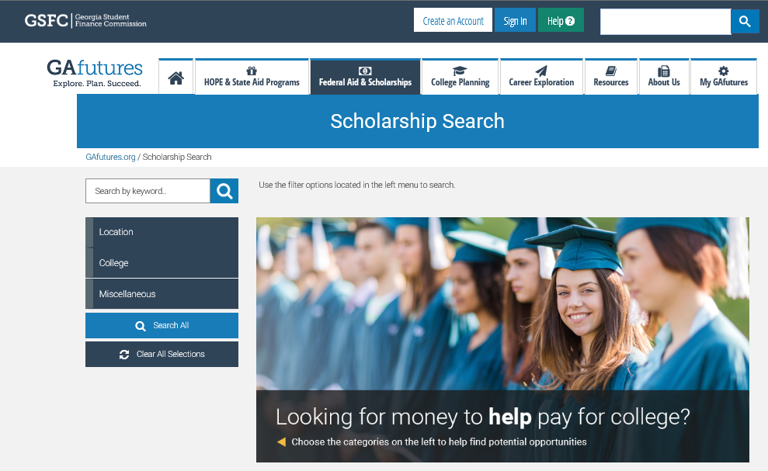
GAfutures Scholarship Search
Scholarship Search Tips
Start search early
Don’t stop at one, two, or three
Be creative
Consider family, hobbies, career interests, medical history, or college major
Look for scholarships even after beginning college
Careeronestop.org
DO NOT PAY ANYONE TO HELP FIND OR APPLY FOR SCHOLARSHIPS!
Notes:
There are thousands of scholarships out there to help all types of students pay for college. Look for local and national scholarships with GAfutures.org’s search tool to find additional sources of financial aid. Some scholarships have some pretty unique eligibility requirements! Are you a vegetarian? An aspiring writer? An avid volunteer in your community? Then there may be a scholarship for you. Here are some tips to help.

Slide 9
Federal Financial Aid Programs Grants
Pell Grant
Undergraduate student with financial need
Maximum amount for 2025-2026 is $7,395
Federal Supplemental Educational Opportunity Grant (FSEOG)
Undergraduate student with exceptional financial need
Pell Grant recipients receive priority
Up to $4,000
Notes:
The federal government has financial aid programs that include grants and work-study awards that do not need to be repaid, as well as various loans that require repayment. For more information, visit studentaid.gov

Slide 10
Federal Financial Aid Programs Grants
Federal Work Study Program
Full-time or part-time undergraduate or graduate student
Earn at least minimum wage
On-campus positions
Campus tour guide
Library
Sporting events
Office assistant

Slide 11
Federal Financial Aid Programs Federal Direct Loans
Direct Subsidized Loan
Direct Unsubsidized Loan
Federal PLUS Loan – for parents of dependent undergraduate students
Grad PLUS Loan – for graduate and professional students
Notes:
The FAFSA also determines the amount of loans, subsidized and unsubsidized, you are eligible for.
These loans, of course, will have to be repaid once you are no longer in school. Repayment begins six months after graduation or if the student is no longer enrolled at least half time.
Federal PLUS Loans are unsubsidized loans made to parents of undergraduate students. If your parents cannot obtain a PLUS loan, you may be eligible to borrow additional Unsubsidized Stafford loan funds. The interest rates may vary based on when the loan is borrowed.
With the Grad PLUS Loan, graduate and professional students are also eligible to borrow under the PLUS Loan program to help pay for their education.

Slide 12
Federal Financial Aid Programs Direct Subsidized Loans
Direct Subsidized Loan
Available to undergraduate students with financial need
Interest is paid by the government while enrolled (at least half time)
Amount determined by institution and based on COA, financial need, other aid and loan limits
Current interest rate 6.53% (undergraduate)

Slide 13
Federal Financial Aid Programs Direct Unsubsidized Loans
Direct Unsubsidized Loan
Available to undergraduate/graduate students
Institution determines the amount based on COA, other financial aid awarded, and loan limits
Student responsible for paying the interest
Can choose to defer interest while enrolled at least half time, but interest will be added to the principal amount of loan
Current interest rate 6.53% (undergraduate)
Current interest rate 8.08% (graduate/professional)

Slide 14
Federal Loan Program Limits
2024-2025Academic Year
Initial Loan Amount for Dependent Students whose Parents are Eligible for a PLUS Loan | Base | Additional Unsubsidized | Annual Maximum Amount
Freshmen | $3,500 | $2,000 | $5,500
Sophomore | $4,500 | $2,000 | $6,500
Junior/Senior | $5,500 | $2,000 | $7,500
Independent Students and Dependent Students whose Parents were Denied a PLUS Loan | Base | Additional Unsubsidized | Annual Maximum Amount
Freshmen | $3,500 | $6,000 | $9,500
Sophomore | $4,500 | $6,000 | $10,500
Junior/Senior | $5,500 | $7,000 | $12,500
Notes:
Depending on what type of loan you and/or your parents qualify for, there are some limits to the amount of funds you can receive.
First-year undergraduates are eligible for loans up to $5,500.
Amounts increase for subsequent years of study, with higher amounts for graduate students. The interest rates may vary based on when the loan is borrowed.

Slide 15
HOPE Scholarship
HOPE Program
HOPE
Scholarship
Zell Miller
Scholarship
HOPE
Grant
Zell Miller
Grant
HOPE Career Grant
Notes:
Next, lets talk about the eligibility requirements for the HOPE Scholarship.
Click

Slide 16
HOPE Scholarship Eligibility Requirements
Students must pursue an associate or bachelor’s degree
Graduate with a 3.0 high school HOPE GPA
After high school graduation, may also be earned in college
4 academically rigorous course credits
Notes:
First, the HOPE Scholarship is awarded to students pursuing an associates or bachelors degree.
Students must graduate with a 3.0 high school HOPE GPA from a Georgia high school, and 4 academically rigorous course credits.
For home school students, the requirements differ. For more information, contact us.
Click

Slide 17
Maintaining the HOPE Scholarship
Students must maintain 3.0 college HOPE GPA at all checkpoints including:
End of every Spring semester/quarter
30/45 attempted semester/quarter hours
60/90 attempted semester/quarter hours
90/135 attempted semester/quarter hours
Three-Term Checkpoint, if enrolled less than full-time for first three semesters/quarters
Notes:
To maintain the HOPE Scholarship while in college, a student must maintain at least a 3.0 college HOPE GPA at all checkpoints including every spring term of enrollment.
Click

Slide 18
HOPE & Zell Miller Scholarships
Students lose eligibility due to one of the following:
GPA requirement not met (3.0 for HOPE; 3.3 for Zell Miller)
Reaching maximum attempted hours
127 semester
190 quarter
Failing to use funds within ten years of high school graduation or equivalent
Exception for active duty military service in United States Armed Forces
Received bachelor’s or first professional degree
Notes:
There are a few ways students can lose their eligibility for the HOPE Scholarship and Zell Miller Scholarship:
Not maintaining your GPA
Reaching the maximum hours allowed
Failing to use your award within seven years
and receiving a bachelor’s or professional degree.

Slide 19
HOPE ADA Limited Extension Request
Has ten year HOPE/Zell Miller Scholarship eligibility limit
Has not reached or exceeded the Attempted-Hours or Paid Hours limits
Has received the HOPE or Zell Miller Scholarship and meets all eligibility requirements
Has been enrolled at an eligible college or university each academic year unless there is a documented long-term illness
Each term of enrollment is less than full time (12 hours or more) due to the disability.

Slide 20
Grants
HOPE Program
HOPE
Scholarship
Zell Miller
Scholarship
HOPE
Grant
Zell Miller
Grant
HOPE Career Grant
Notes:
Now let’s talk about the grants.
Click

Slide 21
HOPE Grant
Eligibility Requirements:
Enrolled in certificate or diploma program
High school diploma/GED not required
High school GPA and/or test scores not considered
Students must maintain a 2.0 college cumulative GPA at the following checkpoints:
30 HOPE Grant paid semester hours
60 HOPE Grant paid semester credit hours
Notes:
Like all components of the HOPE Program, the general eligibility requirements will also apply to the grants.
Yet, what’s different is that grants can only be used for students who are enrolled in a certificate or diploma program.
Also, there is no high school HOPE GPA requirement, and test scores are not considered.
Click

Slide 22
Zell Miller Grant
Eligibility Requirements:
Minimum 3.5 college cumulative GPA
Checkpoints occur at the end of every term of enrollment
Must be a HOPE Grant recipient initially
May be paid retroactively for first term
Maximum 63 combined paid hours Zell Miller and HOPE Grants
Notes:
To keep the Zell Miller Grant, must maintain at least a 3.5 college cumulative GPA every term.
Not eligible for Zell Miller Grant until one semester is completed because would have to have at least a 3.5 college cumulative GPA.
Click

Slide 23
Award Amounts
 | HOPE Scholarship | Zell Miller Scholarship
Public Institutions | portion of tuition | full standard tuition
Private Institutions Full-time | $2,496 per semester (fall, spring, summer) $1,664 per quarter (fall, winter, spring, summer) | $2,985 per semester (fall, spring, summer) $2,034 per quarter (fall, winter, spring, summer)
 | HOPE Grant | Zell Miller Grant
Public Institutions | portion of tuition | full standard tuition
Notes:
At public institutions, the HOPE Scholarship and Grant cover a portion of the tuition. Tuition rates can vary at each institution.
The Zell Miller Scholarship and Grant provide full tuition at our public institutions.
Neither award can be used for books, housing, meal plans, or fees. Only tuition.
Students can receive the HOPE or Zell Miller Scholarship at private institutions; it is a set amount per term of enrollment.
Students do not have to be enrolled full-time for these grants and scholarships. However, the awards are capped at 15 credit hours. This also applies to courses taken in the summer.
Click

Slide 24
Other State Programs
Inclusive Postsecondary Education (IPSE) Grant Program
Provides assistance to students with qualifying intellectual and developmental disabilities, and enrolled in an approved IPSE program.
The grant can assist with tuition, mandatory fees, or program fees.
Notes:
Here are some other programs administered by the Georgia Student Finance Commission.
Georgia National Guard Service Cancelable Loan assists with tuition for undergraduate and graduate school and may be forgiven if the Guard member completes commitment with the National Guard.
Georgia Public Safety Memorial Grant
Public safety officers include: law enforcement officers, firefighters, emergency medical technicians, paramedics, highway emergency response operators (HERO) and prison guards. Funds may be used toward the cost of attendance at eligible colleges or universities in Georgia.
Tuition Equalization Grant provides assistance to eligible students attending full-time at a HOPE-eligible private institution.

Slide 25
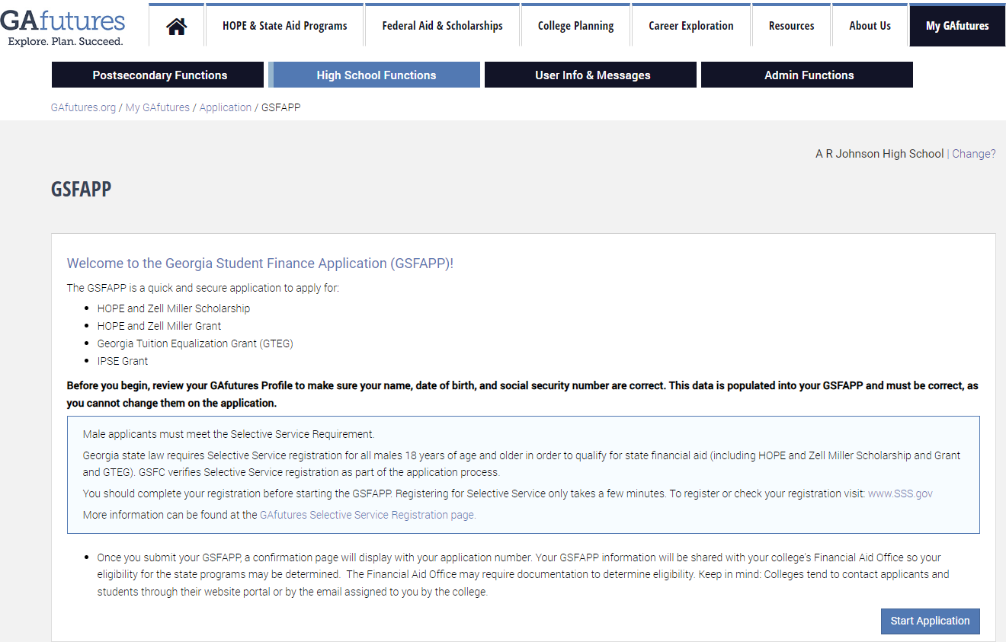
Application and Process
Notes:
A student must apply for the HOPE Program in one of two ways, through the FAFSA and/or the GSFAPPS, located on GAfutures.org.
Click

Slide 26
The Georgia Student Finance Application (GSFAPP)
Determine eligibility for state aid only
One time application
GAfutures account
GA State Aid
HOPE Eligible Institution
Notes:
Students can use the Georgia Student Finance Application or GSFAPPS to apply for the HOPE Program.
No, it’s not the latest app that you can download on your phone. It is a one-time application for state aid only.
To complete the GSFAPPS, students must have GAfutures account.
Click

Slide 27
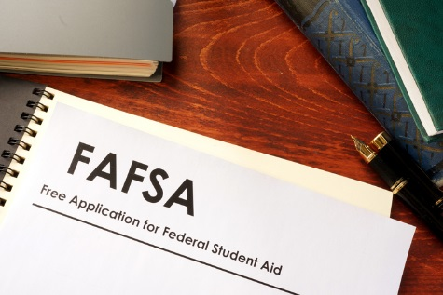
Free Application for Federal Student Aid (FAFSA)
Studentaid.gov
Renew annually
Determines eligibility for federal and state aid
List up to 20 institutions
2025-2026 Application currently available
Typically opens October 1st of each year
Federal Aid
GA State Aid
HOPE Eligible Institution
Notes:
The Free Application for Federal Student Aid or FAFSA becomes available on October 1st each year. Students can submit the application, and it must be renewed annually.
The FAFSA will determine eligibility for Federal Student Aid. To make things easier, some of the information from the FAFSA is also used to determine eligibility for state aid.
Students can list up to 10 institutions on the FAFSA. To receive state aid, one institution must be HOPE eligible.
We have two great documents under the Resources tab on GAfutures.org to guide students through the FAFSA process; yet, that information can also be found here in the links for GAfutures webinar documents.
Click

Slide 28
Bud McCall Post-Secondary Vocational Rehabilitation Grant
Eligibility Requirements
Must have a disability that results in a substantial impediment to employment
Must apply for services and become a GVRA client
Must provide an acceptance letter for an accredited degree program at a college or university OR a degree, diploma, or Technical Certificate of Credit (TCC) program at a technical college
Complete the Free Application for Federal Student Aid (FAFSA) every year
Must apply all comparable benefits for which the individual is eligible, including Pell grants, before applying the Bud McCall Grant to their balance
Must submit updates to include grades, student account details, and class schedule each semester to their counselor to maintain eligibility.

Slide 29
Bud McCall Post-Secondary Vocational Rehabilitation Grant
Total annual grant is $17,725 for up to 5 years.
Tuition: up to $7,395 per year
Maintenance (room, board, and meals): up to $9,430 per year.
Books: up to $900 per year.

Slide 30
Contact Me!
aroberts.gsfc
404-706-1550
aroberts@gsfc.org
Notes:
You can also call our 800 number or email our Client Services with any questions you may have.

Slide 31
Robbie Breshears Tatiana Amill
Walton Options for Independent Living, WIPA Project

Slide 32
How Going to Work Affects Your Benefits
Notes:
JD

Slide 33
It’s complicated but our WIPA Program can help.
Work Incentives Planning and Assistance: Community Work Incentives Counselors are trained to help.
Walton Options, WIPA Project proudly serves the 102 counties in the eastern part of GA through a grant provided by the Social Security.
Notes:
There is no magic number, no take 1 for every 2 dollars rule
WIPA_ Work Incentives Planning and Assistance

Slide 34
MYTH: I can’t work because I have a disability.
Social Security’s work incentives provide opportunities for you to try working while still receiving benefits.
Vocational Rehabilitation or an Employment Network through the Ticket to Work program can help you explore your work goals and options, and offer services to help you achieve your work goals.
Find out more about your rights as a person with a disability, such as reasonable accommodations to perform job duties.

Slide 35
MYTH: If I work I will automatically lose my benefits.
Some work incentives allow you to try to work without affecting your benefits right away.
Depending on the amount of your wages and the type of benefit you receive, you may be able to work and still receive some of your check.
Working will most likely increase your overall monthly income.
Make sure to keep pay stubs and other records and report to Social Security!

Slide 36
MYTH: If I try to go to work, I will automatically lose my Medicare or Medicaid.
Both Medicare Through Social Security Disability Insurance (SSDI) and Medicaid through Supplemental Security Income (SSI) have protections.
If you earn enough that your SSDI checks stop, Medicare can continue for at least 93 months after a Trial Work Period , as long as you still have a disability.
If you currently receive Medicaid with SSI, you may continue to receive Medicaid even after you stop receiving SSI benefits due to earnings from work.
www.chooseworkttw.net

Slide 37
MYTH: If I use my Ticket to go to work, Social Security will conduct a medical review, and I will lose my benefits.
If a medical Continuing Disability Review has already been scheduled for you before you assigned your ticket, Social Security will continue with the medical CDR.
If you participate in the Ticket program with either an Employment Network or your State Vocational Rehabilitation Agency, and make “timely progress” following your individual work plan, Social Security will not conduct a review of your medical condition.
www.chooseworkttw.net

Slide 38
MYTH: If my checks stop because I go to work and then I have to stop working because of my disability, I will have to reapply for benefits all over again.
You will not need to reapply if your benefits ended within the past five years due to your earnings and you meet a few other requirements, including that you still have the original medical condition or one related to it that prevents you from working.
You may even be able to receive up to six months of temporary cash benefits in addition to Medicare or Medicaid coverage while SSA conducts a medical review to determine if your benefits can be reinstated.
www.chooseworkttw.net

Slide 39
MYTH: The IRS will notify SSA about my work income.
NO – It is your duty report your gross wages by the 10th of the month following the month of your wages.
Example: Gross wages earned in August must be reported by September 10.

Slide 40
MYTH: SSA will automatically apply work incentives to my situation.
While some are automatic, many are not.
You should seek out help and learn what incentives apply to you and what documentation is required.
Request that Social Security use work incentives that you think apply to you, and provide accurate documentation. Keep copies for your records.

Slide 41
MYTH: As long as I report my gross wages and employment supports, I will never have to worry about an overpayment.
It is possible to be assessed an overpayment of benefits even with reporting.
You can help out your situation by timely reporting all of your gross wages and work incentives, keeping documentation that you reported, keeping copies of documents you submitted, and not spending any benefits you know you are not entitled to.
We can help you understand what you need, and what records to keep

Slide 42
Working is almost always a better deal!

Slide 43
How to contact the WIPA Project for Services
Call the National Ticket to Work Helpline at 866-968-7842 to be referred to the WIPA project for benefits counseling services

Slide 44
Any Questions

Slide 45
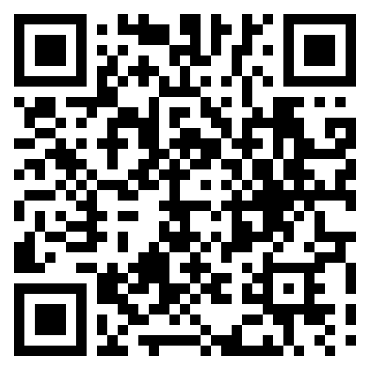
Pathways to Partnerships Family Learning Session Survey
We value your feedback and would appreciate it if you could take a few moments to complete this survey. Your responses will help improve our learning sessions.
The contents of this presentation were developed under a grant from the U.S. Department of Education (Department). The Department does not mandate or prescribe practices, models, or other activities described or discussed in this document. The contents of this presentation may contain examples of, adaptations of, and links to resources created and maintained by another public or private organization. The Department does not control or guarantee the accuracy, relevance, timeliness, or completeness of this outside information. The content of this presentation does not necessarily represent the policy of the Department. This publication is not intended to represent the views or policy of or be an endorsement of any views expressed or materials provided by any Federal agency.

