Slide 1
Shannah Mabry – Pathways to Partnerships, Project Manager Leigh Thrailkill – Pathways to Partnerships, Family Liaison
Pathways to Partnerships

Slide 2
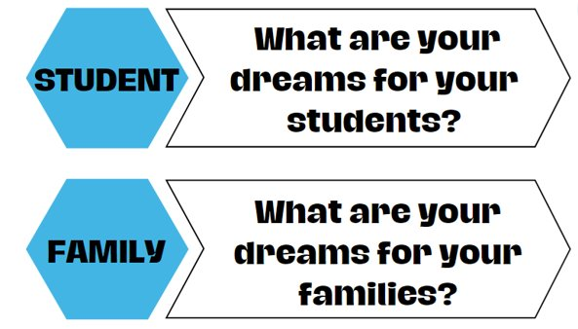
Big Dreams

Slide 3
P2P Mission: To improve training and preparation of children and youth with disabilities in Georgia to eventually obtain and maintain competitive integrated employment in conjunction and coordination with other state, local, and private entities.​

Slide 4
Family Learning Session
What are my child’s choices after high school: work, college, vocational residential certification programs?

Slide 5
Georgia Vocational Rehabilitation Agency
March 27, 2025
GVRA Supporting Transitioning High School Students
Brittanie Burdette, Transition Coordinator
Brittanie.burdette@gvs.ga.gov

Slide 6
Presentation Objectives
Learn about how GVRA supports high school students
Who qualifies for services?
What services might my student receive
Notes:
Our goal with this presentation is to address these most frequently asked questions, and state the questions.

Slide 7
How to Access GVRA Services
Through your local school.
Designated GVRA Staff work with local school system staff
Invite GVRA staff to attend IEP meeting
Transition fairs
School referrals to GVRA with Parental Permission form and copy of IEP or 504 plan
Through GVRA
Referral for HS services only - https://gvs.georgia.gov/form/parental-permission-form
VR Services Referral - https://gvs.ga.gov
GVRA Customer Support - 844-367-4872
Attend Virtual Potential Client Orientation- “Is VR Right for Me”
Held on the Third Wednesday of the month
A recording of the session will also be available on the GVRA website- gvs.ga.gov
Notes:
This slide addresses the first FAQ.
1st – we have transition staff throughout the state assigned to cover all public school districts. Students are typically introduced to GVRA through their schools connecting them. IEP case managers, transition specialists and school counselors are the most common school staff to make referrals to GVRA
2nd - GVRA can also receive referrals directly from anyone for anyone, including for students attending private schools or those homeschooled
3rd – GVRA has a similar live forum as this for potential clients to explore applying for VR services.

Slide 8
Who Qualifies
Potentially Eligible Student (for HS services only):
Between the ages of 14-21 (up until their 22nd birthday)
Eligible and receiving services under an IEP or Section 504
Is participating in a recognized academic setting. (public, private, home based schools, Post-Secondary training.
VR Client:
Physical or mental disability
Poses a substantial impediment to employment
Can benefit from Vocational Rehabilitation Services in terms of a competitive integrated employment outcome.
Notes:
This slide addresses the 2nd FAQ.
Students can qualify for services from GVRA 2 ways.
The first is as a Potentially Eligible Student. Qualifying this way allows them to receive Pre-Employment Transition Services ONLY and these services will only last as long as the student is enrolled in school.
The second way students qualify for GVRA services is to apply and be determined eligible for VR services which allows them to be served as a VR client. This allows students, typically those closer to HS exit or needing more individualized services, to receive Pre-employment transition services as well as individualized VR Transition Services and future VR Employment Services. The whole continuum shown on our earlier slide. Typically, HS students are referred to GVRA early in HS and are served as potentially eligible students and then decide prior to graduation if they will apply for VR services depending upon their needs after HS. Ideally, students who will require VR services after HS to be successful in competitive integrated employment will apply, be determined eligible and have a VR Work Plan in place prior to exiting HS.

Slide 9
Potentially Eligible Student (PTS) Process
GVRA Receives completed Parental Permission Form (PPF) and begins case
GVRA Obtains a copy of the IEP/504/Disability Documentation and case is updated to reflect SWD able to receive Pre-ETS.
GVRA Begins coordinating with Pre-ETS approved Vendors/Providers and Providing direct Pre-ETS Services to students.
Notes:
Briefly describe the process, highlight the needed documentation, and show the simplicity of getting started with Pre-ETS

Slide 10
What are Pre-Employment Transition Services (Pre-ETS)
Pre-ETS represent the earliest set of services available for students with disabilities under the GVRA program
These services are short-term in nature and are designed to help students identify career interests.
Specific set of five required activities
Pre-ETS services are individualized based on the student’s interest and transition goals.
Pre-ETS supplement the school services already in place to support college and career readiness and community participation.
Notes:
These next few slides address the 3rd FAQ regarding what services a student could receive. We will discuss the first group of services on the continuum Pre-ETS.

Slide 11
These are the Five Pre-ETS:
Job exploration counseling- Discussion and activities on job opportunities intended to foster motivation and informed decision-making
Workplace readiness training- Development activities on social and other soft skills that are necessary for employment and independent living
Work-based learning experiences- Placing student in workplaces to help them connect school experiences to future career opportunities
Post-secondary education counseling- Discussion and activities regarding college and other post-secondary opportunities
Instruction in self-advocacy- Activities to improve abilities to communicate, negotiate, and assert one’s interests and desires
Notes:
Our staff work closely with school staff to determine what Pre-ETS are most needed by a student or group of students based upon what the school is already providing to all students, what the school is providing to specific students as part of class curriculum, and what the school is providing to students as outlined in their IEPs and/or 504 plans. Some Pre-ETS are offered as part of the school day by GVRA staff or contracted providers as guest speakers at the school. Other Pre-ETS are offered over school breaks or outside of school hours.

Slide 12
How many Pre-Employment Transition Services?
None of the provisions mandate that all five Pre-ETS activities be provided to each qualifying student by GVRA.
There is no requirement that any one type of Pre-ETS precede another type.
There is no requirement that a person receive a prescribed number of Pre-ETS.
Notes:
Our staff work closely with school staff to determine what Pre-ETS are most needed by a student or group of students based upon what the school is already providing to all students, what the school is providing to specific students as part of class curriculum, and what the school is providing to students as outlined in their IEPs and/or 504 plans. Some Pre-ETS are offered as part of the school day by GVRA staff or contracted providers as guest speakers at the school. Other Pre-ETS are offered over school breaks or outside of school hours.

Slide 13
Getting Ready for Opportunities in Work (GROW)
GROW is available to students looking for an opportunity to explore work and post-secondary education opportunities in a 4-5 day camp-like structure.
GROW is typically during the summer months, but sometimes is scheduled during school breaks
Sites include Roosevelt Warm Springs and Cave Spring campuses
GROW is also offered through private providers across the state
During GROW, students will join peers in work-based learning, career exploration, workplace readiness, post-secondary counseling and self-advocacy activities
Notes:
Look for communication through GVRA website to apply for the summer GROW program

Slide 14
Georgia Vocational Rehabilitation Agency
VR Transition Services

Slide 15
VR Transition Services
Available to students who have applied and been determined eligible for VR services
Documented in the Individualized Plan for Employment (IPE)
VR Transition services allow the student to receive more individualized and intensive Pre-ETS while they are still enrolled in school.
Based upon the unique needs of the student AND requirements to reach their specific vocational goal in competitive integrated employment

Slide 16
GVRA Client Process/Applying for VR Services
GVRA Receives Referral (or the student is already receiving Pre-ETS and requests to apply for VR Services).
The student completes a VR Intake with a VR staff member and signs an application for services.
GVRA Counselor will begin eligibility process, which includes assignment of priority category.
Once eligibility is determined, then GVRA will conduct a needs assessment.
Utilizing information collected during the needs assessment an Individualized Plan for Employment (IPE) will be developed, reviewed and agreed upon by both GVRA and the Client.
Notes:
Again, highlight process, required documentation, etc.

Slide 17
Common Transition Services
Community Work Adjustment Training (intensive Pre-ETS)
Assistive Work Technology
On-the-job training
Specific Vocational training
GVRA Residential Services Pathway Training Programs
Job coaching
Supported Employment
Customized Supported Employment
Individualized Job Placement Services
Notes:
Remind that this is not an exhaustive list, but some of the most frequently used services.
Give a short description of each one

Slide 18
Transition to College Degree, Diploma, and Technical Certificate Programs
Necessary in order to reach their Vocational Goal:
Support Needs/Services
Measurable Skill Gains (progress monitoring)
Credential Attainment
Funding Options include the Bud McCall Grant
Notes:
Some clients will transition to college programs. They go through the regular college application and admissions process and can request VR support for their programs. VR support may be approved for clients if the program is needed for the client to reach their job goal. When VR supports a client in college programming, the client and VR counselor work together to identify support needs and services, track educational progress, document their credential attainment/getting their diploma or degree, and at least annually assess their financial aid and funding options.

Slide 19
Transition to Inclusive Post-Secondary Education
What is IPSE/CTP?
Which colleges have the programs?
www.thinkcollege.net
Georgia has 9 this year, currently 8 are Certified Transition Programs
Important Considerations
Housing/Transportation
Financial Barriers
If approved, GVRA support of up to $3000 per semester may be sent to the program. GVRA contracts with them to provide Pre-ETS and/or work readiness services qualifying students.
Eligible for federal financial aid?
Private and school scholarships?
Educational loans?
Notes:
Inclusive Post-Secondary Education/Certified Transition Programs are college and university programs designed to give students who don’t meet the academic requirements to be considered for college admission to enroll in a college experience on campus that allows them to audit some college classes, have college peers, participate in college activities, & prepare for employment. These programs can be very costly to families, but are one additional options for students considering post HS options for further education and training.
BE SURE TO EMPHASIZE: talk with the school you plan to attend on how they apply GVRA funding.

Slide 20
VR Postsecondary Services & Funding
Services
Funding
Postsecondary Training
Inclusive Postsecondary Training
Vocational Training, Supported Employment, & Job Placement Services
Financial Aid, Need-Based Scholarships, Bud McCall Grant
Georgia Student Finance Commission Grants (IPSE Grant), GVRA supports programs up to $3000 per semester for Pre-ETS per student for up to 4 semesters
GVRA funded – no cost to individuals and families.

Slide 21
Bud McCall Post Secondary Vocational Rehabilitation Grant
Eligibility Requirements:
Meet GVRA eligibility
Provide an acceptance letter to an accredited school
Complete FAFSA
Grant Amount:
Tuition: $7,395 per year
Maintenance: (room, board, and meals) $9,430 per year
Books: $900 per year
Students may qualify for other services such as assistive work technology, or other tools and equipment needed for training.

Slide 22
Employment Services
Employment services are not related to student status of an individual and typically occur toward the end of a VR case. Successful VR cases proceed until the client has obtained competitive integrated employment in their vocational goal area and have maintained employment for at least 90 days.
Common Employment Services Include:
Work Readiness Training
Job Search/Placement Assistance
Supported Employment or Short-Term Job Coaching
Job Accommodation and Support Guidance
Job Retention Strategies
Job Follow-Up/Follow Along
Notes:
This is the last category of services on the continuum and is available to VR clients. These services are not related to student status of an individual and typically occur toward the end of a VR case. Successful VR cases proceed until the client has obtained competitive integrated employment in their vocational goal area and have maintained employment for at least 90 days.

Slide 23
Georgia Vocational Rehabilitation Agency
March 27, 2025
GVRA Supporting Transitioning High School Students
Brittanie Burdette, Transition Coordinator
Brittanie.burdette@gvs.ga.gov

Slide 24
Any Questions

Slide 25
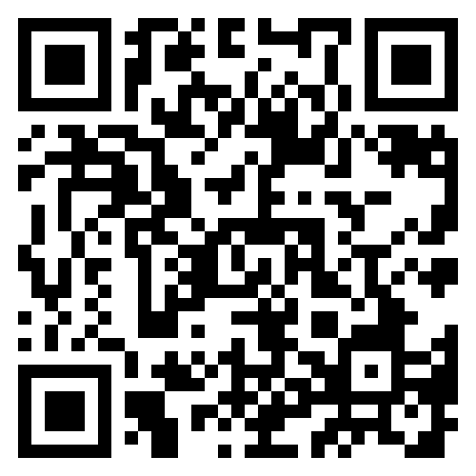
Pathways to Partnerships Family Learning Session Survey
We value your feedback and would appreciate it if you could take a few moments to complete this survey. Your responses will help improve our learning sessions.
The contents of this publication were developed under a grant number H421E230027 from the Department of Education. However, those contents do not necessarily represent the policy of the Department of Education, and you should not assume endorsement by the Federal Government. (Authority: 20 U.S.C. §§ 1221e-3 and 3474)

