Slide 1
Shannah Mabry – Pathways to Partnerships, Project Manager Leigh Thrailkill – Pathways to Partnerships, Family Liaison
Pathways to Partnerships

Slide 2
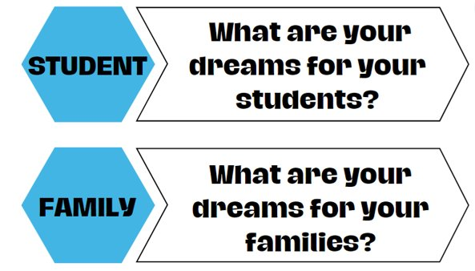
Big Dreams

Slide 3
P2P Mission: To improve training and preparation of children and youth with disabilities in Georgia to eventually obtain and maintain competitive integrated employment in conjunction and coordination with other state, local, and private entities.​

Slide 4
Family Learning Session
How can I help my child set goals and work toward reaching their dreams and how can my child set goals and receive peer support?

Slide 5
Makenzie Morrison
Youth Transition Coordinator
Walton Options, Center for Independent Living

Slide 6
Makenzie Morrison
P2P Instructor
Instructing for about 9 years
Las Vegas, NV - Grades 4th -12th
Augusta, GA - Sylvan Learning Center
Subjects: ELA, Test Taking and Study Skills, Pre-ETS
Hobbies: Spending time with Lana (my cat), writing, art, trivia and spending time with family and friends

Slide 7
About Walton Options
Walton Options for Independent Living is a private, non-profit, non residential Center for Independent Living (CIL).
Established in 1994, Walton Options provides services and resources to help people with all types of disabilities live independently within the community.
We are consumer controlled – 51% of employees and Board of Director Members have a disability.

Slide 8
Our Mission
We believe all persons including those with disabilities, should be able to participate in their community. At Walton Options, we promote equality, inclusion and independence through Personal Choice, Personal Responsibility, Community Access, Education and Employment.
Our goal is to help each person find and utilize the necessary, available resources on their personal journey to independence.

Slide 9
S.M.A.R.T. Goals
S = Specific (clear & exact details)
Personal, school, future career, etc.
M = Measurable (trackable progress)
Improvement, time, academically, personally, etc.
A = Achievable (steps they can do)
Organizers, accommodations, long vs short term, etc.
R = Relevant (Helpful now or in the future?)
Importance, personal, professional, etc.
T = Time-Bound (set deadline)
Week, quarter, semester, end of the year, etc.

Slide 10
Possible Ways We Can Help
Planner
Digital
Physical
Vision Board
Independent Living Skills
Advocacy and Outreach
Modeling
(What works for you?)
CILs
GVRA
Teachers
Peer Support
Groups
Activities
Accommodations

Slide 11
Information & Referral
Of our all of our core services, Information and Referral is the most extensive and most utilized service.
We provide our consumers with resources to help people live their lives independently in their own homes and communities.
We have many community partners that we collaborate to provide extensive Information and Referral Services.
Some of these resources include transportation, housing, finding a personal care attendant or emergency community supports (food, furnishings, disaster planning and preparedness).

Slide 12
Peer Support
Peer Support values the expertise that comes from being a person with a disability and the realization that often times the only person that can really relate to what a person with a disability is going through is someone that has “been there, done that.”
Peer Supporters at Walton Options are people with disabilities who mentor other people with disabilities by demonstrating and encouraging independence. They provide support as well as share their knowledge and experiences as persons with disabilities.
We offer a variety of Peer Support Groups for persons of all ages with disabilities and their families.

Slide 13
Youth Services
Our programs include:
Peer Support Group
Self-advocacy & Disability Culture
Accessible gaming, adaptive sports and leisure
Occupational Horizons

Slide 14
Discussing Accommodations & Disabilities
What works best for them to succeed?
What makes problem solving easier?
What resources do they need to succeed?
Where can you find more resources?
Who can help have these discussions?
What good habits can we teach them?
If you have the desire to achieve, you have the ability to gain independence.

Slide 15
Get in Touch
We’d love to hear from you! Call us for more information !
Georgia – Main Office
948 Walton Way, Augusta, GA 30901
706-724-6262
South Carolina
514 West Ave, North Augusta, SC 29841
803-279-9611
SC Low Country
843-538-1600

Slide 16
Trish Lindsey
Rehabilitation Counselor
Georgia Vocational Rehabilitation Agency (GVRA)

Slide 17
February 27, 2025
Family Learning Session
Scott Hendrix, District Manager
Scott.Hendrix@gvs.ga.gov
Trish Lindsey, Transition Counselor
Trish.lindsey@gvs.ga.gov

Slide 18
GVRA Resources
We feel like we have something to offer every student with a disability, once they are signed up with our organization.
Form a partnership with the schools and families and prepare students to become job ready.
Transition Forum: https://gvs.georgia.gov/transition-services
Is VR Right for Me: https://gvs.georgia.gov/events/2024-12-18/vr-right-me-virtual-prospective-client-orientation

Slide 19
Pre-Employment Transition Services (Pre-Ets)
Our providers will deliver lessons over 5 areas that are important for transition:
Job Exploration
Work Readiness Skills
Self-Advocacy
Counseling on Post-Secondary
Work-Based Learning

Slide 20
Pathful
Our agency will provide a license for all of the PTS/VR cases in your school.

Slide 21
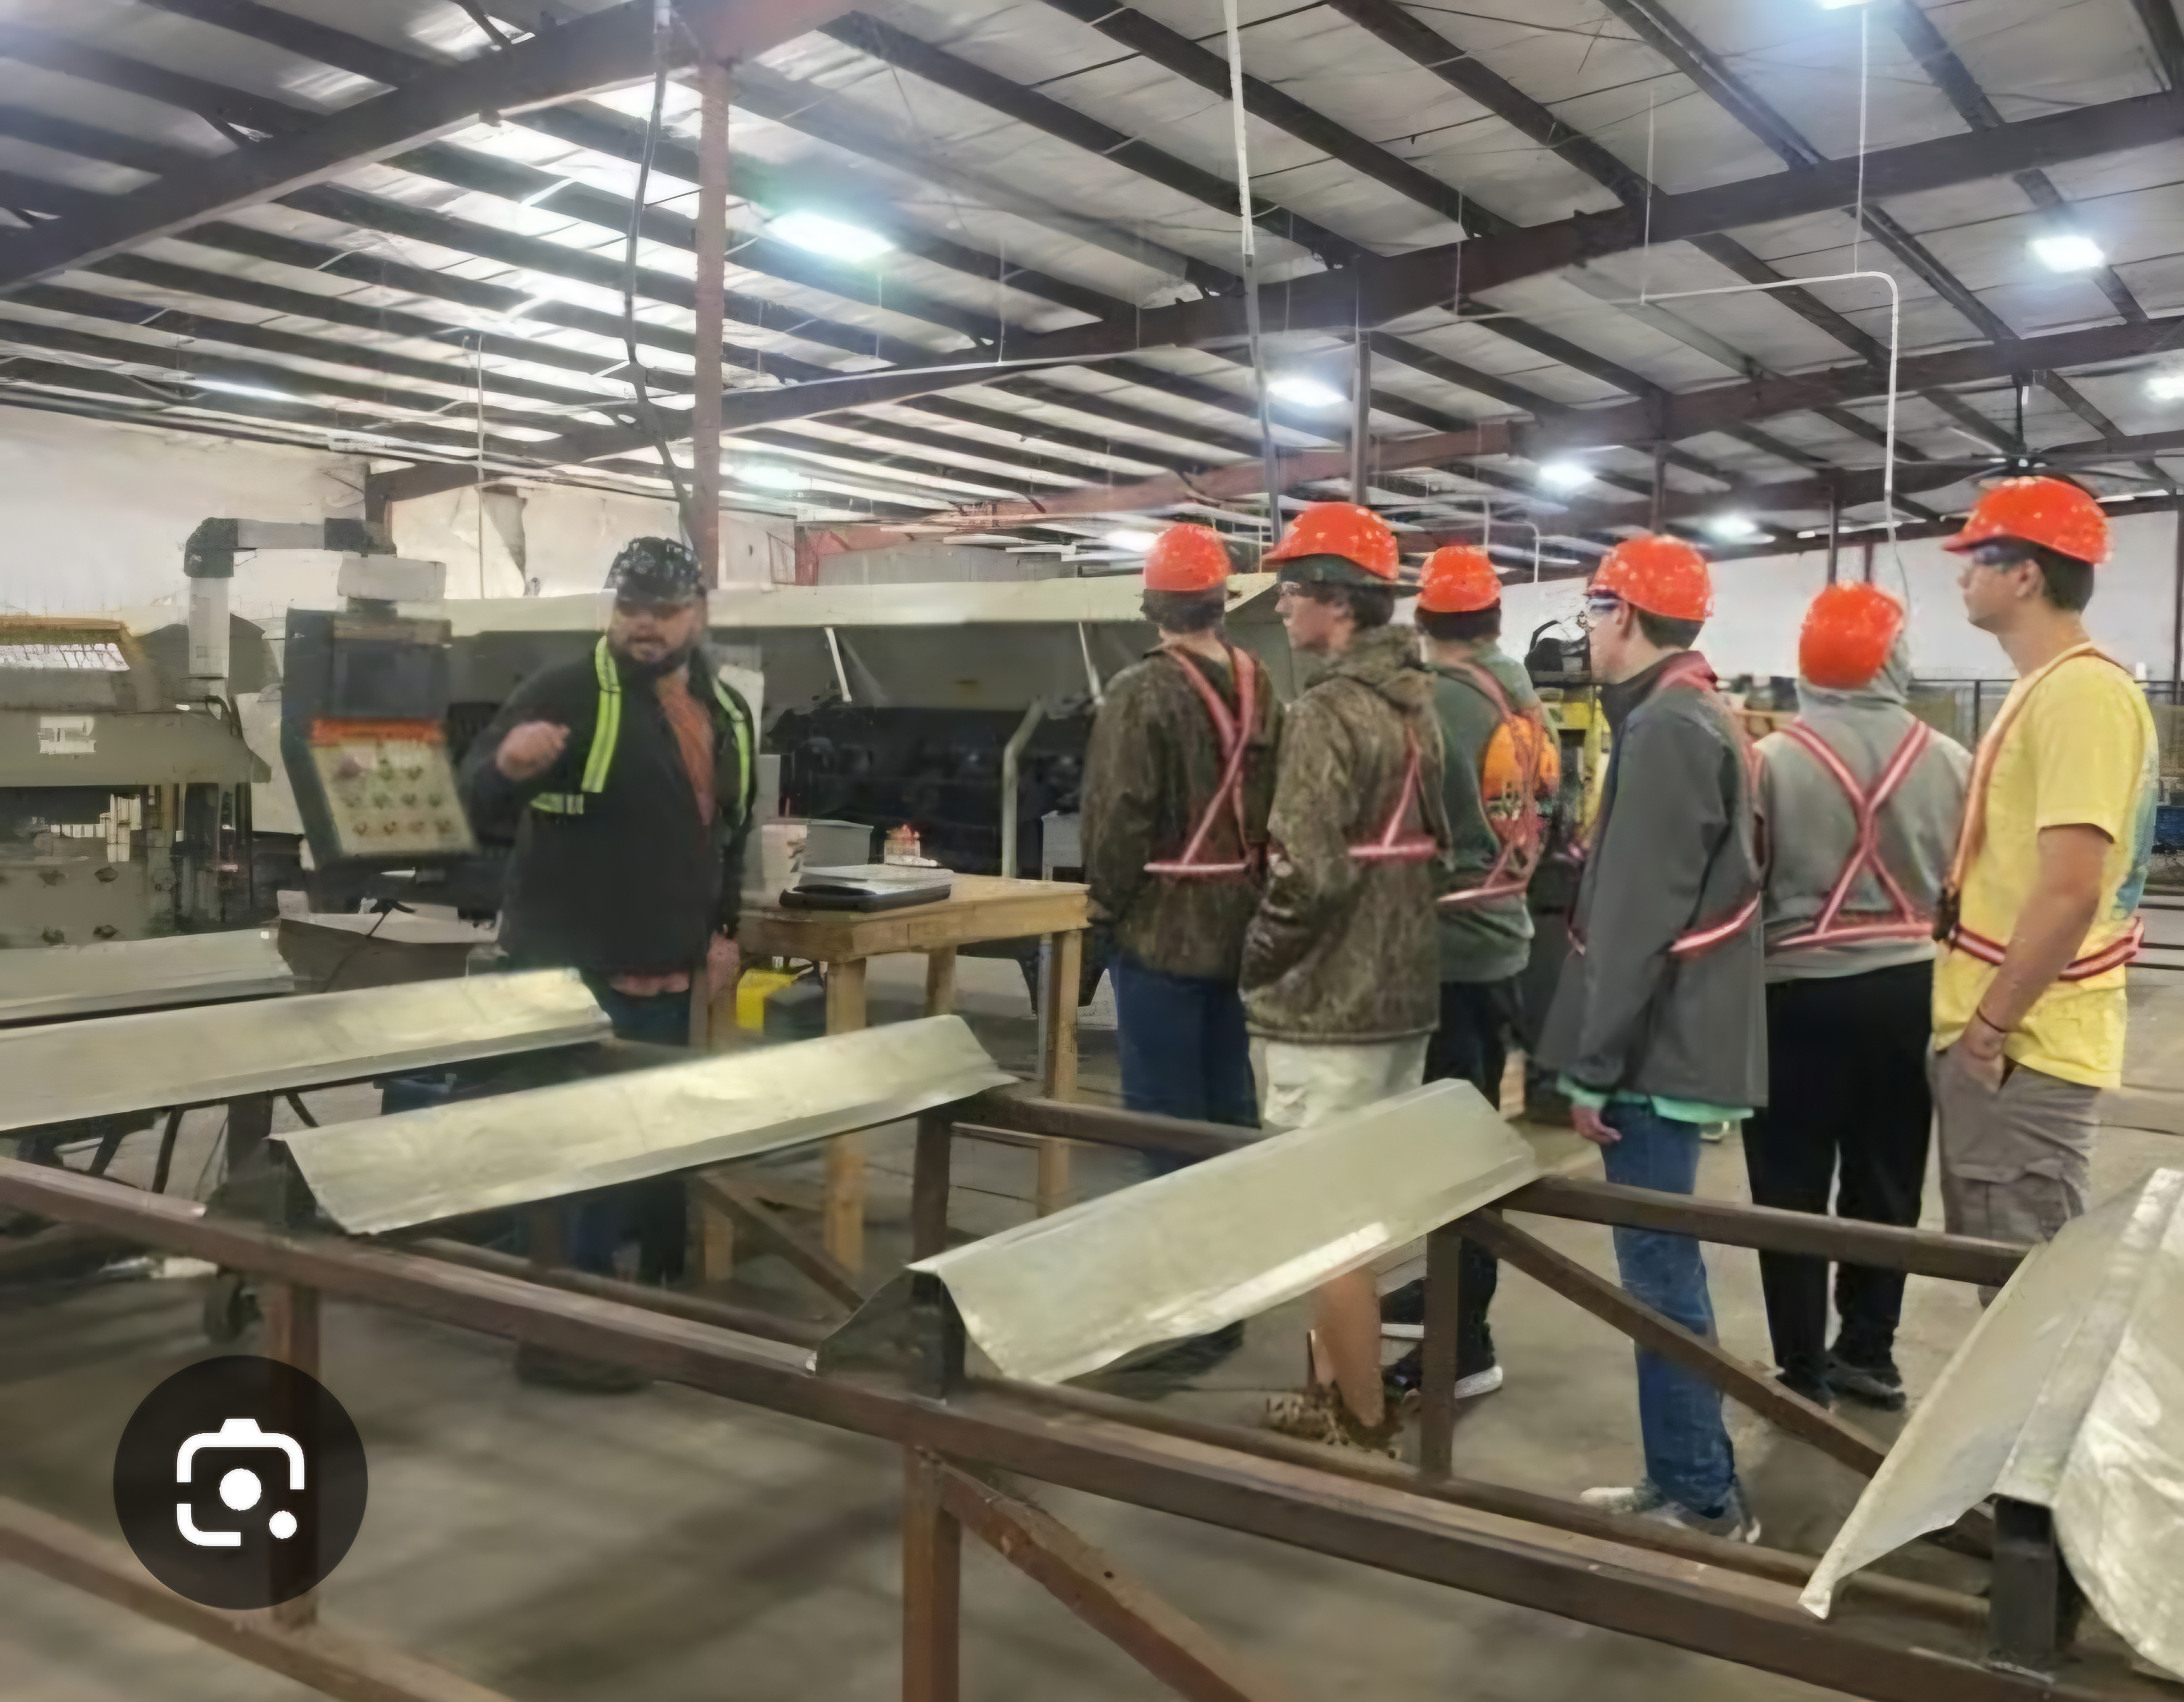
Business, Industry and Post Secondary School Tours
Our Providers will conduct business, industry, and Post-Secondary tours at no cost to the school.
This will give students the opportunity to visit a post-secondary institution and gain more clarification for their future education, and to discover employment opportunities and develop interests for potential employment opportunities after high school.

Slide 22
GROW- Getting Ready for Opportunities in work
Several Providers lead, plan, and execute these events
Multi-Day Seminars that focus on different aspects of transition needs.

Slide 23
Leadership Conferences
Georgia CTI In Columbus
A two day event filled with learning and social activities. 17 high schools had students attend the event.

Slide 24
Manufacturing Institutes
Students will receive 3 industry recognized certificates upon successful completion of the training.
Certified Trainer will provide training on:
OSHA 10 – certification
Lean Six Sigma White Belt Training – certification
Hands Only CPR/AED – certification
Completion of a Lean Hands-On Simulator Project
An engaged manufacturing partner for job expectations presentation

Slide 25
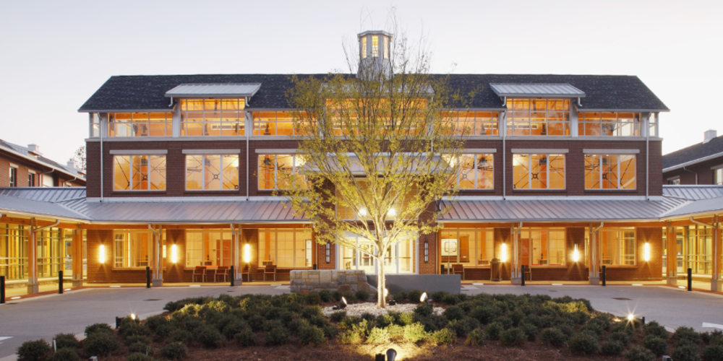
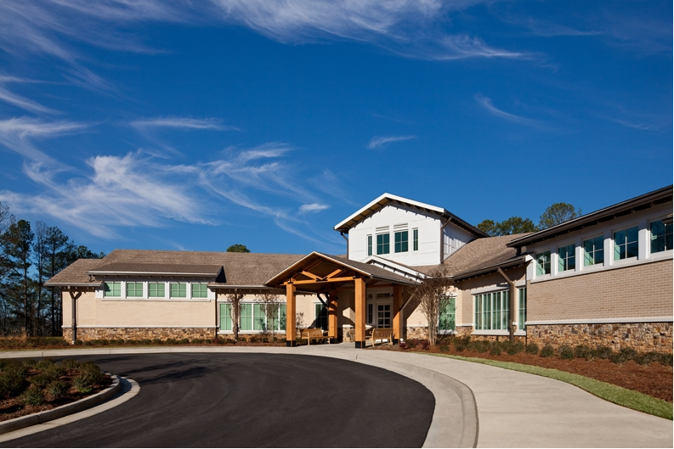
Post Secondary Options
Roosevelt Warm Springs Technical School and Cave Spring Center

Slide 26
Bud McCall Grant
Available to any student that is a Vocational Rehabilitation Client
Will pay up to 17,000 for tuition, housing, meals and maintenance
Will only pay the difference for example
If a student receives Pell Grant that covers tuition, then we will not pay tuition
If a student receives enough financial aid to cover everything

Slide 27
Process to become a GVRA client PTS or Vocational Rehabilitation (VR)
PTS Parent Permission form and a copy of the IEP. (https://gvs.georgia.gov/parental-permission-form)
VR an application will need to be submitted through the online portal (https://referral.gvs.ga.gov/)

Slide 28
Any Questions?

Slide 29
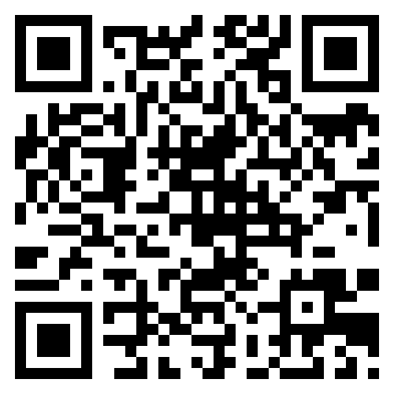
Pathways to Partnerships Family Learning Session Survey
We value your feedback and would appreciate it if you could take a few moments to complete this survey. Your responses will help improve our learning sessions.
The contents of this publication were developed under a grant number H421E230027 from the Department of Education. However, those contents do not necessarily represent the policy of the Department of Education, and you should not assume endorsement by the Federal Government. (Authority: 20 U.S.C. §§ 1221e-3 and 3474)

