Slide 1
Shannah Mabry – Pathways to Partnerships, Project Manager Leigh Thrailkill – Pathways to Partnerships, Family Liaison
Pathways to Partnerships

Slide 2
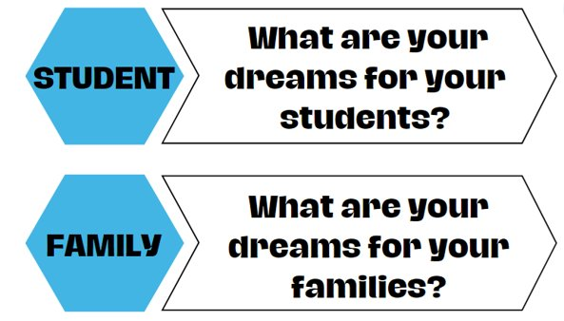
Big Dreams

Slide 3
P2P Mission: To improve training and preparation of children and youth with disabilities in Georgia to eventually obtain and maintain competitive integrated employment in conjunction and coordination with other state, local, and private entities.​

Slide 4
Family Learning Session
What Resources are Available for My Child with a Disability and Our Family?
PART 1
Katie Brown – Assistant Director for Residential Transition Initiatives, Roosevelt Warm Springs

Slide 5
What is GVRA and How Can the Agency Help Your Child?

Slide 6
What is GVRA?
State agency
Helps people with disabilities gain and maintain employment
Example:
Julius has cerebral palsy. He wants to work after high school but will need support on the job site. GVRA can provide supportive employment to help Julius on the job.
Example:
Johnny has ADHD and struggles focusing. He has an IEP in school. Johnny wants to work when he graduates. GVRA can help him after graduation finding and keeping a job!
Example:
Sarah has autism. She wants to become a graphic designer. She needs help with college. GVRA can help her with college and make sure she is successful in getting a job as a graphic designer after school.

Slide 7
Now that we know what GVRA does, how do you get that support for your child?

Slide 8
Pre-Employment Transition Services
For students ages 14-22
Usually provided in the schools
Can focus on 5 things:
Job Exploration
Self-Advocacy
Post-Secondary Counseling
Work Based Learning
Workplace Readiness

Slide 9
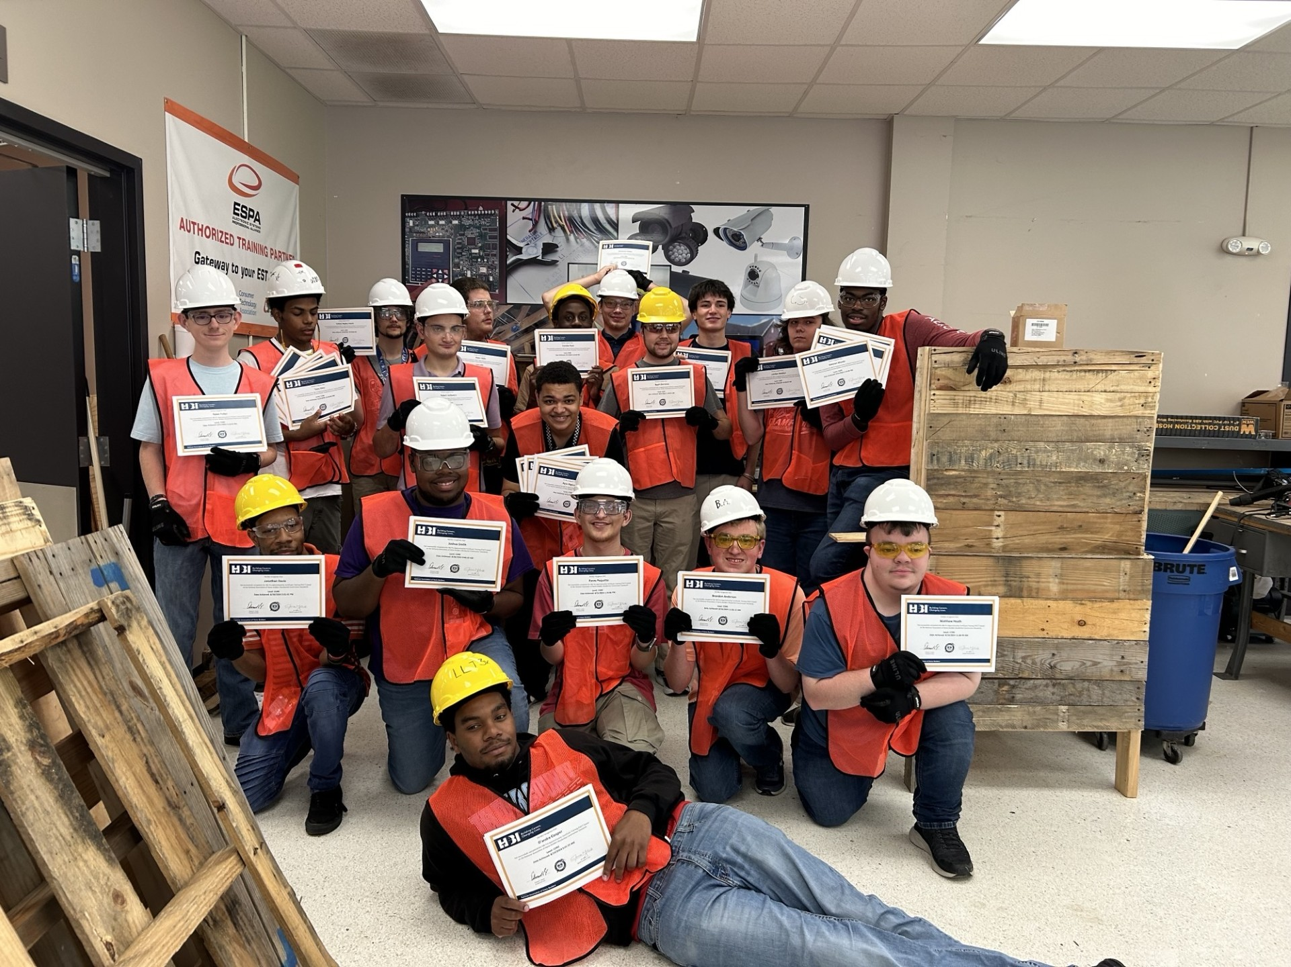
VR Client
Around senior year, students can apply to be a VR client to benefit from numerous services
GVRA Referral Website

Slide 10
Some of the services that you could possibly qualify for are:
Community Work Adjustment
Counseling and Guidance
Help with Self-Employment
Job Opportunities
Supported Employment
Job Coaching
Job Placement
On Job Training
Physical/Mental Restoration
Speech, PT, and OT
Cognitive Rehabilitation
Bud Mcall Grant
Post Graduate Training
Supportive Services
Assistive Work Technology
Glasses or contacts
Hearing aids
Maintenance
Permit or license
Personal Care Attendant
Residence/Vehicle Modification
Tools and equipment
Worksite accommodations
Transportation
Computer/Smart Devices

Slide 11
Let's Talk About a Few
Bud McCall Grant
Undergraduate students who meet the requirements are eligible for the grant for up to five (5) years. If a student receives financial aid or support such as the Pell Grant, state grants, scholarships, or other funding, the Bud McCall Grant will be paid only after that aid has been applied.
Tuition: up to $7,395 per year
Maintenance (room, board, and meals): up to $9,430 per year
Books: up to $900 per year

Slide 12
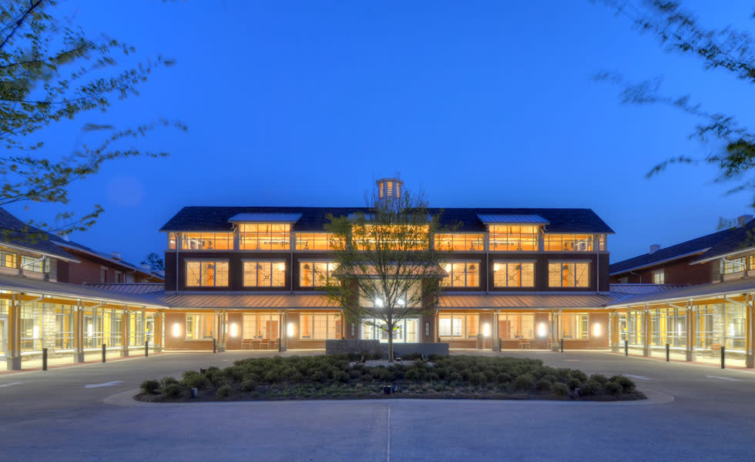
Roosevelt
Warm Springs
#RWS-2.0

Slide 13
Current PATHWAY Offerings
Light Electrical/
Carpentry
Logistics/Warehousing
Hospitality
Low Voltage Wiring
Certified Nursing Asst.
(C.N.A)
Auto Detailing
Retail (CVS)
Heavy Equipment
Operator
(Excavator & Bulldozer)
* * All program offerings allow for the opportunity to earn nationally accredited industry certifications ! * *

Slide 14
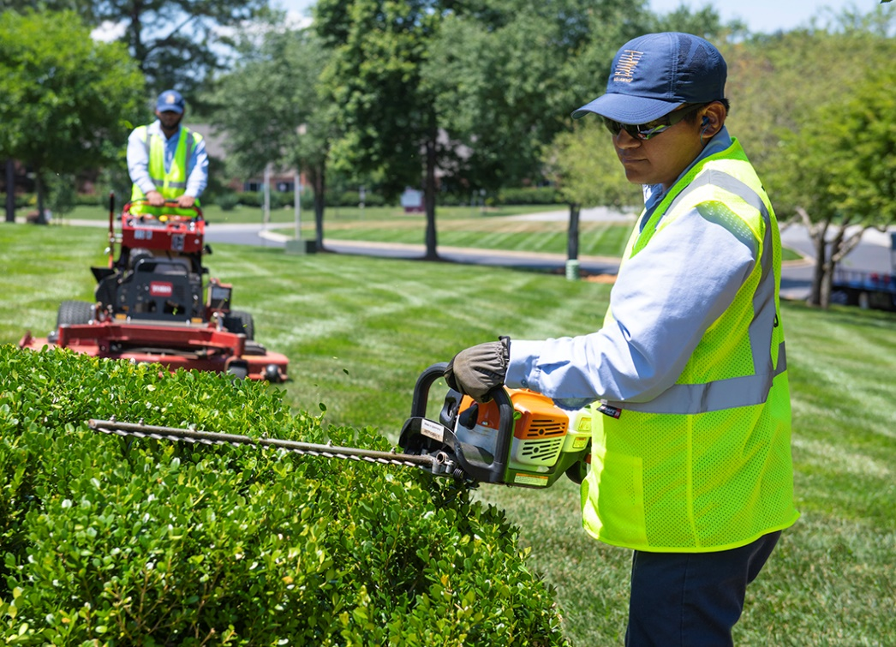
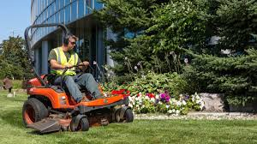
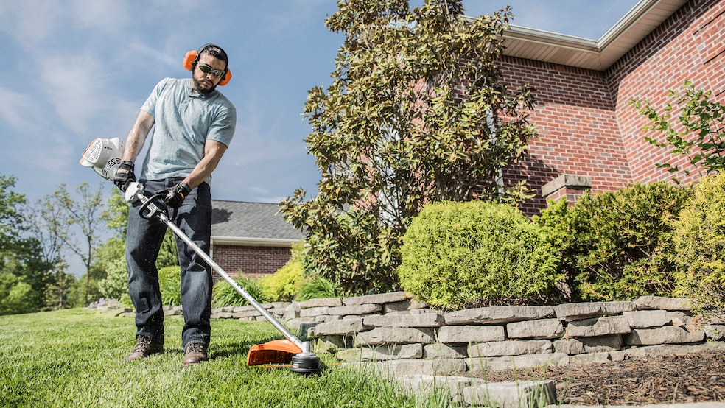
New PATHWAY Offering Coming Jan. 2025
Landscape Maintenance & Design
(w/ Small Engine Repair)

Slide 15
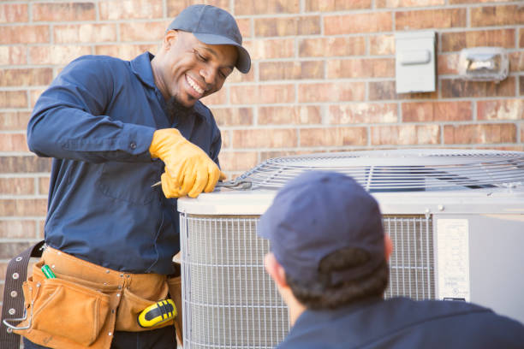
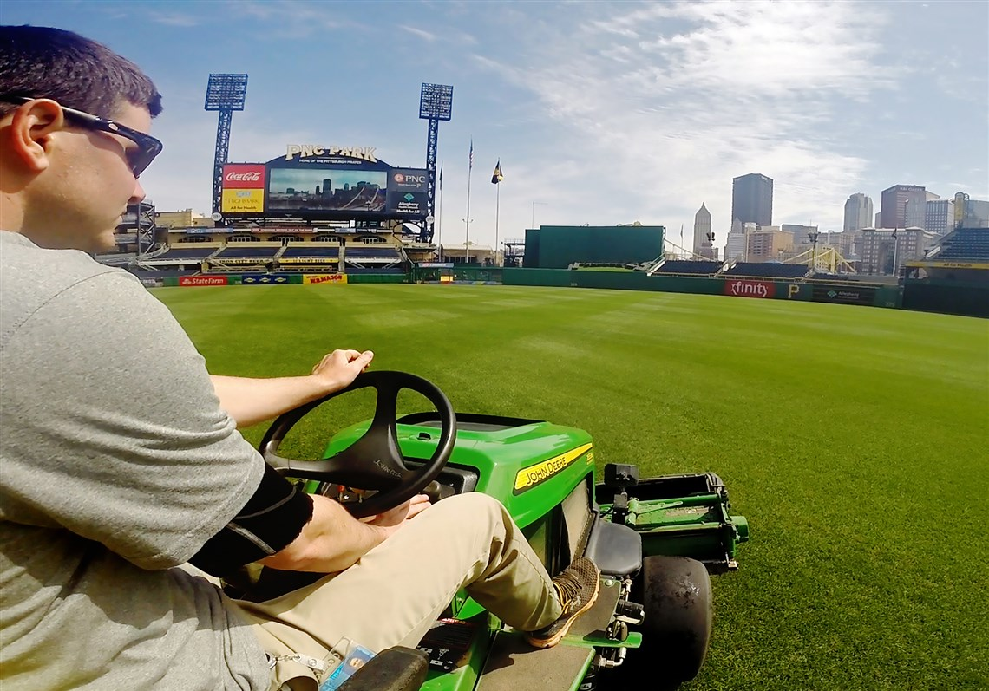
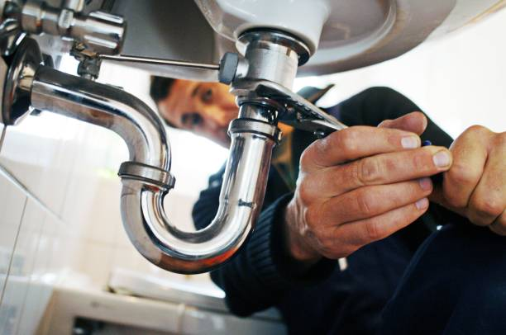
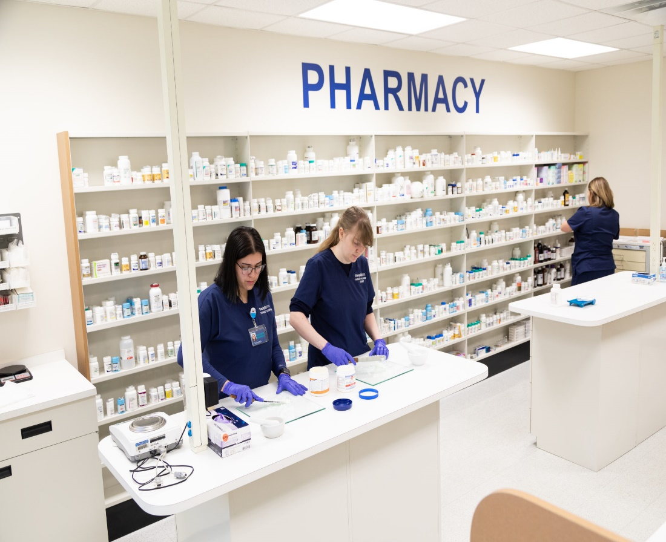
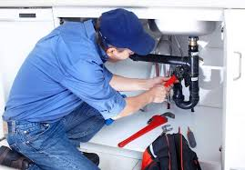
Future pathway expansion Plans including…
Construction Jumpstart Options Such As:
HVAC Basics
Plumbing
Commercial and Residential Painting
Groundskeeping / Turf Management
Pharmacy Technician

Slide 18
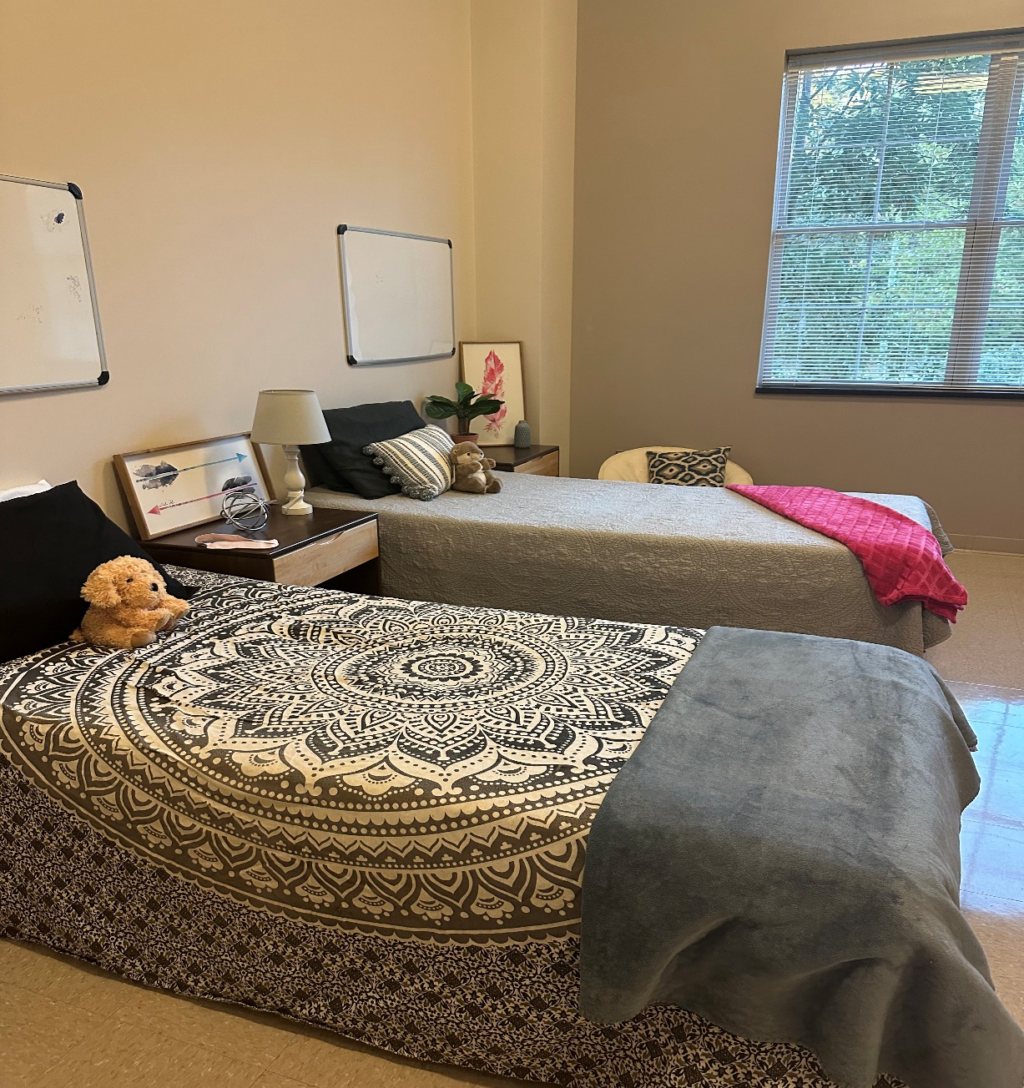
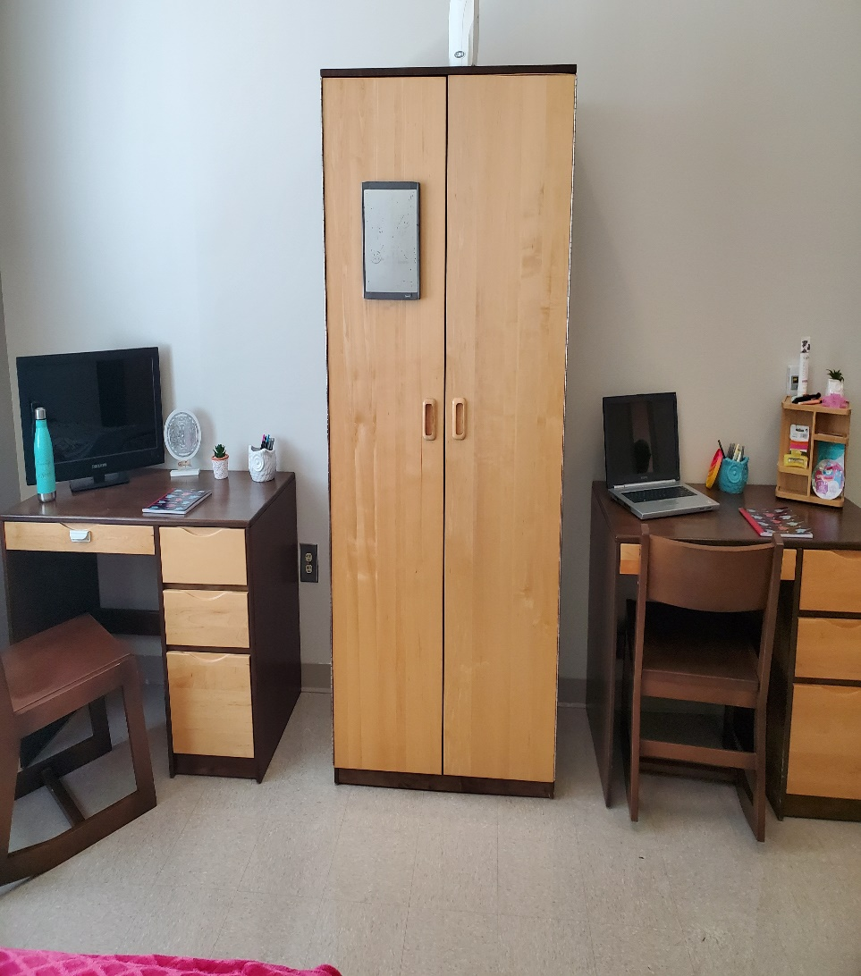
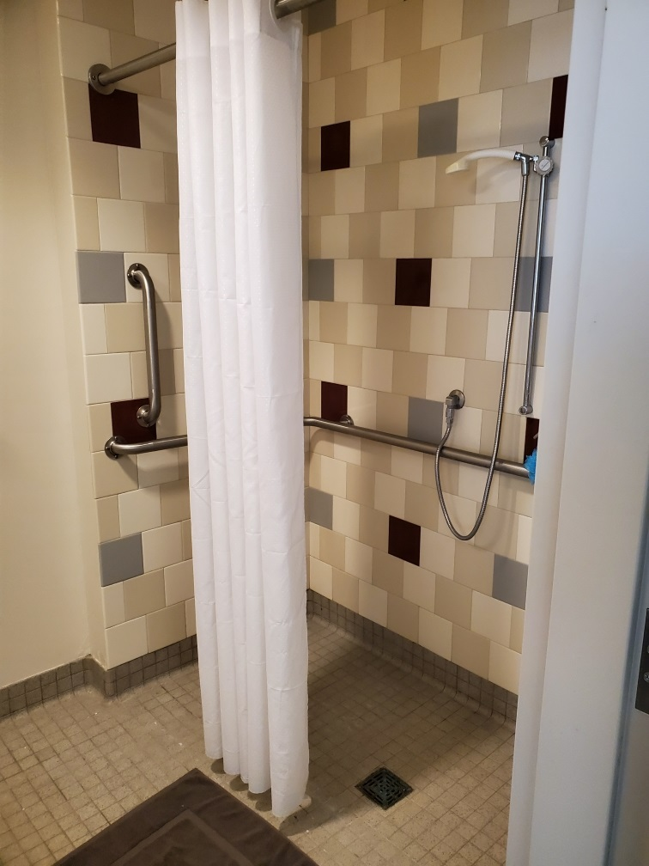
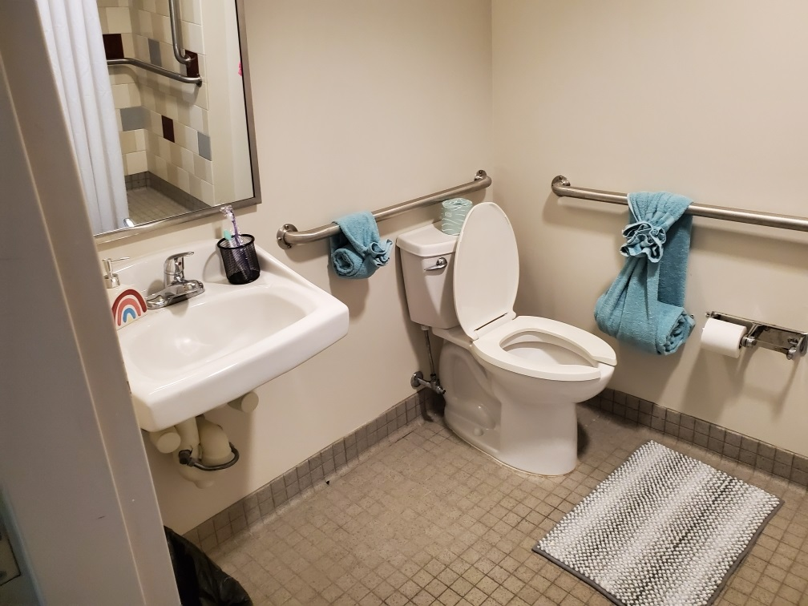
Dorm Life

Slide 19
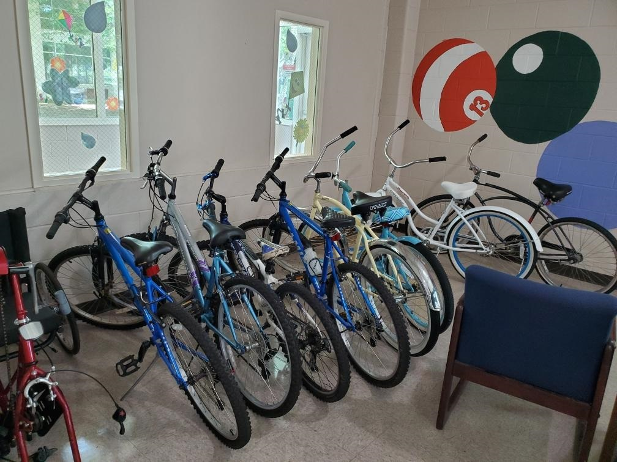
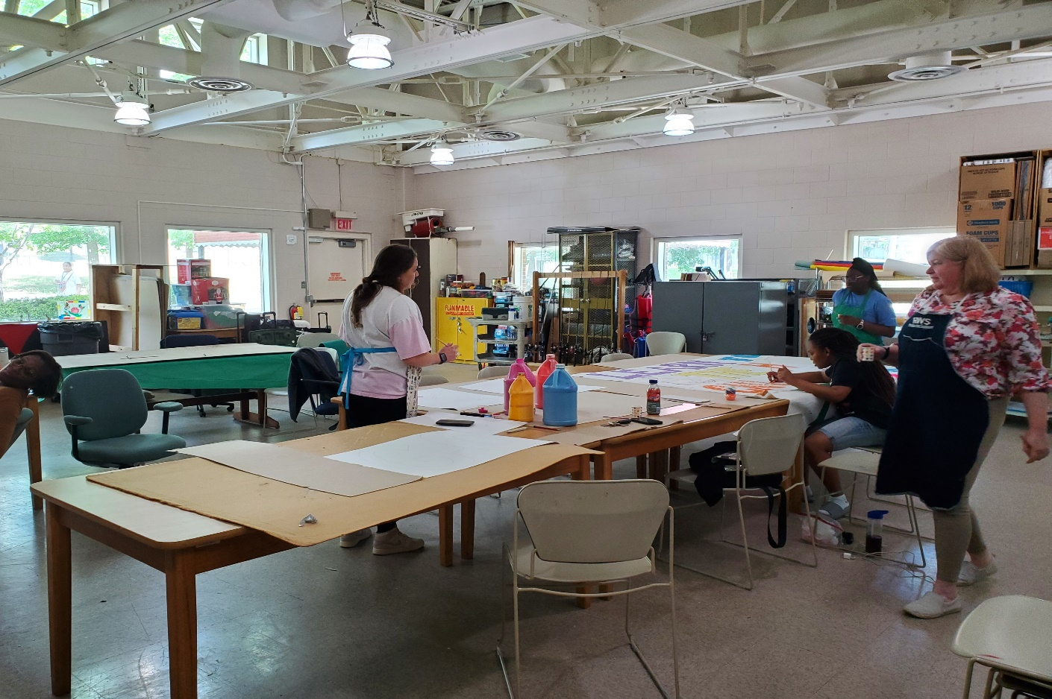
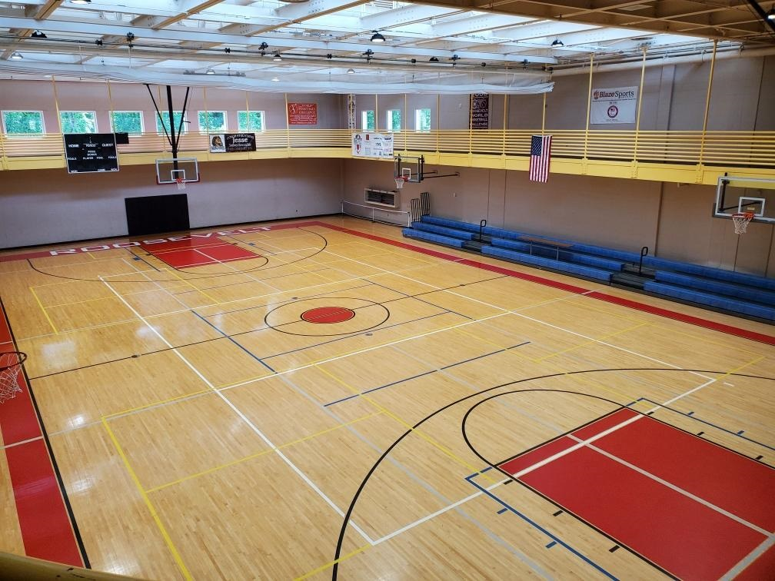
Center for Therapeutic Recreation (CTR)

Slide 20
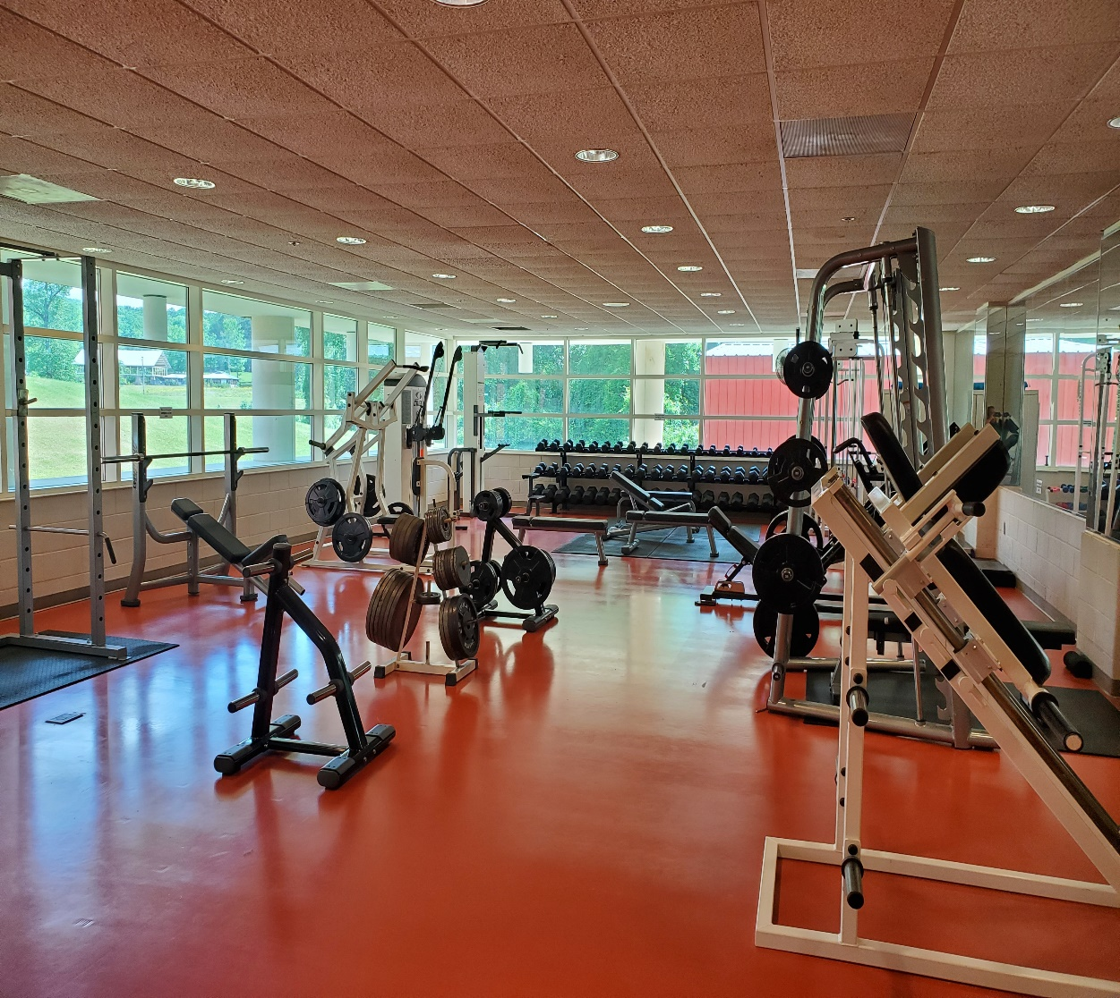
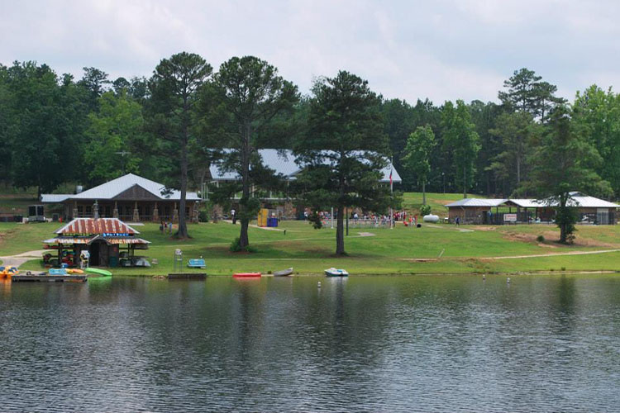
More CTR and Campus Amenities

Slide 21
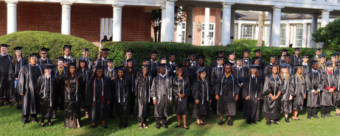
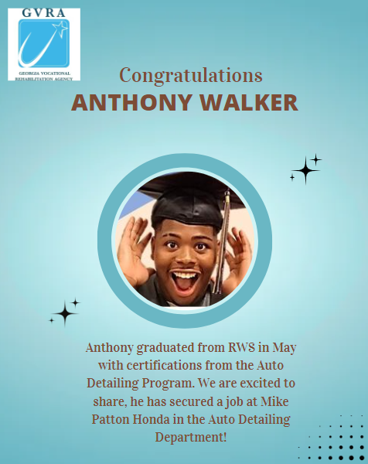
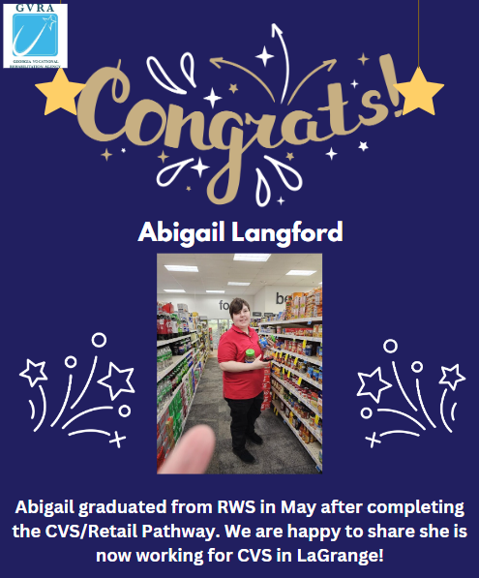
What happens after graduation?
Each student is assigned a provider and employment specialist at beginning of semester
They work with students throughout semester to determine strengths, weaknesses, and job opportunities that exist in hometowns
Help them build resumes and set up job interviews for once they leave campus
Providers and employment specialists continue to work with student for 90 days after graduation to ensure gainful employment

Slide 22
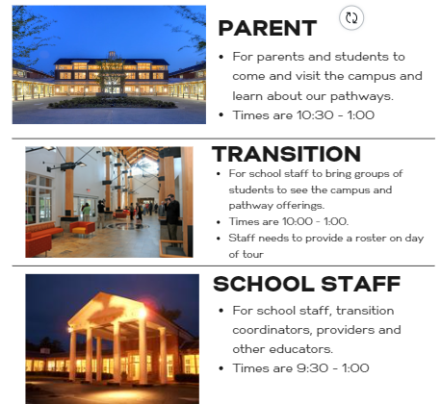
TOURS
Include the following in the email:
Contact Name, Email address and phone number
What type of tour? Parent, Transition or School Staff
Number of participants (Max 32)

Slide 23
Already a VR Client?
Not a VR Client?
Contact Jamie Fox, Admissions Manager, at Jamie.fox@gvs.ga.gov OR reach out to your local VR counselor
Click on this link to begin the process to becoming a VR client: https://referral.gvs.ga.gov/
Contact your VR counselor or reach out to RWS directly at rws.csc.referrals@gvs.ga.gov to receive an application for admission and information on admissions criteria
Admission decision will be made upon receipt of completed application and required supporting documents
Clients will be notified directly by RWS staff of their admissions status (admissions packet if accepted to RWS, referral to local field counselor for additional supports if criteria is not met)
In fall 2025, students must be in the age range of 18-24
Current Admissions Process

Slide 24
#RWS-2.0

Slide 25
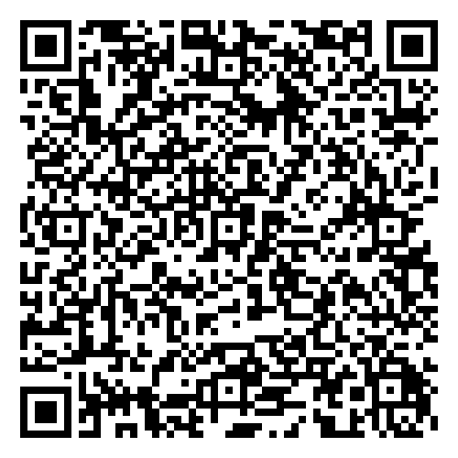
Pathways to Partnerships Family Learning Session Survey
We value your feedback and would appreciate it if you could take a few moments to complete this survey. Your responses will help improve our learning sessions.
The contents of this publication were developed under a grant number H421E230027 from the Department of Education. However, those contents do not necessarily represent the policy of the Department of Education, and you should not assume endorsement by the Federal Government. (Authority: 20 U.S.C. §§ 1221e-3 and 3474)

