Slide 1


Shannah Mabry – Pathways to Partnerships, Project Manager
Leigh Thrailkill – Pathways to Partnerships, Family Liaison
Pathways to Partnerships

Slide 2

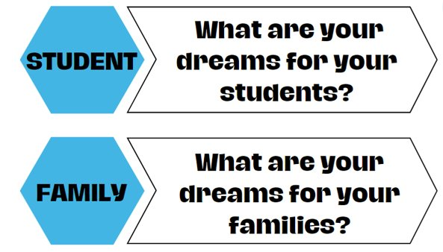
Big Dreams

Slide 3

P2P Mission
P2P Mission: To improve training and preparation of children and youth with disabilities in Georgia to eventually obtain and maintain competitive integrated employment in conjunction and coordination with other state, local, and private entities.​

Slide 4
Family Learning Session
What Resources are Available for My Child with a Disability and Our Family?
PART 2
Makenzie Morrison – Youth Transition Coordinator, Walton Options Center for Independent Living
Melanie Berry – Community Educator, LIFE Center for Independent Living

Slide 5
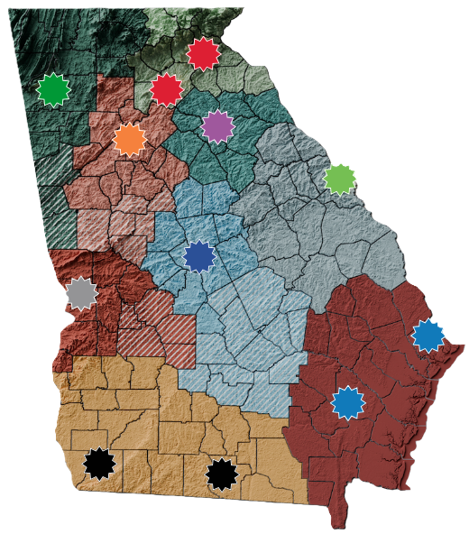
Disability Resource Center - Satellite Office
615 F Oak Street
Gainesville, GA 30501
Phone: 770-534-6656
CILs Across the State
Access 2 Independence
2000 Hamilton Rd. Suite B
Columbus, GA 21904
Phone: 706-405-2393
TTY: call GA Relay 711 access2independence.com
Serves the following counties in West Central Georgia: Chattahoochee, Harris, Marion, Muskogee, Quitman, Stewart, Talbot, Taylor and Webster. Also, serves (information and referral only) Crisp, Dooly, Macon, Schley, and Sumter.
Disability Resource Center (Main Office)
170 Scoggins Drive
Demorest, GA 30535
Phone: 706-778-5355
TTY: call GA Relay 711 or at 800-255-0135
disabilityresourcecenter.org
Serves the following counties in North Georgia: Banks, Dawson, Forsyth, Franklin, Habersham, Hall, Hart, Lumpkin, Rabun, Stephens, Towns, Union, and White.
LIFE (Living Independence for Everyone) (Main Office:)
4811 Waters Avenue
Savannah, GA 31406
Voice: 912-920-2414
TTY: 912-920-2419
Fax: 912-920-0007
lifecil.org
Serves the following counties in Southeast Georgia: Bryan, Bulloch, Camden, Chatham, Effingham, Evans, Glynn, Liberty, McItosh, Tattnall and Toombs.
BAIN (Bainbridge Advocacy Individual Network)
711 East Shotwell Street
P.O. Box 1674
Bainbridge, GA 39818
Phone: 229-246-0150
TTY: call GA Relay 711 or at 800-255-0135
baincil.org
Serves the following counties in Southwest Georgia: Baker, Clay, Decatur, Early, Grady Miller, Mitchell, Seminole, Thomas, and Randolph.
LIFE - Satellite Office
213 West JL Tyre St
Screven, GA 31560
Phone: 912-385-2214
Serves the following counties in Southeast Georgia: Appling, Bacon, Brantley, Candler, Charlton, Long, Pierce, Ware, Wayne.
disABILITY Link
1901 Montreal Rd
Suite 102
Tucker, GA 30084
Voice: 404-687-8890
TTY: 404-687-9175
Toll Free Voice/TTY: 800-239-2507
Fax: 404-687-8298
disabilitylink.org
Serves the following counties in Metro Atlanta: Cherokee, Clayton, Cobb, Coweta, DeKalb, Douglas, Fayette, Fulton, Gwinnett, Henry, Newton, and Rockdale. Also, serves (information and referral only) Butts, Lamar, Merriwether, Pike, Spalding, and Upson.
BAIN - Satellite Office
2215 Bemiss Road, Unit B
Valdosta, GA 31602
Phone: 229-262-7499
Serves the following counties in Southwest Georgia: Atkinson, Berrien, Brooks, Clinch, Colquitt, Cook, Echols, Dougerty, Lanier, Lee, Lowndes, Tift, Terrell, and Worth.
Multiple Choices
145 Barrington Drive
Athens, GA 30605
Voice: 706-850-4025
Fax/TTY: 706-850-4044
Toll Free: 877-549-1020
Toll Free Fax/TYY: 866-449-2020
multiplechoices.us
Serves the following counties in Northeast Georgia: Barrow, Clarke, Elbert, Greene, Jackson, Madison,, Morgan, Oconee, Oglethorpe, and Walton.
Disability Connections
3695 Broadway
Macon, GA 31206
Phone: 478-741-1425
TTY: call GA Relay 711 or at 800-734-2117
Fax: 478-755-1571
disabilityconnections.com
Serves the following counties in Central Georgia: Baldwin, Bibb, Crawford, Houston, Jasper, Jones, Monroe, Peach, Pulaski, Putnam, Twiggs and Wilkinson. Also, Serves (info. & referral only) Ben Hill, Bleckley, Coffee, Dodge, Irwin, Jeff Davis, Laurens, Montgomery, Telfair, Treutlen, Turner, Wheeler, and Wilcox.
Northwest Georgia Center for Independent Living
527 Broad Street Suite 101
Rome, GA 30161
Voice: 706-314-0008
Toll Free: 866-888-7845
TTY: 706-802-0280
Fax: 706-314-0011
nwgacil.org
Serves the following counties in Northwest Georgia: Bartow, Catoosa, Chattooga, Dade, Fannin, Floyd, Gilmer, Gordon, Haralson, Murray, Paulding, Pickens, Polk, Walker, and Whitfield. Also, servers (information and referral only) Carroll, Heard, and Troup.
Walton Options for Independent Living (WOIL)
P.O. Box 519
Augusta, GA 30903-5019
Voice: 706-724-6262
TTY: 706-261-0199
Toll Free: 877-821-8400
Fax: 706-724-6729
waltonoptions.org
Serves the following counties in East Georgia: Burke, Columbia, Emanuel, Jefferson, Jenkins, Johnson, Lincoln, Richmond, Screven, and Washington.

Slide 6
Centers for Independent Living (CILs)
  Centers for Independent Living are private, non-profit, non- residential Centers for Independent Living (CIL).
  CILs are consumer controlled – 51% of employees and Board of Director Members have a disability.

Slide 7


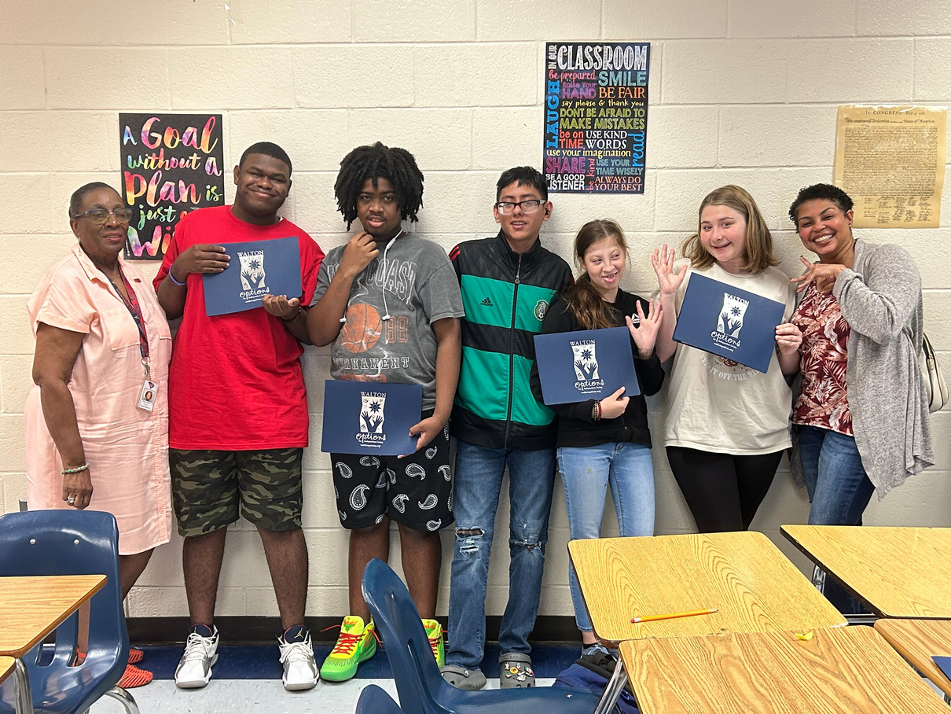

Our Mission
  We believe all persons including those with disabilities, should be able to participate in their community. At Walton Options, we promote equality, inclusion and independence through Personal Choice, Personal Responsibility, Community Access, Education and Employment.
  Our goal is to help each person find and utilize the necessary, available resources on their personal journey to independence.

Slide 8

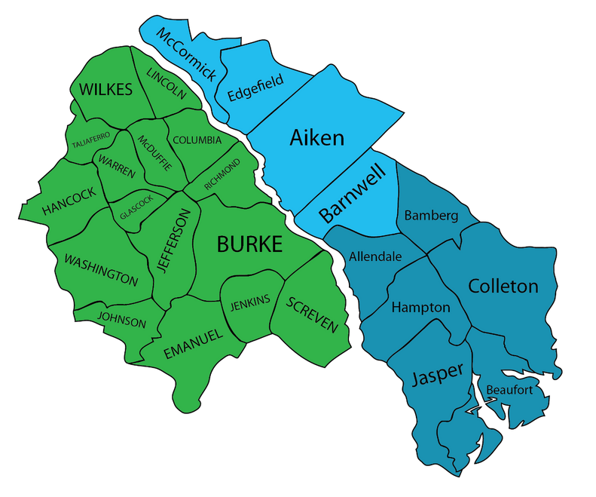
Service Areas
  In Georgia, we serve: Burke, Columbia, Emanuel, Glascock, Hancock, Jefferson, Jenkins, Johnson, Lincoln, McDuffie, Richmond, Screven, Taliaferro, Washington, Warren, and Wilkes Counties. (16 counties)
  In South Carolina, we serve: Aiken, Allendale, Bamberg, Barnwell, Beaufort, Colleton, Edgefield, Hampton, Jasper and McCormick Counties. (10 Counties)

Slide 9

Core Services
Information and Referral
Independent Living Skills
Transitions
Advocacy and Outreach
Peer Support

Slide 10
Information & Referral
  Of all our core services, Information and Referral is the most extensive and most utilized service.
  We provide our consumers with resources to help people live their lives independently in their own homes and communities.
  We have many community partners that we collaborate to provide extensive Information and Referral Services.
  Some of these resources include transportation, housing, finding a personal care attendant or emergency community supports (food, furnishings, disaster planning and preparedness).

Slide 11

Programs within Core Areas
  Assistive Technology
  Community Access and Education
  Home Modifications
  STAR Equipment Reuse Program
  Nursing Home / Institutional Transitions
  Employment Services
  Work Incentive Planning and Assistance
  Youth Development
  Leisure and Recreation
  *Most of our services are provided at no or low cost to consumers
If you have the desire to achieve, you have the ability to gain independence.

Slide 12


Counties served by LIFE
Promoting independent living and advancing community change for EVERYONE
Serving 20 Counties in Southeast Georgia
Evans
Glynn
Liberty
Long
McIntosh
Pierce
Tattnal
Toombs
Ware
Wayne
Appling
Bacon
Brantley
Bryan
Bulloch
Camden
Candler
Charleton
Chatham
Effingham

Slide 13
Five Core Services
Information & Referral
Independent Living Skills
Transitions
Advocacy
Peer Support

Slide 14

Peer Support and Advocacy
Peer Support - We have all been there, in need of a listening ear. Our Peer Supporters are people with disabilities who share similar experiences with others with disabilities. Trained peer supporters assist in bringing about change by sharing experiences in a broad array of situations. They do not, however, provide professional, medical, financial or legal advice.
Advocacy – Self-Advocacy and Community Advocacy involve the removal of architectural, attitudinal, and communication barriers to independent living and community accessibility. Advocacy may involve community volunteering and organizing, public speaking, and networking.

Slide 15
Why Connect to CIL
Why should I connect to LIFE?
The primary goal of our CIL is to provide individuals with disabilities the tools to live as independently and as fully engaged in their community as they wish to be.
LIFE embraces and adheres to the Independent Philosophy based on the concepts of consumer control, self-advocacy, community change, cross-disability participation, and community focus. We achieve this through the delivery of our five core Independent Living Services.
We desire to empower people with disabilities in their quest for equal rights and equal opportunities to allow them to live full, satisfying, autonomous lives in their communities.

Slide 16

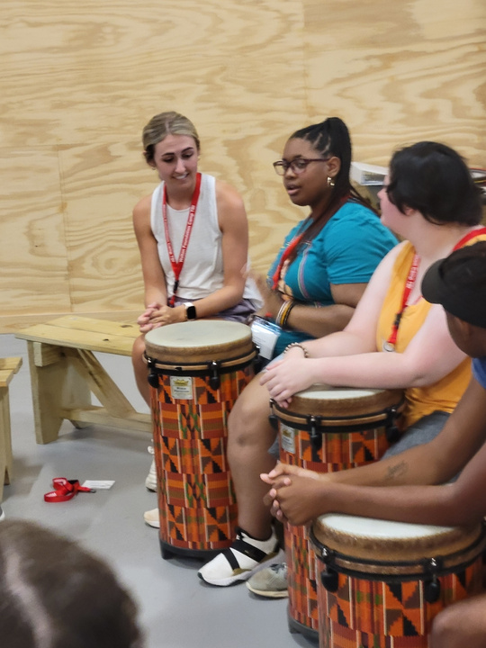
Youth Services
Our programs provide options for youth as they look to the future.
For a young person with a disability, the future may present challenges but it should not stop you from achieving your goals. Through our programs and partnerships, we are able to work with youth on their journey to independence.

Slide 17






Youth Services Continued
Our programs include:
Occupational Horizons
Self-advocacy & Disability Culture
Accessible gaming, adaptive sports and leisure
CareerBOOST Program
Peer Support Group

Slide 18
Get in Touch
We’d love to hear from you! Call us for more information!
  Georgia – Main Office
    948 Walton Way, Augusta, GA 30901
    706-724-6262
  South Carolina
    514 West Ave, North Augusta, SC 29841
    803-279-9611
  SC Low Country
    843-538-1600
  Main Office
    4811 Waters Avenue, Savannah, GA 31404
    912-920-2414
  Satellite Office
    213 West J.L. Tyre Street, Screven, GA 31560
    912-385-2214

Slide 19
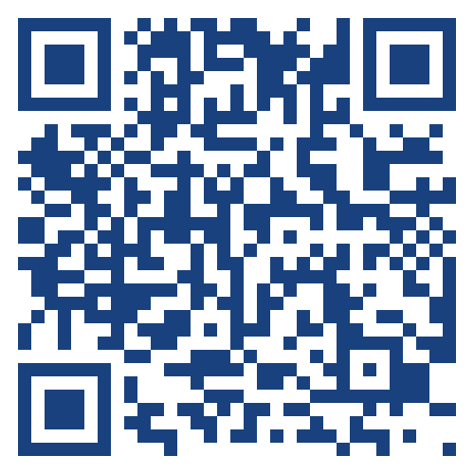

Pathways to Partnerships
Family Learning Session Survey
We value your feedback and would appreciate it if you could take a few moments to complete this survey. Your responses will help improve our learning sessions.
The contents of this presentation were developed under grant H421E230027 from the U.S. Department of Education (Department). The Department does not mandate or prescribe practices, models, or other activities described or discussed in this document. The contents of this presentation may contain examples of, adaptations of, and links to resources created and maintained by another public or private organization. The Department does not control or guarantee the accuracy, relevance, timeliness, or completeness of this outside information. The content of this presentation does not necessarily represent the policy of the Department. This publication is not intended to represent the views or policy of or be an endorsement of any views expressed or materials provided by any Federal agency. (EDGAR75.620)

