Slide 1


Shannah Mabry – Pathways to Partnerships, Project Manager
Leigh Thrailkill – Pathways to Partnerships, Family Liaison
Pathways to Partnerships

Slide 2

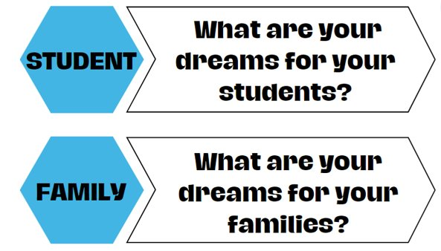
Big Dreams

Slide 3

P2P Mission
P2P Mission: To improve training and preparation of children and youth with disabilities in Georgia to eventually obtain and maintain competitive integrated employment in conjunction and coordination with other state, local, and private entities.​

Slide 4
Family Learning Session
What Resources are Available for My Child with a Disability and Our Family?
PART 1
Katie Brown – Assistant Director for Residential Transition Initiatives, Roosevelt Warm Springs

Slide 5

What is GVRA and How Can the Agency Help Your Child?

Slide 6



What is GVRA?
State agency
Helps people with disabilities gain and maintain employment
Example:
Julius has cerebral palsy. He wants to work after high school but will need support on the job site. GVRA can provide supportive employment to help Julius on the job.
Example:
Johnny has ADHD and struggles focusing. He has an IEP in school. Johnny wants to work when he graduates. GVRA can help him after graduation finding and keeping a job!
Example:
Sarah has autism. She wants to become a graphic designer. She needs help with college. GVRA can help her with college and make sure she is successful in getting a job as a graphic designer after school.

Slide 7
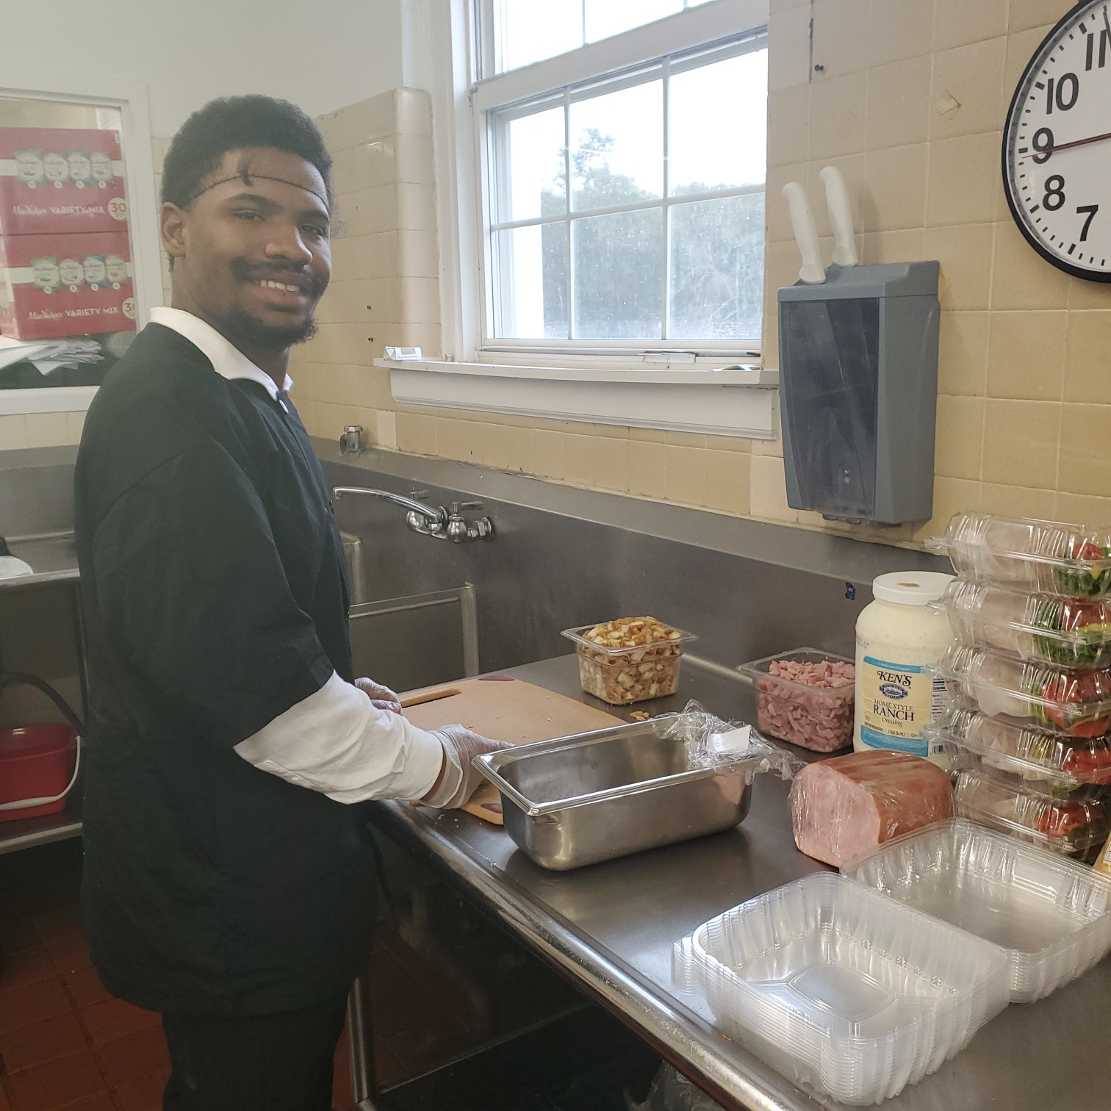
Now that we know what GVRA does, how do you get that support for your child?

Slide 8
Pre-Employment Transition Services
For students ages 14-22
Usually provided in the schools
Can focus on 5 things:
Job Exploration
Self-Advocacy
Post-Secondary Counseling
Work Based Learning
Workplace Readiness

Slide 9
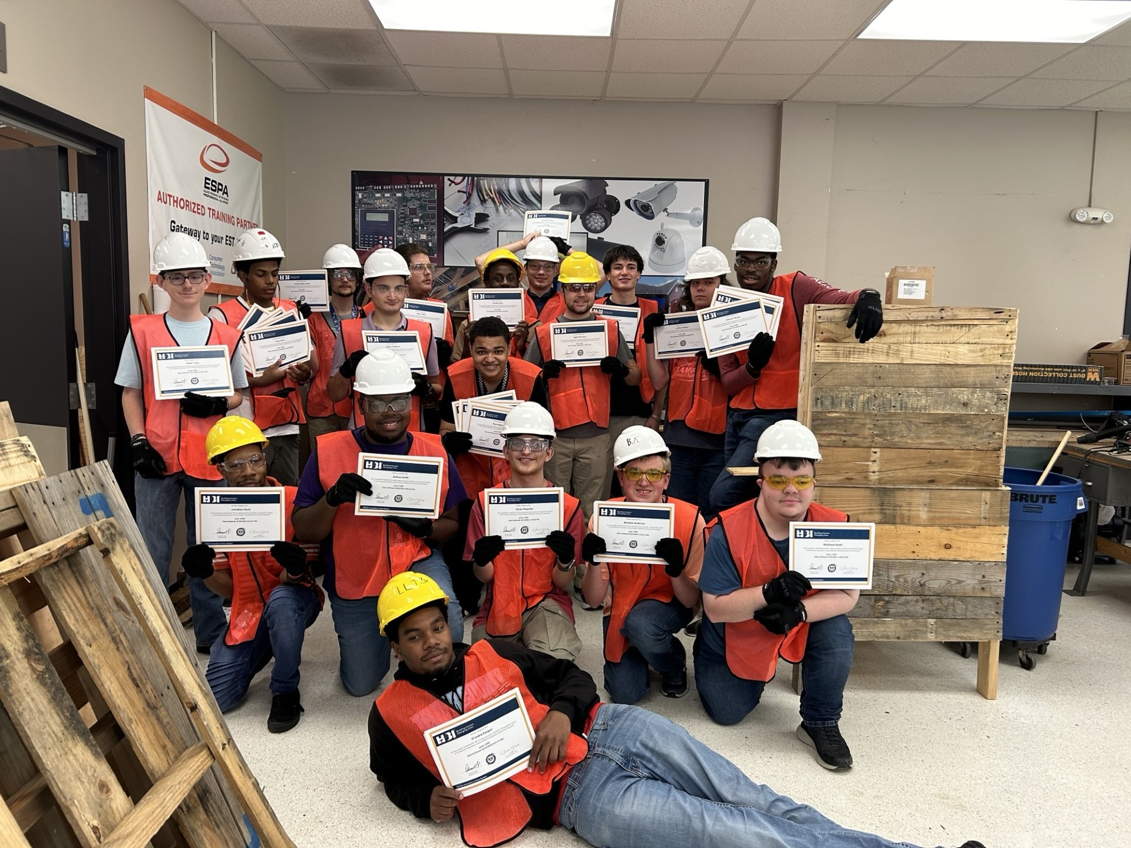
VR Client
Around senior year, students can apply to be a VR client to benefit from numerous services
GVRA Referral Website

Slide 10
Some of the services that you could possibly qualify for are:
Community Work Adjustment
  Counseling and Guidance
  Help with Self-Employment
  Job Opportunities
  Supported Employment
  Job Coaching
  Job Placement
  On Job Training
  Physical/Mental Restoration
  Speech, PT, and OT
  Cognitive Rehabilitation
Bud Mcall Grant
Post Graduate Training
Supportive Services
Assistive Work Technology
Glasses or contacts
Hearing aids
Maintenance
Permit or license
Personal Care Attendant
Residence/Vehicle Modification
Tools and equipment
Worksite accommodations
Transportation
Computer/Smart Devices

Slide 11

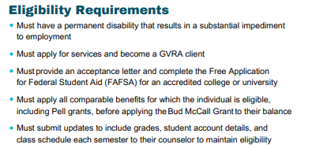
Let's Talk About a Few
Bud McCall Grant
Undergraduate students who meet the requirements are eligible for the grant for up to five (5) years. If a student receives financial aid or support such as the Pell Grant, state grants, scholarships, or other funding, the Bud McCall Grant will be paid only after that aid has been applied.
Tuition: up to $7,395 per year
Maintenance (room, board, and meals): up to $9,430 per year
Books: up to $900 per year

Slide 12
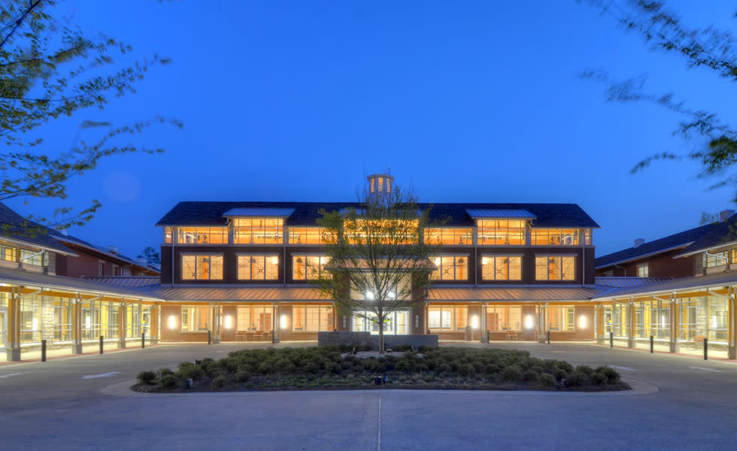
Roosevelt
Warm Springs
https://www.canva.com/design/DAGbtyjeQ3k/XzhL84yTuNNNLGQ42b0qPQ/view?utm_content=DAGbtyjeQ3k&utm_campaign=designshare&utm_medium=link2&utm_source=uniquelinks&utlId=h208452040b
#RWS-2.0

Slide 13

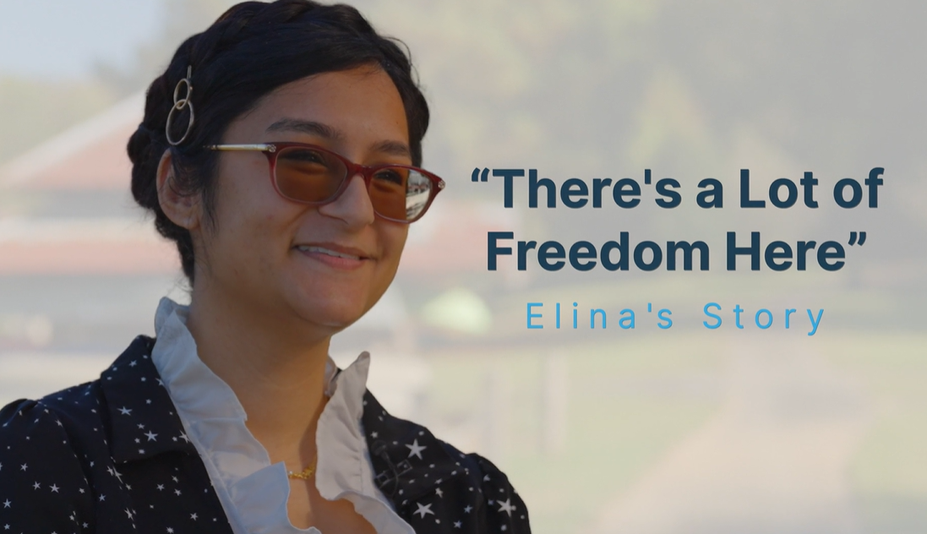
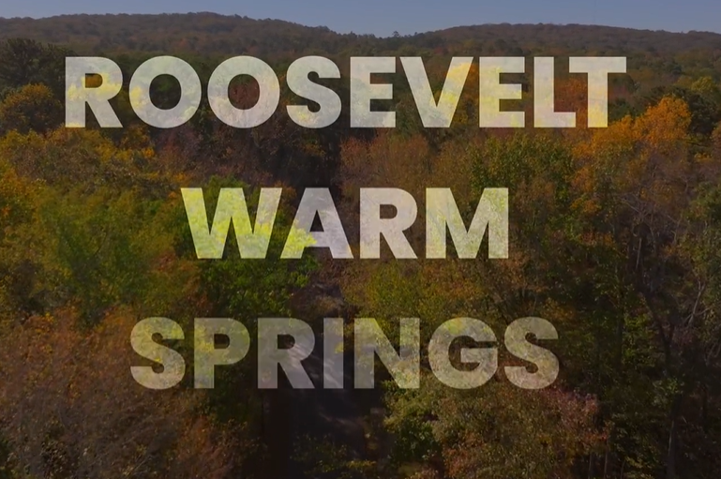
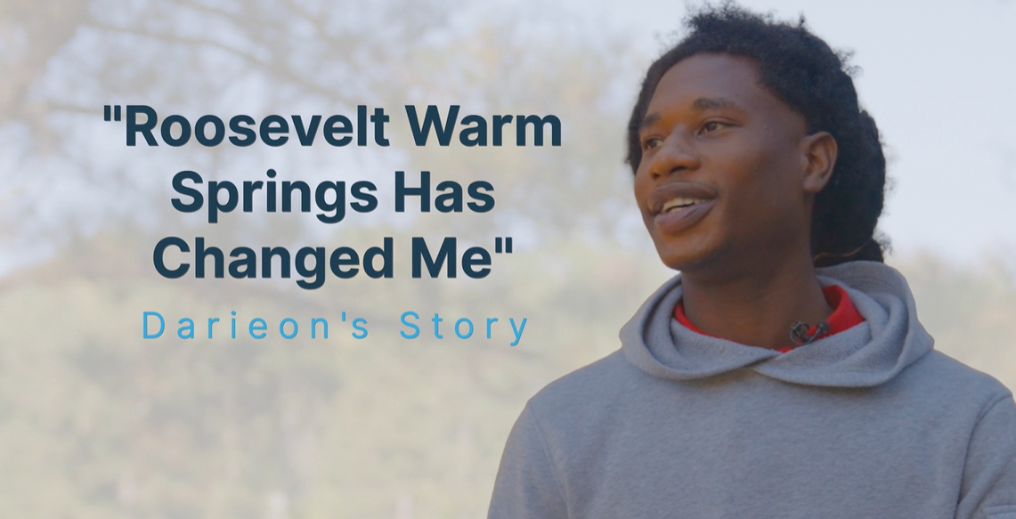
Virtual Tour and Testimonials
Click on the images to view videos
#RWS-2.0

Slide 14
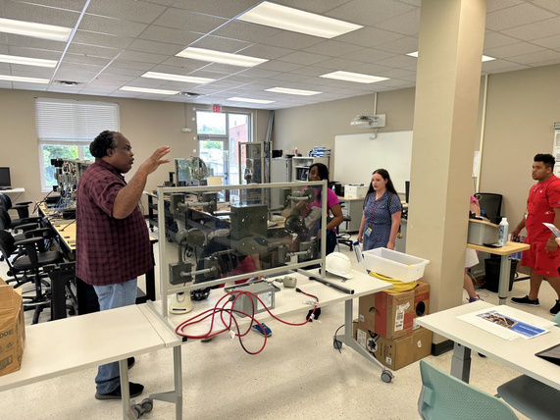
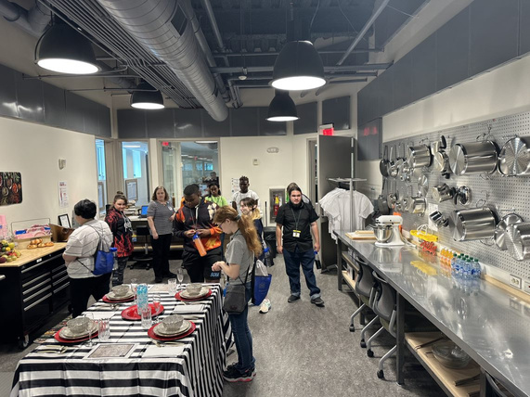
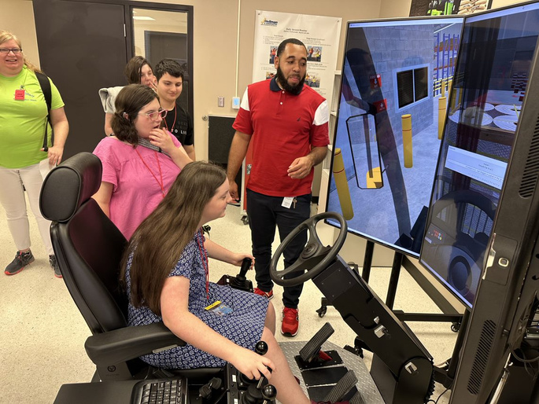

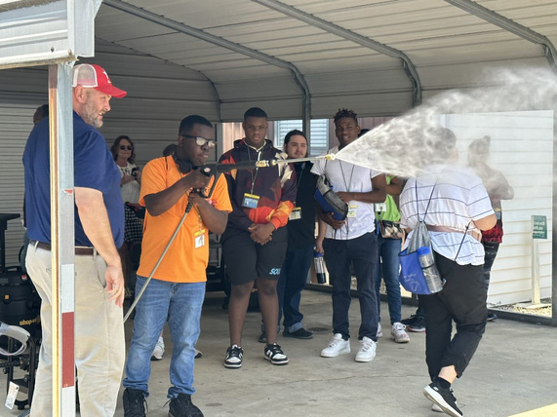
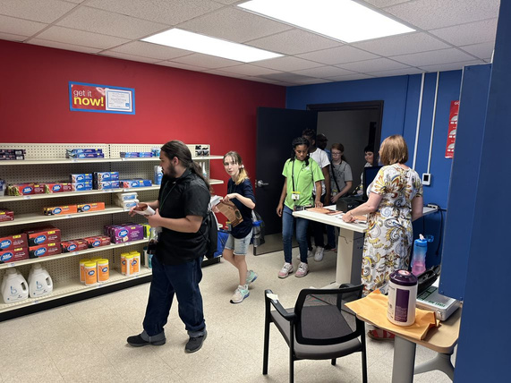
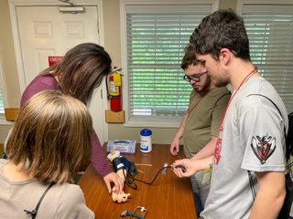
Current PATHWAY Offerings
Light Electrical/
Carpentry
Hospitality
Logistics/Warehousing
Certified Nursing Asst.
(C.N.A)
Auto Detailing
Retail (CVS)
Heavy Equipment
Operator
(Excavator & Bulldozer)
All program offerings allow for the opportunity to earn nationally accredited industry certifications!

Slide 15

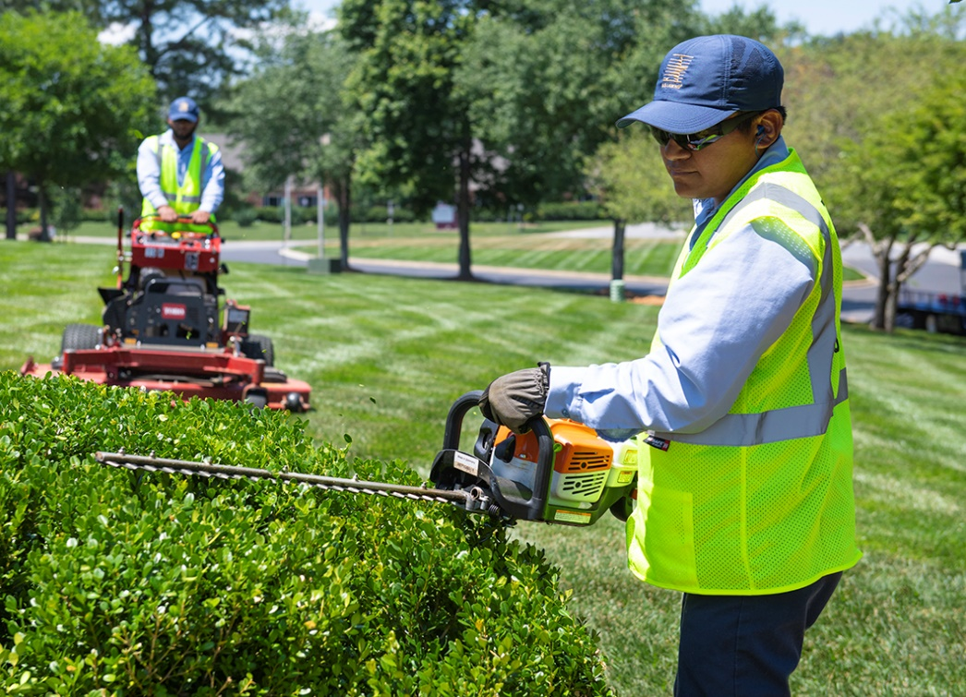



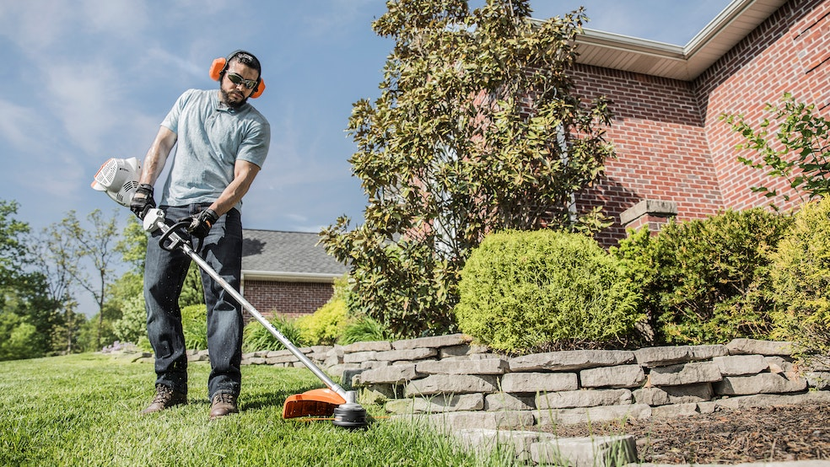
New PATHWAY Offering for Spring 2025
Landscape Maintenance & Design
(w/ Small Engine Repair)

Slide 16

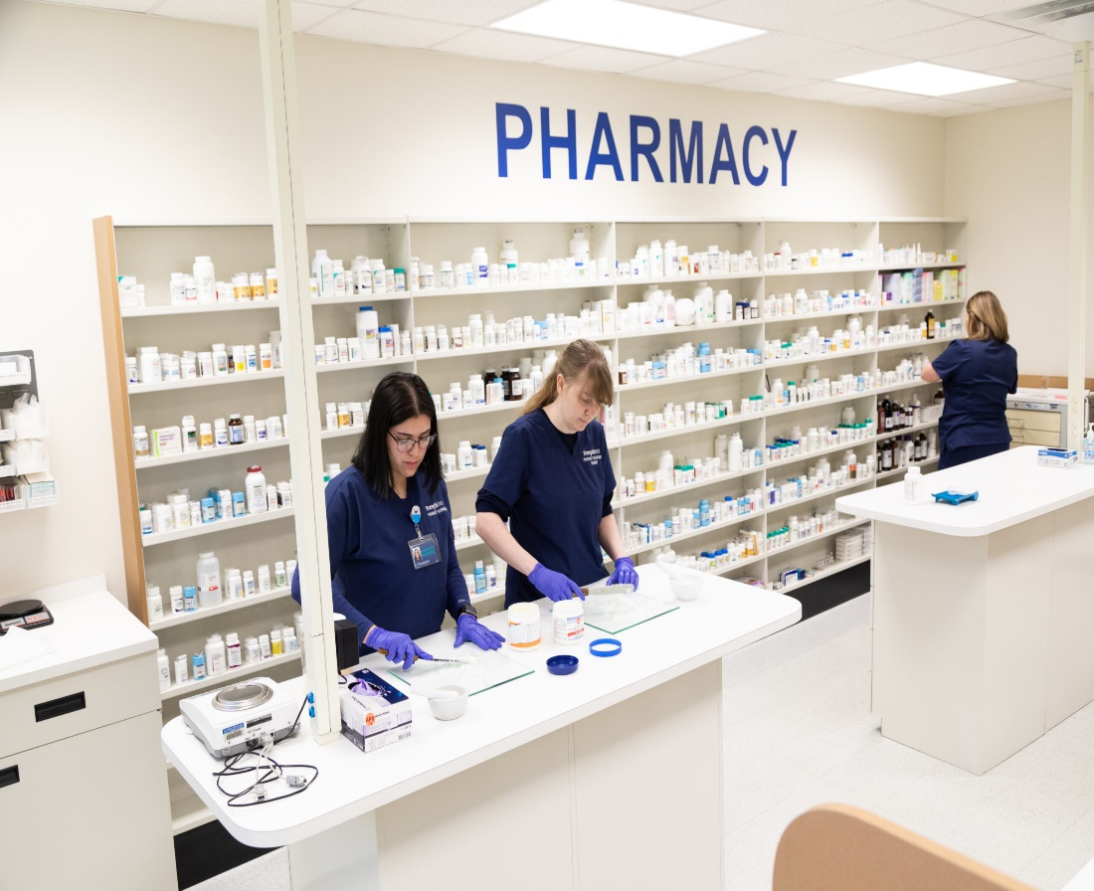
Pharmacy Technician
Future pathway expansion Plans including…
Beginning Jan 2026!

Slide 17
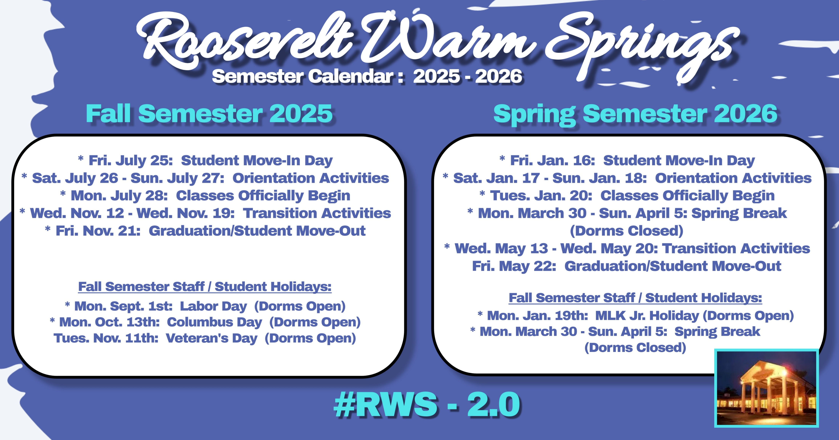
RWS Semester Calendar

Slide 18
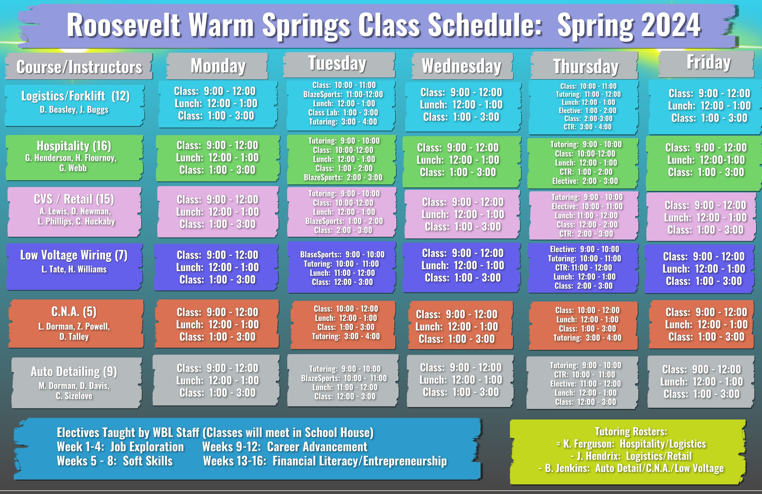
RWS Class Schedule Continued

Slide 19
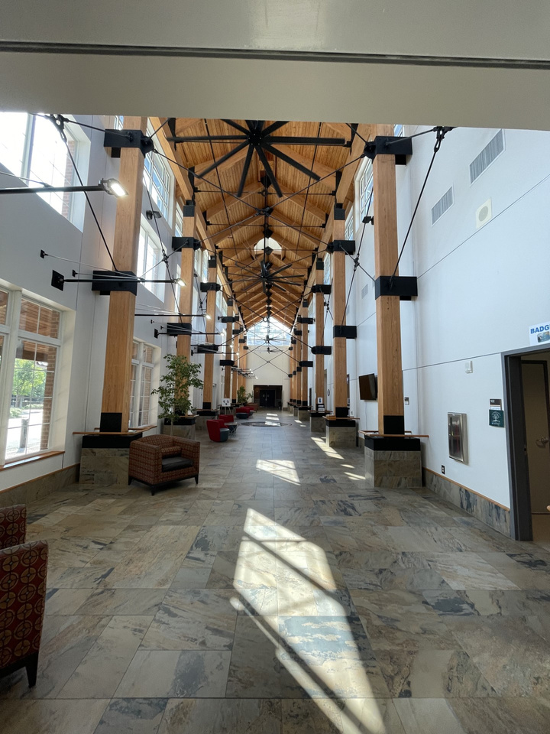
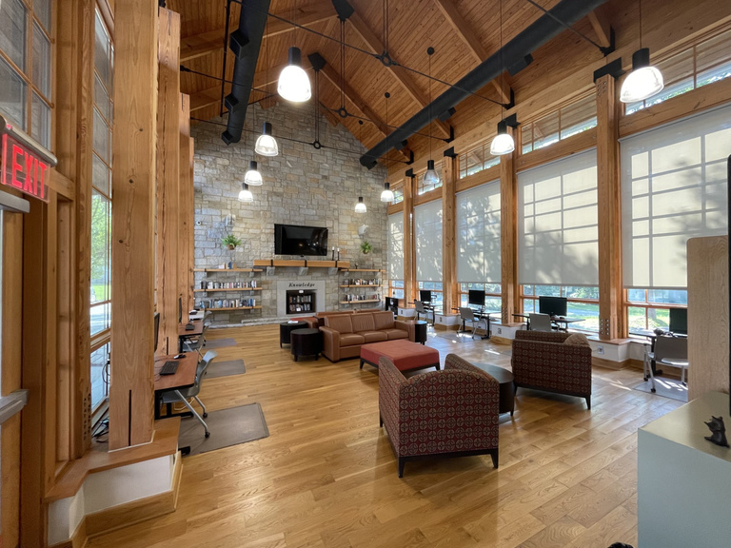
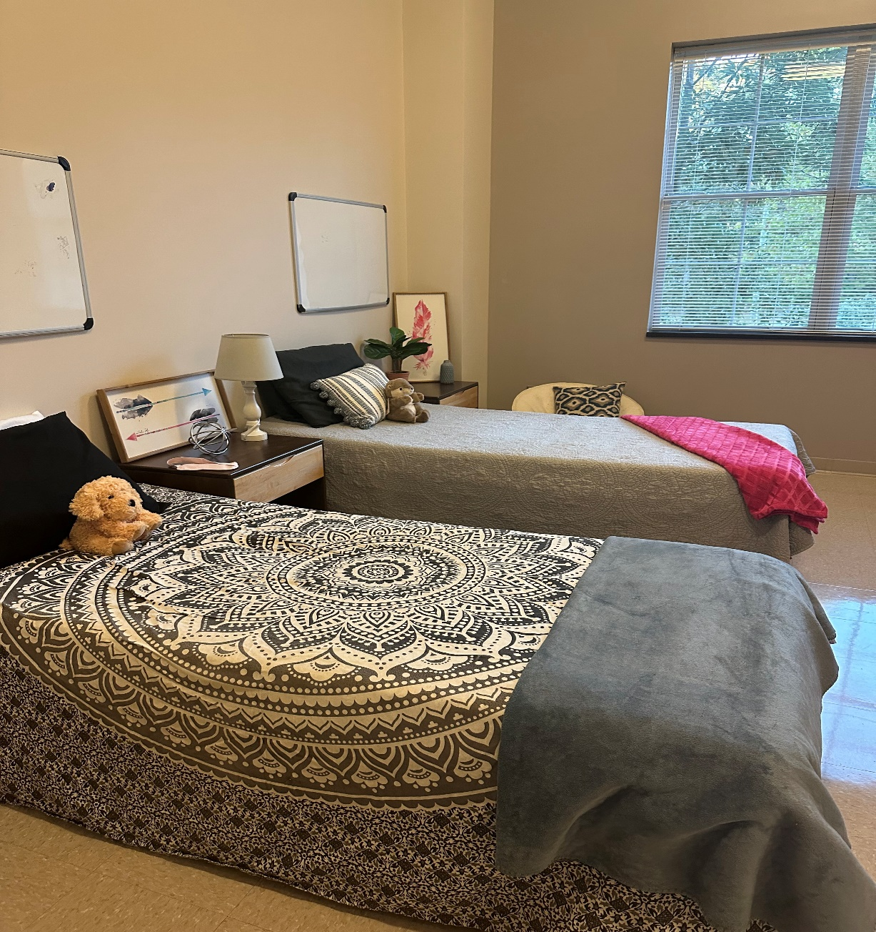
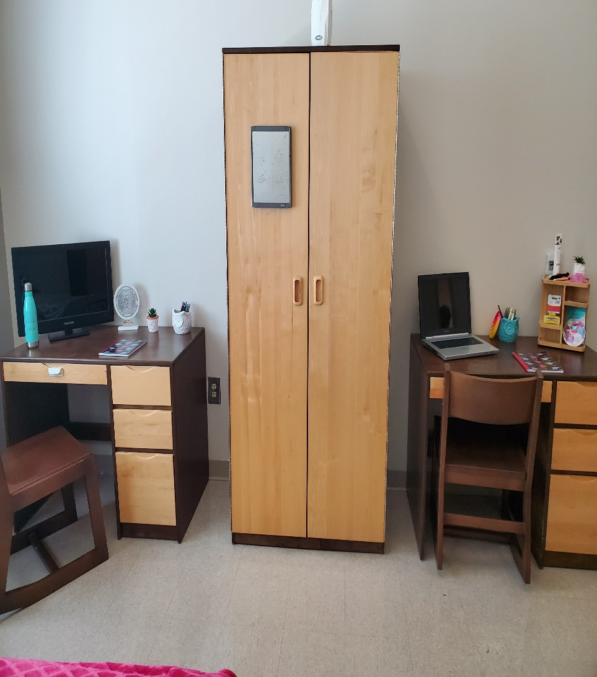
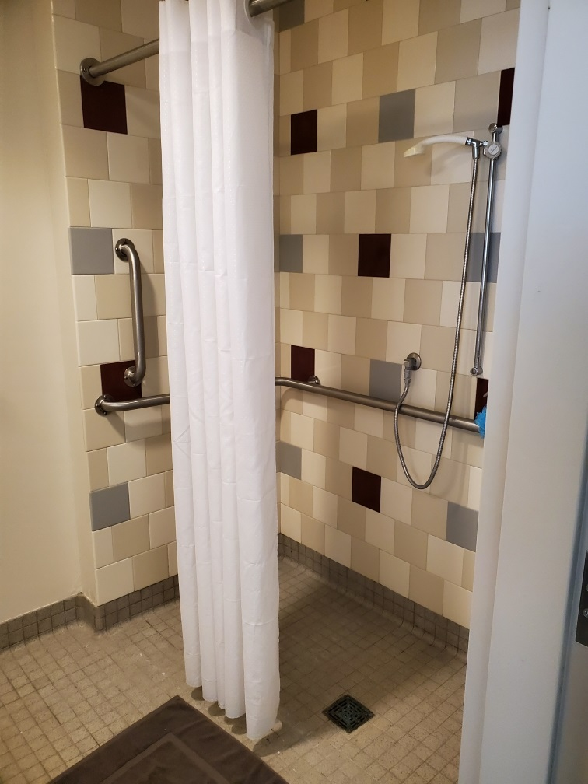
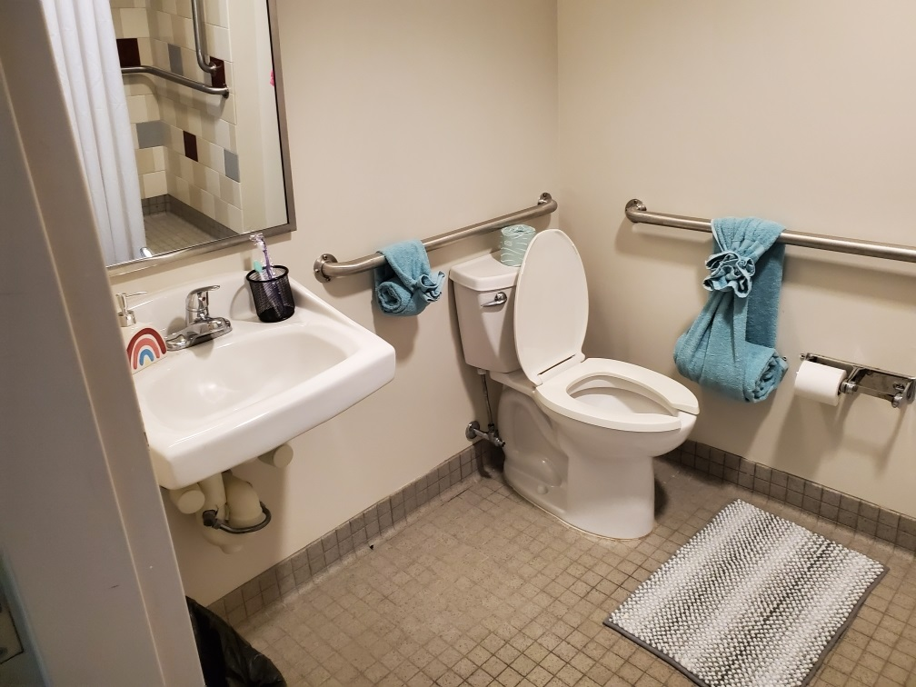
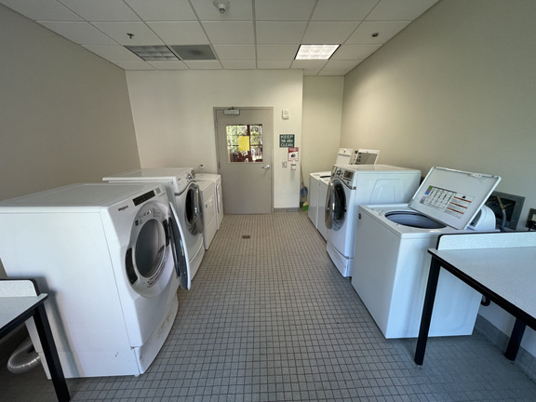
Dorm Life

Slide 20
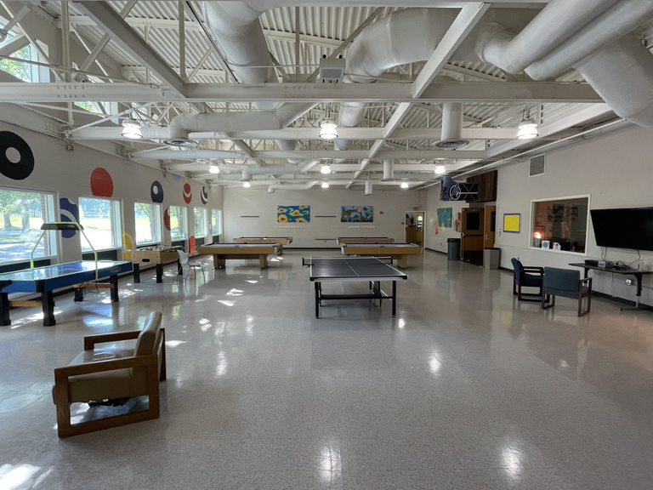
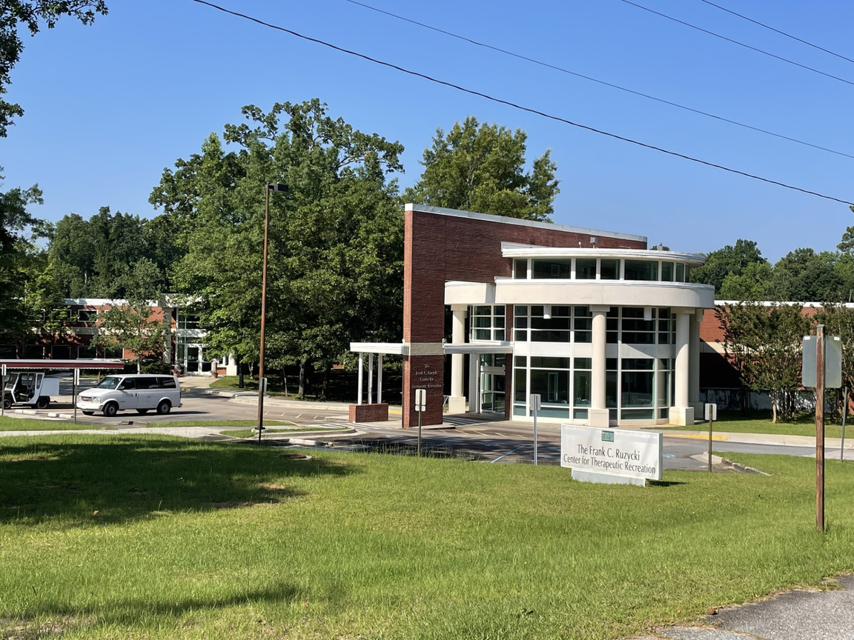
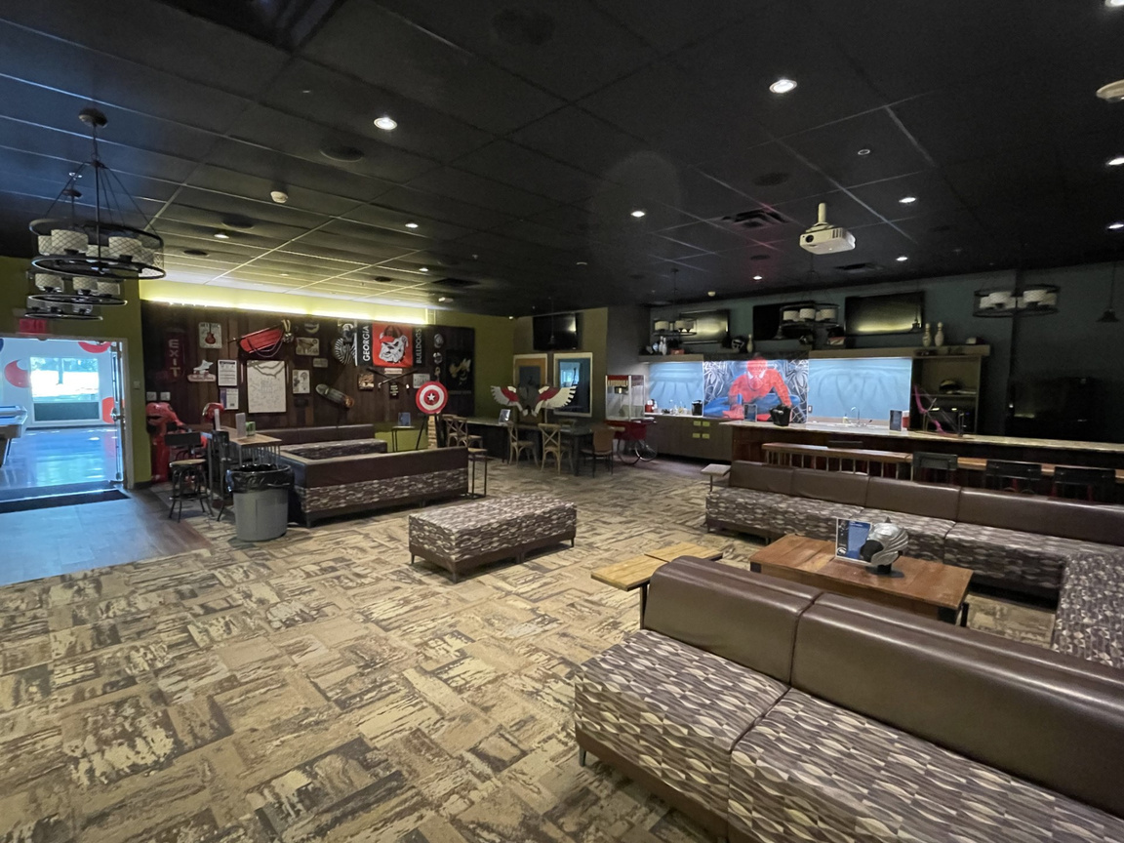
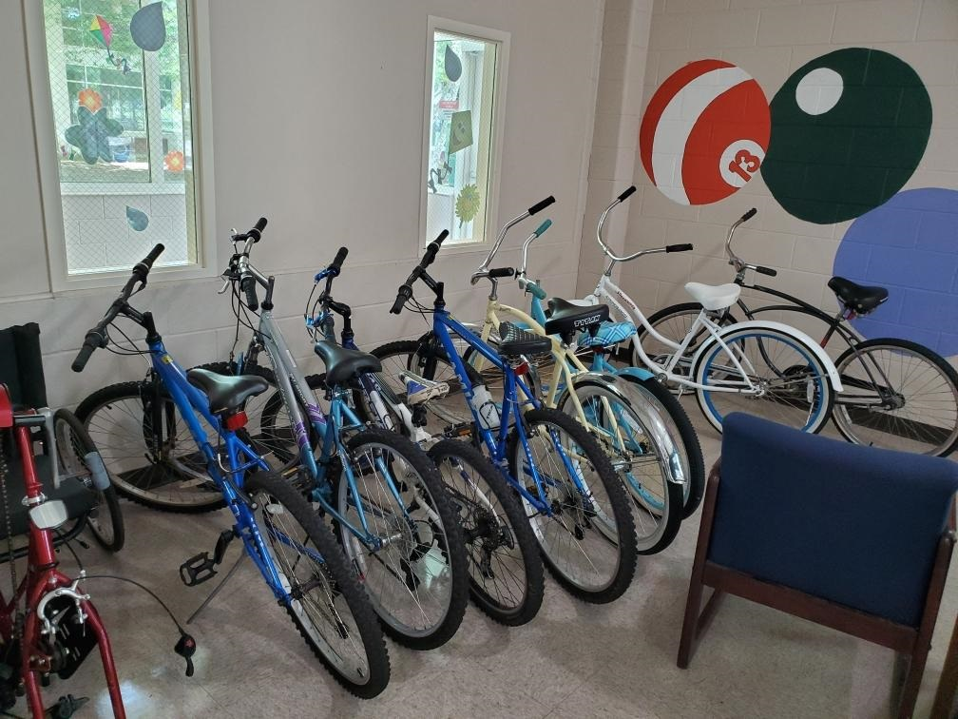
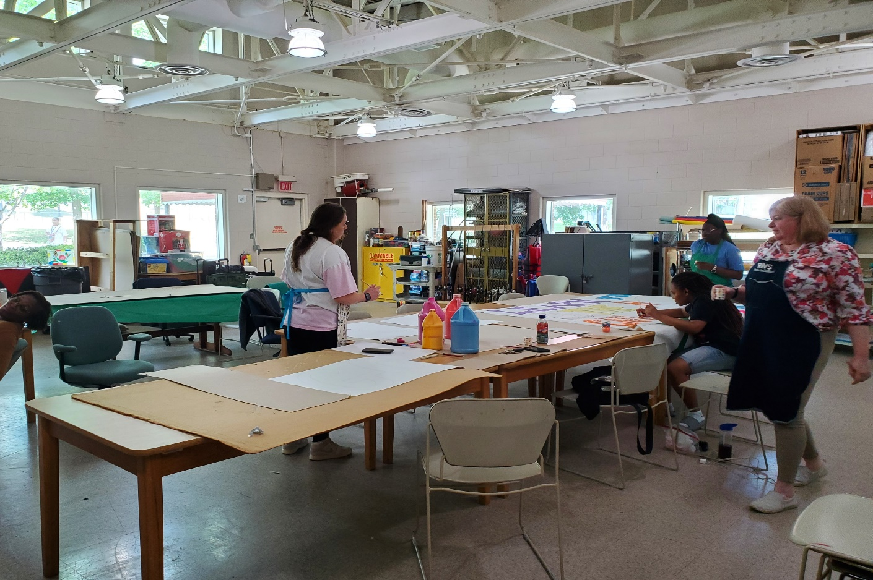
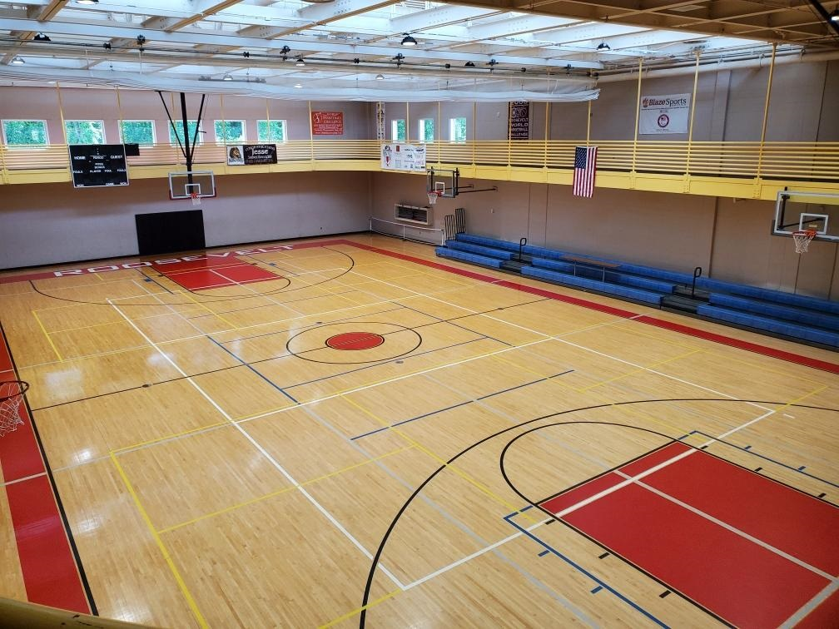
Center for Therapeutic Recreation (CTR)

Slide 21
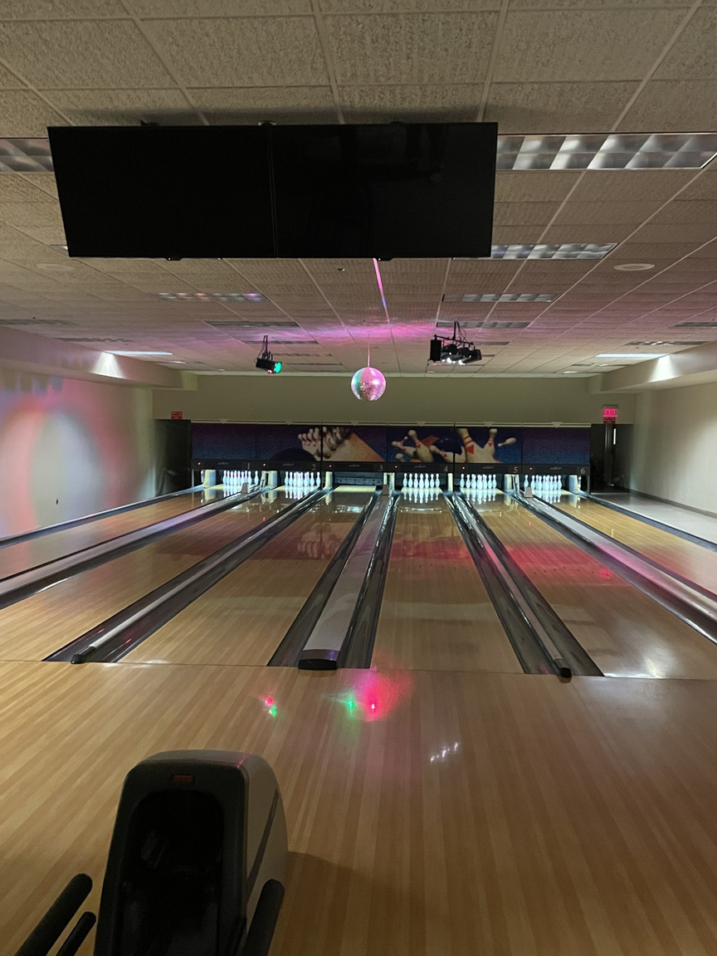
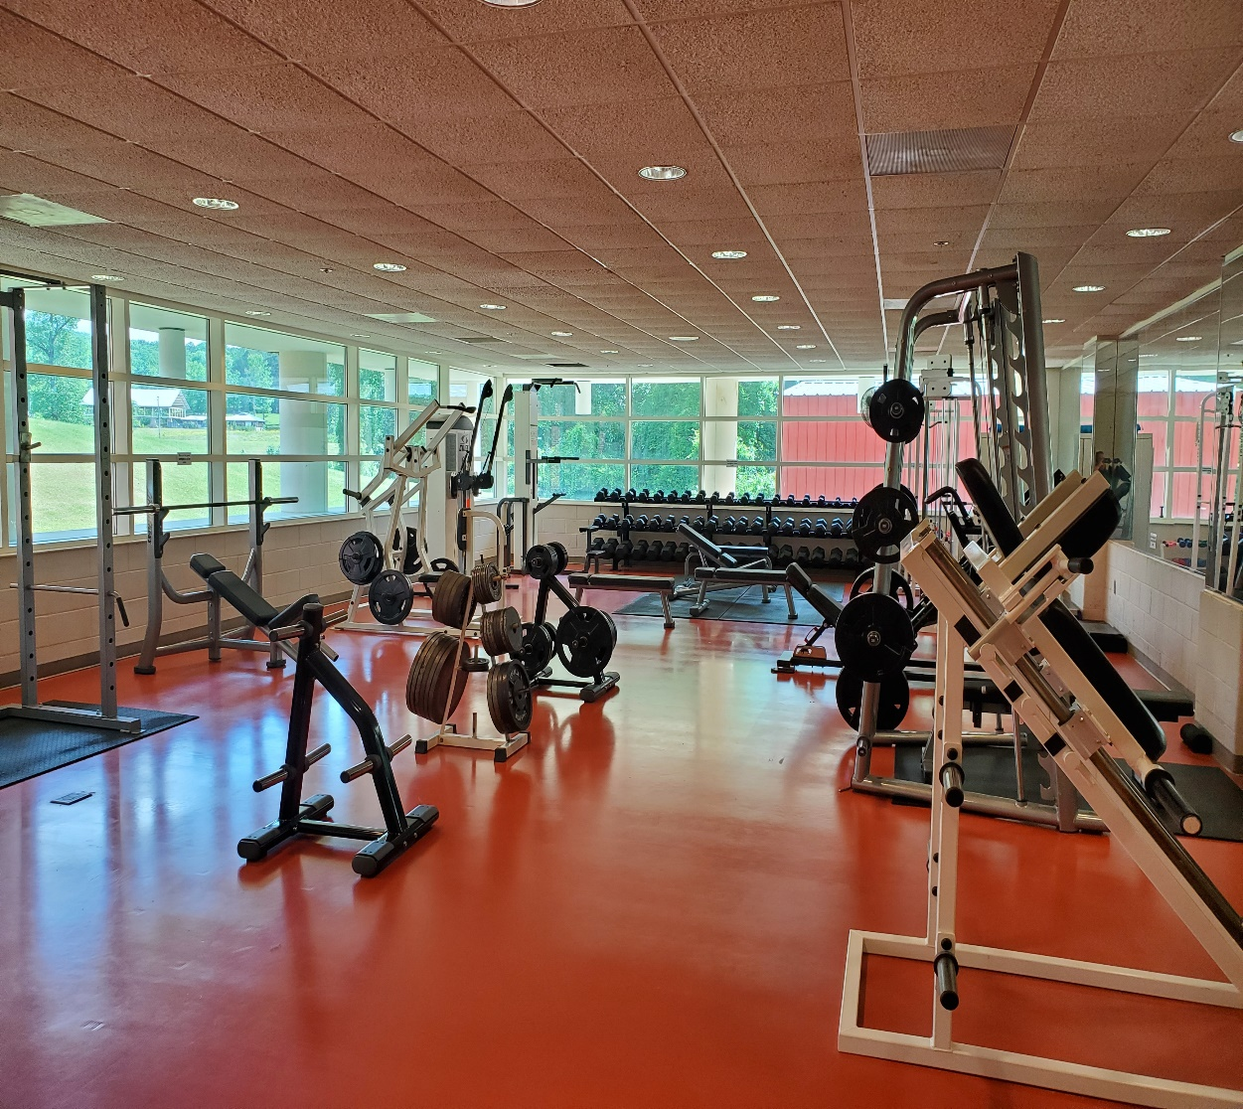
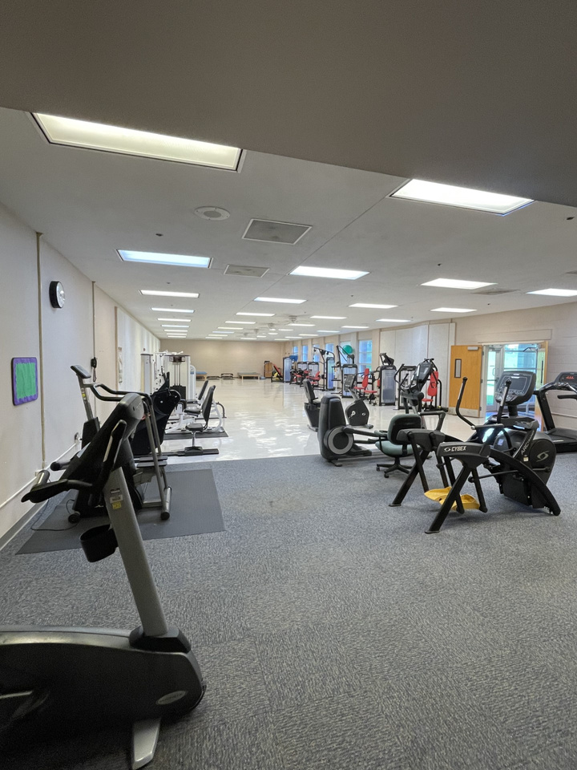
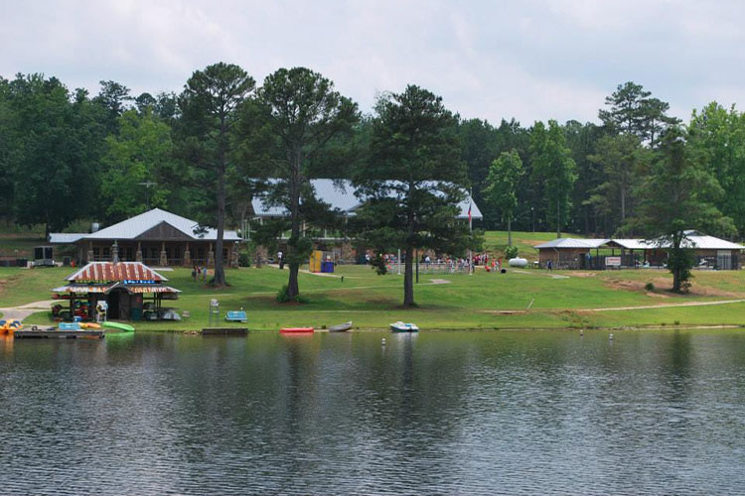
More CTR and Campus Amenities

Slide 22
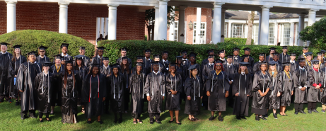


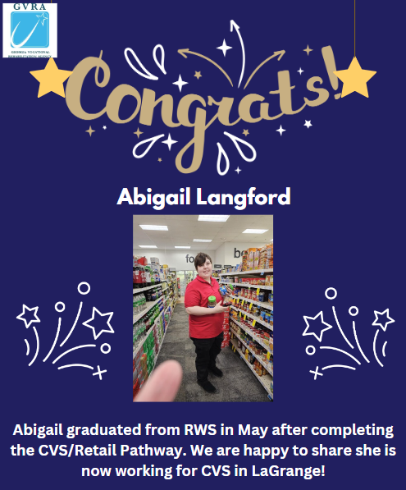
Don't Worry! We Have Your Back!
So, what happens after graduation?
At the beginning of the semester, each student is assigned a provider and RWS Employment Specialist to help support achieving their employment goals.
This team works with students throughout their time at RWS to determine strengths, potential areas for improvement, and to identify job opportunities available in students' hometowns that would be a good fit.
They also provide support to students in – building resumes, honing interview skills, and scheduling interviews for high interest jobs after completing their RWS pathway certifications.
RWS Employment Specialists and providers continue to work with students for 90 days after graduation to ensure graduates successful obtain and retain gainful employment.

Slide 23

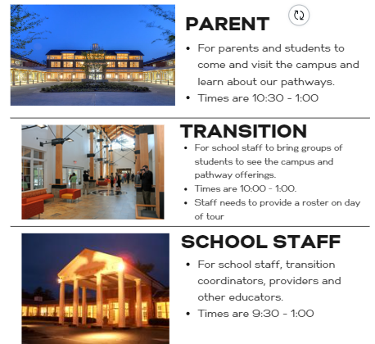


TOURS
Include the following information in your email:
Contact Name, Email address and phone number
Type of tour you are requesting (Parent, Transition or School Staff)
Number of participants attending (Max 32)

Slide 24

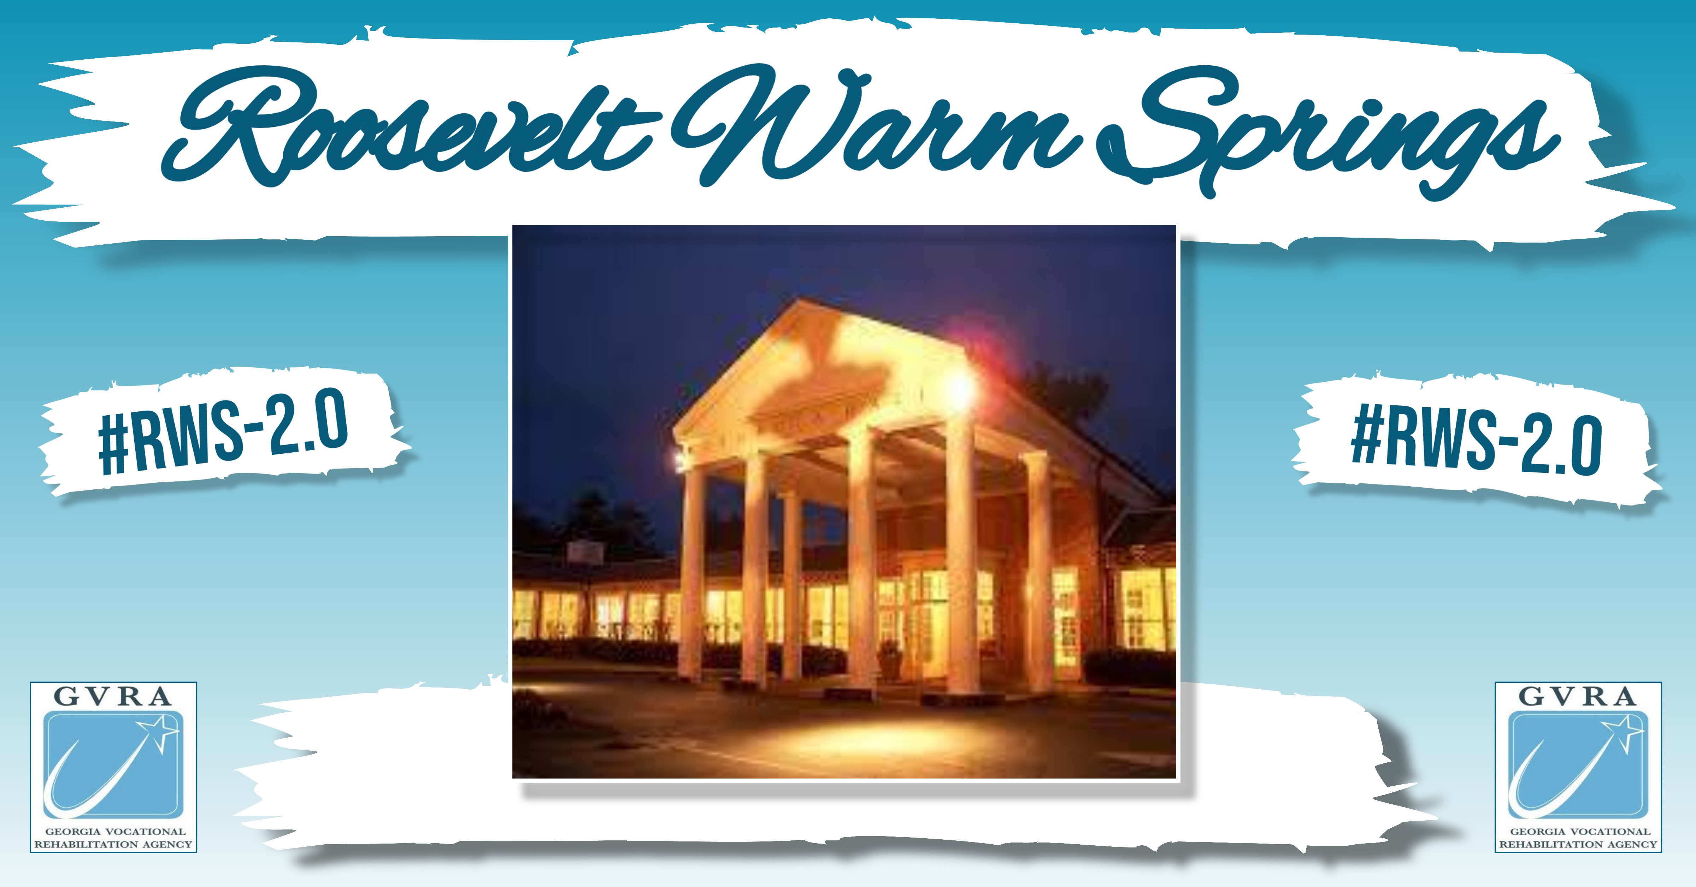
Current Admissions Process
  Click on the link below to begin the process of becoming a VR client. When applicable, make to indicate that you are interested in RWS:
  https://referral.gvs.ga.gov/
  Staff from the GVRA Intake Team will follow up with you to gather additional information, confirm VR eligibility, and discuss next steps for applying to RWS.
Already a VR Client?
Not a VR Client?
  Contact your VR counselor or reach out to RWS directly at rws.csc.referrals@gvs.ga.gov for more information on RWS admissions criteria or to request an application.
  Applications and their supporting documents are reviewed by the RWS Admissions panel on a weekly basis. (Please note: Applications are not considered until all necessary documents have been submitted)
  After review, clients and their VR counselor will be notified by RWS staff of their admissions status (Please Note: If applicants do not meet criteria for admission, they will be contacted by their local field counselor to discuss additional opportunities available through GVRA)

Slide 25



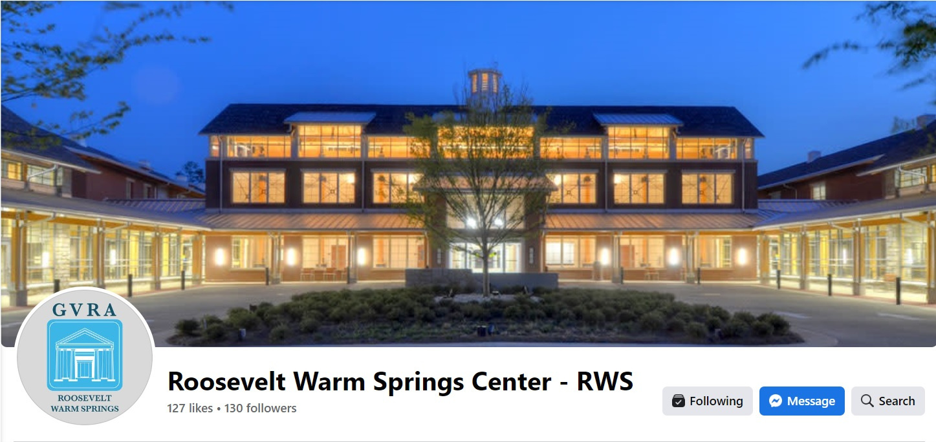

#RWS-2.0

Slide 26
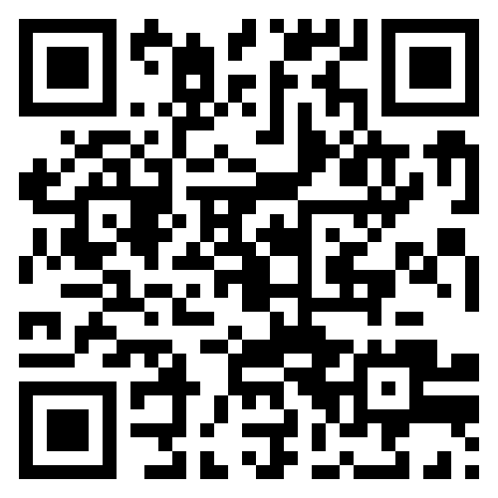

Pathways to Partnerships
Family Learning Session Survey
We value your feedback and would appreciate it if you could take a few moments to complete this survey. Your responses will help improve our learning sessions.
The contents of this presentation were developed under grant H421E230027 from the U.S. Department of Education (Department). The Department does not mandate or prescribe practices, models, or other activities described or discussed in this document. The contents of this presentation may contain examples of, adaptations of, and links to resources created and maintained by another public or private organization. The Department does not control or guarantee the accuracy, relevance, timeliness, or completeness of this outside information. The content of this presentation does not necessarily represent the policy of the Department. This publication is not intended to represent the views or policy of or be an endorsement of any views expressed or materials provided by any Federal agency. (EDGAR75.620)

