Slide 1
Georgia Vocational Rehabilitation Services (GVRS) Board Meeting
Wednesday, August 9, 2023
Chairman Tom Wilson

Slide 2
Chairman’s Welcome
Welcome and Remarks
Roll Call and Agenda

Slide 3
Consent Agenda
Previous Board Meeting Minutes Approval
FY2023 & FY2024 Budgets

Slide 4
Georgia Vocational Rehabilitation Agency
FY 2024 Program Based Budget
Program Name | FY 2023 Expenditures | FY 2024 Current Budget
 |  | State | Federal | Other | Total
Business Enterprise Program | $2,925,020 | $326,141 | $2,443,269 | - | $2,769,410
Departmental Administration | 9,535,556 | 2,436,787 | 7,846,048 | 304,597 | 10,587,432
Disability Adjudication Services | 57,945,139 | - | 70,300,638 | - | 70,300,638
Georgia Industries for the Blind | 5,010,339 | - | - | 4,669,691 | 4,669,691
Vocational Rehabilitation | 70,390,121 | 23,625,421 | 73,950,659 | 5,063,038 | 102,639,118
Total | $145,806,175 | $25,085,798 | $154,540,614 | $10,037,326 | $190,966,289

Slide 5
Georgia Vocational Rehabilitation Agency
FY 2024 Budget Comparison
GVRA | Total Expenditures | Current Budget | Percent of Budget
300-Personal Services | $5,726,859 | $91,646,559 | 6%
301-Operating Expenses | 554,571 | 7,130,112 | 8%
303-Vehicle Purchases | 76,323 | 0
304-Equipment | 0 | 176,754 | 0%
305-Computer Charges | 59,779 | 6,404,967 | 1%
306-Real Estate Rentals | 913,669 | 9,630,661 | 9%
307-Telecommunications | 97,236 | 2,930,896 | 3%
309-Capital Outlay | 0 | 0 | 0%
312-Contractual Services | 323,820 | 13,411,744 | 2%
314-Transfers | 0 | 155,000 | 0%
315-Grants and Benefits | 149,733 | 4,591,091 | 3%
319-Other | 295,570 | 1,476,985 | 20%
320-DAS CE/ME | 726,330 | 21,060,000 | 3%
321-VR Case Services | 1,919,405 | 32,351,520 | 6%
Total Expenditures | $10,843,295 | $190,966,289 | 6%

Slide 6
GVRA Update
Chris Wells, Executive Director
Chris.Wells@gvs.ga.gov

Slide 7
Georgia Vocational Rehabilitation Agency Updates – Strategic Planning
Agency Mission: Empowering Georgians with disabilities to live independent lives.
Agency Vision: To build a client-focused agency that partners with the community to expand opportunities for Georgians with disabilities.
Agency Core Values: Collaboration, Compassion, Integrity, Innovation, and Service

Slide 8
Georgia Vocational Rehabilitation Agency Updates – Strategic Planning
Improve recruitment and retention
Continual process improvement
Improve Service Delivery
Increase the number of individuals served
Improve efficiency and effectiveness of services
Increase focus on customer satisfaction
Enhance partnerships
Increase collaborative partnerships with providers
Increase collaborative partnerships with state agencies
Increase collaborative partnerships with other stakeholders
Investment in Infrastructure

Slide 9
Georgia Vocational Rehabilitation Agency Updates – Strategic Planning

Slide 10
Georgia Vocational Rehabilitation Agency Updates – Strategic Planning

Slide 11
Georgia Vocational Rehabilitation Agency Updates – Key Initiatives
Disability Innovation Fund - Subminimum Wage to Competitive Integrated Employment (SWTCIE)
Federal Grant to Move 14C holders into competitive integrated employment
Revamped Residential Services
Nonpublic Postsecondary Education Commission (GNPEC)
Six certification programs
Restrictive Policy Initiative
Removing restrictive policies to include financial needs
Shepherd Center
Partnering to transition clients from Shepherd into VR
Georgia Academy for the Blind
GVRA is in the second year of a dedicated counselor at GAB

Slide 12
Georgia Vocational Rehabilitation Agency Updates – Key Initiatives
Georgia Pathways or Expansion
During the 2019-2020 Regular Session, the Georgia General Assembly passed Senate Bill 106, the Patients First Act, which authorized the Department of Community Health (DCH) to submit a Section 1115 Demonstration waiver to the Centers for Medicare & Medicaid Services (CMS) which may include an increase in the income threshold up to a maximum of 100% of the Federal Poverty Level (FPL)
Georgia Pathways creates an opportunity for Georgians between the ages of 19 and 64 up to 100% of the FPL, who are not otherwise eligible for Medicaid, to gain access to affordable, quality healthcare
Bobby Dodd Bridge Academy
Cisco Certified Support Technician (CCST) Cybersecurity certification is your way to mastering entry-level cybersecurity concepts and topics
Tommy Nobis Center
Academy is an Accelerated Vocational Training Program that will provide the education, training, and life skills young adults with disabilities need for successful employment

Slide 13
Georgia Vocational Rehabilitation Agency Updates – Prospective Initiatives
Disability Innovation Fund - Pathways
GVRA applied for a second grant as a collaboration with the Centers for Independent Living, Georgia Department of Education, and local school systems to offer pre-vocational rehabilitation services to middle and high school students
PROJECT SEARCH in Cave Spring Center
Fully funded by GVRA
Potential to allow for first residential project search in year two
IPSE Grant
Potential opportunity to increase funding through a federal match with adjustments that align with vocational services requirements

Slide 14
Georgia Vocational Rehabilitation Agency Updates – Challenges
Education and Training
Vocational Rehabilitation Services
Employment Goals
Balancing pre-vocational rehabilitation services
Life Skills
Equipment
Assistive Work Technology
Balancing Local Education Agency Needs

Slide 15
Roosevelt Warm Springs
Chip Medders
Dennis.Medders@gvs.ga.gov

Slide 16
Roosevelt Warm Springs NOW
Roosevelt 2.0 has a Two-Fold Mission
Provide a quality post-secondary educational option for ANY qualifying student
Exemplary instructional practices to support students' successful pathway completion as measured by obtaining industry-recognized certifications

Slide 17
Roosevelt Warm Springs
Hospitality
Various stackable certifications earned through AHLEI (American Hotel & Lodging Educational Inst.) including:
Guest Room Attendant
Restaurant Server
Kitchen Cook
Breakfast Attendant
Front Desk Receptionist
Maintenance
Tourism
CNA / Home Health
Certifications can be earned in CPR/First Aid, C.N.A. Licensure, and Home Health Care. Job Opportunities in:
Nursing Homes
Rehabilitation Centers
Private Home Health Care
Hospitals
Medical Clinics/Offices

Slide 18
Roosevelt Warm Springs
Auto Detailing
Certifications earned through International Detail Association and OSHA-10 certification with potential employment in areas such as:
Automotive Company
Auto Dealership
Auto Body Shop
Equipment Rental Company
Potential Self-Employment
CVS/Retail
Program offers certifications in National Retail Foundation, Retail Fundamentals, Customer Sales/Service, Inventory Logistics, or Business Retail. Employment for this Pathway Includes:
Cashier
Stock/Inventory
Customer Service Rep
Loss Prevention Officer
Merchandiser

Slide 19
Roosevelt Warm Springs
Logistics/Warehouse
Certifications earned through Manufacturing Skills Standards Council and Forklift Operation. Employment is available in areas such as:
Forklift Operation
Material Handler
Stock Clerk
Warehouse Shipping & Receiving
Inventory Clerk
Low-Voltage Wiring
Program offers certifications in OSHA-10, Residential Electronics Systems Integrator, and Electronics Design and Installation. Potential Employment for this Pathway Includes:
Cable/Internet Installation
Lighting Contractors
Phone Companies
Security System Installers
Audio-Video Installers

Slide 20
Roosevelt Warm Springs
Additional Pathways Coming Soon
CVS / Pharmacy Technician
As Component of Construction Pathway
Heavy Equipment Operation
As Component of Agriculture Pathway
Landscape Maintenance and Design

Slide 21
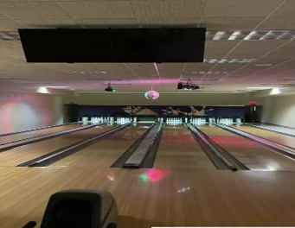
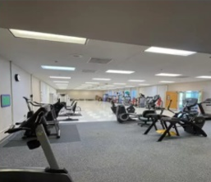
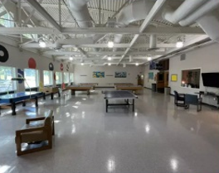
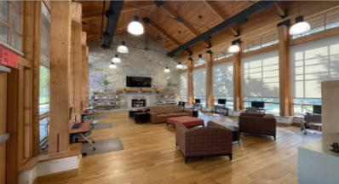
Roosevelt Warm Springs
Campus Life: Facilities/ Amenities

Slide 22
GVRA Experience
Sam Armas, Summer Internship Program

Slide 23
GVRA Experience
Sam Armas
Summer Internship Program

Slide 24
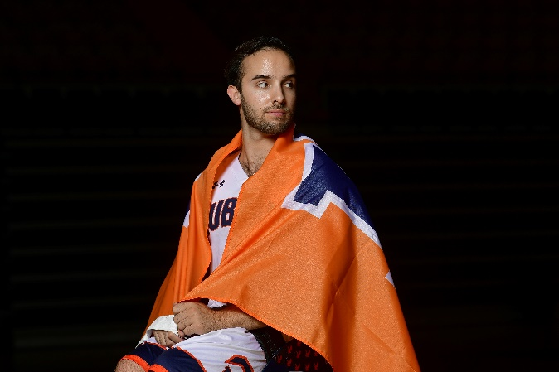
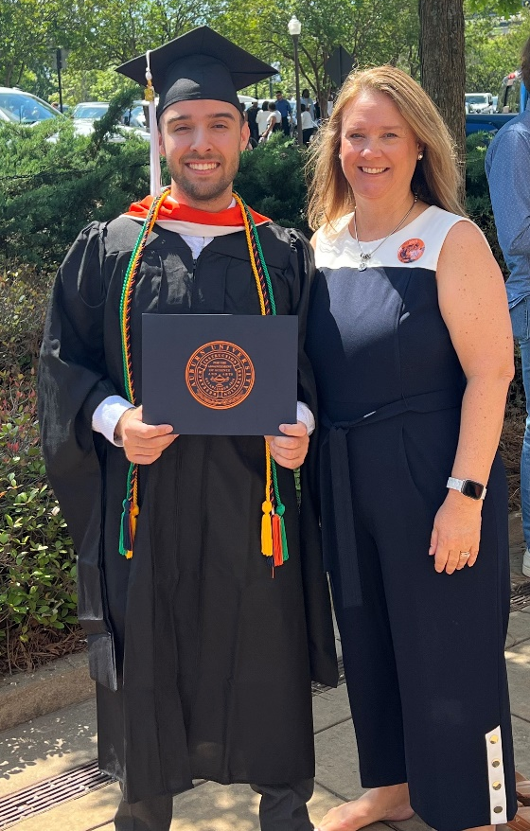
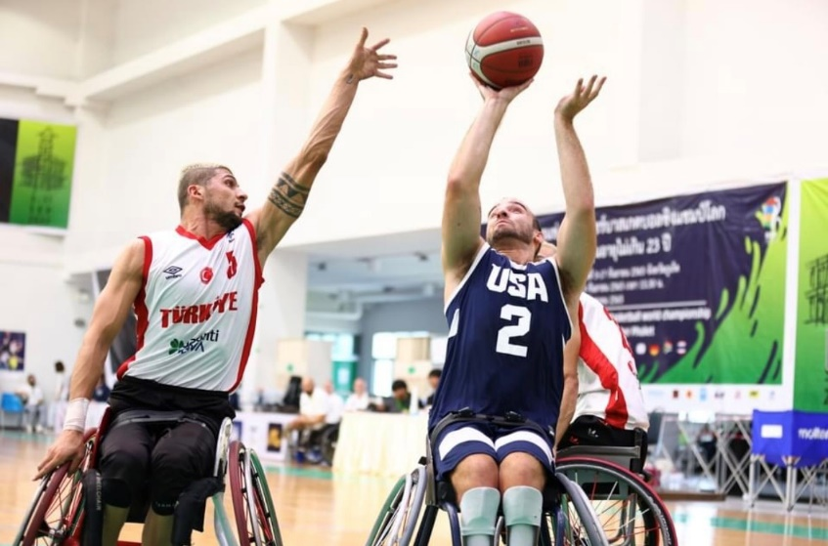
GVRA Experience

Slide 25
New Business/Old Business
TBD

Slide 26
Public Comments/Adjournment
Wednesday, August 9th, 2023
Georgia Vocational Rehabilitation Services Board

