Slide 1
Georgia Vocational Rehabilitation Agency
May 13th-17th, 2024
Provider Small Group Sessions
Fiscal Compliance
VR_FiscalCompliance@gvs.ga.gov

Slide 2
Provider Small Group Session
10:00 AM – 10:15 AM Welcome & Introductions
10:15 AM – 11:00 AM Topic of Discussions
PRS Title Change, New FCS & Reporting Manager
VR Fiscal Compliance Email Address
Invoicing and Timesheets/Sign-in sheet
Add/Remove Contractual Services
G.R.O.W. Program
Background Check (Idemia)
Website Updates & Additions
Vendor Portal Training Schedule
Vendor Portal Payments Processed
SAO Payment Email Notifications
11:00 AM – 11:30 AM Questions
11:30 AM – 12:00 PM VR Staff and Provider Discussions

Slide 3
PRS Title Change, New FCS & Reporting Manager
Ayesha Hussain - Districts 1 & 2
Della Showers - Districts 3 & 4
Balaji Nekkanti - Districts 5 & 7
Betty McCants- Districts 6 & 8
Changes:
Sharon Angel has officially retired from the agency as of March 1st.
Fiscal Compliance Specialist Reporting Supervisor is Tawnya Reid
Provider Relations Specialist title changed to Fiscal Compliance Specialist effective March 1, 2024
Courtney Sapp reports to Jeff Allen
Betty McCants who is the new FCS has replaced Courtney Sapp for districts 6 & 8

Slide 4
VR Fiscal Compliance Email Address
Change In Email Address
As part of the restructuring, All providers are no longer required to send emails to the Provider Management email address at providermanagment@gvs.ga.gov
We have created a new email address specifically for the use of VR Fiscal Compliance related issues and correspondence.
VR_FiscalCompliance@gvs.ga.gov
***Note: Carbon Copying (Cc) your FCS’s when sending an email to the new address is still an option.

Slide 5
Invoicing & Timesheet
Invoice is the bill for services
Timesheets/Sign-In are for participants to sign that they were in attendance for the service being rendered
If signature(s) is missing, then it must be stated in Section B of attestation. The reason(s) must list under section B of the invoice.
Please avoid stating “See Timesheet” this is not an invoice
Pre-ETS services please use one of the following billing methods
1.Half hour method = round up or down to the half hour
Example: 35 mins was provided round down to 30 min. 45 min provided round up 1hr
2.Minute method = 60/rate= cost per min
Cost per min X number of min provided.

Slide 6
G.R.O.W. Program
Getting Ready For Opportunities In Work
G.R.O.W. Components
GROW is a weeklong experiential program that exposes the participant to all five of the required areas:
Self Advocacy
Work Readiness Training
Job Exploration
Work Based Learning
Counseling on Post Secondary Enrollment.
Completed in groups of 30 or less. There should be no more than 15 students to one instructor
Providers will have to submit at the end of the week an invoice, daily sign in sheet, and a summary report on each individual that participated in the weekly programming.
Invoicing Documents are to be submitted to fiscalservices@gvs.ga.gov.
G.R.O.W. Flyers
Must consist of the following if not using GVRA’s approved flyer:
GVRA Logo, name and contact
Service Dates and location
Age Group
Request GVRA logo through your FCS or the Provider Management web page.
Submit your flyer to providermanagment@gvs.ga.gov or your FCS for review and approval

Slide 7
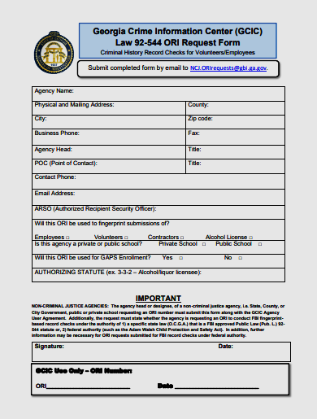
New Background Check Vendor
GVRA will be transitioning to a new background check vendor Idemia & Security USA LLC (Idemia) on or before July 1, 2024
For further details you can visit: https://gcicweb.gbi.state.ga.us/
If your agency does not have an ORI Number, you can complete the ORI Request Form provided on the website above
Your FCS will provide you with more updates as they become available

Slide 8
GVRA Website Updates & Additions
Please visit www.gvs.georgia.gov for changes to include:
Page Name:
Refer to the Provider Management link for all resources
Located under Memos and Notices:
Added Critical Incident Reporting Sign
Located under Provider Forums:
Added Small Group Sessions PowerPoints
Added and Located under Invoicing Documents:
Added all invoicing document templates
Added and Located under Forms:
Added GVRA Logo Request
SCR (Supplier Change Request Form)
W-9
New Referral Form
Added and Located under Provider Reports:
Added progress reports and Year End Summary Report

Slide 9
Vendor Portal Payments Processed
If the authorization is paid it can be found in the vendor portal under Closed Authorizations
Select the blue Detail Number on the Authorization Detail Page to see the Processed Payment
Requests
Processed Payments section in the vendor portal will display the payment information.
Check your Payment ID Number with your ACH received in the SAO Supplier/Marketplace
Portal to ensure payment has been completed on closed authorization
***The vendor portal does not send automatic payment email notifications

Slide 10
Vendor Portal Training Schedule
Change in Schedule
We will no longer have trainings semi-monthly.
Trainings will now be
conducted once
every month. You have the option to chose a date that is convenient for you during registration.

Slide 11
Automatic Payment Email Notifications
Please register with the Georgia State Accounting Office’s Supplier Portal to receive payment information after a payment has been completely processed.
Go to https://sao.georgia.gov/teamworks/teamworks-financials/vendor-payment-management
Click on Supply Portal link to view payment information.
Click on User Registration or Sign In with your credentials.
What are the benefits of registering for the Supplier Portal?
View Payments and receipts (3 years history) from state agencies
View Invoices (3 years history) to state agencies
View payment remittance on invoices and payments
Check outstanding balances and payment status
View & download Purchase Orders (3 years history) from state agencies
Self maintenance of the supplier’s firm’s Contacts, Addresses and selected NIGP Codes
1

Slide 12
SAO Payment Details
If you have already registered and would like to see your payment details, follow these simple steps:
Sign in to your SAO account
Click on the Work Center Box
Go to Manage Transactions
Click on Payments
Search by the Invoice Number or a desired date range to see payment information.
Click on the reference number to see additional payment details
You will be able to access the SAO Portal 24 hours/day, 7days/week. If you have problems accessing the portal, please call (404) 657-6000 for assistance.

Slide 13
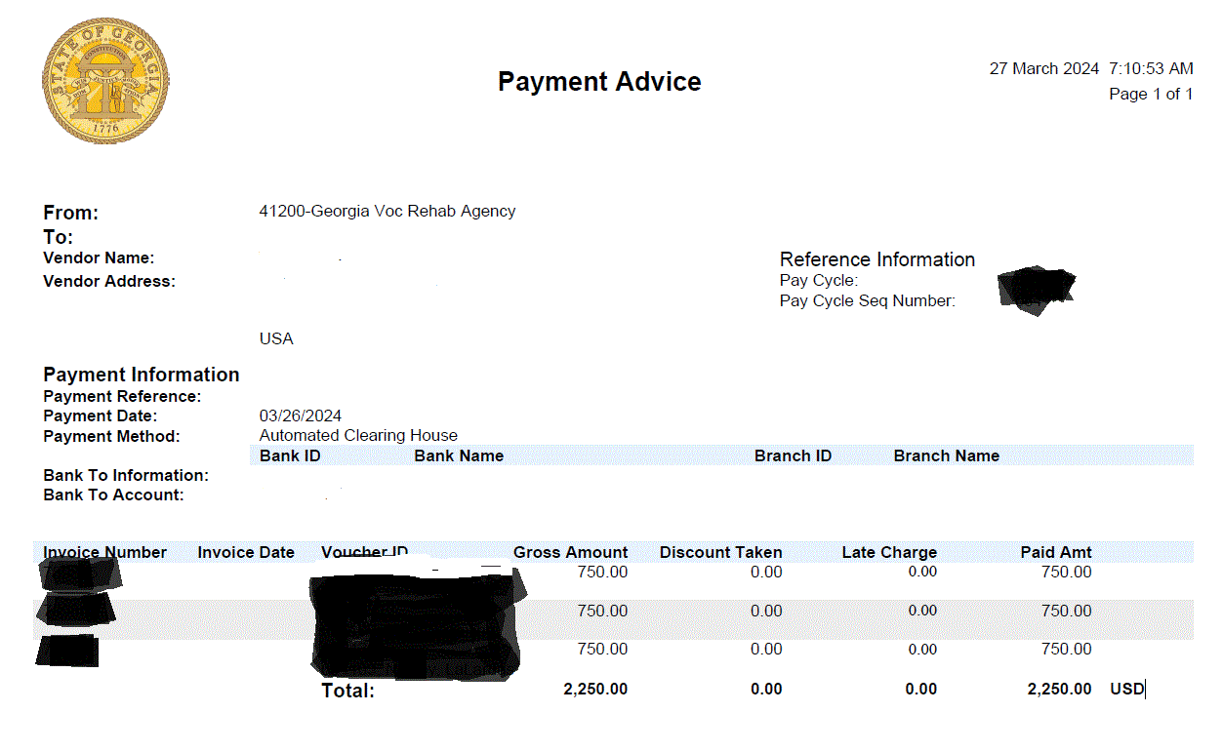
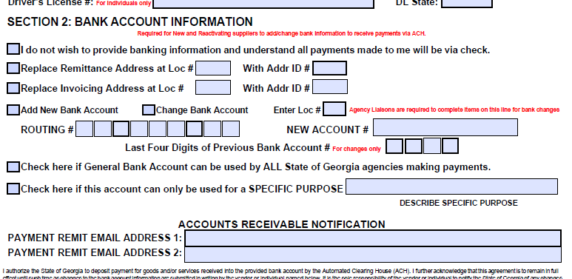
Payment Advice Notifications
Vs
Account Receivable Notifications
PAYMENT ADVICE NOTIFICATION
Every time you receive a payment, an email from donotreply@sao.ga.gov along with the attachment gives a detailed description of what payments were made on which participants, and the amount received.
An example of Payment advice notification can be seen below,
ACCOUNT RECEIVABLE NOTIFICATION
The account receivable can be opted in Supplier change request form, formerly known as vendor request form. You are allowed the convenience of receiving payment remittance email notifications once approved for ACH Payments. If you are not receiving ACH payment email notifications or need to make changes to the email address currently on file, please complete the SCR form which is on GVRA website and send it to your Fiscal Compliance Specialist.

Slide 14
Questions?
May 13-17, 2024
Provider Small Group Sessions
Fiscal Compliance
VR_FiscalCompliance@gvs.ga.gov

