Slide 1
Georgia Vocational Rehabilitation Agency
January 11, 2024
Provider Supported Employment Training

Slide 2
Objectives
Discuss the two major Supported Employment changes that became policy 1.1.2024
Discuss new service: Supported Self Employment
Discuss changes in provision of Extended Services in all types of Supported Employment, as well as associated forms
Refresh on basic principles of Supported Employment
Notes:
The most important thing we need to talk about today is the policy change that impacts SE Still, there are some parts of SE that would benefit from Refresher so we will hit on those today.

Slide 3
Three Types of Supported Employment Offered at GVRA
Traditional Supported Employment
IPS (Individual Placement and Supports ) Supported Employment
Customized Supported Employment
Notes:
Traditional used most, across the board. It is typically what one thinks of when they consider Supported Employment
IPS is a model designed for those with SPMI. It is based on the Traditional Model, but has some unique features built in (such as rapid engagement, zero exclusion, team/whole person approach). GVRA uses this model as part of an MOU with DBHDD BH side.
Customized is typically used with I/DD but that is not a requirement-it can be used anytime you are looking at complex disability with many factors involved, with someone where it is very unclear what sort of work and/or environment will help them achieve their goals, and the likelihood of more extended supports, some of these personal, going forward
GVRA and dBHDD also have a collaboration around I/DD and supported employment and both TSE & CSE are used, but due to Medicaid waiver, we are utilizing a list of Dually approved providers-approved by both agencies. This allows the case to continue smoothly after GVRA closure, with no interruptions.

Slide 4
What is Supported Employment?
Supported Employment is competitive integrated employment for individuals with the most significant disabilities for whom such employment has not traditionally occurred, or as the result of a significant disability, requires intensive support services along with extended follow up for the life of the job in order to achieve and maintain meaningful employment.
Notes:
VR only offers individual approach-no groups. Extended supports are still required in Supported Employment-they always were. What is changing is that we are not putting this responsibility on the original provider, per Fed regs
CIE: integrated is a community setting in which an individual with the most severe disabilities interacts with non-disabled individuals, other than the non-disabled individual providing their support services, to the same extent that non-disabled individuals in comparable positions interact with others. Same pay, same benefits, same promotional opportunities.
It is not temp work, it is not a job working for the provider, or in a position contracted with a provider. It is not working in a business set up specifically (often as a charity) to hire and provide employment to those with disabilities, where only the supervisor/owner is considered non-disabled. It is not a taking a crew of individuals into a business to perform a duty such as janitorial.

Slide 5
Supported Employment is PLACE & TRAIN
There are no pre-requisites for Supported Employment, it is an all inclusive model - one service divided into several parts (phases)
If an individual is going into Supported Employment, we already know they cannot work completely independently and they need supports & assistance. Vocational Evaluations, work evaluations, job trials, etc are NOT needed to determine “what they can do.” This is worked out in real time, in the real world, with real rewards and real consequences.
For Customized Supported Employment, this is even MORE true. Discovery is much different that any other assessment out there but is also more individualized, more in depth, and more revealing. Any other type of assessment is very likely to show completely different results.
Notes:
This applies to all types of SE. IPS cases come with the dx up front. The DD collaboration cases also come with the dx up front. We do not have to go beyond that and secure more records. Part of the purpose of the Services Identification meeting is to discuss with the individual, or the individual and their family, what types of supports they will benefit from. Discuss concerns there. Sending someone to a work trial in a job that has nothing to do with their interests often sets them up to fail, and discourages them more, and really tells you nothing,
Prior to SE, they do not have to prove to anyone they can complete an interview-SE provider will help them do that, often sitting with them, they don’t have to prove they can be at work every single day, they don’t have to prove anything to anyone. This all unfurls as part of SE.
Discovery is a very individualized, very intensive process that takes 6-8 weeks on average and 35-45 hours on average and focuses on the positive, while interacting with the person in their own environment. This is so much more revealing than having them in a testing situation for a few hours and getting results that are designed t rule out everything they cannot do, per that testing.

Slide 6
What is Traditional Supported Employment?
Supported Employment is competitive integrated employment for individuals with the most significant disabilities for whom such employment has not traditionally occurred, or as the result of a significant disability, requires intensive support services along with extended follow up for the life of the job in order to achieve and maintain meaningful employment.
Traditional is what most people think of when they hear “Supported Employment.” Traditional means developing/locating an existing job and helping with accommodations/supports. It is expected that the long term supports will lessen in Traditional, more so than in Customized Supported Employment.
Notes:
Traditional Supported Employment is the same definition as “Supported Employment”
Typically these are existing jobs, and accommodations are negotiated. A different work schedule so that they can manage the bus, perhaps being responsible for 9 widgets per hour instead of 10. AWT is a big help here. They can help with Apps that assist someone in staying on track with their work duties, remembering which duty comes next, etc.
This is for any disability, although we do tend to use it with BH and I/DD. It can be for physical disabilities too. Adapting a work space so that someone can be efficient and successful.
Supported Self employment is NOT part of this model.

Slide 7
What is Individual Placement & Supports (IPS) Supported Employment?
IPS is an evidence-based, heavily researched, nationally recognized program.
It is targeted specifically for the severe and persistent mental illness (SPMI) population
IPS SE is based on 8 principles:
Zero exclusion
Rapid job search
Competitive employment
Systematic job development
Integration of rehabilitation and mental health services
Attention to worker preferences
Personalized benefit counseling
Unlimited & individualized supports
Notes:
The new changes will not change the core of what IPS is. The extended supports will not change. For years, IPS has “stepped down” cases to Case management after GVRA closes the file and likely that will continue.
In fact, GVRA has “sped up” the pace of all cases so that most cases are progressing to plan within the first 30 days
Supported self employment does not apply in this model because it is part of CSE and CSE is not used in IPS.

Slide 8
What is Individual Placement & Supports (IPS) Supported Employment? continued
In Georgia, IPS is linked directly to our Memorandum of Understanding (MOU) with DBHDD.
DBHDD provides the funding to the providers & they choose the providers. They also determine how many individuals (slots) a provider can serve at any one time
Notes:
There are 22 IPS providers, but a few of these are in more than one location in the state. They follow the fidelity standards which are annually reviewed by DBHDD. They have one assigned counselor at GVRA.

Slide 9
Traditional/IPS Supported Employment Phases
Services Identification and Extended Services Agreement
Job Development/Placement
Training and Initiation of On-Going Supports, Part 1
Training and Initiation of On-Going Supports, Part 2
Stabilization
Notes:
The 3&4 phases are divided in half. This is the Minimum 3 month period where an individual will acclimate to their job and truly be ready for stabilization but this phase can extend as long as 24 months and that clock starts running on first day of employment.
Every single case cannot move at the minimum mark, people are all different and have different needs. It is reasonable to assume that if the extended supports are moving to a “Natural Support” more prep needs to go into this before the case is turned over.
We will talk about the different phases in more detail when we review the SE Forms / Invoices
The provider exits the case at the end of phase 4. this can be confusing when Medicaid waiver is involved and the same provider is going to provide the extended services but GVRA stops paying that provider from Supported Employment funds. Monthly reporting stops.

Slide 10
What is Customized Supported Employment?
This is Competitive Integrated Employment, for an individual with the most significant disability, that is based on an individualized determination of the strengths, need, and interests of the individual.
It is negotiated to meet the specific abilities of the individual and the needs of the employer, and is carried out through flexible strategies.
Notes:
It is not restricted to people with Development Disabilities, but is commonly used that way.
This is often used within our DBHDD/GVRA collaboration about waiver DD cases, because these individuals typically will need more long term supports, and the Waiver is more suited for this.
This always begins with Discovery.
Discovery has essential elements: interviews with the people close to that person, in several walks of life (not all at one place). It is always performed on the person’s turf. It involves an element of job exploration-truly just to try out jobs, not as part of negotiation.
Discovery reports use positive language, always looking for what someone can do, not ever used to screen out
These jobs are CREATED and NEGOTIATED. Typically, they bypass the interview/application process, or use alternative means (visual resume for example). Development happens with one single person at a time. The provider goes to an employer to negotiate for Jane Doe, not to see what openings there are for anyone with certain skills.
Supported Self employment is an outcome of this type of SE.

Slide 11
Customized Supported Employment Phases
Customized Services Identification & Extended Services Agreement
Customized Discovery Assessment & Profile
Customized Discovery Profile Meeting
Customized Job Creation/Negotiation
Customized Training & Initiation of On-Going Supports, part 1
Customized Training & Initiation of On-Going Supports, Part 2
Customized Stabilization
Notes:
GVRA counselor must justify moving to the next phase and has final decision on this
We will talk about the different phases in more detail when we review the SE Forms / Invoices. GVRA makes their last payment as stabilization begins and the provider exits the case. Monthly reporting stops.

Slide 12
Supported Self-Employment

Slide 13
Supported Self-Employment means a method to, or environment within which, an eligible individual with most significant disabilities may pursue a Competitive Integrated employment outcome match to their skills & interest, with intensive and long term supports in order for the individual to achieve their employment goal.
Discovery Phase: this is the time to explore all employment options, including Supported Self employment.
Notes:
Supported Self Employment is only used with Customized Supported Employment.
Discovery is also the time to talk about the individual’s ability for length of work: how many hours per week? Per day? How many days per week? Document this in discovery, ESPECIALLY if the expectation is less than 10 hours per week.
Discovery has essential elements: interviews with the people close to that person, in several walks of life (not all at one place). It is always performed on the person’s turf. It involves an element of job exploration-truly just to try out jobs, not as part of negotiation.
Discovery reports use positive language, always looking for what someone can do, not ever used to screen out. Supported Self employment is a chance to explore microbusinesses, very small enterprises on a tiny scale, suitable for that one individual

Slide 14
Supported Self-Employment
Is not a stand-alone service - it is an option of Customized Supported Employment
Providers must be a Certified Business Tech to deliver this service
GVRA is setting up an initial training group to train provider staff all across the state for our first year
Notes:
This will be one possible CIE outcome of CSE.
If Discovery shows the person is best suited for a microbusiness, or small business of their own, then this will be discussed and decided upon in the Discovery Profile meeting. The phases remain the same but there are two differences:
1. the staff person delivering the service has not only ACRE certification, but also CB Tech certification and
2. instead of efforts toward a job with an employer, efforts will be on establishing this person in Supported Self Employment
3. CB Tech. this is IN ADDITION to ACRE training. GVRA will lead off with training about 25 provider staff across the state. Every effort will be made to spread these out so that all parts of Georgia will have access to this service. GVRA will pay for the initial training. Provider Management will amend the contracts accordingly but will likely include requirements for service in exchange for this training.

Slide 15
Extended Supports
Notes:
Extended supports have always been required for Supported Employment, per Federal regs, for the life of the job. That is not changing. The responsibility for these services is.

Slide 16
363.53 Federal Regulations
Transfer of the individual to extended supports:
no later than 24 months after they begin their job, unless exceptions are documented
the source of these extended services is identified at the beginning of the process so there is no interruption in service for the individual
The discussion about who will be responsible for Extended supports happens at the beginning-in the Services Identification meeting. The source is identified with reasonable expectation this will be available.
1. for example, Medicaid Waiver services will continue the services when someone has a waiver.
2. If Natural supports are identified, there needs to be a discussion about preparing the Natural Support for this job.
Notes:
Medicaid Waiver will take over with the DD collaboration cases, which is the purpose behind the Dual Provider list.
Typically, IPS cases will roll to Case Management services. This has always been how this was handled. The IPS department itself has to move a case in order to open up a slot, they have never personally stayed on the case for as long as the person is employed.
Natural supports can be any unpaid support: family, friends, community of faith, even the employer. If someone is paid to provide support, they are not a Natural Support. They may need more preparation - consider including them in job coaching, let them see what is expected, let them understand the job as it should be done
It is more important than ever to provide the intensive supports during t&I that help a person reach stabilization. The counselor needs to remain involved in the case and be the judgment point of when someone has reached stabilization. Since the provider will be exiting at this point, it is CRUCIAL that this person be truly stable. Even more so if the Natural support is stepping in. Typically this is not a professional and if the person is not stable, they may have more difficulty helping them maintain successful employment.

Slide 17
Extended Supports
These are still required for the duration of the job, the difference is who provides them.
The need for long term extended supports is one of the qualifiers for being eligible for supported employment
Minimum of two visits per month with the individual and one with the employer
It is going to be difficult to maintain contact with the employer if the provider is not involved at the time of job development. Instructing an individual to complete on line applications on their own is not Job Development or Job negotiation
Job supports will be most intense right after they become employed. That is the likely time for in person job coaching, for meeting with the individual and/or the employer to work out issues, working out a transportation plan, etc.
Notes:
The provider GVRA is paying must be out of the case for a minimum of 90 days prior to file closure, per Fed regs.
Double billing: A provider still cannot bill both agencies at once. This is more crucial on the Medicaid Waiver side than for IPS.
At the point the case enters stabilization, no more payments will be made by GVRA, but the case is still open. The same rules apply-GVRA must close their case before you can transfer to DBHDD funding.
DUAL providers must be used for the DD collaboration cases. This insures the individual has a smooth transition to their Medicaid waiver services.
Final payment: if the person remains successfully employed in the stabilization phase, after the original provider has exited the case, the GVRA Counselor will issue a $1000 payment. This is not paid from SE funds. Again, when that individual moves to the stabilization phase, they need to be stable. All concerns & difficulties are worked out during T&I, and reported on in detail in monthly reports. There are minimum time frames but the this is not the focus. The focus is on that individual and their ability to continue successfully with lessened supports.

Slide 18
Supported Employment
Forms / Invoices
Notes:
Following this we have pictures of the new invoices, and the front pages of the two reporting forms that will be part of SE

Slide 19
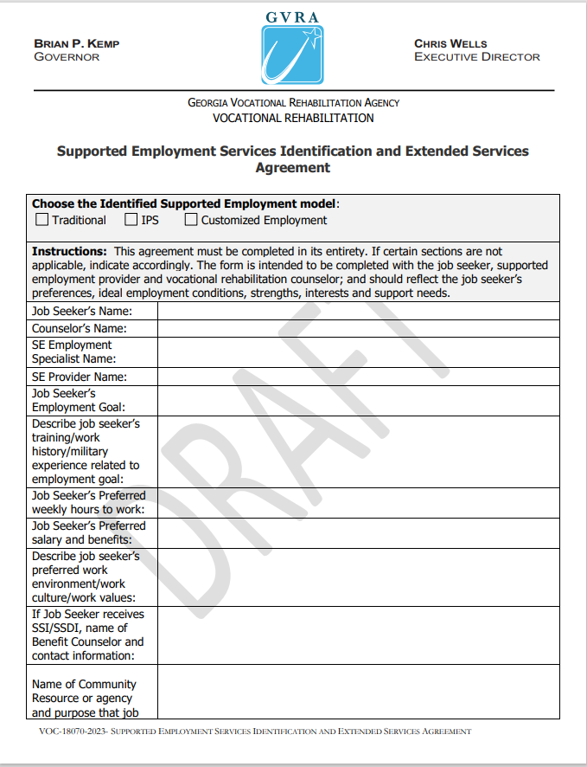
Notes:
SHOW DOCUMENT ON SCREEN
We have combined the first and last report into one, for two reasons:
1. We must identify the extended supports up front. We must stretch, in some cases, to identify who this will be, particularly if our only choice is natural. We need verification that person is willing to take on this role and the source of extended services is named in this report.
2. The purpose of the Extended services plan was for the provider to describe what they would do. That is no longer the case. They are out of the picture. Even if it is the same provider (waiver), that provider no longer reports to GVRA about their activities.
This SE Identification and Extended Services Agreement should be written by the GVRA counselor in collaboration with the Provider and Individual. The counselor will incorporate statements from the provider and the individual. It will be individualized every time. This is where you identify the extended supports source BY NAME. there is a meeting between all parties to finish the development of this agreement, and to discuss the supports that are needed. The provider needs to understand up front what is needed and what is expected and if they don’t feel they can provide this level of support, that is the time to decline. With SE, no extra job coaching will be paid and the case will not be rushed into the next phase.
List a real job goal, an actual job. One single job. Only one. And it must match the plan

Slide 20
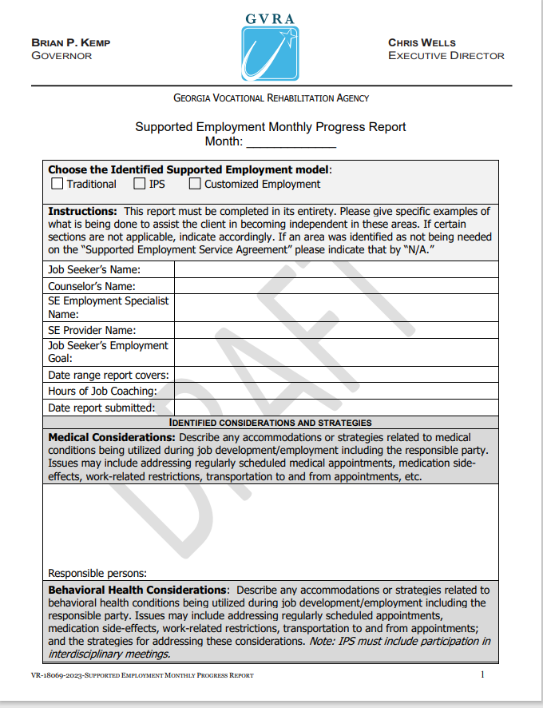
Notes:
SHOW DOCUMENT ON SCREEN
The monthly report has not changed.
It must be detailed, must be individualized, and must report on progress toward the goals initially identified. The counselors are told to turn the report back if this does not happen. It is more important than ever to document progress toward stabilization, document problems and how they were resolved, document that a person is ready to be successful with less active supports going forward
Do not move to the next phase if there are no reports. The reports are the justification as to why the case moves to the next phase.
Document progress and setbacks. If you come asking to repeat a phase, it will help to have monthly reports documenting everything you already tried, and what happened.

Slide 21
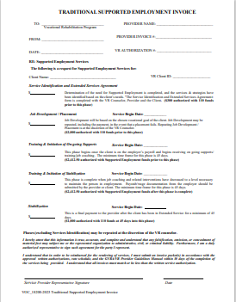
Notes:
SHOW DOCUMENT ON SCREEN
In all types of SE, the GVRA counselor is the one with the final word on when to move to the next phase. They have the judgment and authority, and they should be meeting & Communicating regularly with the individual and with the provider about progress. Monthly reports must be in place to help with documentation. If a counselor is not talking to you, call their supervisor, or call the supported employment coordinator. There has to be communication between all parties. The individual is a GVRA client as well as the provider client, a counselor can and will talk to them separately from the provider, if appropriate.
Now, more than ever, it is crucial for an individual to be truly stabilized when they enter that phase.
These are the minimum time frames. SE can go on for 24 months, starting with first day of employment. If the person is still in need of intensive supports, this case will not move forward on the minimum time frame and there can be no expectation that it will.
Time frames are not different. They are readjusted and moved around. Total money is the same, just moved around. The final $1000 is tied to the person’s successful employment. It is important the the jobs being developed/negotiated are a job the individual really wants, and is truly suited to their situation, and that they have adequate time to become trained and comfortable in this.
In all of the SE types, there is a payment built on the end. If that individual moves into stabilization, is truly ready, and remains employed, then GVRA will issue a final payment to the provider, from 110 funds, not from SE funds.

Slide 22
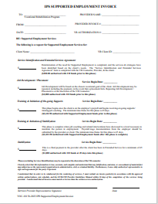
Notes:
SHOW DOCUMENT ON SCREEN
IPS invoice is just like the one shown prior. The times are not different, just adjusted. The money is not different, just rearranged.

Slide 23
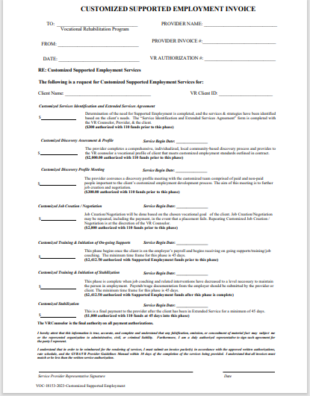
Notes:
Again, this is like the two prior invoices. This is a good point to mention Discovery. Everyone who has taken ACRE no matter the source (Marc Gold or Griffin Hammis) knows what Discovery is supposed to contain and what the report should look like. It happens on the person’s turf. Multiple interviews of different people, from different settings, are included. Pictures are often part of this. Often a visual resume is included. Direct quotes from the person are included. Very specific job negotiations & creations are recommended. Hours/availability needs to be addressed at this juncture. Any specific restrictions needs to be mentioned now. If the report is not appropriate, the counselors are being instructed to turn it back for revision. As we go forward, we are looking at fidelity guidelines for Customized Supported employment in GA, and fidelity administrators are being brought in as part of our SWTCIE grant. All of this is to strengthen the service of CSE, make sure it is true to the original principles, and delivered as intended for the individuals.

Slide 24
Questions? / Comments?

