Slide 1

2023 Quarterly Provider Information Forum
Sheila Pierce, Director of Program Support
Sheila.pierce@gvs.ga.gov or Sharon.hall@gvs.ga.gov

Slide 2

Provider Forum
Agenda Items
9:00 – 9:15 Room Open / Arrival
9:15 – 9:30 Welcome (Chris Wells)
9:30 - 10:00 Pre-Employment Transition Services (Jeff Allen)
10:00 – 10:20 Client Services (Jennifer Howell)
10:20 – 10:40 Provider Update Report (Sheila Pierce)
10:40 – 11:00 Break
11:00 – 11:30 Roosevelt Warm Springs and Cave Springs (Dennis Medders &
Elizabeth Watts)
11:30 – 11:50 Supported Employment (Sharon DeMille)
11:50 - 12:00 Provider Questions (Sheila Pierce)
12:00 – 1:00 Networking: Meet District Representatives

Slide 3
Provider Forum
Welcome
Chris Wells, Executive Director
Chris.Wells@gvs.ga.gov or Arlene.Fowler@gvs.ga.gov

Slide 4
Georgia Vocational Rehabilitation Agency
Agency Updates – Strategic Planning
Agency Mission: Empowering Georgians with disabilities to live independent lives.
Agency Vision: To build a client-focused agency that partners with the community to expand opportunities for Georgians with disabilities.
Agency Core Values: Collaborative, Compassion, Integrity, Innovation, and Service

Slide 5
Georgia Vocational Rehabilitation Agency
Agency Updates – Strategic Planning
Improve recruitment and retention
Continual process improvement
Improve Service Delivery
  Increase the number of Individuals Served
  Improve efficiency and effectiveness of services
  Increase focus on customer satisfaction
Enhance partnerships
  Increase collaborative partnerships with providers
  Increase collaborative partnerships with state agencies
  Increase collaborative partnerships with other stakeholders
Investment in Infrastructure

Slide 6
Georgia Vocational Rehabilitation Agency
Agency Updates – Strategic Planning

Slide 7
Georgia Vocational Rehabilitation Agency
Agency Updates – Strategic Planning

Slide 8
Georgia Vocational Rehabilitation Agency
Agency Updates – Key Initiatives
Disability Innovation Fund - Subminimum Wage to Competitive Integrated Employment (SWTCIE)
  Federal Grant to Move 14C holders into competitive integrated employment
Revamped Residential Services
  Nonpublic Postsecondary Education Commission (GNPEC)
  Six certification programs
Restrictive Policy Initiative
  Removing restrictive policies to include financial needs
Shepherd Center
  Partnering to transition clients from Shepherd into VR
Georgia Academy for the Blind
  GVRA is in the second year of a dedicated counselor at GAB

Slide 9
Georgia Vocational Rehabilitation Agency
Agency Updates – Key Initiatives
Georgia Pathways or Expansion
  During the 2019-2020 Regular Session, the Georgia General Assembly passed Senate Bill 106, the Patients First Act, which authorized the Department of Community Health (DCH) to submit a Section 1115 Demonstration waiver to the Centers for Medicare & Medicaid Services (CMS) which may include an increase in the income threshold up to a maximum of 100% of the Federal Poverty Level (FPL)
  Georgia Pathways, creates an opportunity for Georgians between the ages of 19 and 64 up to 100% of the FPL, who are not otherwise eligible for Medicaid, to gain access to affordable, quality healthcare
Bobby Dodd Bridge Academy
  Cisco Certified Support Technician (CCST) Cybersecurity certification is your way to mastering entry-level cybersecurity concepts and topics.
Tommy Nobis Center
  Academy is an Accelerated Vocational Training Program that will provide the education, training, and life skills young adults with disabilities need for successful employment.

Slide 10
Georgia Vocational Rehabilitation Agency
Agency Updates – Prospective Initiatives
Disability Innovation Fund - Pathways
  GVRA applied for a second grant as a collaboration with the Centers for Independent Living, Georgia Department of Education, and Local School Systems to offer pre-vocational rehabilitation services to middle and high school students.
Project Search in Cave Spring Center
  Fully funded by GVRA
  Potential to allow for first residential project search in year two
IPSE Grant
  Potential opportunity to increase funding through a federal match with adjustments that align with vocational services requirements

Slide 11
Georgia Vocational Rehabilitation Agency
Agency Updates – Challenges
Education and Training
  Vocational Rehabilitation Services
  Employment Goals
Balancing pre-vocational rehabilitation services
  Life skills
  Equipment
  Assistive Work Technology
Balancing Local Education Agency Needs

Slide 12
Policy and Compliance Services Updates
Pre-Employment Transition Services
Jeff Allen, Director of Policy and Compliance
Jeff.Allen@gvs.ga.gov or Harriett.young@gvs.ga.gov

Slide 13
Georgia Vocational Rehabilitation Agency
Goal: Serve More Students
GVRA is required to spend 15% of its federal draw down on Pre-Employment Transition Services:
Provider Assists in 5 Required Areas
  Job Exploration Counseling
  Work-Based Learning Experiences
  Postsecondary Education Opportunities
  Workplace Readiness Training
  Instruction in Self-advocacy
Rough estimate for the amount Georgia must reserve for Pre-ETS (based upon the ability to drawdown the total 110 allotments): $14-$15 million
Estimated 90,000 students with a 504 or IEP

Slide 14
Georgia Vocational Rehabilitation Agency
PRE-ETS Progress

Slide 15
Georgia Vocational Rehabilitation Agency
Strategies: Serve More Students
Focus on serving more in each school across all disabilities
  Know your population
  Review Provider Manual for opportunities that fit your audience
Providers leveraging relationships with the schools to help gain access to more students
  Partner with other providers
  Communicate with local staff of events and schools you are speaking with
  After-School/ Weekend opportunities.
Joint outreach by promoting PRE-ETS partnership with GVRA
  Does the school or parents know that this is a public/private partnership
  Are we using GVRA logos or communicating the impact of funding opportunities?

Slide 16
Georgia Vocational Rehabilitation Agency
Strategies: Challenges
The 15% reserve doesn’t factor in cost-saving measures.
Some of the Pre-ETS costs require manual data entry by field staff and have been underreported
Administrative functions related to Pre-ETS are not allocable and can be time-consuming.
Participation in some Pre-ETS activities requires additional tasks on local educators at a time when they are also facing staff shortages
Reporting Requirements
  Case Management System
  Federal Requirements

Slide 17
Georgia Vocational Rehabilitation Agency
Provider Statistics
Fiscal Year | Students | Providers | Students Per Provider | Expenses | Cost Per Student
FY 2018 | 2,111 | 67 | 32 | $2,135,285 | $1,012
FY 2019 | 5,179 | 77 | 67 | $7,956,582 | $1,536
FY 2020 | 3,438 | 67 | 51 | $4,152,601 | $1,208
FY 2021 | 945 | 33 | 29 | $797,810 | $844
FY 2022 | 4,003 | 48 | 83 | $3,371,962 | $842
FY 2023 | 5,487 | 44 | 125 | $4,497,338 | $820
FY 2024 (Goal) | 26,250 | 35 | 750 | 13,125,000 | $500

Slide 18
Georgia Vocational Rehabilitation Agency
Section 107 of the Rehabilitation Act
Section 107 of the Rehabilitation Act requires RSA to conduct periodic monitoring of State VR agencies
PRE-ETS 15% allocation will be reviewed annually beginning FFY 2021
For FFY 2021, 39 of 78 VR Combined, General, and Blind Agencies did not meet their 15% requirement under Section 107 of the Rehabilitation Act.
Reporting Period covers the Pandemic
General VR funding can be impacted which impacts all 150 providers
GVRA is on track to meet its 15% allocation for FFY 2022 which ends September 30, 2023 (due to two year grant cycle)

Slide 19
Client Services Updates Report
Jennifer Howell, Director of Client Services
Jennifer.Howell@gvs.ga.gov or erica.shedd@gvs.ga.gov

Slide 20
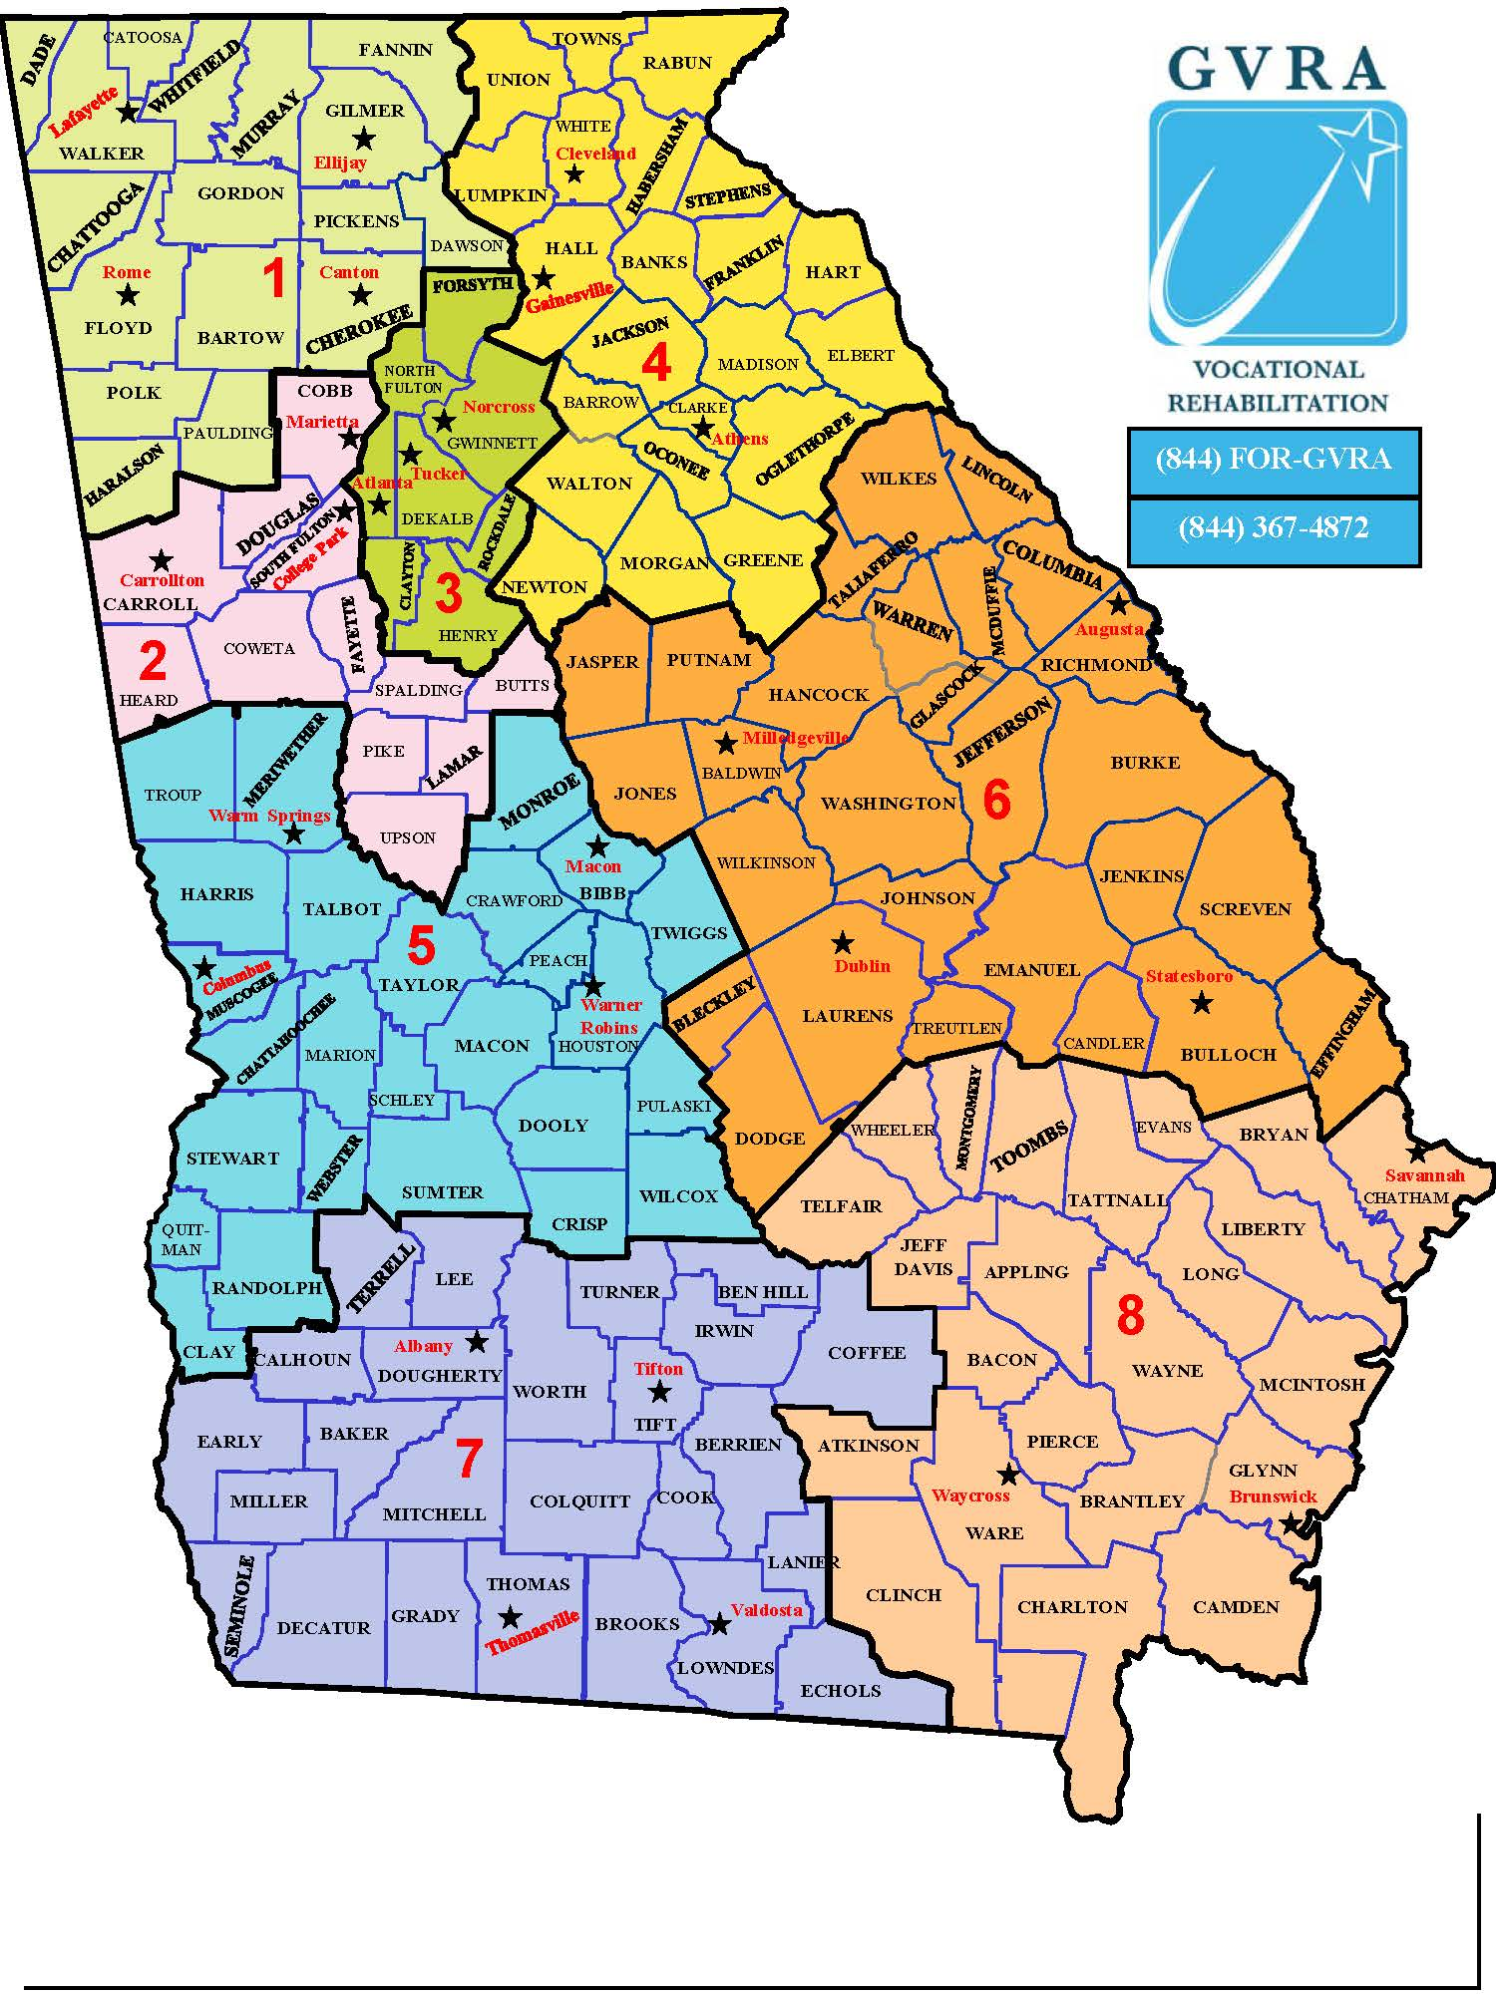
Georgia Vocational Rehabilitation Agency
District Map

Slide 21
Georgia Vocational Rehabilitation Agency
Referrals to the Vocational Rehabilitation program can be sent through the online portal found on the GVRA website at:
GVRA Referral Website (ga.gov)
Individuals can also call our Customer Care line and submit a referral over the phone at:
844-367-4872

Slide 22
Georgia Vocational Rehabilitation Agency
District | District Manager | Offices
1 | Matthew Salmon | Lafayette, Rome, Ellijay, and Canton
2 | Celeste Harris | Marietta, Carrollton, and College Park
3 | Tamika Wright | Atlanta/Piedmont, Tucker, and Norcross
4 | Shari Kaplan | Cleveland, Gainesville, Athens
5 | David McConnell | Warm Springs, Columbus, Macon, and Warner Robins
6 | Lee Davis | Augusta, Milledgeville, Dublin, and Statesboro
7 | Cathy Johnson | Albany, Tifton, Thomasville, and Valdosta
8 | Candace Mims | Savannah, Waycross, Brunswick

Slide 23
Provider Updates
Sheila Pierce, Director of Program Support
Sheila.Pierce@gvs.ga.gov or Sharon.hall@gvs.ga.gov

Slide 24
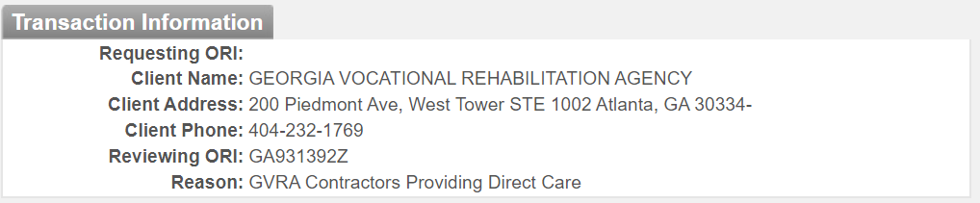
Georgia Vocational Rehabilitation Agency
Provider Updates
Program Reviews
    Through Mid-July we have completed more than 80 this FY
    Purpose is to give you feedback on your contract compliance and client service delivery performance
Background Checks
Changes since we met in April
New provider – FieldPrint effective May 1, 2023
New Rates – effective September 1, 2023, cost for background checks will increase GAPS Fee Change | Applicant Services (state.ga.us)
Remember: Requesting is never GVRA and Reason is always GVRA Contractor

Slide 25
Georgia Vocational Rehabilitation Agency
Provider Updates
FY24 Contracts
July 28, 2023 VR prepares contract documents for Fiscal Services
August 1, 2023 – September 29, 2023, Fiscal Services prepares
documents and routes to providers for review and
signature
October 1, 2023 Deadline for all FY24 agreements to be executed
Changes in the Pre-ETS Agreements: # of students and amounts
Payment Processing
  Must be for an authorized service
  Must be submitted timely
  Must be submitted correctly
    Vendor Portal
    Fiscal Services
Will only process payments for this budget Federal Fiscal Year

Slide 26
Georgia Vocational Rehabilitation Agency
Provider Updates
Current PRS Names and District Assignments
- All providers are assigned to a PRS
- PRSs are providers first-point-of-contact
Role of the PRS

Slide 27
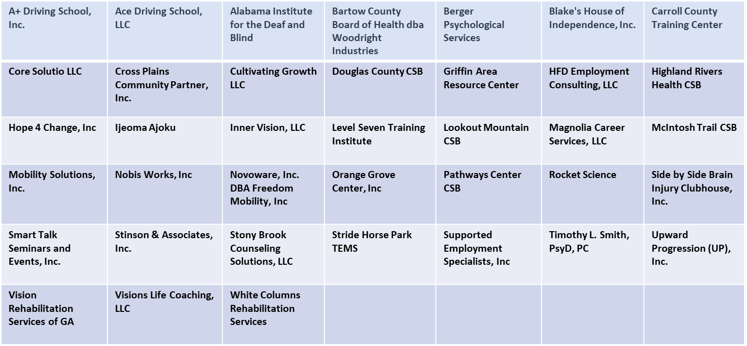
Georgia Vocational Rehabilitation Agency
Provider Updates
  D1 and D2 - Provider Relations Specialist: Ayesha Hussain

Slide 28
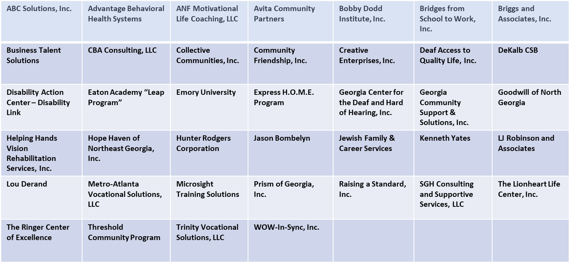
Georgia Vocational Rehabilitation Agency
Provider Updates
  D3 and D4 - Provider Relations Specialist: Della Showers

Slide 29
Georgia Vocational Rehabilitation Agency
Provider Updates
  D5 and D7 - Provider Relations Specialist: Vacant
Albany Area CSB | Annandale at Suwanee | Absolute Quality Interpreting Services | B. Smith Associates, LLC | Behavioral Health Services of South Georgia | Ben Hill Board of Health The Jessamine Place | Connecting Communities and Families, Inc.
Dynamic Learning Centers | Easter Seals Southern Georgia, Inc. | Easter Seals West Georgia, Inc. | Employment Matters of South Georgia | Gainesville Jaycees Vocational Rehab Center, Inc. | G & B Works, Inc. | Generations to Come Center, LLC
Georgia Committee on Employment of People with Disabilities | Georgia Interpreting Services Network | Goodwill of the Southern Rivers | Goodwill Middle Georgia | I Haul Transportation, Inc. | Nathan’s Driving School, Inc. | New Horizons CSB
New Ventures, Inc. | Nova Counseling and Consulting Services, LLC | Oconee CSB | Phoenix Elite Solutions, LLC | River Edge CSB | Shepherd Center, Inc. | The Arc Macon, Inc.
The Arc of Southwest Georgia, Inc. | The Frazer Center, Inc. | The Rehab Center, LLC | Tift County Board of Health | Tree of Life, Inc. | ViewPoint Health | Visually Impaired Foundation of Georgia, Inc.
Wiregrass Resource Group | WizABILITY Group, LLC | Workplace Learning Solutions, LLC

Slide 30
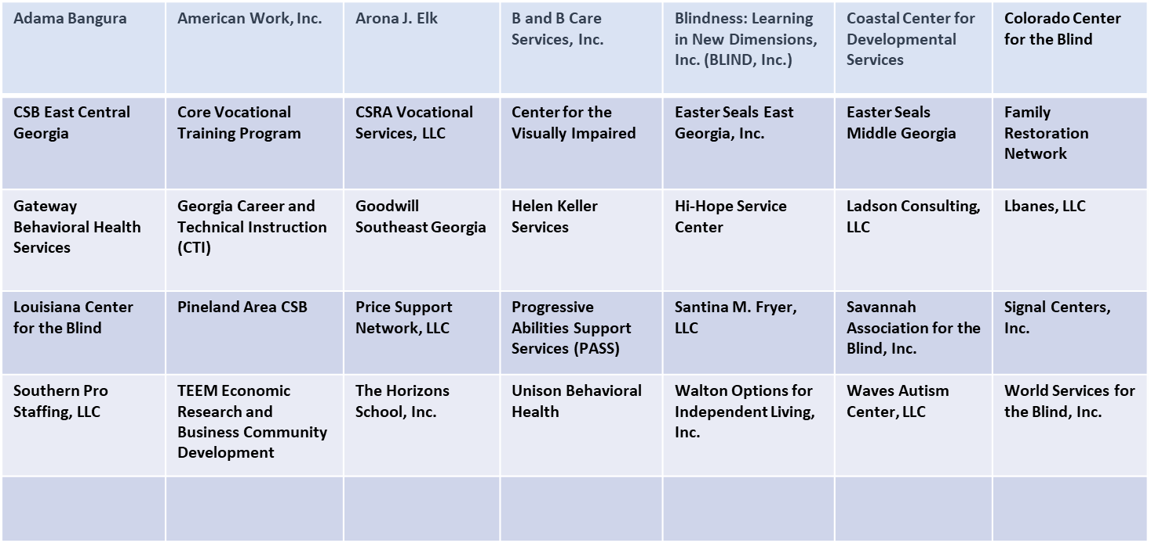
Georgia Vocational Rehabilitation Agency
Provider Updates
  D6 and D8 - Provider Relations Specialist: Courtney Sapp

Slide 31
Georgia Vocational Rehabilitation Agency
Provider Updates
PRS can help you:
If you have a payment problem
If you don’t know the correct way to submit a payment request
If you need more training on using the provider portal
If you need to remove someone or add someone to the portal
If you have a problem contacting a counselor
If you don’t know who to contact about a problem or question
If your local office has assigned a different or new counselor
If you have a question about your Agreement
If you need to make changes to your GVRA vendor profile
If you have a question about the background check process
If you want to add a service or delete a service from Agreement
If you have a question about your program review
If you want to know the status of an amendment to your agreement, etc.

Slide 32
Georgia Vocational Rehabilitation Agency
Provider Updates
Provider Report Cards implementation FY24
Goal:
- Increase the number of participants we serve
- Provide quality services to all participants
Evaluation Indicators:
  Number of participants served: Potentially Eligible Students & VR Clients
  Number of services delivered
  If VR Client -
  Employment Outcomes of VR Clients Receiving Service within FY
  - Wages, Weekly Hours, & Benefits
  - Employment Rate
  Client Satisfaction Rate

Slide 33
Georgia Vocational Rehabilitation Agency
Provider Updates
Provider Reminders
1. Quality services for participants is our priority
2. Timeliness is very important
Payment request submittals (30 days)
Referrals to include pre-ets
Privacy forms plus online registration to get GVRA Letter
3. Processes must be followed:
Authorization required before starting any work
Only payment requests with valid authorizations are paid
Only staff authorized by Agency can provide services
Must include proof of client participation with payment requests
4. If in doubt:
Contact PRS
Follow instructions: Agreement, Provider Guidelines Manual, Quarterly Meetings
5. Building Partnerships

Slide 34
Break
20 - Minutes

Slide 35
Residential Services
Dennis Medders, Residential Director
Dennis.Medders@gvs.ga.gov

Slide 36
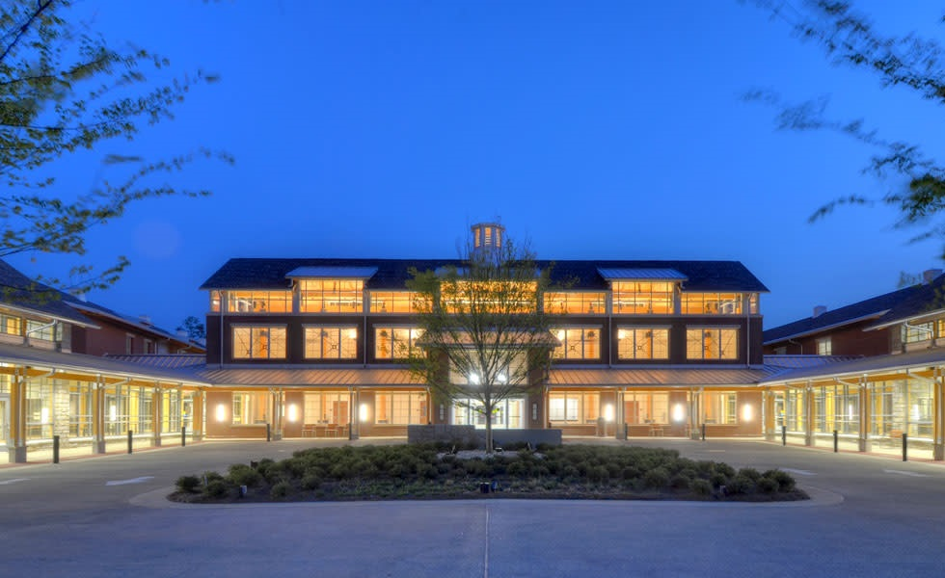
Roosevelt Warm Springs

Slide 37
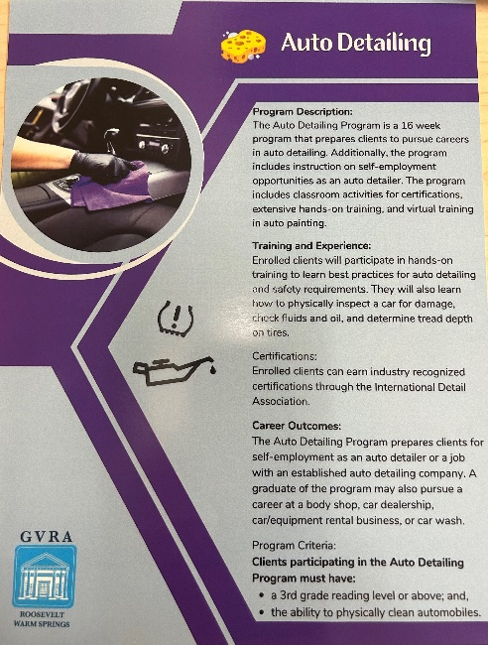
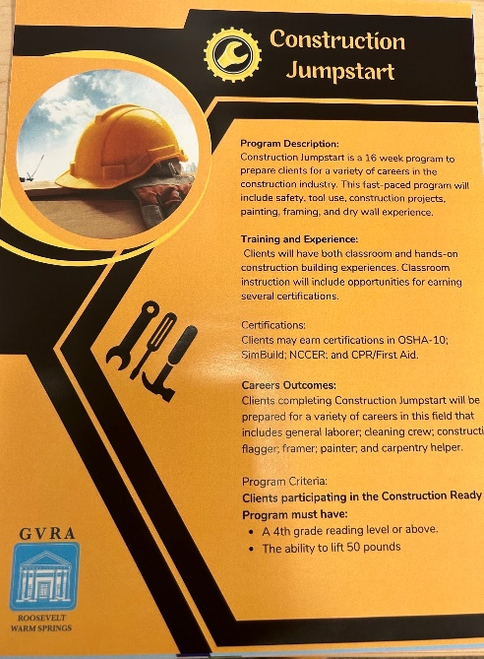

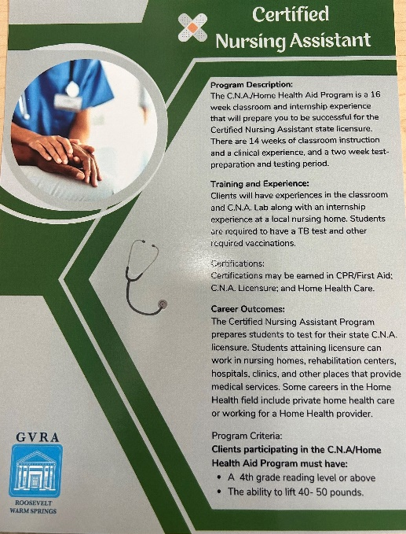
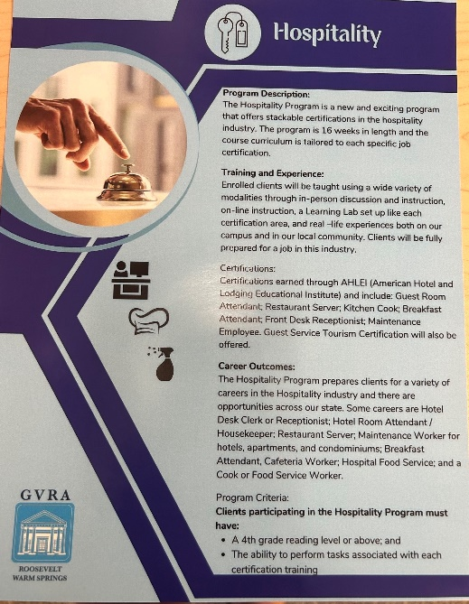

Pathway Options

Slide 44

Application
Fall 2023

Slide 45
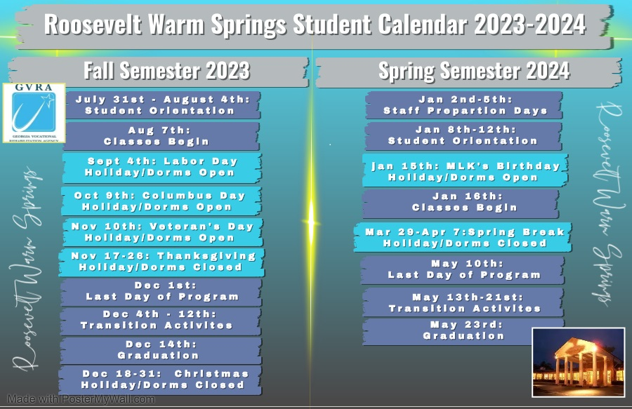

Slide 46
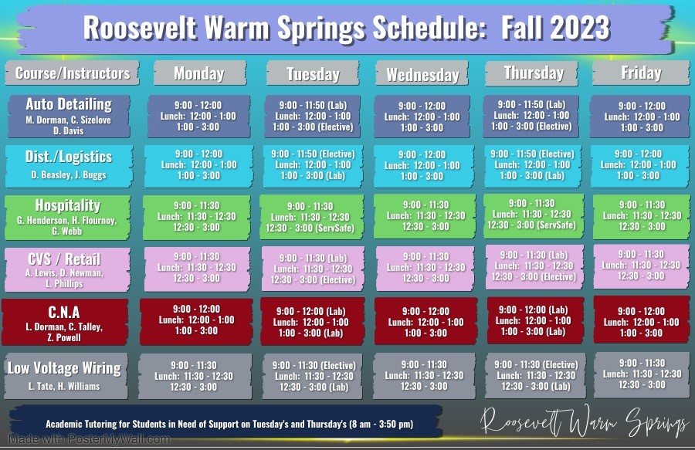

Slide 47
Dorm Life

Slide 48
Center for Therapeutic Recreation

Slide 49
Center for Therapeutic Recreation

Slide 52
Policy and Compliance Services Updates
Supported Employment
Sharon Demille, Supported Employment Coordinator Sharon.Demille@gvs.ga.gov or Harriett.young@gvs.ga.gov

Slide 53
Georgia Vocational Rehabilitation Agency
Supported Employment
Supported Employment is competitive integrated employment for individuals with the most significant disabilities for whom such employment has not traditionally occurred, or as the result of a significant disability, requires intensive support services along with extended follow up for the life of the job in order to achieve and maintain meaningful employment.

Slide 54
Georgia Vocational Rehabilitation Agency
Supported Employment
Types of Supported Employment
  Traditional Supported Employment (TSE)
  Customized Supported Employment (CSE)
  Individual Placement and Supports (IPS)

Slide 55
Georgia Vocational Rehabilitation Agency
Supported Employment
I.P.S. is ….
Individual Placement and Supports (IPS)- is an evidence-based model of supported employment for people with serious mental illness. The IPS approach assumes everyone can work with the right supports. The person decides when and how they want to work.
There are no prerequisites (work adjustment, pre-vocational, sheltered, enclave, work evaluations or otherwise).
IPS SE has been researched and proven to get higher rates of employment for people with severe and persistent mental illness.

Slide 56
Georgia Vocational Rehabilitation Agency
Supported Employment
Customized employment (CE) refers to competitive integrated employment, for an individual with the most significant disability, that is based on an individualized determination of the strengths, needs, and interests of the individual with a significant disability, is negotiated to meet the specific abilities of the individual and the needs of the employer, and is carried out through flexible strategies.

Slide 57
Georgia Vocational Rehabilitation Agency
Supported Employment
Proposed Policy Changes that Impact Supported Employment
At this point, these changes are proposed only.
These changes will necessitate changes in procedures also
All proposed changes are in line with Federal Regulations for Supported Employment

Slide 58
Georgia Vocational Rehabilitation Agency
Supported Employment
Proposed Policy Changes that Impact Supported Employment
Supported Self Employment
  This is a type of CSE
Extended Services
  Continue to be required for the duration of the job, the change will be who delivers this service

Slide 59
Questions

