Slide 1
Day at the Braves
June 30, 2024
GROW rate of $1750 will be used for each student- to get students there, provide them with food and a curriculum for the bus ride on financial literacy (work-place/Self-advocacy)
Providers will bus students to stadium
State Road and Toll Way Authority (SRTA) staff will conduct travel training to the students prior to entering stadium (workplace readiness)
Starting at 9:30 students will enter the stadium
At the stadium prior to the game the Braves have assembled a panel that will talk with the students about various jobs at the stadium (job exploration)
Students will be able to enjoy the Braves game
Logistics still in the works
Notes:
Move referral to Application Status in AWARE – If self-referral or if C has communicated with individual and they want to apply. Not just if referral is received and contact letter is sent for intake appt.

Slide 2
GROW Planning for Summer 2024
start pulling together plans and marketing them to the local VR offices
If the same students from last year plan to attend this year, the session needs to be different than last year
Notes:
Move referral to Application Status in AWARE – If self-referral or if C has communicated with individual and they want to apply. Not just if referral is received and contact letter is sent for intake appt.

Slide 3
Students with a Disability RSA 911 SWD Reporting as of 10/30/23 for the 2nd quarter beginning 10/1/23, SWD count includes VR & PTS cases who met criteria, District 6 GA DOE pop includes 616 students in D8 Counties per district map

Slide 5
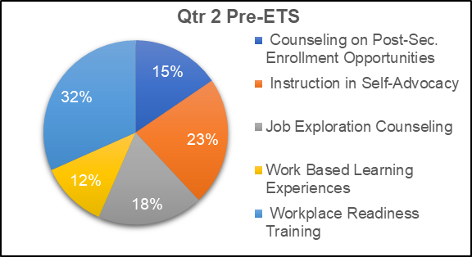
Qtr 2 Pre-ETS
Notes:
Expedite the VR case process……

Slide 6
SFY24 Pre-ETS Authorization Payments as of 10/31/23: $993,410 Notes: Payment amounts based on Issue Date and Payment sent to Accounting System Date occurring on or after July 1, 2023 SWD Reported on RSA 911 Receiving a Pre-ETS as of 10-30 -23: QTR 1: 36% QTR 2: 29.4% ( up from 25.4%)

