Slide 1
Georgia Vocational Rehabilitation Agency
April 24, 2024
Provider Information Forum
Provider & Strategic Relations Management
providermanagement@gvs.ga.gov

Slide 2
Provider Information Forum Agenda
10:00 AM – 10:05 AM Welcome & Introduction of Newly Structured Teams
10:05 AM – 10:45 AM Program Updates from Provider & Strategic Relations
Provider & Strategic Relations Team/Responsibilities
Braves Game Day
GROW Updates
RWS Fall Registration
Provider and Client Complaints Process
Critical Incident Reporting
Prospective Providers Website Changes
Background Check-Idemia & Security USA LLC
10:45 AM – 11:15 AM Fiscal Compliance Updates
Fiscal Compliance Team/Responsibilities
Program and Fiscal Reviews
Provider Management Website Changes
11:15 AM – 12:00 PM Small Group Discussion
Breakout to respective District Room

Slide 3
Provider Management
Jeff Allen
Provider & Strategic Relations Administrator
Courtney Sapp
Provider Relations Specialist

Slide 4
Provider Management Responsibilities
Conduct provider forums (state and local).
Recruit and onboard new providers.
Assist with programmatic related Provider issues.
Host provider trainings.
Program oversight of partnerships with the Centers for Independent Living.
Assist with Program oversight of the Older Blind Program.
Manage MOUs with other strategic partners such as (DJJ, DBHDD, DOE).

Slide 5
GVRA Day At The Braves
GAME DAY
SUNDAY, JUNE 30, 2024
GAME TIME
1:35PM
PARTICIPANTS
RATE
LOCATION
ATLANTA BRAVES TRUIST PARK
2000 STUDENTS CAN PARTICIPATE
ALL INCLUSIVE RATE
$1750 PER STUDENT

Slide 6
ALL INCLUSIVE RATE - $1750 PER STUDENT
Snacks to/from Truist Park
T-Shirts for Students
Transportation Fees
Lodging (if required)
Parking at Truist Park ($50-$75)
Speaker on Bus
Interpreter
Transportation

Slide 7
Additional Information
GVRA will cover the cost of the tickets to the game.
Each Ticket includes an additional $20 value for food at the ballpark.
GVRA will cover the ticket of one Chaperone. Any additional chaperone ticket may be purchased through the below link. Tickets are set back specifically for our event, so you do not have to rush to purchase. There isn’t a 100% guarantee the tickets will be near your students, but the Braves and GVRA will work together to try and get them as close as possible.
https://fevo-enterprise.com/Gvra
Parking can be purchased by contacting Isabel de Armas with the Braves
Isabel.deArmas@braves.com
404-614-1421
All groups will report directly to the Braves Stadium, Drop off will be outside of the 3rd Base Gate.
More to come on pickup information

Slide 8
GAME DAY ITINERARY
Bus or transportation depart:
Location and time to be determined by each provider
9:30 am Gates open for GVRA students
10:15 am Panel starts
11:00 am Q&A open to the audience
11:15 am panel ends and students released to go to seats and grab lunch
1:35 pm Game Starts
5:00ish Game Ends and students board buses to return to pickup locations

Slide 9
PROCESS FOR APPROVAL
Attendance support for GVRA approved potentially eligible students only
Providers should submit names of students to the local GVRA office no later than Friday May 3rd for consideration
If not already a PTS case need PPF and IEP/504
GVRA Local office staff will provide approval or denial by May 17th for any student referred
Providers will have from May 17th to June 28th to finalize plans for approved students

Slide 10
GVRA GROW Updates
Getting Ready for Opportunities In Work
19 of 37 approved providers have submitted dates for GROW sessions
There are 157 tentative sessions
Continue to plan sessions and submit to Provider Management inbox

Slide 11
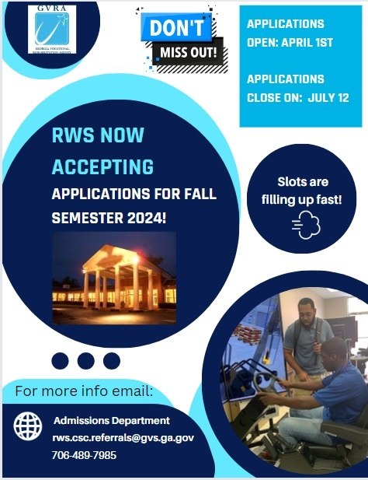
Roosevelt Warm Springs
Fall Registration

Slide 12
Complaint Process
This process is for when CLIENTS have a compliant against a Provider.
New Process will go live on 5/1/2024.
Notification
Investigation of Complaint
Outcome of Investigation
Appeal
Probation, Suspension, and Termination of a Provider
Notes:
A. Notification:
Client contacts their Counselor or Counselor’s Supervisor.
Counselor or Counselor’s Supervisor fill out the GVRA Client Complaint Form
Forward the GVRA Client Complaint Form to the DM and the Provider and Strategic Relations Administrator
If Provider committed abuse, fraud, neglect, or discrimination refer to Director of Policy and Compliance and the General Counsel’s Office immediately.
Provider will be notified within 5 business days about the complaint.
B. Investigation of Complaint
1. Allegation investigated within 10 business days:
Interview client.
Interview provider’s director.
Notify Provider that client is dissatisfied.
Ask Provider to call to discuss.
If no response from provider, follow-up within 7 days.
Interview GVRA staff.
Interview other individuals identified during investigation.
Review supporting documentation provided by client and provider.
2. If discrimination, suspend service to Client and discuss alternative service delivery.
If the allegation related to abuse/neglect, suspend service delivery to all clients.
Notify appropriate licensing or legal authorities.
Discuss alternative service delivery to client.
Communicate decisions to client, staff, and provider(s).
C. Outcome of Investigation
Forward the conclusion to the Director of Program Support.
If complaint has merit, ensure that recommendations are within business and legal parameters.
Service Provider will be notified in writing of the outcome.
Letter to client regarding outcome and decision
Final determination/notification placed in the separate complaint files (provider and client).
Final recommendation(s) sent to all VR staff as appropriate.
D. Appeal
If provider chooses to appeal decision or corrective action plan, this appeal will be reviewed.
Consultation with the Office of General Counsel to render a decision.
The decision will then be communicated to senior GVRA leadership.
E. Probation, Suspension, and Termination of a Vendor
If provider is found to have committed violations, provider will be subject to sanctions.
Sanctions may include probationary continuation, suspension for a discretionary period of not more than thirty (30) days, or termination (absolute or limited time).
During probationary and suspension periods, or during negotiations, a temporary replacement of provider may be considered.

Slide 13
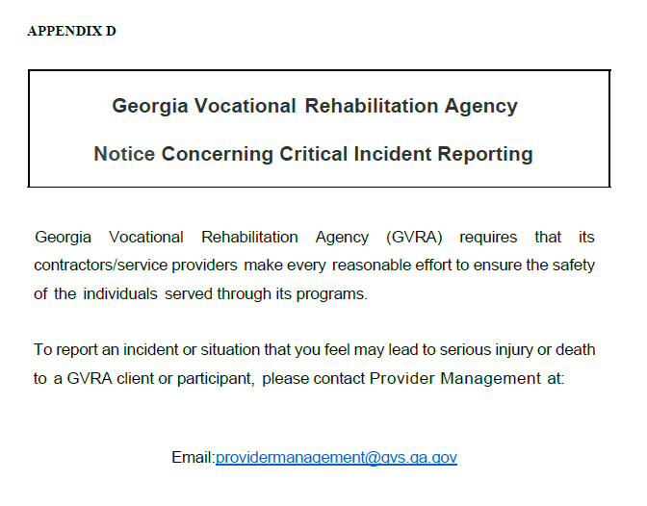
CRITICAL INCIDENT REPORTING
Provider has the responsibility for ensuring the health and safety of all GVRA clients/participants served are not placed in any jeopardy. The Provider shall be responsible for implementing an effective response system when critical incidents occur. This responsibility includes, but is not limited to, any and all subcontractors employed by the Provider to provide services pursuant to this contract.

Slide 14
Prospective Providers Website
GVRA welcomes interested providers to join our network of service providers to support Georgians with disabilities.
We have established an open enrollment period for new providers.
April 1st-June 15th annually.
Interested providers who want to become an authorized provider should email ProviderManagement@gvs.ga.gov.
New Webpage for Prospective Providers
https://gvs.georgia.gov/vocational-rehabilitation/prospective-providers

Slide 15
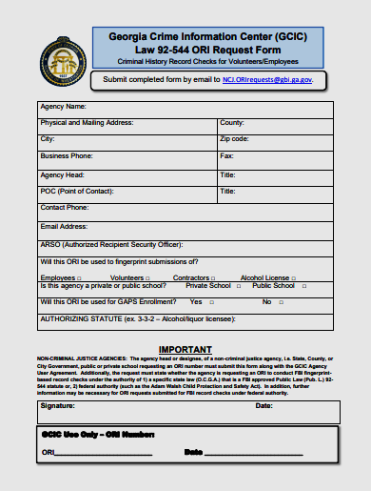
New Background Check Vendor
GVRA will be transitioning to a new background check vendor Idemia & Security USA LLC (Idemia) on or before July 1, 2024
For further details you can visit: https://gcicweb.gbi.state.ga.us/
If your agency does not have an ORI Number, you can complete the ORI Request Form provided on the website above

Slide 16
Georgia Vocational Rehabilitation Agency
April 24, 2024
Fiscal Compliance
Fiscal Operations
providermanagement@gvs.ga.gov

Slide 17
FISCAL COMPLIANCE TEAM
TAWNYA REID
FISCAL OPERATIONS SUPERVISOR
AYESHA HUSSAIN
DISTRICTS 1 & 2
DELLA SHOWERS
DISTRICTS 3 & 4
BALAJI NEKKANTI
DISTRICTS 5 & 7
BETTY MCCANTS
DISTRICTS 6 & 8

Slide 18
AYESHA HUSSIAN DISTRICTS 1 & 2
Ace Driving School LLC | Alabama Institute for the Deaf and Blind | Blake’s House | Carroll County Training Center
Core Career (NSITE) | Core Solutio LLC | Cross Plains Community Partner Inc | Cultivating Growth LLC
Deaf Access to Quality Life Inc | Douglas County Community Service Board | Griffin Area Resource Center | HFD Employment Consulting LLC
Highland Rivers Health Community Service Board | Hope 4 Change Inc | Lookout Mountain Community Service Board | McIntosh Trail Community Service Board
Nobis Works Inc | Freedom Mobility Inc | Orange grove Center Inc | Pathways Center Community Service Board
Raising A Standard Inc | Rocket Science | Stinson & Associates | Stride Horse Park TEMS
Turning Point | Vision Rehabilitation Services of GA | White Columns Rehabilitation Service

Slide 19
DELLA SHOWERS DISTRICTS 3 & 4
Advantage Behavioral Health Systems | ANF Motivational Life Coaching LLC | Avita Community Partners | BlazeSports America
Bobby Dodd | Bridges from School to Work Inc | Briggs & Associates Inc | CBA Consulting
Collective Communities Inc | Community Friendship Inc | Core Inc | Creative Enterprise
Eaton Academy | Georgia Center for the Deaf and Hard of Hearing Inc | Georgia Community Support & Solutions Inc | Goodwill of North GA
Hunter Rodgers Corp | Inner Vision LLC | Jason Bombelyn | Jewish Family & Career Services
Kenneth Yates | LJ Robinson | LBanes LLC | Lou Derand
SGH Consulting & Supportive Services LLC | Side By Side Brain Injury Clubhouse Inc | The Ringer Center for Excellence | WOW In-Sync Inc

Slide 20
BALAJI NEKKANTI DISTRICTS 5 & 7
AmericanWork Inc | Arona J Elk | Legacy Behavioral Health | CSRA Vocational Services LLC
ODATOC | Easter Seals Southern Georgia | Employment Matters of South Georgia | G&B Works
Goodwill Industries of Southern Rivers | Hi-Hope Service Center | Magnolia Career Services LLC | Metro-Atlanta Vocational Solutions LLC
New Horizons Community Service Board | New Ventures | Phoenix Elite Solutions LLC | River Edge Community Service Board
Shepherd Center Inc | Stony Brook Counseling Solutions LLC | Supported Employment Specialists Inc | The Arc of Southwest Georgia Inc
The Rehab Center LLC | Diversified Enterprises | Tree of Life Inc | View Point Health
Visually Impaired Foundation of Georgia | Wiregrass Resource Group | WizAbilitiy Group LLC | Workplace Learning Solutions LLC

Slide 21
BETTY MCCANTS DISTRICTS 6 & 8
B and B Care Services Inc | B Smith & Associates LLC | Coastal Center for Developmental Services | Colorado Center for the Blind
Center for the Visually Impaired | Easter Seals East | Easter Seals Middle | Family Restoration Network
Gateway Behavioral Health Services | Georgia Career and Technical Institute (CTI) | Georgia Committee on Employment of People with Disabilities (HSHT) | Georgia Interpreting Services Network (GISN)
Goodwill Middle Georgia | Goodwill Industries of the Coastal Empire | Louisiana Center for the Blind | MicroSight Training Solution Inc
Prism of Georgia Inc | Progressive Abilities Support Services | Savannah Association for the Blind Inc | Serenity Behavioral Health
Signal Center | Southern Pro Staffing LLC | TEEM | The Lionheart Life Center Inc
Timothy L Smith | WAVES | World Services for the Blind Inc

Slide 22
Financial Compliance Specialist
Contracts
Payment/Billing
Amendment Status
Vendor Portal
Add/Delete Service
Background Check
Program / Fiscal Review
Provider Profile Updates

Slide 23
Program and Fiscal Reviews
Update to the Provider Guideline Manual Contract Monitoring
Format
On-site, virtual desk review, or documentation review
Dates Availability & Staff to be present
Measures
Financial Stability
Financial dependence on federal support
Strength of the program or business management system
History of performance
Adherence to programmatic or fiscal terms and conditions
Timeliness and quality of required reports
Program and participant experience
Commitment to appropriate advocacy roles
Notes:
The provider guideline is being updated to include a comprehensive contract monitoring of both program and fiscal components. It is also being designed to have one monitoring protocols for providers that work across various programs VR/IL/OB
GVRA involved staff will include Contract Administrator to direct the process, Program Coordinators and Fiscal Compliance Team to review identified measures. We ask the provider include relevant staff such as program managers and fiscal managers to be apart of the monitoring process.
The format of the reviews will be On-site visits which are visits to the providers locations. The onsite reviews will be full scope visits based on risk assessment of the contract and will cover a broad range of compliance and performance requirements. The Virtual desk review will be done via Zoom or Teams Calls to include inquires into performance and comparison to rules and regulations. The final format, is documentation review where the provider will submit documents for review. Document Reviews are limited scope typically focusing on a specific matter.
In preparation for the resuming of reviews, FCS will reach out to the selected providers. We ask that you cooperate by providing potential dates and staff who are available and most appropriate to participate.
The Measures to be evaluated are:
Financial Stability: long-term sustainability, create & follow a budget, operating in an efficient manner, funds used in allowable manner
Financial Dependency on Federal support: public funding, GVRA funding solely, other revenue streams-do they align with core business
Strength of the Program or Business Management: The capacity of the provider, provider staffing, IT infrastructure
History of Performance: cooperation/interaction with participants, staff, and other stakeholders. Response to correcting deficiencies as identified
Adherence to program / fiscal terms and conditions: Compliance with Rules and Regulations
Timeliness & Quality of Reporting: Invoices, program year-end reports, case notes, timesheets, supportive documents
Program and participant experience: opportunity to provide feedback both ways, survey of participants, reporting of incidents, complaints, challenges, and success stories
Commitment to appropriate advocacy roles: ensure we are acting in the best interest of the participants.
This is a glimpse in the contract monitoring process. The administration’s hope is to use contract monitoring as an avenue for identify and communicate remedies and corrective actions, to establish expectations, and ensure the VR network is providing the best service to participants.

Slide 24
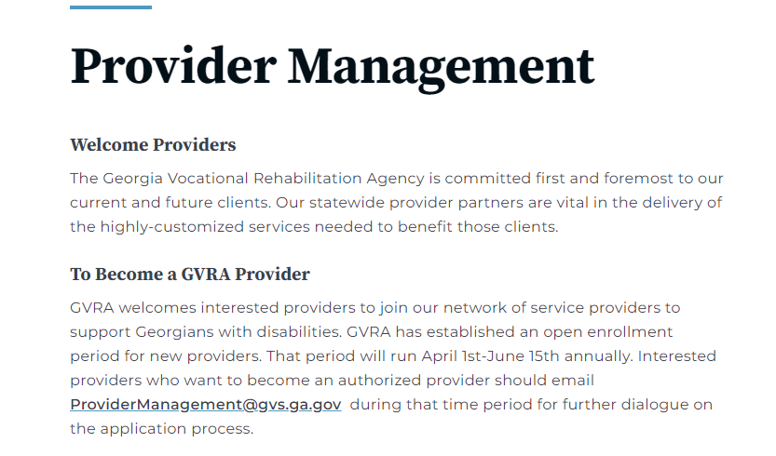
Provider Management Website
The Provider Management website has been updated. Please use the resources that are made available to you on the website. If you can not locate what you are looking for, please reach out to your respective FCS.
https://gvs.georgia.gov/vocational-rehabilitation/provider-management

Slide 25
Break Out Sessions
If you have any questions, please bring them up during this time with your FCS.
Thank you for your time and attention today.
We appreciate all you do for Georgians with disabilities.
GVRA Provider Management

