Slide 1
1st 2023 GVRA Provider Information Forum Wednesday January 25, 2023
10:00 am Welcome and Agenda Overview
10:05 am Provider Staff Background Checks
10:30 am Provider Invoice Packets
Individual Authorizations & Group Authorizations
10:45 am Provider Program Reviews
Meet New PRS (Provider Relations Specialists)
11:00 am Updates and What’s New
11:15 am Group Questions/Information Sharing
11:30 am Adjournment

Slide 2
Provider Background Check Process Sheila Pierce
Program Support

Slide 3
Topics for Today
Why Background Checks are required
Steps to Establish a Provider ORI - Originating Case Identifier
Steps to Register an Employee
Steps to obtain a Personal Background Check Report after being Fingerprinted

Slide 4
1. Why is a Background Check Required?
To be compliant with Provider Service Agreement (K-09)
a. The Contractor agrees that, for the filling of positions or classes of positions having direct care/treatment/custodial responsibilities for services rendered under this Agreement, applicants selected for such positions shall undergo a criminal history investigation which shall include, at minimum, a national and state fingerprint-based criminal history record check pursuant to O.C.G.A. §§ 35-3-34.2 and 35-3-35. Fingerprint record checks shall be submitted through the system established by the Georgia Crime Information Center (GCIC) of the Georgia Bureau of Investigations
b. The Contractor agrees that, pursuant to O.C.G.A. §§ 35-3-34.2 and 35-3-35, GVRA will receive and review the criminal history report of Contactor’s applicants generated through GCIC. Based upon the information contained in the criminal history report, GVRA will provide a letter of fitness to Contractor indicating that the applicant may be involved in or associated with services under this Contract or any aspect that places the applicant within direct care/treatment and/or custodial relationship with a GVRA participant.
c. Contractor shall be required to maintain an updated list of staff members providing direct services to GVRA participants and include a letter of fitness for each staff member in its employee files. Contractor shall provide an updated list of staff members providing direct services to GVRA participants and produce a fitness determination letter for each staff member upon request.
d. Contractor will ensure that any subcontractor used has completed this background check process and met the GVRA criteria to provide direct services to GVRA participants.
e. Contractors providing Pre-Employment Transitions Services (Pre-ETS) agree to be subject to local additional background checks required by their local school districts/or schools where GVRA participants are being served. Contractor understands they are subject to completing such background checks at their own expense.

Slide 5
Criminal Background Checks
Summary
Providers are responsible for ensuring all employees working with GVRA participant complete a background check (State of Georgia and a National check)
Determination letters from GVRA required for each provider employee working with GVRA participant
To satisfy requirement the letter must be from GVRA and not another Agency as other Agencies have their requirements that they screen for
This requirement extends to any subcontractors working with you to deliver services to a GVRA participant

Slide 6
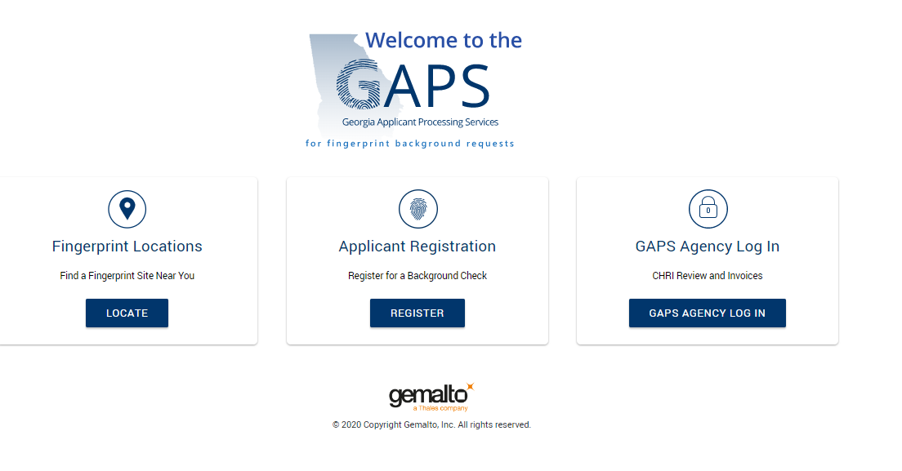
2. Establish a Provider ORI
Link for Registering Individual: GAPS Applicant Processing Service (gemalto.com) in browser enter: https://www.aps.gemalto.com/ga/index.htm then enter

Slide 7
Establish a Provider ORI

Slide 8
Establish a Provider ORI

Slide 9
Establish a Provider ORI – Originating Case Identifier (number assigned to person requesting background check)

Slide 10
3. Register a Provider Employee
Link for Registering Individual: GAPS Applicant Processing Service (gemalto.com) in browser enter: https://www.aps.gemalto.com/ga/index.htm then enter

Slide 11
Register a Provider Employee

Slide 12
Register a Provider Employee

Slide 13
Register a Provider Employee

Slide 14
Register a Provider Employee

Slide 15
Register New Employee
When you complete the registration information correctly, there is no delay
The Registration will come to GVRA electronically as the REVIEWER
By correctly entering your ORI we will know who to send the determination letter to as REQUESTER
Please Note:
Every provider employee working with a VR participant is required to have a background check
Every provider employee required to have a determination letter from GVRA in their employee file no matter how long they have worked for the provider organization
No provider employee can work with a VR participant unless they have a determination letter in advance from GVRA
The required letter must be a GVRA letter and not another State Agency or any other entity

Slide 16
Obtain a Personal Background Report

Slide 17
Obtain a Personal Background Report

Slide 18
Obtain a Personal Background Report

Slide 19
Obtain a Personal Background Report

Slide 20
Obtain a Personal Background Report
These Steps can be followed for an individual to get their personal report
Errors in the report information can be addressed by the individual who the report belongs to
Questions from GVRA about information in the report will be directed to the individual named on the report

Slide 21
Additional Information Required for each applicant Registered – Form must be completed in its entirety, signed - email to: providermanagement@gvs.ga.gov

Slide 22
Additional Information Required for each applicant Registered This information should be given to the employee to read and understand before the process begins

Slide 23
Additional Information Required for each applicant Registered This information should be given to the employee to read and understand before the process begins. It must be signed and submitted to: providermanagement@gvs.ga.gov

Slide 24
Additional Information Required for each applicant Registered

Slide 25
Additional Documents
Forms that need to be signed can not be a typed name but must be signature We do accept an adobe, DocuSign or computer-generated signature. If handwritten it must be legible
Information on Forms must be accurate and 100% match what is submitted in the electronic GAP System Registration
Name Spelling
Date of Birth
Address
If signed documents are not received by the time that the electronic registration is submitted, the electronic registration will not be approved
When there is a discrepancy with the signed documents information and the electronic registration information – the registration will not be approved

Slide 26
Common Errors
Problems encountered resulting in rejection of registration:
Name spelling on privacy documents and GAP System registration not matching
Address on privacy documents and GAP System registration not matching
Birth date on privacy documents and GAP System registration not matching
Listing GVRA as both requestor and reviewer - registration will be rejected
Handwritten signature on privacy documents required, if not handwritten document will be returned
Timing for submitting Privacy documents – They are not submitted when GAP Registration review conducted
Checking the box that the Provider employee is a GVRA Employee

Slide 27
Reminder: Provider Staff Background Checks
Background check results are REVIEWED by GVRA Background Check Unit
Determination letters are issued by GVRA Background Check Unit
If there is a question about information on a criminal report it will take longer to complete the process – be patient
Both Privacy documents and Online Registrations must be accurate and submitted timely
Each provider must have their own ORI
Recap:
GVRA is always the REVIEWER
Provider is always the REQUESTOR
Every electronic Registration must have signed Privacy Documents to be processed

Slide 28
Provider Invoice Packets
Eduardo Martinez
Business Operations Analyst Manager

Slide 29
Group vs Individual Authorizations
Group Authorization
Individual Authorization
PTS cases
(Invoice Packets)
Group Sign-Sheet (include all attendees)
Group Activity Report (include all attendees)
Group Invoice (include all attendees)
Documents Submitted to FiscalServices.gvs.ga.gov
PTS, VR Cases
(Invoice Packets)
Individualized Sign-In/Timesheet
Individualized Activity Report/Progress Reports
Individualized Invoice
Documents Submitted via Aware’s Vendor Portal
Notes:
PDF format

Slide 30
Invoice Requirements (Provider Guidelines Manual)
VR Participant Name
Invoice Number, Provider Name, Address and contact information
VR Authorization Number
Name of Provider staff delivering service
Description of Service Provided (and service code) as Authorized
Date(s) of Service
Start and end time for each individual service participant received
Amount requested for services provided must not exceed the amount of the Authorization
Notes:
Wanted to reinforce

Slide 31
Important Timeframes
Invoices must be submitted no later than 30 days after authorized is completed.
Invoices submitted before authorized services are completed per the issued authorization will not be paid.
Providers must allow up to 30 days for approved invoices to be processed and payment issued.
Reminder: Services must be pre-authorized. If there is an issue with an authorization you have received, please let staff know immediately.

Slide 32
Provider Program Reviews
Sharon Angel
Provider Program Administrator

Slide 33
Program Review Process for FY’23
Who will receive a Program Review/Site Visit for FY’23
Who conducts the Program Review
How much notification is provided
Who is required to attend the Program Review
Where will the Program Review be conducted

Slide 34
How long does the Program Review last
How do you prepare for the Program Review
Client Files
Employee Files
Tour of facility if appropriate
Feedback from VR Counselors

Slide 35
Preliminary findings and observations
Provider may give feedback on process
Written Report Provided within 30 days
Additional questions: send to
ProviderManagment@gvs.ga.gov

Slide 36
Updates and What’s New
Sheila Pierce
Program Support

