Slide 1

10am-12 noon

Slide 2

All things Invoicing with VR
FOSS TEAM
Who is the FOSS TEAM (Fiscal Operations Support Specialist) are the final approver of all payments that are submitted for services rendered with an approved authorization.
Invoicing
Documentation
Timely Payments

Slide 3
Why are we here?
The original sample invoice provided in April 2023 included the invoice, attendance log/sign-in sheet as one document.
What has happened:
Sign in sheet and invoice are being separated and the sample invoice has been deviated from its original purpose
What we Noticed:
It seem after reviewing information being submitted that providers like the idea of having separate documents
The issue
The documents are not supporting one another

Slide 4
Covering The Basics
Invoicing
Accurately Record Services Provided
Document payments due for services rendered
Support Your Invoice
Eliminate confusion by being consistent
Provide clear information to support what is being billed
Avoid Delay of Payments
Send documentation to the correct location
Check on your submitted information

Slide 5
INVOICING

Slide 6
The Invoice
A written agreement of completed services and request for payment.
Key components of Invoicing:
Providers Name/ Remit Address/ Phone number and/or email address
Invoice Date
Invoice Number
Authorization number
VR Contract Service Code and/or Description
Service Date(s)
Units of services, Subtotals for each service and total payment due
Participant Name(s) to whom the service was rendered
Instructor or Facilitator Name
Page numbers if there is more than one page
Please be sure to include all heading information on each pages
Complete the proof of participation section (A&B) of the Attestation Statement also be sure to sign and date. This statement has been provided to us by GVRA legal team and cannot be altered.

Slide 7
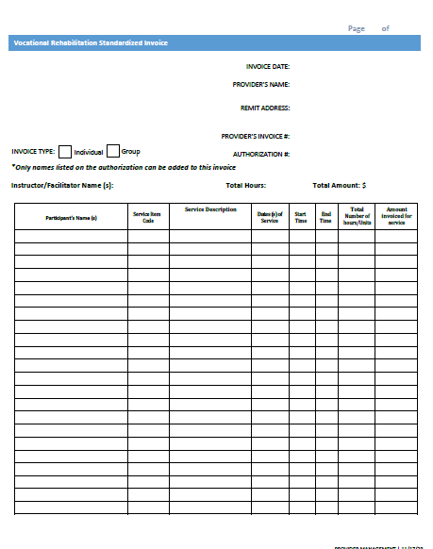
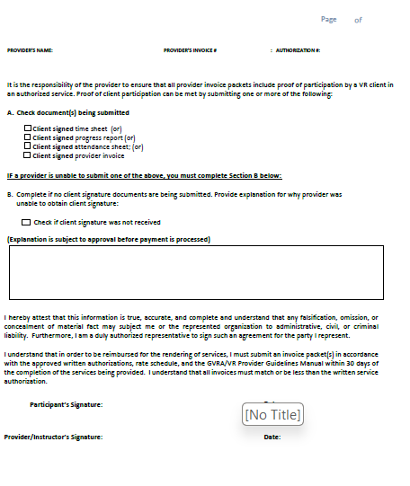
Sample Invoice for Services
https://gvs.georgia.gov/document/document/vr-standard-invoice-fillable/download

Slide 8
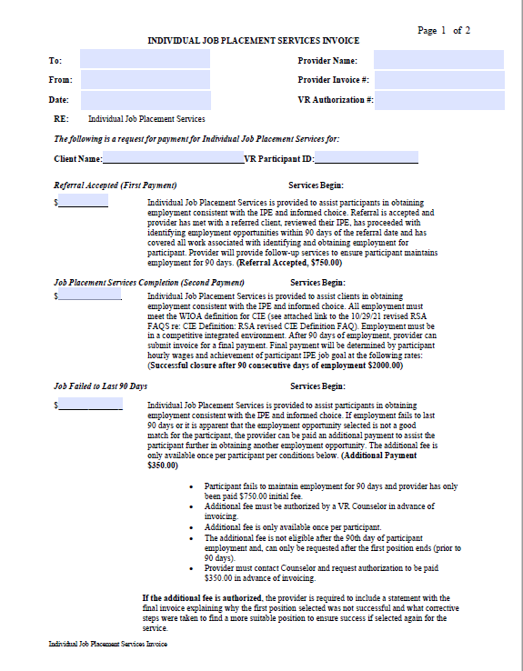
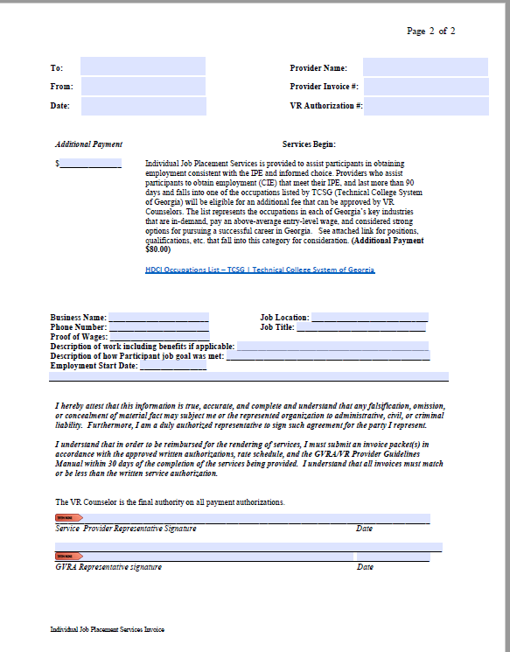
Individual Job Placement Services Invoice
https://gvs.georgia.gov/document/document/individual-job-placement-services-invoice/download (click link)

Slide 9
Support Employment Invoice Old Service Codes
Participants in plan status before 1.31.2024
Receive authorizations utilizing “OLD”SE-Service Codes.
Utilize the “Old” invoices that corresponds with the codes authorized
Participant begin SE services using the old codes and rates they will stay on that same path until case closure.
There should not be any mixing of old and new codes or rates
https://gvs.georgia.gov/document/document/provider-supported-employment-powerpoint-training-11124/download (support employment training 1.11.2024)
https://gvs.georgia.gov/document/document/ips-se-invoice-revised-format-fillable-old-121423/download
https://gvs.georgia.gov/document/document/customized-se-invoice-revised-format-fillable-old-121423/download
https://gvs.georgia.gov/document/document/traditional-se-invoice-revised-format-fillable-old-121423/download

Slide 10
Support Employment Invoice New Service Codes
Participants in plan status after 2.1.2024
Receive authorizations utilizing “NEW” SE-Service Codes.
Utilize New invoices that corresponds with the codes authorized
Participant begin SE services using the new codes and rates they will stay on that same path until case closure.
There should not be any mixing of new and old codes or rates
https://gvs.georgia.gov/document/document/ips-se-invoice-updated-2-12-24-new/download
https://gvs.georgia.gov/document/document/customized-se-invoice-updated-2-12-24-new/download
https://gvs.georgia.gov/document/document/traditional-se-invoice-updated-2-12-24-new/download
https://gvs.georgia.gov/document/document/provider-supported-employment-powerpoint-training-11124/download (support employment training 1.11.2024)

Slide 11
DOCUMENTATION

Slide 12

Support the Invoice
Key Components of Supporting Documentation
Provider’s Name
Location or School Name
Authorization #/Group#/ or Provider Invoice Number
Service Description or Service Code (only one code for each)
Instructor or Facilitator Name(s)
Printed Participant Name and Participant Signature
Date(s) of Service
Start and End time of service
Total number of hours or units provided for each participant
If the attendance/timesheet is more than one page, please be sure to include all heading information on each page(s)

Slide 13
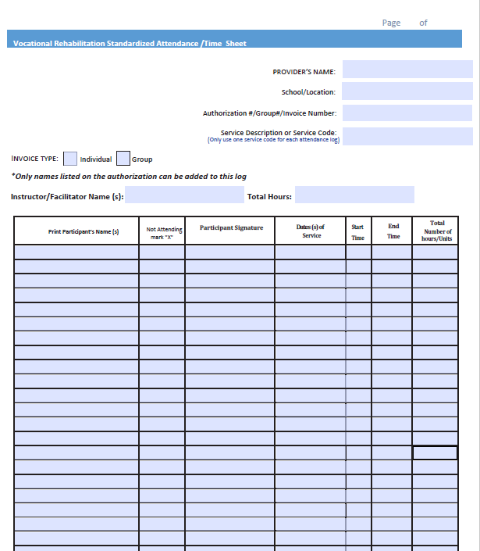
Sample Attendance Sheet/ Time Sheet

Slide 14
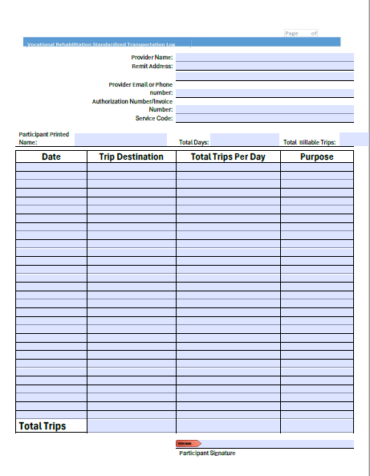
Sample Transportation Log
https://gvs.georgia.gov/document/document/vr-sample-transportation-log/download

Slide 15
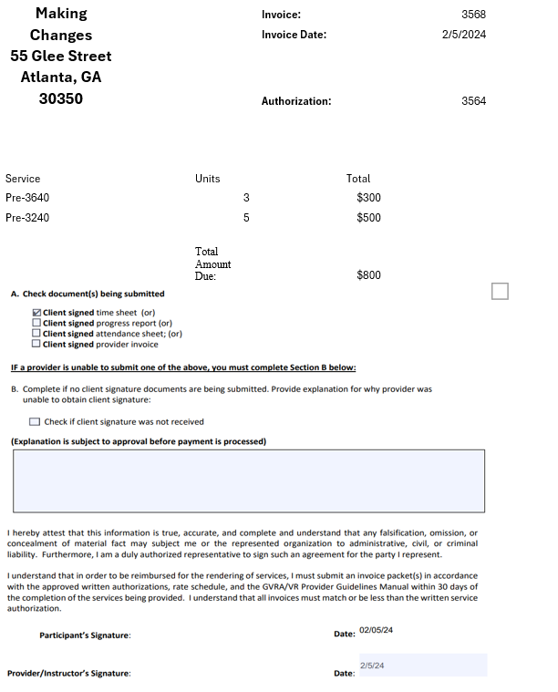
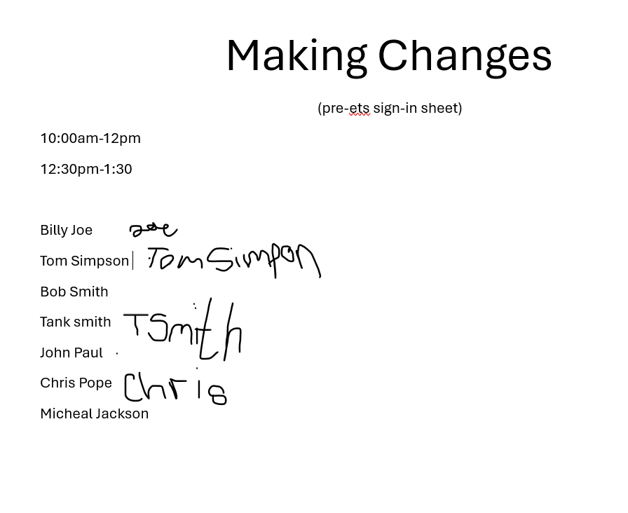
Let’s work together

Slide 16
Sending Invoice Packets
Individual Authorizations- upload to VR Vendor portal
Invoice packet: should include the Invoice, the attendance log/time sheet and any other document that supports the invoice for payment. Reports should be uploaded in the progress report section of the portal.
Group Authorizations- Send a email
Fiscalservices@gvs.ga.gov
Invoice packet: should include the Invoice, the attendance log/time sheet and any other document that supports the invoice for payment. Reports(Activity form) should be emailed with the packet.
Support Employment Authorizations
Email Reports to VR Counselor
Upload Invoice to VR Vendor Portal

Slide 17
Timely Payments
Completed invoice packet
Needs to be submitted with-in 30 days from the last date of service to receive payment timely
Rejected Invoice Packet
Per your contract incorrect submitted invoices and or documentations need to be corrected and resubmitted with-in 5 business days from the time communication is sent
Cancellation
If failure to correct the invoice and/or documentation timely, and the authorization has exceeded 30 days from the end of authorized service dates, the authorization will be cancelled..
Communication
It is the providers responsibility to check the portal for invoice status and if experiencing concerns do not hesitate to reach out to the Provider Relation Specialist.

Slide 18
Documents can be found on our agency website: Providers and Prospective Providers (https://gvs.georgia.gov/vocational-rehabilitation/providers-and-prospective-providers )
Please refer to the Fee Rate Schedule for payment processing required documentation
(https://gvs.georgia.gov/document/document/fy24-fee-rate-schedule-2-7-24/download )

Slide 19
Thank You Attending

