Slide 1
Georgia Vocational Rehabilitation Services (GVRS) Board Meeting
Wednesday, March 8, 2023
Chairman Tom Wilson

Slide 2
Chairman’s Welcome
Welcome and Remarks
Roll Call and Agenda
Previous Board Meeting Minutes Approval

Slide 3
Executive Director’s Report
Chris Wells, Executive Director
Chris.Wells@gvs.ga.gov

Slide 4
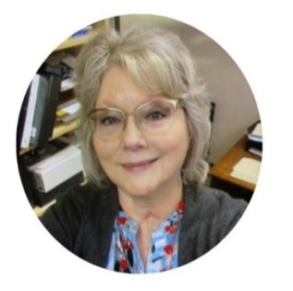
Agency Spotlight
December Employee of the Month
M’Leesha Smith, Counselor 1
January Employee of the Month
Pamela Stewart, Assistant Director of Residential Learning
Notable Hires
Dennis “Chip” Medders – Residential Director – RWS
Matthew Salmon – District One Manager
Tamika Wright – District Three Manager
Shannan Brown – Transition Liaison - Georgia Academy for Blind
Earnest Baulkmon – Training Manager

Slide 5
Georgia Vocational Rehabilitation Agency Current Events
Rehabilitation Services Administration (RSA)
Federal Monitoring for 2023
Still working with RSA to complete final findings from 2020 monitoring
Comprehensive State Needs Assessment (CSNA)
Required every three (3) years to assist with vocational service improvements
Strategic Planning
Working with UGA to develop a new strategic plan, campus master plan, and emergency management plan
Capital Investments
Working with contractors to procure renovations to multiple facilities
Policy and Procedures
Still aligning agency to uniformity in policy and procedures
Hiring
Agency has been down counselors and adjudicators since FY 2019; in process
of hiring 50 new counselors and other support positions

Slide 6
Georgia Vocational Rehabilitation Agency Pressure Points
Residential Services
Aligning services for long-term sustainability
Deferred Maintenance
Georgia Industries for the Blind
Investment and Resources
Business Enterprise Program
2020 and 2023 RSA Monitoring
External Review of Policies, Procedures, and Financials
Potential unallowable expenses
Blind and Low Vision Bills
Bill has been consistently sponsored
Disability Adjudication Services
Run by the federal government, but partners with the state
Currently a year backlog on claims
Social Security offices critical to disability benefits hit breaking point

Slide 7
Georgia Vocational Rehabilitation Agency Agency Expenditures
GVRA | Total Expenditures | Current Budget | Percent of Budget
300-Personal Services | $41,712,926 | $88,086,981 | 47%
301-Operating Expenses | 4,675,938 | 7,135,732 | 66%
303-Vehicle Purchases | 0 | 0
304-Equipment | 238,291 | 62,854 | 379%
305-Computer Charges | 2,530,101 | 6,214,445 | 41%
306-Real Estate Rentals | 4,244,009 | 9,379,858 | 45%
307-Telecommunications | 1,241,857 | 2,488,054 | 50%
309-Capital Outlay | 59,123 | 0
312-Contractual Services | 13,129,028 | 13,839,076 | 95%
314-Transfers | 32,500 | 207,500 | 16%
315-Grants and Benefits | 3,825,552 | 5,082,101 | 75%
319-Other | 427,594 | 480,032 | 89%
320-DAS CE/ME | 11,535,473 | 21,066,212 | 55%
321-VR Case Services | 10,614,782 | 32,072,386 | 33%
Total Expenditures | $94,267,174 | $186,115,231 | 51%

Slide 8
Georgia Vocational Rehabilitation Agency House Bill 18 - AFY 2023 Appropriations
Program | Caption | Rec.
Business Enterprise Program | No Changes | N/A
Departmental Administration | No Changes | N/A
Disability Adjudication Services | No changes | N/A
Georgia Industries for the Blind | Increase funds for one-time funding to upgrade to a cloud-based ERP system for Georgia Industries for the Blind. | $134,016
Georgia Industries for the Blind | Transfer funds from the Vocational Rehabilitation program to the Georgia Industries for the Blind program to support production needs. | $742,854
Vocational Rehabilitation | Transfer funds from the Vocational Rehabilitation program to the Georgia Industries for the Blind program to support production needs. | ($742,854)*
Vocational Rehabilitation | Increase funds for the Georgia Radio Reading Service. | $128,150

Slide 9
Georgia Vocational Rehabilitation Agency House Bill 19 - FY 2024 Appropriations
Caption | Business Enterprise Program | Departmental Administration | Vocational Rehabilitation | Total
Increase funds to provide a $2,000 cost-of-living adjustment. | $12,270 | $227,229 | $753,624 | $993,123
Reflect an adjustment to agency premiums for Department of Administrative Services administered insurance programs. | - | (50,324) | (90,549) | (140,873)
Reflect an adjustment in TeamWorks billings. | - | 52,190 | 154,638 | 206,828
Reflect an adjustment in Merit System Assessment billings. | (154) | (705) | (5,495) | (6,354)
28.24.5 - Reduce funds for the Georgia Commission for the Deaf or Hard of Hearing | - | - | (20,000) | (20,000)
Total | $12,116 | $228,390 | $792,218 | $1,032,724
Notes:
Commission for the Deaf or Hard of Hearing reduction of $20,000 – Commission attached to DHS; have been working with agency to transfer to DHS for the Commission.

Slide 10
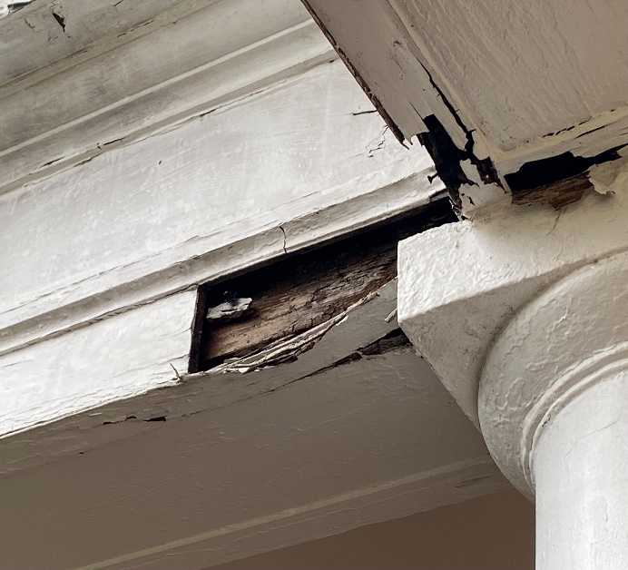
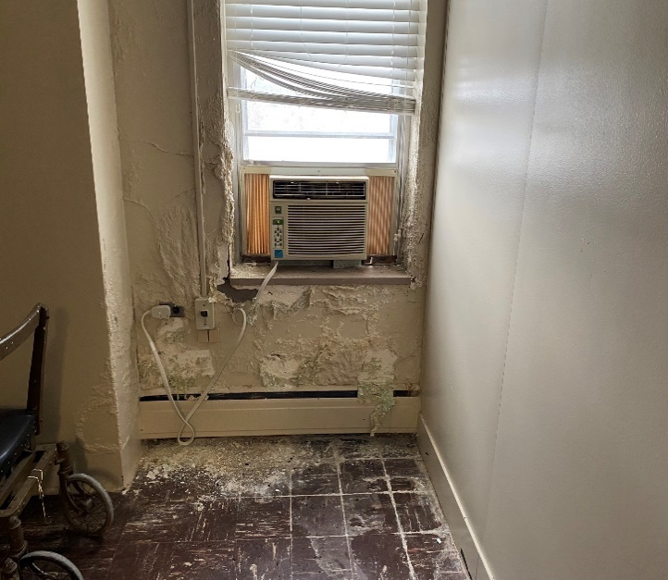
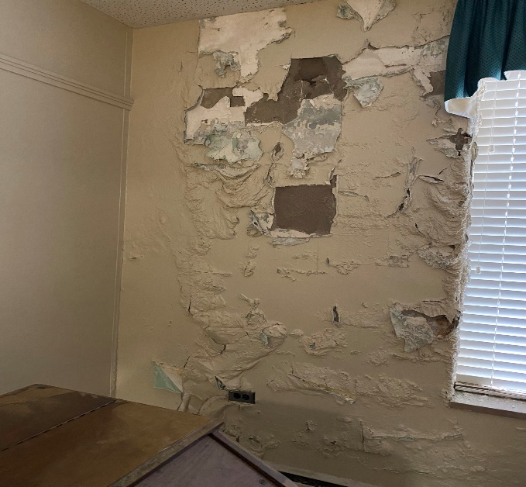
Georgia Vocational Rehabilitation Agency House Bill 19 - FY 2024 Capital Investment
FY 2024 Bond Recommendation | Governor’s Rec.
Major maintenance, renovations, and repairs, Roosevelt Warm Springs, Warm Springs, Harris County. | $7,810,000
GVRA commissioned a facilities assessment in FY 2022 to evaluate major maintenance, renovation, and repair needs of 13 primary buildings on the historical Roosevelt Warm Springs campus. The report suggested $62M in needs to bring facilities back online.
Notes:
Commission for the Deaf or Hard of Hearing reduction of $20,000 – Commission attached to DHS; have been working with agency to transfer to DHS for the Commission.

Slide 11
Georgia Vocational Rehabilitation Agency Projects
Priority | Project | Total Cost
1 | GIB HVAC (Initial) | 86,041.71
1 | GIB Chiller (includes HVAC rental) | 217,486.25
1 | GIB Administrative Bldg Air Handlers | 100,000.00
1 | GIB Paper Sheeter | 219,000.00
1 | RWS Mobile Units | 50,000.00
1 | RWS Smokestack | Insurance
Priority 1: |  | 672,527.96
2 | E&T Abatement/Flooring/Painting/Lighting/Bathrooms | 991,100.00
Priority 2: |  | 991,100.00
3 | CTR Fire Alarm | 238,700.00
3 | CTR Dehumidifier | 1,248,048.00
3 | CTR Pool Renovation | 1,000,000.00
3 | CTR Snack Bar Renovation | 100,000.00
Priority 3: |  | 2,586,748.00
4 | GIB Griffin Roof Admin/Only | 500,000.00
4 | GIB Griffin Fire/Plumbing Upgrade | 500,000.00
Priority 4: |  | 1,000,000.00

Slide 12
Program and Legislative Updates
Bethany Whetzel, Executive Deputy Director of Programs
Bethany.Whetzel@gvs.ga.gov

Slide 13
Program Highlights Disability Adjudication Services (DAS)
Through February 10, 2023, DAS had processed 31,877 total claims for FFY23
The DAS three (3) month rolling quarter accuracy rate (November – January) is 94.1%
DAS continues to hire. FFY-to-Date, DAS has onboarded 16 new hires along with four (4) Returning Retirees
State | Cases | Average Days
AL | 23,945 | 196
FL | 102,531 | 295
GA | 42,266 | 252
KY | 56 | 6
MS | 13,289 | 131
NC | 17,630 | 96
SC | 32,472 | 379
TN | 17,953 | 149
Grand Total | 250,142 | 295

Slide 14
Program Highlights Business Enterprise Program (BEP)
Working with APO and Fiscal to ensure that the BEP process for contracts follows state procurement guidelines and policies
The solicitation for Ft. Benning was released on 2/15 – GVRA is the incumbent. Over the next few weeks, we will be preparing our bid for submission
Working on a payroll transition plan for the blind vendors, effective July 1, 2023. There will be no use of federal funds
Currently working on a new solicitation and job opportunity for full food service at Clay National Guard Army

Slide 15
Program Highlights Vocational Services
Conducting statewide training in February on the VR Process, with a focus on rapid engagement
Agencywide Supervisor Training will be held in March
Posting to hire Project Coordinator for SWTCIE grant
Closed 734 clients since July 1, 2022
Partnering with Shepherd Center to improve the vocational, health, and financial
outcomes of persons with the most severe TBIs. Two (2) referrals have been received
and counselors are working to provide rapid engagement and coordinate service
delivery with Shepherd Center
Posted 50 counselor openings statewide, with interviews beginning February 13, 2023

Slide 16
Program Highlights Legislative Updates
Legislation
Georgia General Assembly - HR 168 (ga.gov)
Encourages the Employment First Committee to form a study and sunset 14C Organizations
Supplemental Materials Employment of Workers with Disabilities | U.S. Department of Labor (dol.gov)
14(c) Certificate Holders | U.S. Department of Labor (dol.gov)
https://rsa.ed.gov/sites/default/files
/subregulatory/RSA-FAQ-21-05.pdf
https://rsa.ed.gov/about/programs/disability-innovation-fund-subminimum-wage-to-competitive-integrated-employment
Senate Bill 8, Senate Bill 274, Georgia General Assembly - HB 399 (ga.gov) and Fiscal Note
Blind and Low Vision Bills seeking cradle-to-grave services

Slide 17
Georgia Industries for the Blind (GIB)
Dan West, Plant Manager
Dan.West@gvs.ga.gov

Slide 18
Georgia Industries for the Blind (GIB)
GIB Products

Slide 19
Georgia Industries for the Blind (GIB)
GIB Improvements
Pallet of cut Pressboard

Slide 20
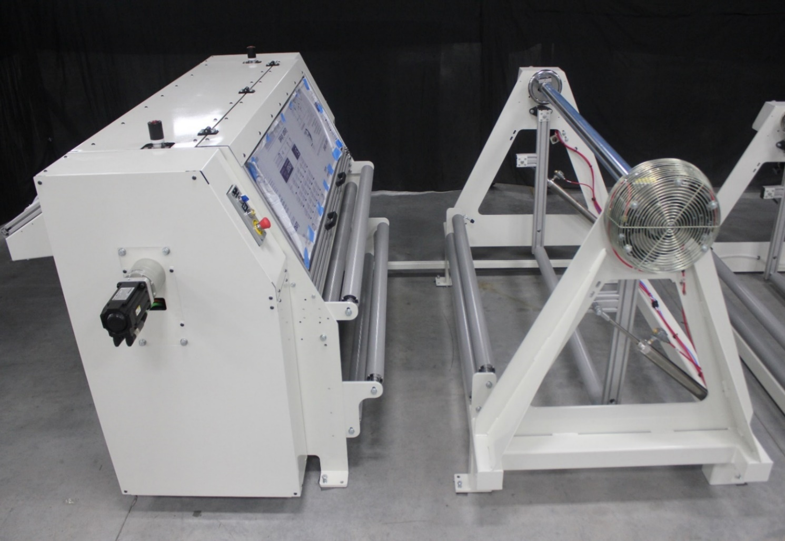
Georgia Industries for the Blind (GIB)
New Developments
Paper Sheeter Machine

Slide 21
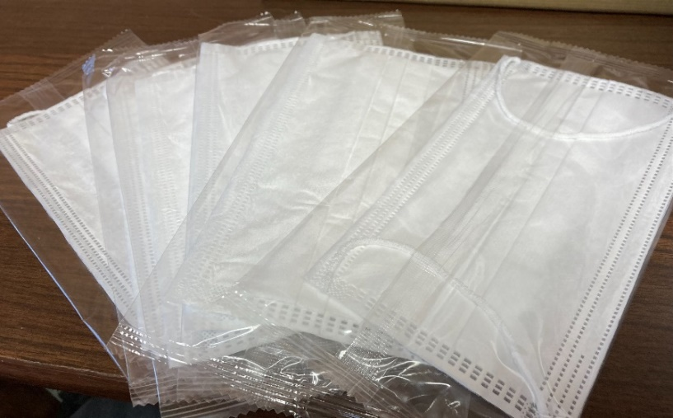
Georgia Industries for the Blind (GIB)
New Developments
3-PlyMasks

Slide 22
Residential Services
Tamika Wright, Interim Director, Residential Services
Tamika.Wright@gvs.ga.gov

Slide 23
Residential Services Program Highlights
In July 2022, RWS re-opened post COVID and had our largest vocational intake in over a year
December 2022, graduated over 80 students
January 2023, took final group of students under the old vocational programs and rolling admissions. These students are projected to graduate March 24, 2023
New Director started March 1, 2023
G.R.O.W. is a weeklong program that exposes the participant to all five of the required areas under WIOA. Each day will be filled with experiences from one of the five areas; Self-Advocacy, Career Exploration, Work Place Readiness, Counseling on Post-Secondary Opportunities, and Work Based Learning Experiences
Striving for 100 participants each week at RWS and 40 at CSC. We plan to utilize this opportunity to showcase our new vocational programs, which will potentially increase our enrollment
Process for referrals to residential programs through vocational services

Slide 24
Residential Services Next Steps
Our focus post March graduation will be to retrain our staff in the following areas:
CPR/First Aid
Crisis Intervention
New Supervisor training
Case management training
Active shooter training
AWARE training
RSA 911 data and how it relates to residential services
Pre-Employment Transition Services (Leveraging Residential Services to serve more rural areas)

Slide 25
Residential Services
Next Steps

Slide 26
Residential Services
Next Steps

Slide 27
Residential Services
Next Steps
 | FY 2016 | FY 2017 | FY 2018 | FY 2019 | FY 2020 | FY 2021 | FY 2022 | Goals
Clients Served | 568 | 433 | 546 | 940 | 1,050 | 665 | 670 | 5,000
Less those served in services only | (260) | (131) | (275) | (634) | (698) | (393) | (436) | (3,500)
Vocational Training Programs (Boarding and Non-Boarding) | 308 | 302 | 271 | 306 | 352 | 272 | 234 | 1,500

Slide 28
Rehabilitation Services Administration (RSA)
Jeff Allen, Director of Policy and Compliance
Jeff.Allen@gvs.ga.gov

Slide 29
RSA Monitoring and Technical Assistance
Monitoring will be onsite March 28-30, 2023
Focus will be to identify root causes for the return of unused federal funds
Residential expenditures, services, and outcomes.
Two areas of Focus:
Performance of the VR and Supported Employment programs
Financial Management of VR and Supported Employment program
Technical Assistance will be provided

Slide 30
Board Announcements
Old Business
New Business

Slide 31
Public Comment and Adjournment

