Slide 1

Georgia Vocational Rehabilitation Agency
September 9, 2025
FY25 4th Quarter Provider Forum
Jeff Allen, Provider Relations Administrator
Jeff.Allen@gvs.ga.gov

Slide 2

Agenda
Georgia Vocational Rehabilitation Agency
4th Quarter Provider Forum
10:00a – 10:05a: Welcome
10:05a – 10:20a: Updates from Client Services
10:20a – 11:00a: GSU - Community of Practice
11:00a – 11:20a: GVRA Fiscal Update
11:20a – 11:50a: KPIs-Frequently Asked Questions
11:50a – 12:00p: Wrap-Up
2

Slide 3
Georgia Vocational Rehabilitation Agency
September 9, 2025
Client Services Updates
Matthew Salmon, Assistant Director of Client Services
Matthew.salmon@gvs.ga.gov

Slide 4
Vocational Rehabilitation- Client Services

Slide 5
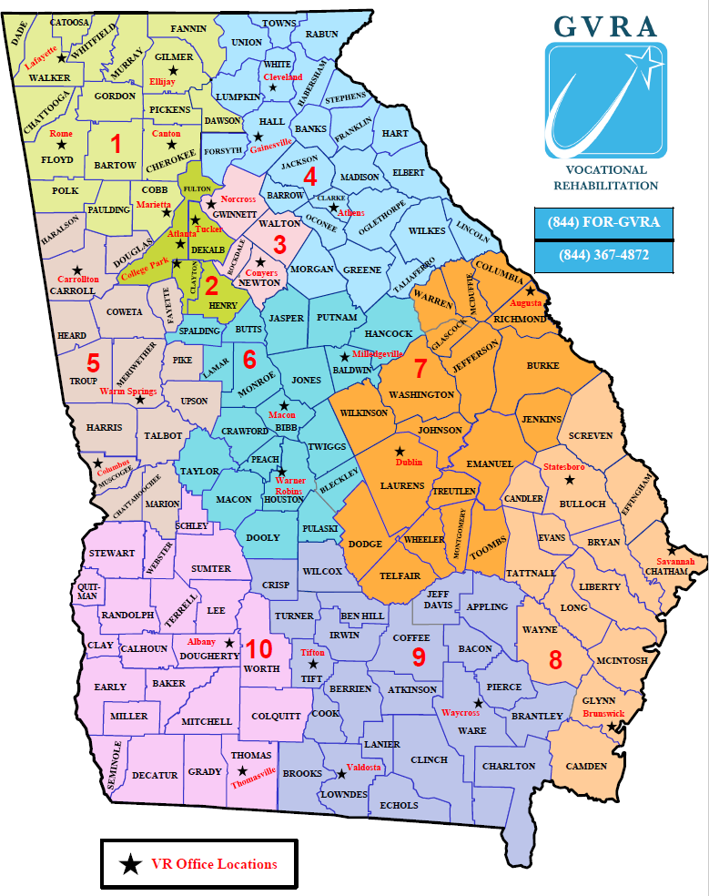
Vocational Rehabilitation- Office Locations
District 1
  Ellijay/ Canton, Lafayette, Marietta, Rome
District 2
  Atlanta, College Park, Tucker
District 3
  Norcross, Conyers
District 4
  Athens, Cleveland, Gainesville
District 5
  Carrollton, Columbus, Warm Springs
District 6
  Macon, Milledgeville, Warner Robins
District 7
  Augusta, Dublin
District 8
  Brunswick, Savannah, Statesboro
District 9
  Tifton, Valdosta, Waycross
District 10
  Albany, Thomasville
District 11
  BVI, DHoH, SE

Slide 6
Vocational Rehabilitation- Client Services KPI
KPI | Priority | Metric
Timeliness (DOE, IPE, Employment) | High | 90% compliance
Employment Rate | High | 50%
Measurable Skills Gain | High | 48%
Potentiality Eligible compared to GADOE | High | 50%
PTS Cases that apply for VR services | Medium | 3,162
Services Paid & Actual Services | Medium | 31,732
Successful Closures | Medium | 1,500
PTS Application | Low | 14,500
VR Applications | Low | 10,000
Credential Attainment | Low | 35%

Slide 7
Georgia Vocational Rehabilitation Agency
September 9, 2025
Community of Practice (CoP)
Molly Tucker, Georgia State University

Slide 8
Provider Relations
Community of Practice (CoP)
Facilitated by the Center for Leadership in Disability (CLD) at Georgia State University

Slide 9
Provider Relations CoP Purpose & Expectations
The Provider Relations CoP provides employers with technical assistance to support their ability to recruit and retain young adults with disabilities.
The CoP will meet quarterly for 90-minute sessions to receive content related to best practices within disability employment and engage in discussions with colleagues.
Individuals who were designated to participate in the CoP are expected to attend each session.
Save the Date! The first CoP Session will be held on Tuesday, November 18^{th,} from 11:00 am – 1:00 pm. A link to register and additional details coming soon!

Slide 10
Provider Relations CoP Surveys
The Center for Leadership in Disability (CLD) at Georgia State University administered two surveys to inform the Community of Practice (CoP) for employment service providers contracted with the Georgia Vocational Rehabilitation Agency (GVRA).
The first survey was administered to leaders of organizations contracted with GVRA to learn more about their organization and designate a representative to participate in the CoP.
  The survey was sent out on June 1st and closed on June 30th.
  63 valid responses were collected.
The second survey was administered to the designated representatives to understand their goals, interests, and availability to participate in the CoP.
  This survey was sent out on July 15th and closed on August 15th.
  49 valid responses were collected.

Slide 11
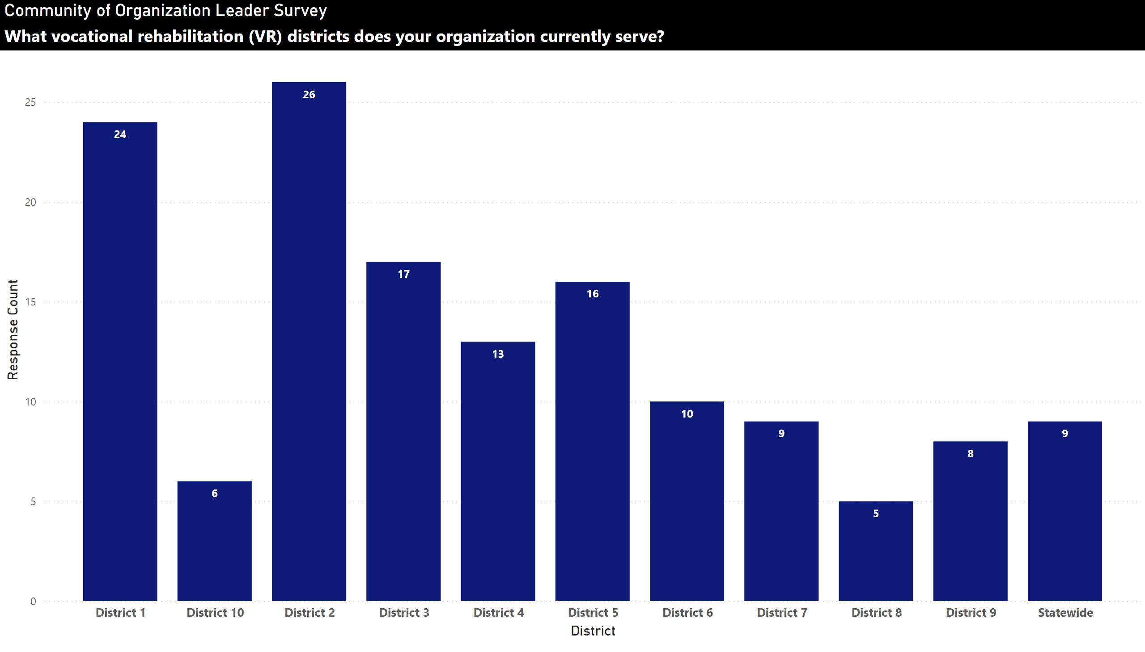
Provider_District
Notes:
Community of Organization Leader Survey
No alt text provided

Slide 12
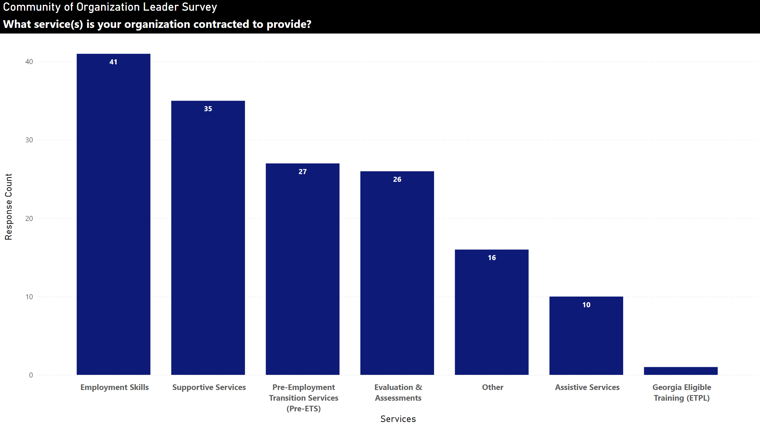
Provider_Contracted Services
Notes:
Community of Organization Leader Survey
No alt text provided

Slide 13
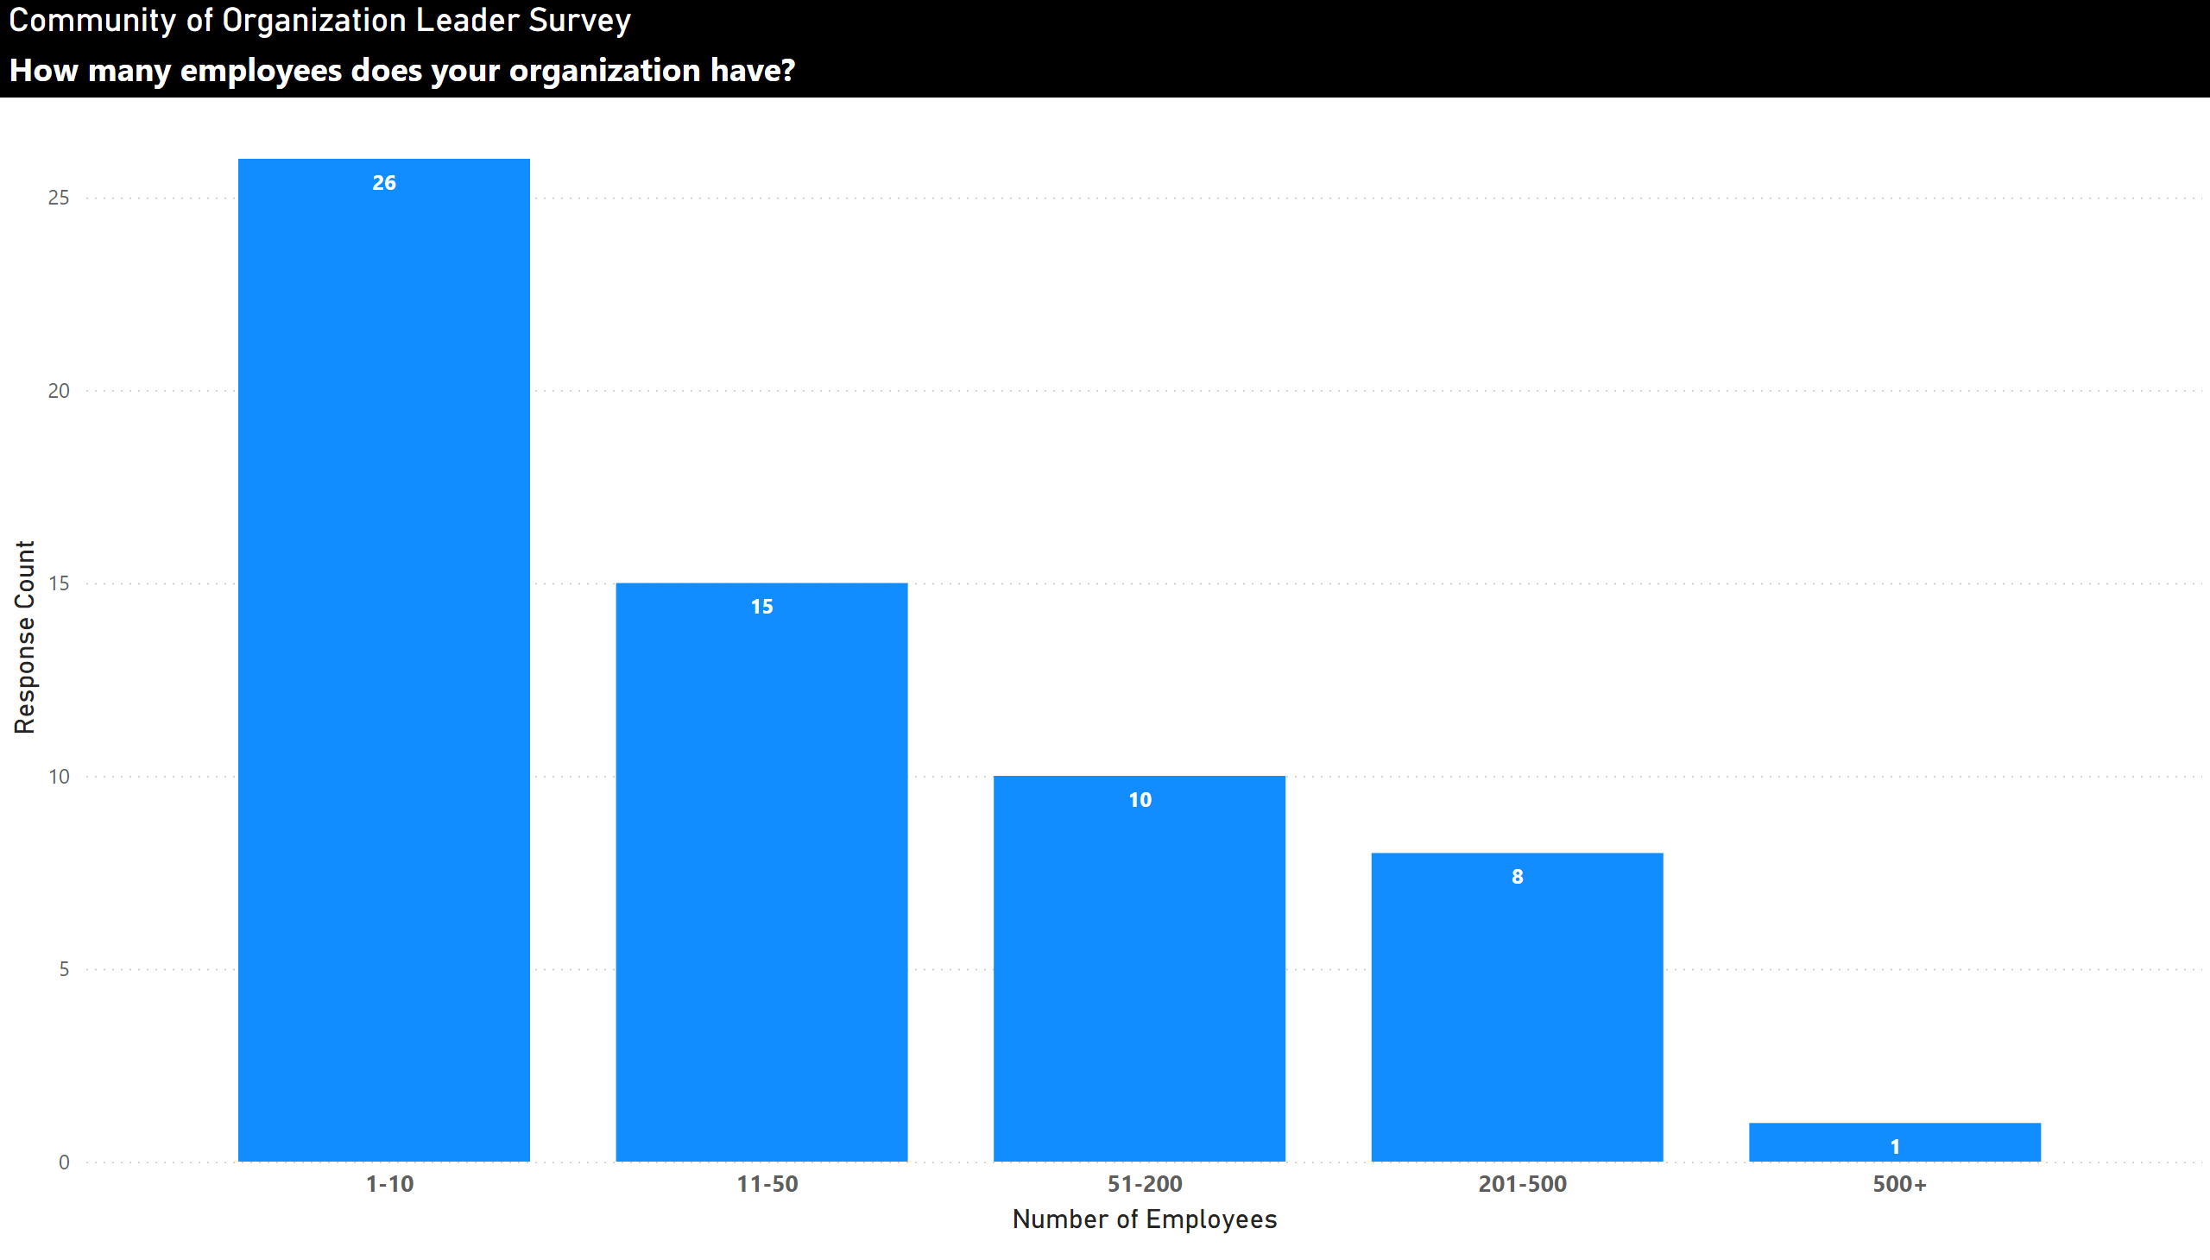
Provider_#ofEmployees
Notes:
clusteredColumnChart
No alt text provided
Community of Organization Leader Survey
No alt text provided

Slide 14
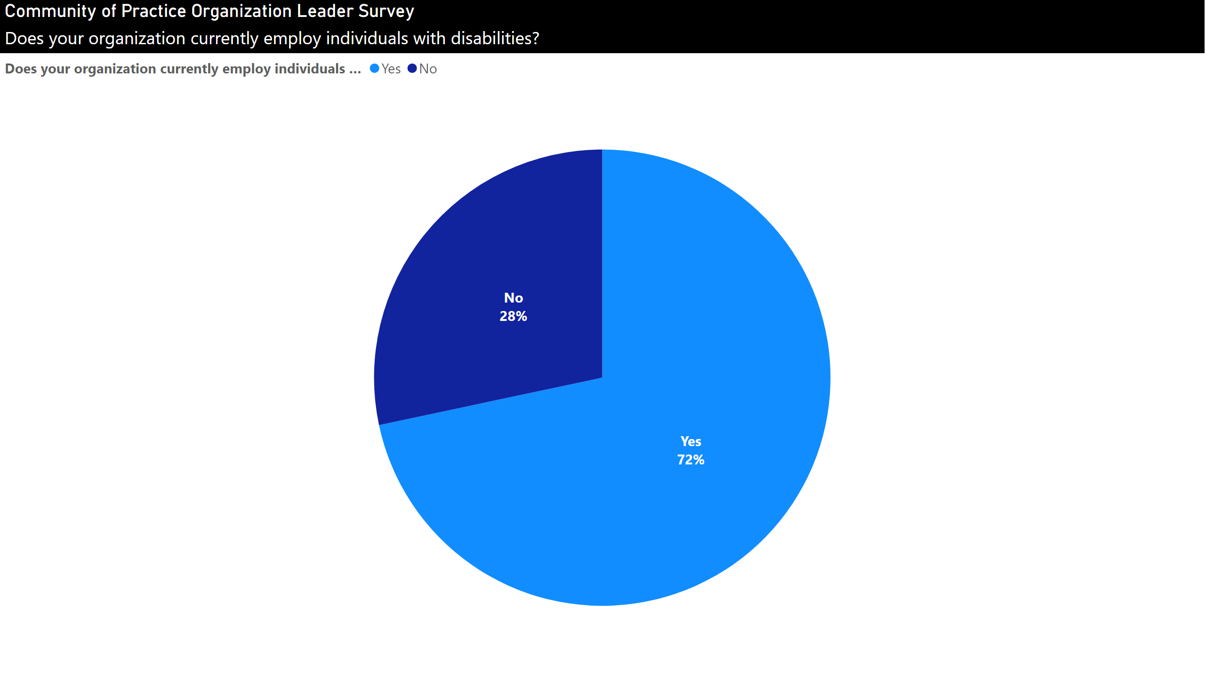
Provider_EmployYes/No
Notes:
Community of Practice Organization Leader Survey
No alt text provided

Slide 15
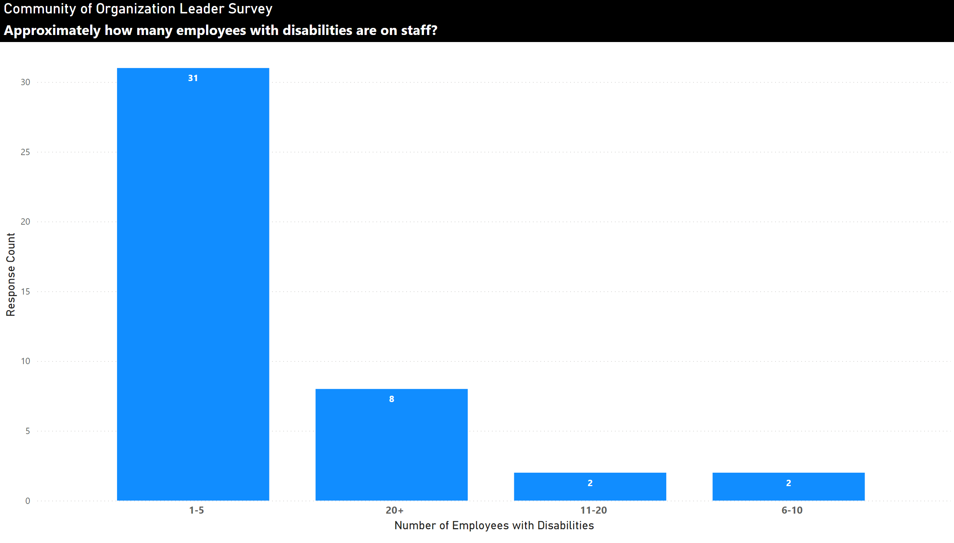
Provider_# of IDs
Notes:
Community of Organization Leader Survey
No alt text provided

Slide 16
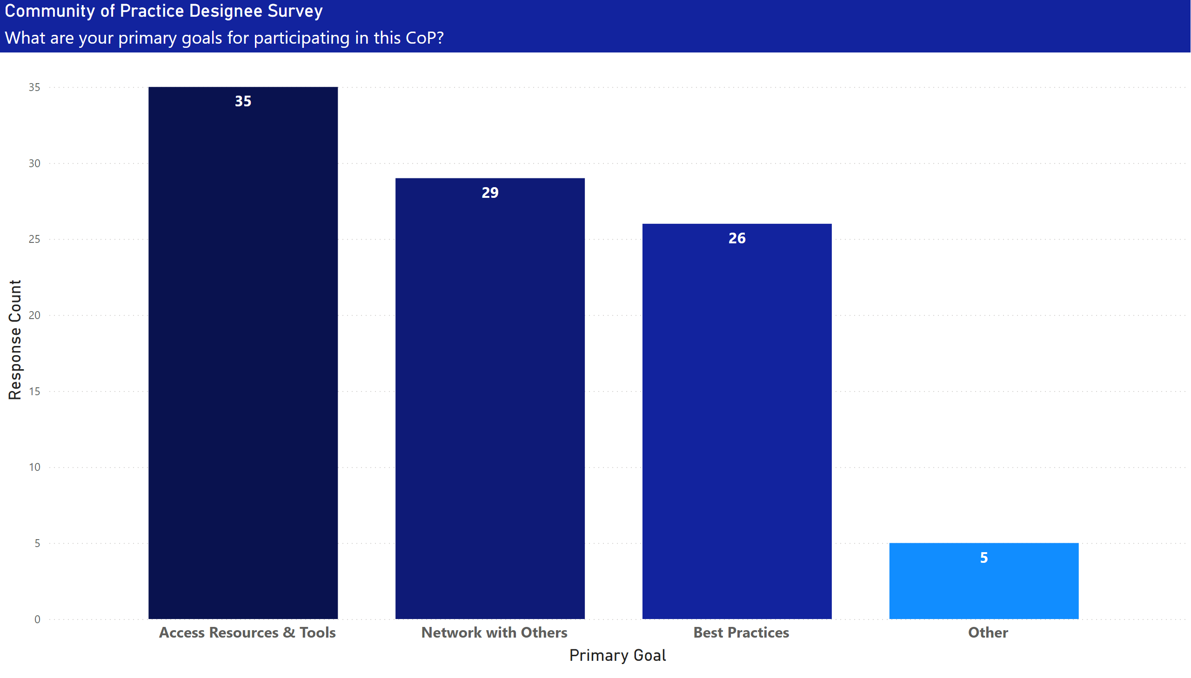
Primary Goals
Notes:
Community of Practice Designee Survey
No alt text provided

Slide 17
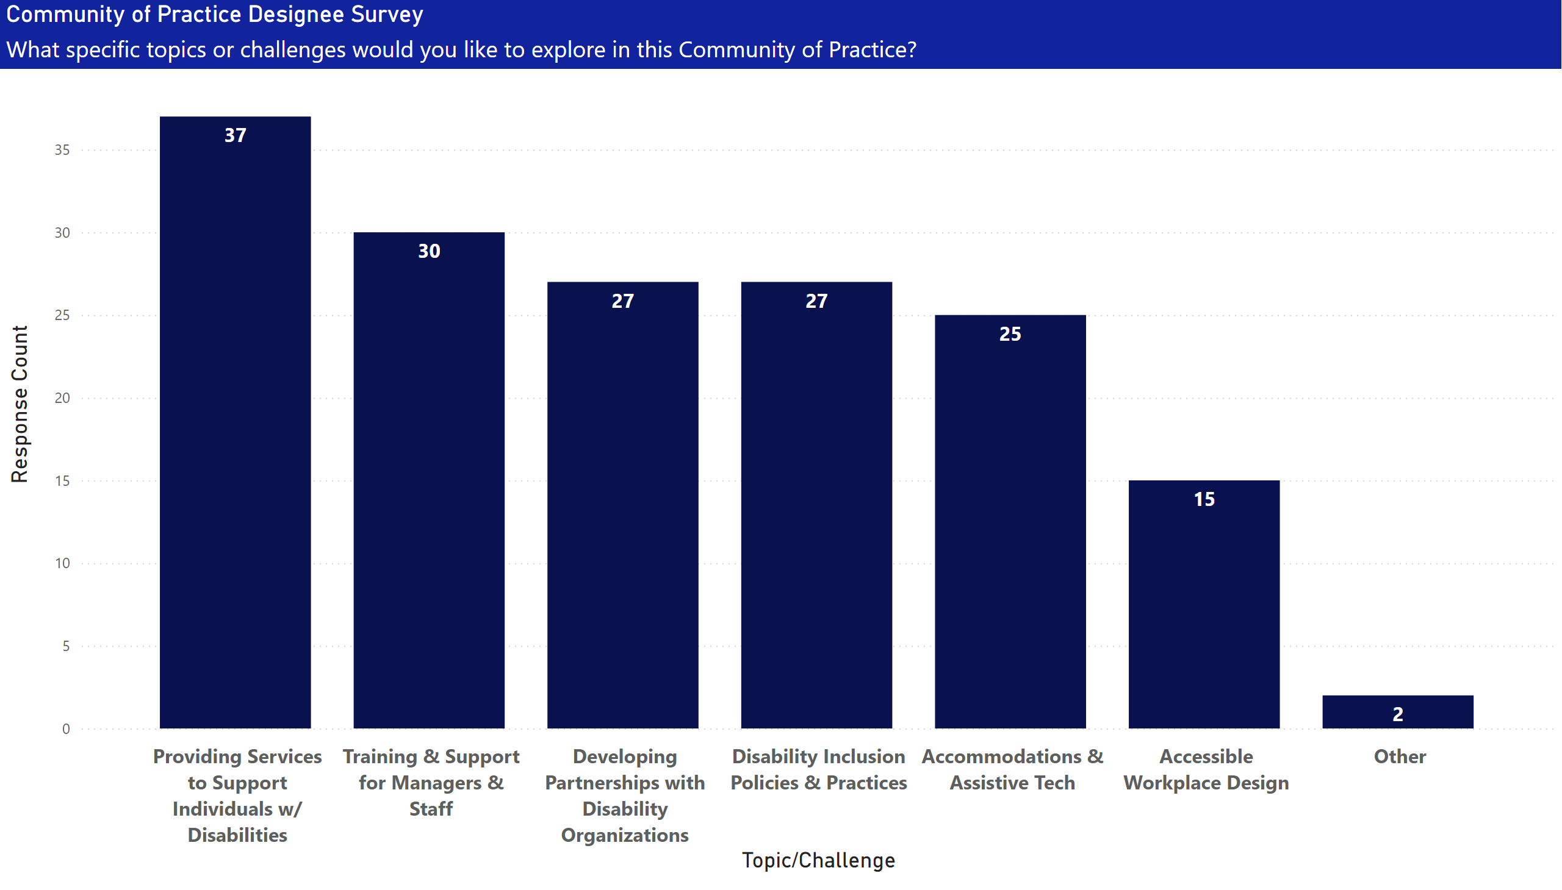
Topics & Challenges
Notes:
Community of Practice Designee Survey
No alt text provided

Slide 18
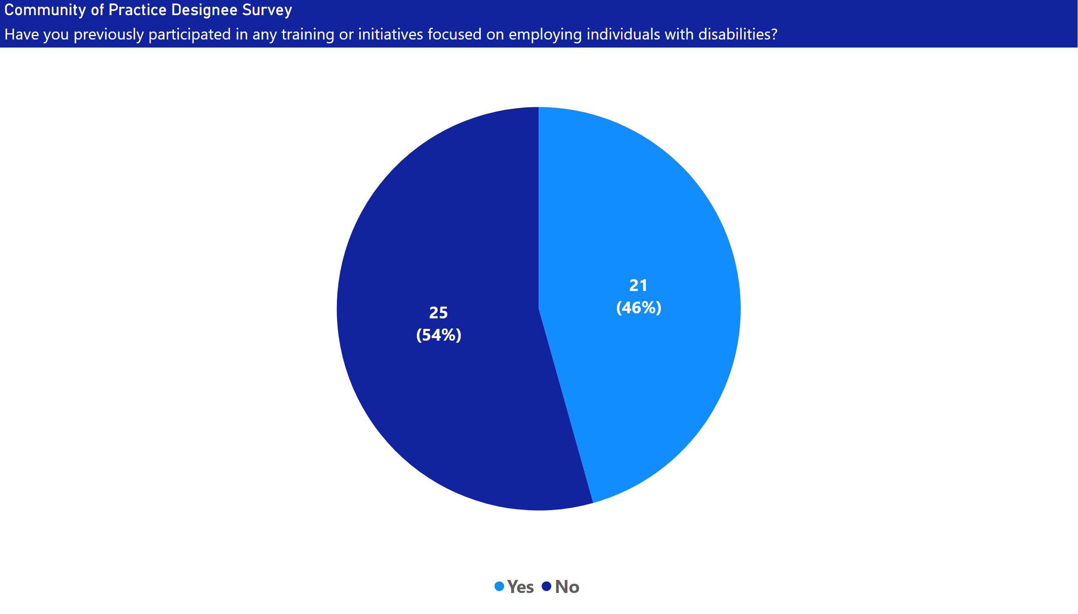
Previous Participation
Notes:
Community of Practice Designee Survey
No alt text provided

Slide 19
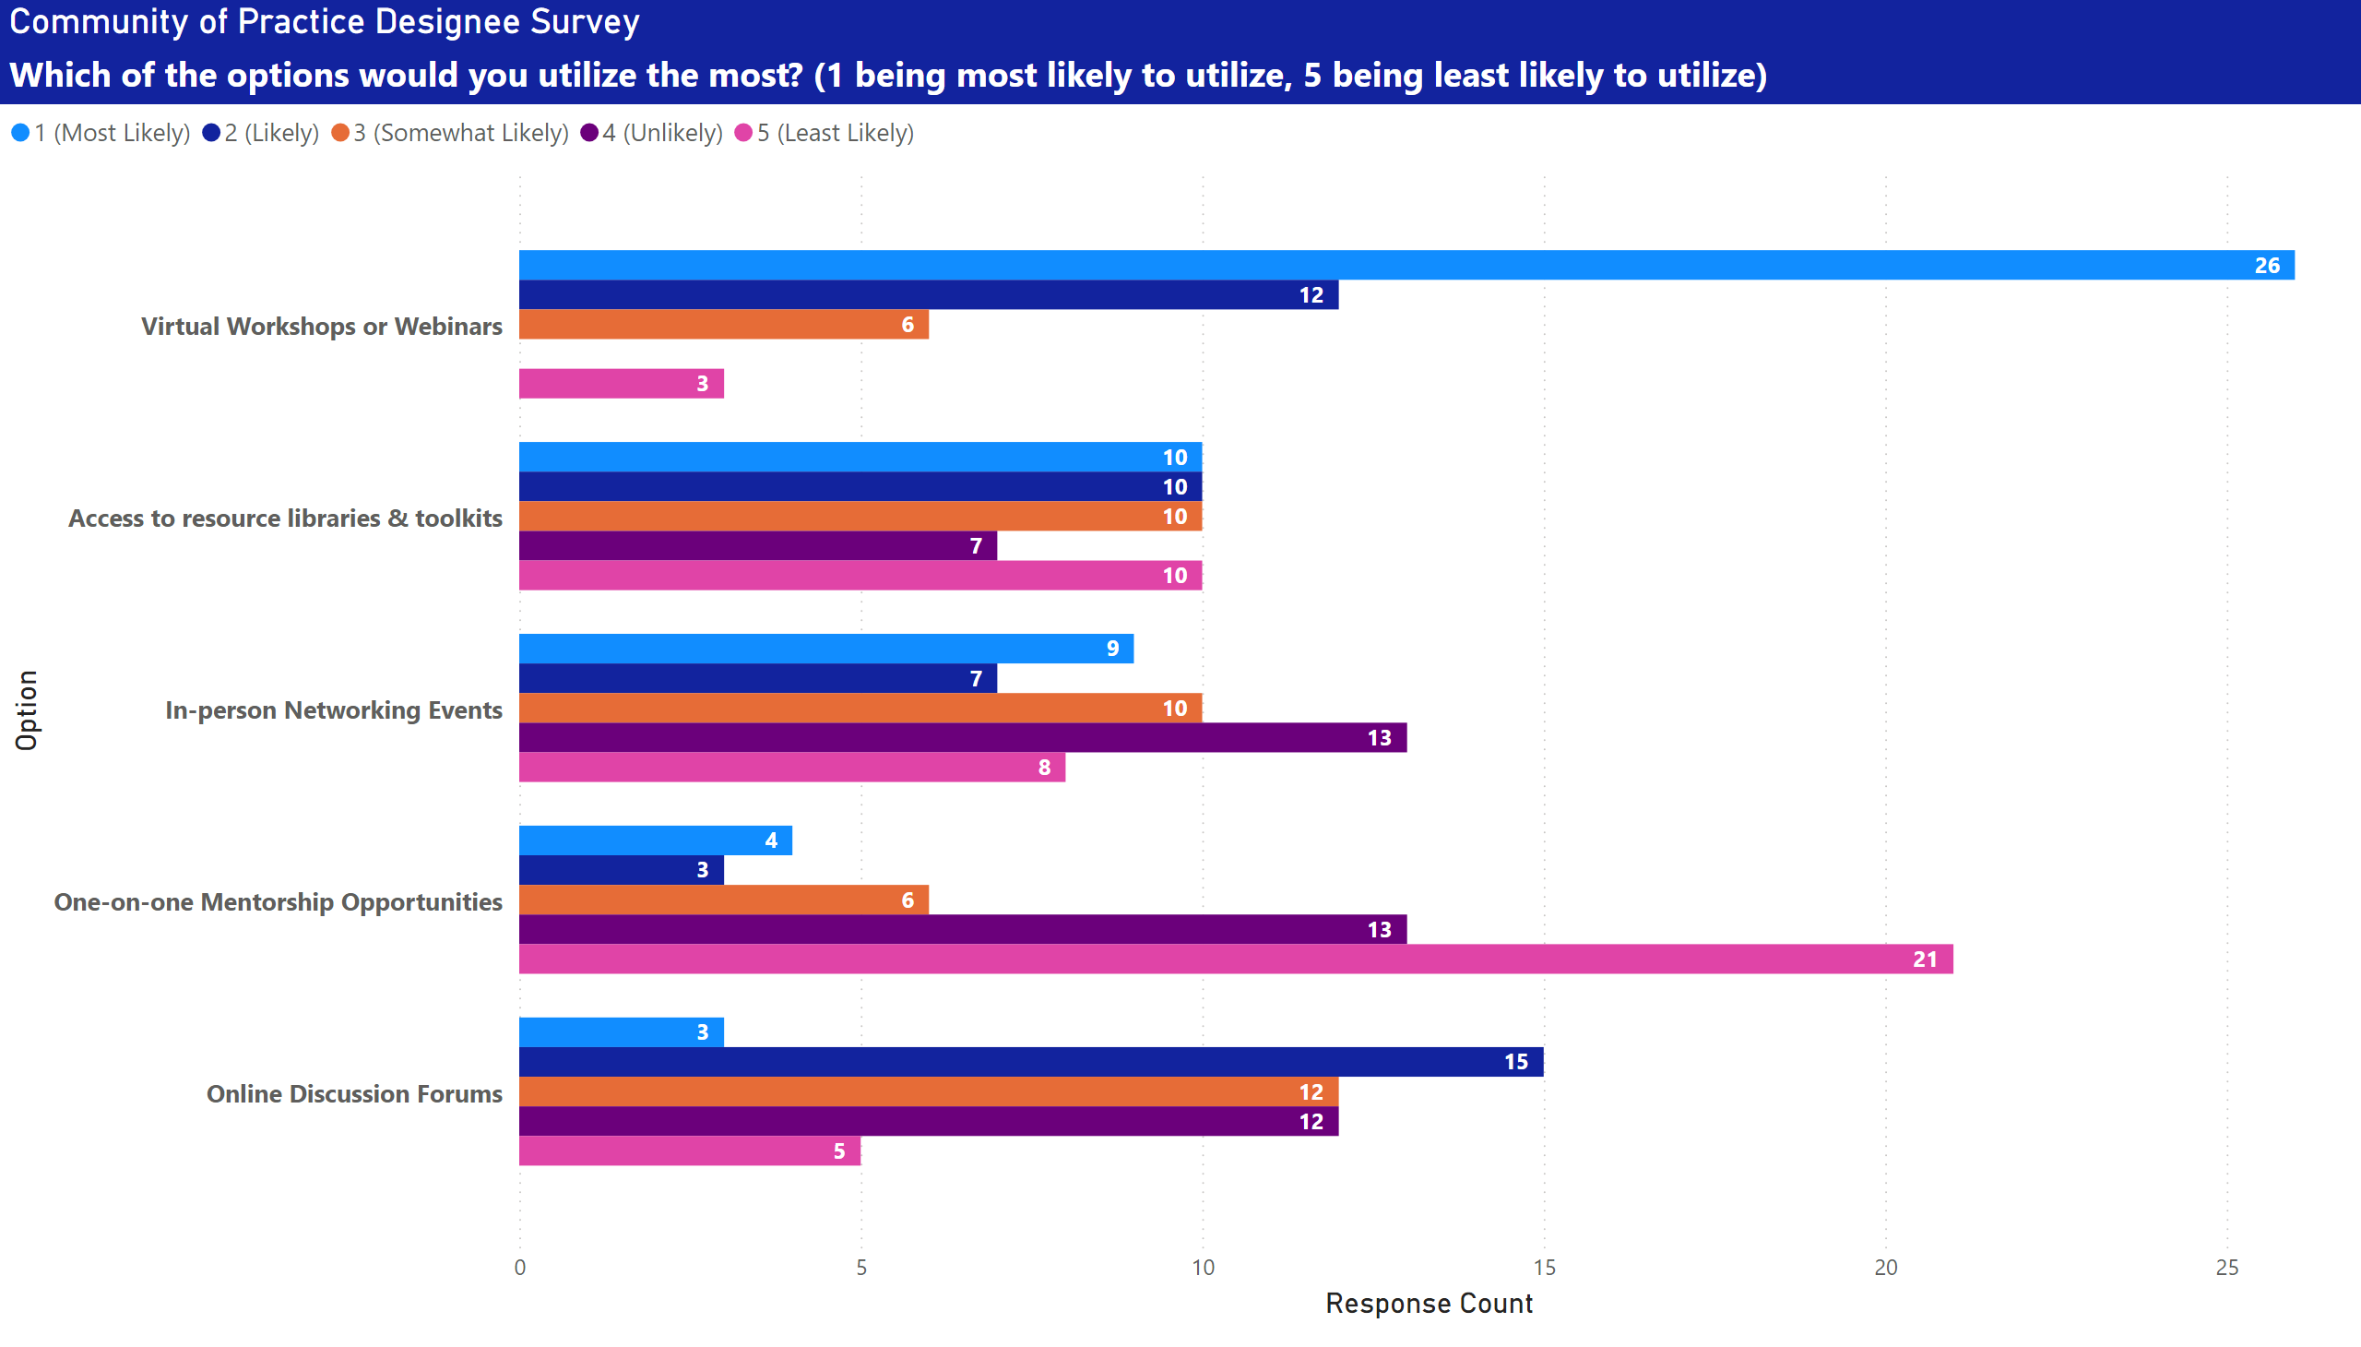
Utilization Options
Notes:
Community of Practice Designee Survey
No alt text provided

Slide 20
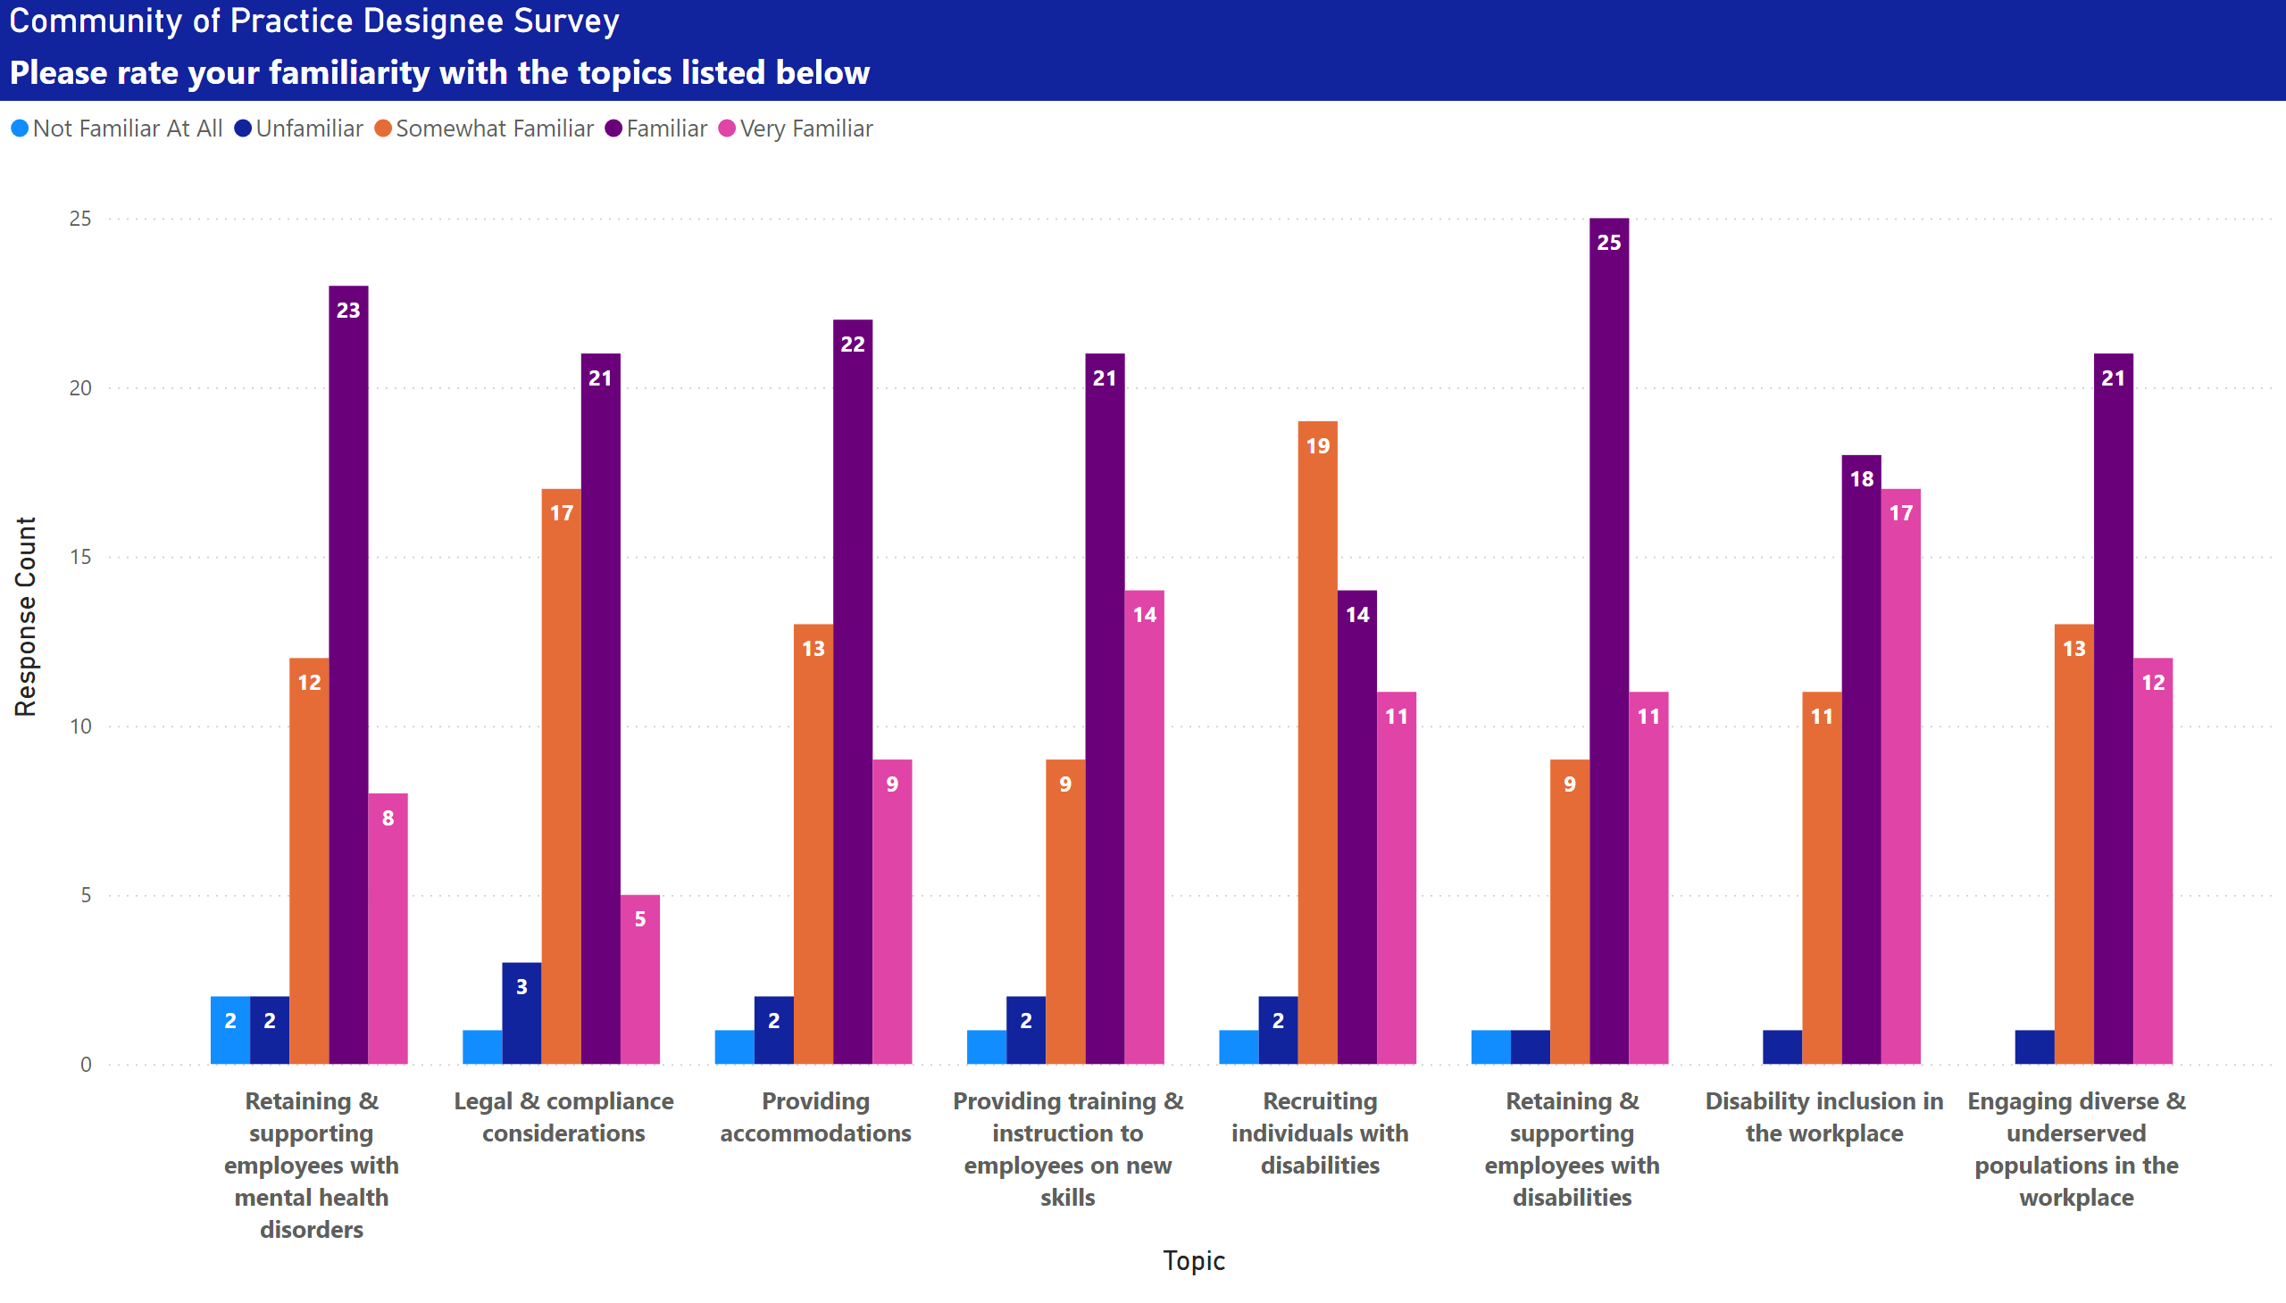
Familiarity with Topics
Notes:
Community of Practice Designee Survey
No alt text provided

Slide 21
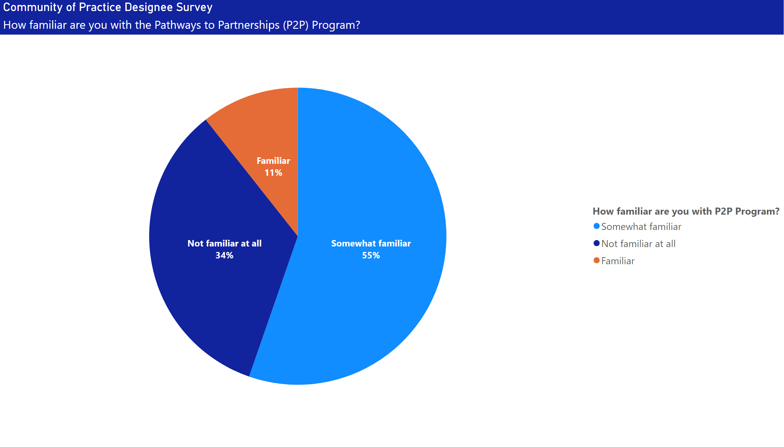
Familiarity with P2P
Notes:
Community of Practice Designee Survey
No alt text provided

Slide 22
Questions?

Slide 23
Provider Relations CoP Session 1
Tuesday, November 18th
11:00 am – 1:00 pm
Location & Registration Link Forthcoming
Contact: Hasset Zelealem (hzelealem1@gsu.edu)

Slide 24
Fiscal Updates
Andrea Waddy Willis. Deputy CFO
Andrea.Waddy-Willis@gvs.ga.gov
September 9, 2025

Slide 25
Georgia Vocational Rehabilitation Agency
Fiscal Need to Know
Contracts
Nichols, Cauley, & Associates (NCA) -performance reviews to assess compliance, financial accountability, and service quality.
FFY 2026 Contracts routed for 6-month agreement period; evaluate and extended based service needs, funding availability, and KPIs met.
Cost Measures & Documentation
Only reimbursing allowable, allocable, reasonable, and necessary costs validated through documentation.
Payment of pre-authorized services only. Do not work without an authorization as the services are not obligated. No payment exceptions will be granted for services rendered without an authorization.
Complete invoices submissions which includes a participant signatures; the team has right to reject and request additional documentation.
Authorization & Invoices
Invoices not submitted within 30 days of service end date can and will be cancelled.
Cancelled authorization will not be reissued as the funds are de-obligated; no payment exceptions will be granted for authorization cancelled because of untimely submission.
Rejections not address within 5 days of notice, can and will be cancelled; no payment exceptions for untimely re-submission of a rejected invoice.

Slide 26
Georgia Vocational Rehabilitation Agency
September 9, 2025
Frequently Asked Questions - KPIs
Jeff Allen, Provider Relations Administrator
Jeff.Allen@gvs.ga.gov

Slide 27
Georgia Vocational Rehabilitation Agency
KPIs Providers FAQs
Invoice Timeliness: 95%
Should Providers submit invoices to AWARE by the 15th business day of service end date?
Will this benchmark expedite payment timeliness? If not, why move up the timing if it does not positively impact GVRA’s ability to pay within their stated 30-day timeline?
Answer:
GVRA payment term will remain at 30 days as noted in GVRA policy and the Provider Guidelines Manual.
The benchmark will now be invoice accuracy, meaning an invoice rejection rate of 20% or less. This will ultimately lead to faster processing to meet the 30 days.

Slide 28
Georgia Vocational Rehabilitation Agency
KPIs Providers FAQs
Authorization Rate: 90%
Will you clarify the 90% goal for authorization request and cancellation?
2. How will a pre-ETS provider be held accountable for 90% of authorizations resulting in payment and services rendered when we are getting the lists from the schools 14 business days (basically 3 weeks in advance) and then the students are not able to participate?
Answer:
If the majority of providers consistently meet their key performance indicators (KPIs), it is expected that payment processing timelines will improve. During the current fiscal year, more than 80,000 individual services were cancelled. This volume equates to approximately two and a half months of work for the billing team that ultimately proved unnecessary.

Slide 29
Georgia Vocational Rehabilitation Agency
KPIs Providers FAQs
Customer Satisfaction Rate- 80%​
Who will conduct the participants' surveys in the Pre-ETS program?
Answer:
Surveys will be shared with Clients, and school system staff in the area of service. It will either be sent by the Transition Liaison or PRS.

Slide 30
Georgia Vocational Rehabilitation Agency
KPIs Providers FAQs
Service Delivery Timeliness: 90% ​
Will a provider be penalized for this 'refer-early-and-often' effort, but the student not be served within 15 days?
Answer:
This metric doesn’t impact our Pre-ETS only providers, as we already have a well-established practice for authorization requests and the 4x4x4 rule. Also, when we say referral, we don't mean referral to GVRA, we are referencing referral for a specific service. There are some other variables that we are looking into related to this particular benchmark.

Slide 31
Georgia Vocational Rehabilitation Agency
KPIs Providers FAQs
PTS cases transition to VR Cases- 50%
1.How will a pre-ETS provider be held accountable for 50% of PTS cases being moved to VR cases when this is a VR responsibility?
Answer:
Yes, it is GVRA's responsibility & goal to move PTS cases to VR Cases, but through the provider service model, it is our providers who introduce PTS students to the VR system. A provider will be acknowledged for supporting GVRA's goal when students they served in high school transition to a VR case.

Slide 32
Georgia Vocational Rehabilitation Agency
KPIs Providers FAQs
Participants obtain an industry recognized certification or credential- 85%
As a Pre-ETS provider, would have no way to complete this task, as we are exposure to employment skills only. Could you elaborate on what you are looking for here with this benchmark?
Answer:
This metric is not for Pre-ETS providers, it is only for providers that GVRA has approved a specific training program under employment skills training. We are also looking into this metric to align with our WIOA partners.

Slide 33
Georgia Vocational Rehabilitation Agency
KPIs Providers FAQs
Will providers receive a performance report based on each KPI (quarterly, annually)?
Yes, the Provider relations team is working with the data team to develop a quarterly report for providers. You also can check in with your assigned PRS team any time to gauge where you are.

Slide 34
Wrap-up
Jeff Allen, Provider Relations Administrator Jeff.Allen@gvs.ga.gov
September 9, 2025

Slide 35
Georgia Vocational Rehabilitation Agency
Points of Note:
        Updates on contract renewals

Slide 36
Georgia Vocational Rehabilitation Agency
Wrap-Up
      BREAKOUT SESSIONS
      1:00pm – 3:00pm
      Links are in your email and will be posted in the chat. Please join the respective breakout session at 1:00pm.

